Slide 1
Assignment 4 Due Tuesday, March. 26 at 11:00 PM 25 points
COMP 322 Internet Systems
Spring 2019

Slide 2
Problem 1 (15 pts.)
If an element has an id attribute with value "v", then get a reference to an object corresponding to the element (and assign it to obj) with
obj = document.getElementById("v");
Can then assign the element content by assigning to the object’s innerHTML attribute, e.g.,
obj.innerHTML = "An example";
Goes between the opening and closing tags
May contain markup
Can append content to the end of what’s already there with, e.g.,
obj.innerHTML += " of dynamic content";

Slide 3
Example
<html>
<head>
<meta charset="utf-8">
<title>Example for Assignment 3, Problem 1</title>
<script type="text/javascript" src="prob1ex.js">
</script>
</head>
<body>
<p id="pid">The number is </p>
<table id="tid" border="1" width="50%">
<caption>The table</caption>
<table>
<p onclick="start()">Go!</p>
</body>
</html>

Slide 4
File prob1ex.js
function start()
{
var pobj = document.getElementById( "pid" ),
tobj = document.getElementById( "tid" );
pobj.innerHTML += 3;
tobj.innerHTML += "<tr><td>1</td><td>2</td></tr>"
+ "<tr><td>3</td><td>4</td></tr>";
}
Function start() gets references to the objects for the first p and the table
Appends
“3” to the content of the p and
2 rows to the content of the table (after the caption)

Slide 5
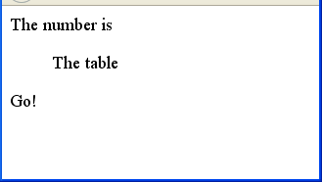
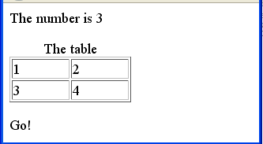
When 1st loaded, rendered as at right
After Go! Is clicked, rendered as shown

Slide 6
For this problem, your given the following HTML document
<html>
<head>
<meta charset="utf-8">
<title>Assignment 3, Problem 1</title>
<script type="text/javascript" src="prob1.js">
</script>
</html>
<body onload="start()">
<table id="input" border="1" width="50%">
<caption>The Input Array</caption>
</table>
<p id="sum"> The sum of all elements is </p>
<table id="rowS" border="1" width="50%">
<caption>Row Sum</caption>
</table>
<table id="colS" border="1" width="100px">
<caption>Column Sum</caption>
</table>
</body>
</html>

Slide 7
Once the document is loaded, calls function start(), defined in prob1.js as
function start()
{
var rows = prompt( "Number of rows", 1 ),
cols = prompt( "Number of columns", 1 ),
inAr;
inAr = inputArray(rows, cols);
sumAll( inAr );
rowSum( inAr );
colSum( inAr );
}
You write the functions inputArray(), sumAll(), rowSum(), and colSum()

Slide 8
Function inputArray() is passed the number of rows and columns
Builds a 2D array by prompting the user for integers
Don’t have to verify input
Returns this array
First constructs a string representing the array as table rows (tr elements containing td elements)
Appends this to the content of the first table element (just after the caption)
Need a nested loop
Get by with 1 nested loop: construct the string as the values are obtained from the user

Slide 9
sumAll() is passed the array
Sums all the values (across all rows and columns)
Concatenates this sum to the end of the content of the p element
rowSum() adds the rows together (i.e., forms the sum of each column)
Forms a tr whose td’s contain the column sums
Concatenates it to the end of the content of the 2nd table (after the caption)
colSum() adds the columns together (i.e., forms the sum of each row)
Forms a string that’s a sequence of tr’s
Each has 1 td, containing the sum of the respective row
Concatenates this to the end of the content of the 3rd table
Neither of the last 2 functions requires an additional array
Just form the string as you produce the sums

Slide 10
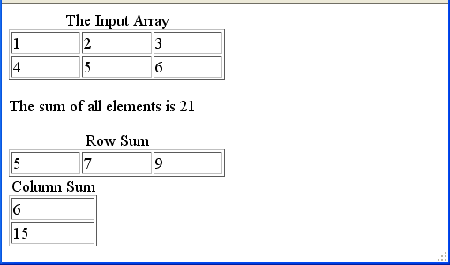
Example
The rendering when the user answered
2 for the number of rows and
3 for the number of columns
Then entered in the prompts 1, 2, 3 (1st row), and 4, 5, 6 (2nd row)

Slide 11
Problem 2 (10 pts.)
Maintain an associative array whose keys are people’s names
An associated value is an object with 3 properties
deposits: an array of the person’s deposits
withdrawals: an array of the person’s withdrawals
balance: the person’s current balance
An account starts out with a 0 balance
The current balance is the sum of the deposits minus the sum of the withdrawals
Write HTML file prob2.html that loads JavaScript file prob2.js
When the body is finished loading, function go() is called
The body has an empty div element with id "recs"

Slide 12
Function go() first calls function init()
Prompts for names until the user clicks Cancel
Each name becomes a key in an associative array
The associated value is an object with
its deposits and withdrawals properties initialized to []
its balance property initialized to 0
It returns this associative array, assigned to, say, recs in go()

Slide 13
Function go() next calls update(), passing it recs
Loops through rounds as long as the user clicks OK (not Cancel) in the confirmation box
In each round, it loops over all the names of people
For each person, it asks for their deposit and their withdrawal for that round
The user enters “0” if no deposit or no withdrawal was made
If the deposit isn’t “0”, it’s added to the end of the deposits array
Similarly, the withdrawal is added to withdrawals
The person’s balance is also updated each round
To add x to the end of an array, use its push() method
If ar is an array, ar.push(x) adds x to the end of ar, increasing its length by 1

Slide 14
Finally, go() calls outRecs(), passing it recs
Assigns to, say, recsRef a reference to the div element (id "recs")
Constructs in, say, recStr a string with all the info in assoc array recs
This string is assigned to the innerHTML property of recsRef
For each element of recs, string has 1 line with the name followed by ‘:’
The next 3 lines have, resp.,
the array of deposits
the array of withdrawals
the balance
for the person named
Each of these 3 lines begins with 2 spaces—use &nbsp;
Use the toString() method of the arrays to get a quick string representation of the contents of these arrays

Slide 15
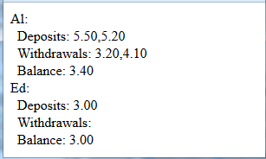
Screenshot shows the output when names were “Al” and “Ed”
The update went through 2 rounds
1st round
Al deposited 5.50 and withdrew 3.20
Ed deposited 3.00 and withdrew nothing
2nd round
Al deposited 5.20 and withdrew 4.10
Ed neither deposited nor withdrew

