Slide 1
Assignment 9 Due Tuesday, April 30 20 points total
COMP 322 Internet Systems
Spring 2019

Slide 2
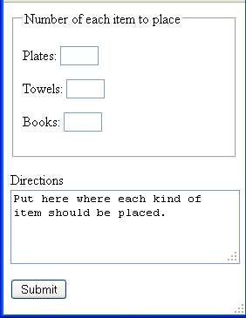
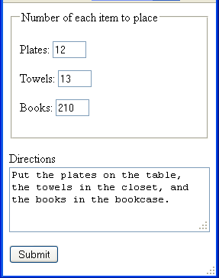
Problem 1 (5 points)
Write an HTML document rendered as shown (left)
Asks for the number of various items
Textarea for directions on where to put them
Default text shown
Form filled out with numbers for the various items and directions

Slide 3
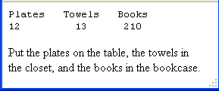
Request is sent to prob1.php
Rendering of HTML for above values shown
Echoes out headings for the various kinds of items
Uses printf() to output the numbers
Reserve fields 4 characters wide for each number field
Leftmost number left justified in its field
Other 2 right justified
Split the directions so they occupy 2 lines as close as possible to being of equal length without breaking up a word

Slide 4
Hint
Get rid of whitespace at the beginning or end of the directions string by applying trim() to it
Set an index variable to (just before) the middle of the string
Increment it as long as the character it indexes isn’t equal to a space

Slide 5
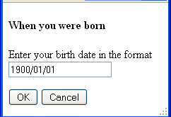
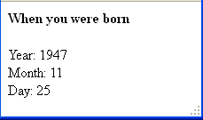
Problem 2 (7 points)
Write an HTML document, prob2.html—see the rendering
Example date in the textbox is the initial content
Button labeled OK is the submit button
Button labeled Cancel is reset button
Sends a request is sent to prob2.php—see the screenshot
The rendering of the HTML it when 1947/11/25 is entered
Use a regular expression to capture the 3 date components
Output on separate lines

Slide 6
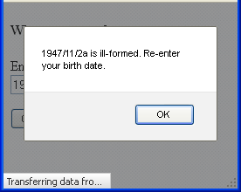
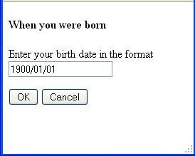
If the date is ill-formed, the HTML of the response raises an alert
Ignore the text in the lower left corner
When the alert is dismissed, see the initial rendering of prob2.html
Copy and paste the form in prob2.html as pure HTML in an else clause in prob2.php

Slide 7
How to produce the alert box
Can embed JavaScript in the values of event attributes using the javascript pseudo-protocol
Prefix the JavaScript with “javascript:”
E.g., clicking the p element raises an alert box with content Hi
<p onclick="javascript:alert('Hi')">Click me!</p>
Can similarly raise an alter box when the page finishes loading
<body onload="javascript:alert('Hi')">
What makes this difficult here is that the PHP has to construct the opening body tag with the alert() call with a string as its content
Need quotes within quotes, within quotes
Only 2 kinds of quotation marks (single and double)

Slide 8
Escape 1 of the pairs of quotation marks
If $err contains the error message, use
echo " <body onload='javascript:alert(\"".$err."\");'>";
Don’t include any newlines in the error message
alert() doesn’t allow multiline content

Slide 9
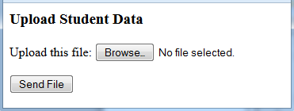
Problem 3 (6 pts.)
Write an HTML document prob3.html
Place it below the document root
Initial rendering as shown
The button labeled Browse is the rendering of an input element with type="file" and name="datafile"

Slide 10
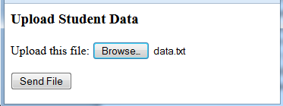
The Blackboard page for this assignment provides a file data.txt
30 10
28 a3
29 12
31 9
The enrollments by gender in repeated offerings of a given course
In each line, the 1st number is the number of males, the 2nd is the number of females
The 2nd line has an error: a3
Put data.txt in the same folder as prob3.html
Click the Browse button and navigate to data.txt and select it
The button labeled Send File is the submit button

Slide 11

When Send File is clicked, a POST request with the uploaded file is sent to prob3.php (in the same folder as prob3.html)
prob3.php moves the data file to folder uploads immediately below the document root (i.e., "/uploads/")
Opens this file and reads it
Sums the number of males and the number of females
Includes the totals in the response
Any lines in the file that can’t be interpreted as 2 numbers are echoed back, identified as ill-formed
Don’t contribute to the totals

Slide 12
Use a regular expression to extract the 2 numbers from a line read from the file
Any amount of whitespace (including none) before the 1st number, any amount (including none) after the 2nd
Use the ^ and $ anchors
Some whitespace (and nothing else) between the 2 numbers

Slide 13
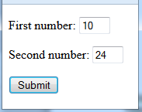
Problem 4 (6 points)
You’ll send (in a request) an array with string keys
E.g., consider this form (see the rendering)
<form action="ex.php" method="get">
<p>First number: <input type="text" name="num[first]" /></p>
<p>Second number: <input type="text" name="num[second]" /></p>
<p><input type="submit" value="Submit" /></p>
</form>
The names of the textboxes form an array with string keys
Keys are not within additional quotation marks
When the form is submitted, the URL in the address bar is
http://localhost/c322f13/HW9/ex.php?num[first]=10&num[second]=24

Slide 14
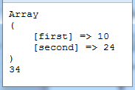
ex.php first assigns the value of form variable num (the array) to program variable $num.
<?php
$num = $_GET['num'];
?>
In the HTML body, it dumps out the array contents and echoes the sum of the 2 elements in the array (see the rendering)
<body>
<pre>
<?php
print_r($num);
echo $num['first'] + $num['second'];
?>
</pre>
</body>

Slide 15
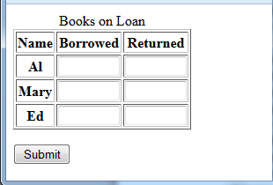
Write an HTML document prob4.html, initially rendered as shown
The table has a caption, a 1-row head, and a 3-row body
The row labels are th cells
Also a submit button
When it’s clicked, a GET request is sent to prob4.php (in the same folder)
The contents of the table-body cells except for the 1st column are textboxes with size="8"
The names in the textboxes in the 2nd column form associative array borrowed
Keys are the same as the names in the 1st column
The names in the textboxes in the 3rd column form associative array returned
Keys again are the same as the names in the 1st column

Slide 16
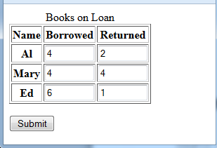
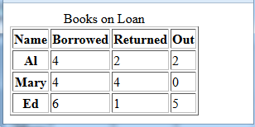
Script prob4.php reproduces the table with an additional column
The screenshot below right is the rendering of the HTML produced when the form was filled out as shown in the screenshot below left
The column labeled Out has the number of books checked out
The values in this column are the differences of the values in the previous 2

