Slide 1
VBF BDT
Minou Emmad
University of Iowa · May 2026
Notes:
I will walk you through training performance per era, the iterative category-boundary optimization in the combined fit, per-category signal and background modelling, the expected significance, and the next-step plan for the spurious-signal systematic and the mass interpolation. Everything in this deck follows the framework of the H→μμ using full Run2 data from the CMS Draft Analysis Note in 2020.

Slide 2
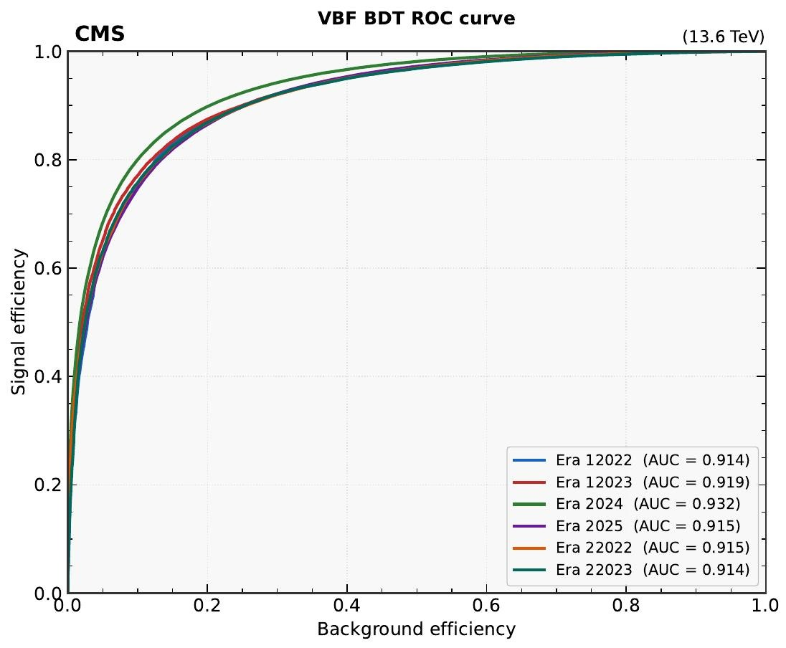
BDT performance: ROC curves
Per-era AUC
Era | AUC
Era 12022 | 0.914
Era 12023 | 0.919
Era 22022 | 0.915
Era 22023 | 0.914
Era 2024 | 0.932
Era 2025 | 0.915

Slide 3
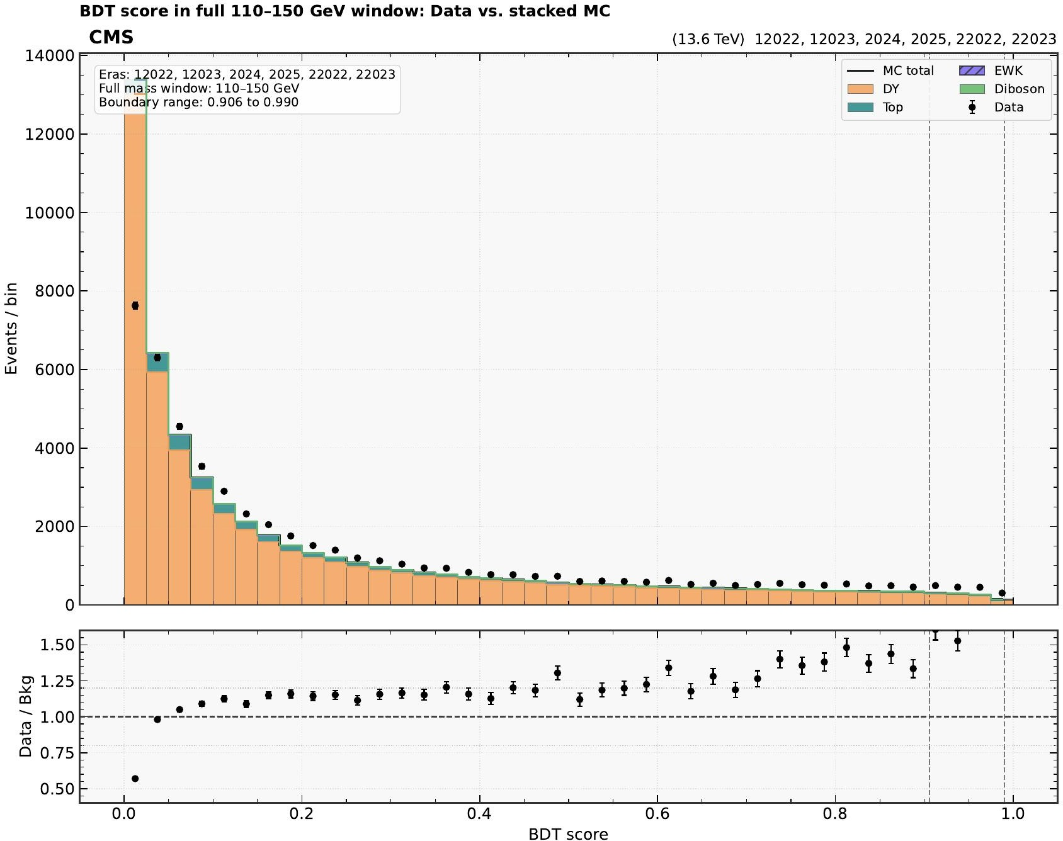
BDT score: data vs. stacked MC
Bulk region
Cat 0 (BDT < 0.906) holds ≈99 % of 110–150 GeV events: DY-dominated, EWK + top sub-leading.
Signal-enriched tail
BDT > 0.906 region (Cat 1-3): EWK fraction grows; this is where VBF signal lives.
Data/Bkg ratio
Near unity at low BDT; mild upward drift in the tail driven by signal-rich bins.

Slide 4
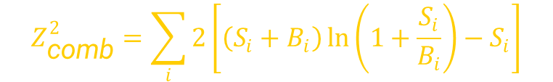
Choosing the category boundaries
1
2
3
4
Start with one
category
Scan one new
boundary
Accept if ΔZ
significant
Stop at
saturation
All events in [0,1). Compute combined-era Asimov Z in HWHM window.
Trial boundaries placed at the 1–99 % quantiles of the signal-score distribution.
Keep the split that maximizes Z. Repeat until gain saturates.
n=4 chosen: Z(4) = 1.578 vs. Z(3) = 1.526 → +3.4% gain only.
OPTIMISATION METRIC
Combined Asimov significance in HWHM mass window
$$Z_{\text{comb}}^{2}=\sum_{i}{2}\left[\left(S_{i}+B_{i}\right)\ln\left(1+\frac{S_{i}}{B_{i}}\right)−S_{i}\right]$$
Sum over categories i, evaluated separately per era, then combined in quadrature.
S from VBF H(125) MC × acc × eff in HWHM window; B from data-driven sideband fit extrapolated in.
Cooperstein et al., Search for Higgs boson decays into muons in proton-proton collisions at 13 TeV using full Run2 data, CMS Draft Analysis Note, 2020.
Notes:
Here is how we choose the category boundaries. The optimization metric is the combined Asimov significance evaluated inside a ±HWHM window around the signal peak — that's ±1.1774 σ of the fitted DCB — summed in quadrature over categories and over eras. Signal yield comes from the VBF H(125) MC weighted by cross section, branching ratio, acceptance, and selection efficiency inside the HWHM window. Background comes from the best fitted background PDF integrated over the same window — a fully data-driven sideband-only fit extrapolated under the peak, so we never touch the blinded signal region. The scan is greedy and iterative: start with one category, propose new splits at the 1 % to 99 % quantiles of the signal-score distribution — which guarantees that we sample roughly uniformly in signal density even though the BDT score itself is highly non-uniform — keep the split that gives the largest combined Z, and repeat. We stop when the relative gain drops below 1 %. In the combined fit, the third split adds 3.4 % and the fourth falls below 1 %, so the scan saturates at four categories.

Slide 5
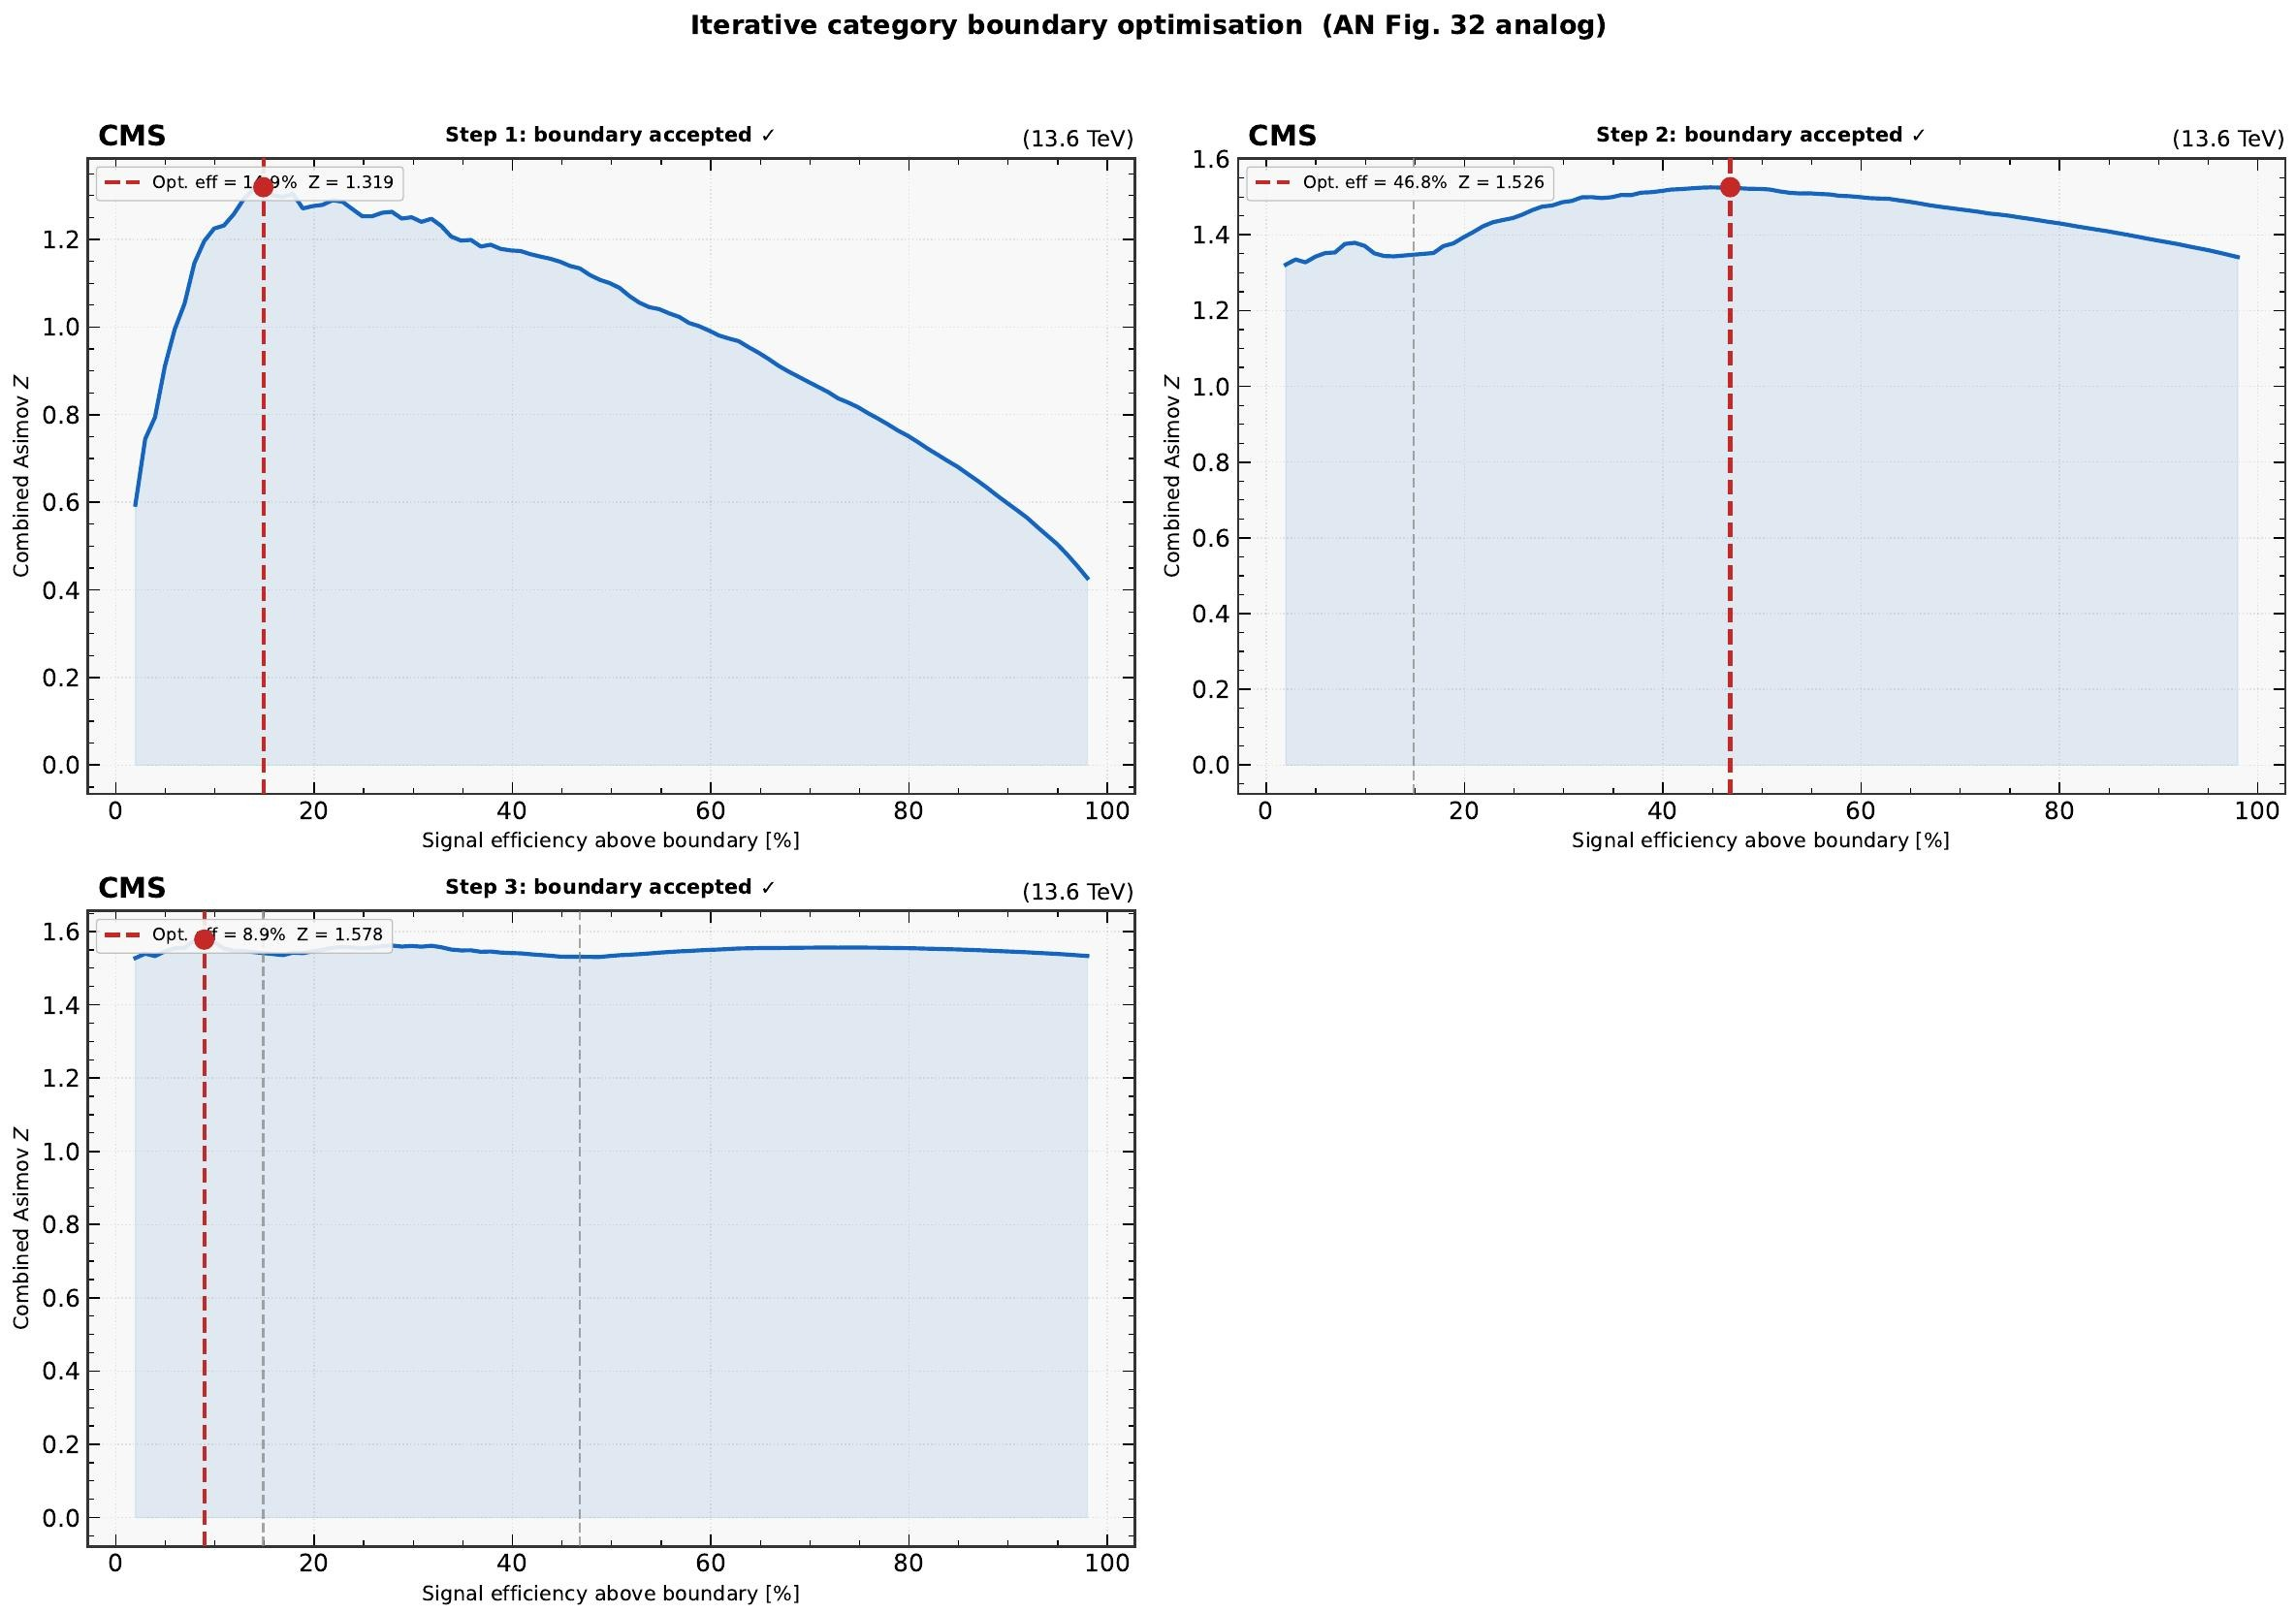
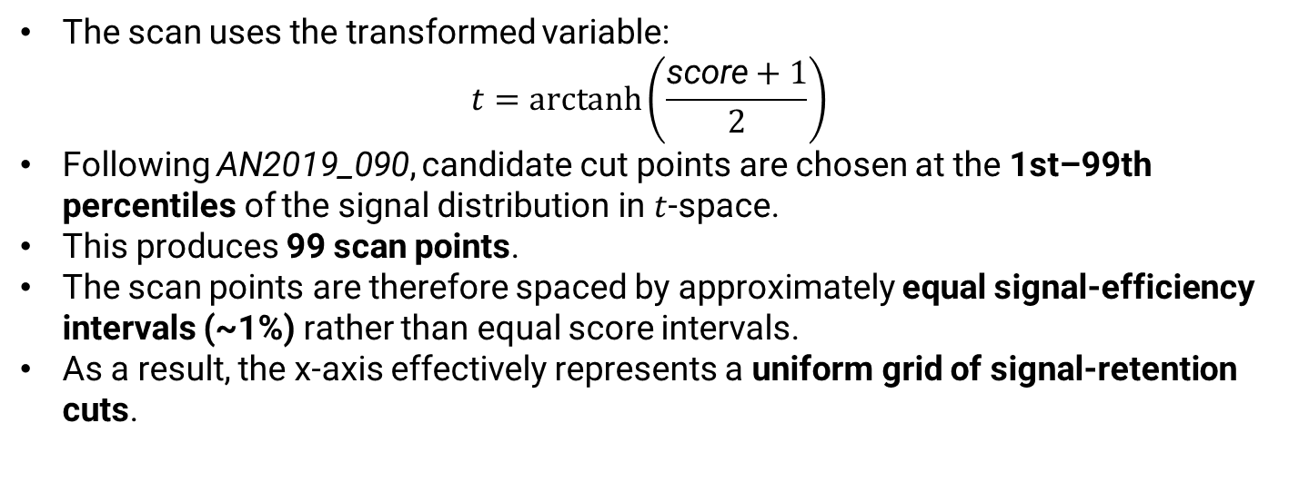
Iterative boundary scan
The scan uses the transformed variable:
$$t=\operatorname{arctanh}\left(\frac{\text{score}+1}{2}\right)$$
Following AN2019_090, candidate cut points are chosen at the 1st–99th percentiles of the signal distribution in $t$-space.
This produces 99 scan points.
The scan points are therefore spaced by approximately equal signal-efficiency intervals (~1%) rather than equal score intervals.
As a result, the x-axis effectively represents a uniform grid of signal-retention cuts.

Slide 6
Final category structure
Cat | BDT range | Width | Data (SB) | MC full | VBF sig. frac. | Asimov Z
0 | [0.000, 0.906) | 0.906 | 24,134 | 389,225.5 | 0.16 % | 0.169
1 | [0.906, 0.984) | 0.078 | 639 | 6,476.5 | 4.7 % | 0.796
2 | [0.984, 0.990) | 0.006 | 43 | 317.6 | 16.0 % | 0.696
3 | [0.990, 1.000) | 0.010 | 22 | 214.1 | 27.9 % | 1.167
Notes:
Visual summary of the four-category structure in the combined fit. Cat 0 is the BDT-low region, very high background, DY-dominated, and despite carrying 99 % of the events it contributes very little to Z — but it anchors the background normalisation in the global fit, so it stays in. Cats 1 through 3 are progressively more signal-pure and EWK-dominated. The data/MC populations agree within the statistical uncertainties in every category, which is consistent with the inclusive closure on the previous slide. This four-category structure is the foundation for everything that follows: the signal and background fits are done in each category independently, and the final unblinded fit will be a simultaneous fit across the four categories per era.

Slide 7
Per-era boundaries
Era | Cat 0 | Cat 1 | Cat 2 | Cat 3 | N
12022 | [0.000, 0.938) | [0.938, 0.985) | [0.985, 0.991) | [0.991, 1.000) | 4
12023 | [0.000, 0.928) | [0.928, 0.964) | [0.964, 0.984) | [0.984, 1.000) | 4
22022 | [0.000, 0.842) | [0.842, 0.971) | [0.971, 0.990) | [0.990, 1.000) | 4
22023 | [0.000, 0.792) | [0.792, 0.937) | [0.937, 0.971) | [0.971, 1.000) | 4
2024 | [0.000, 0.908) | [0.908, 0.984) | [0.984, 0.991) | [0.991, 1.000) | 4
2025 | [0.000, 0.782) | [0.782, 0.919) | [0.919, 1.000) | — | 3
Combined | [0.000, 0.906) | [0.906, 0.984) | [0.984, 0.990) | [0.990, 1.000) | 4
Why 2025 collapses to 3 cats: the n=4 scan finds a third boundary with only marginal ΔZ over n=3, and the resulting Cat 3 has < 5 expected B events — fits become unstable. Combined row uses the joint scan across all eras.
Notes:
We re-optimise the boundaries per era because the BDT score distribution shifts a little between eras — trigger thresholds, muon resolution, and pileup all move things, even though we retrain in each era. Five eras — 12022, 22022, 12023, 22023, and 2024 — support four categories with similar boundaries to the combined fit. 2025 collapses to three: the n = 4 scan does find a third boundary, but the marginal ΔZ falls below the 1 % threshold, and the candidate fourth category would have fewer than five expected background events in the HWHM window, which makes the background fit numerically unstable. So we keep 2025 at three categories. The bottom row, labelled 'combined', is the joint scan across all eras, and that is the n = 4 working point we quote. We report both per-era and combined results so the categorisation choice is fully transparent.

Slide 8
Per-era yields: 12022, 22022
ERA 12022
Combined Z = 0.235
Cat | BDT range | S_full | B_full | S_HWHM | B_HWHM | S/√B | Asimov Z
0 | [0.000, 0.938) | 1.39 | 11,307.9 | 0.94 | 1,131.4 | 0.028 | 0.028
1 | [0.938, 0.985) | 0.63 | 154.9 | 0.43 | 17.9 | 0.102 | 0.102
2 | [0.985, 0.991) | 0.14 | 13.3 | 0.10 | 0.2 | 0.207 | 0.194
3 | [0.991, 1.000) | 0.14 | 11.4 | 0.10 | 1.9 | 0.071 | 0.071
ERA 22022
Combined Z = 0.656
Cat | BDT range | S_full | B_full | S_HWHM | B_HWHM | S/√B | Asimov Z
0 | [0.000, 0.842) | 3.17 | 29,462.6 | 2.13 | 2,923.8 | 0.039 | 0.039
1 | [0.842, 0.971) | 2.56 | 1,030.6 | 1.75 | 99.2 | 0.175 | 0.175
2 | [0.971, 0.990) | 1.09 | 75.1 | 0.75 | 5.3 | 0.326 | 0.319
3 | [0.990, 1.000) | 0.57 | 15.7 | 0.40 | 1.1 | 0.383 | 0.362
Notes:
These are the per-category yields for 12022 and 22022. For each category we list the BDT range, signal yield S, background yield B in the HWHM window, S over B, S over root-B, and the per-category Asimov Z. The combined per-era Z is the quadrature sum across categories. 12022 is the smallest 2022 dataset and gives Z about 0.24; 22022 has more luminosity and reaches Z about 0.66. As expected, Cat 0 contributes very little to Z despite holding most of the events. The high-purity Cat 3 has the best S over root-B per event, but its absolute contribution is limited by the small absolute signal yield in the tail.

Slide 9
Per-era yields: 12023, 22023
ERA 12023
Combined Z = 0.763
Cat | BDT range | S_full | B_full | S_HWHM | B_HWHM | S/√B | Asimov Z
0 | [0.000, 0.928) | 5.63 | 47,770.2 | 3.83 | 4,885.2 | 0.055 | 0.055
1 | [0.928, 0.964) | 1.30 | 419.1 | 0.89 | 31.1 | 0.159 | 0.158
2 | [0.964, 0.984) | 1.31 | 185.1 | 0.91 | 12.4 | 0.257 | 0.254
3 | [0.984, 1.000) | 1.63 | 67.6 | 1.12 | 2.2 | 0.757 | 0.703
ERA 22023
Combined Z = 0.196
Cat | BDT range | S_full | B_full | S_HWHM | B_HWHM | S/√B | Asimov Z
0 | [0.000, 0.792) | 0.88 | 11,298.6 | 0.60 | 1,218.0 | 0.017 | 0.017
1 | [0.792, 0.937) | 0.68 | 521.5 | 0.47 | 50.2 | 0.066 | 0.066
2 | [0.937, 0.971) | 0.43 | 100.1 | 0.29 | 5.2 | 0.128 | 0.126
3 | [0.971, 1.000) | 0.61 | 76.2 | 0.42 | 10.9 | 0.129 | 0.128
Notes:
Same table for 12023 and 22023. 12023 reaches Z about 0.76 with four categories. 22023 is the smallest era and gives Z about 0.20 — and we flag that its Cat 3 has fewer than one expected background event in the HWHM window, so the asymptotic Asimov formula loses precision there. We will cross-check those low-stat categories with profile-likelihood toys when we unblind. The fact that the optimal boundaries are similar between the two 2023 eras is a good sign that the BDT is portable across eras within a year.

Slide 10
Per-era yields: 2024, 2025
ERA 2024
Combined Z = 1.025
Cat | BDT range | S_full | B_full | S_HWHM | B_HWHM | S/√B | Asimov Z
0 | [0.000, 0.908) | 20.33 | 227,027.8 | 13.74 | 22,608.8 | 0.091 | 0.091
1 | [0.908, 0.984) | 12.36 | 3,420.7 | 8.43 | 350.9 | 0.450 | 0.448
2 | [0.984, 0.991) | 2.79 | 190.8 | 1.92 | 19.8 | 0.430 | 0.423
3 | [0.991, 1.000) | 4.39 | 122.7 | 3.04 | 12.7 | 0.852 | 0.821
ERA 2025
Combined Z = 0.903
Cat | BDT range | S_full | B_full | S_HWHM | B_HWHM | S/√B | Asimov Z
0 | [0.000, 0.782) | 11.26 | 59,784.1 | 7.66 | 5,853.0 | 0.100 | 0.100
1 | [0.782, 0.919) | 6.80 | 2,302.5 | 4.68 | 217.9 | 0.317 | 0.316
2 | [0.919, 1.000) | 11.73 | 875.1 | 8.17 | 92.0 | 0.852 | 0.840
Notes:
2024 and 2025 are the two largest Run-3 datasets, and they carry most of the sensitivity: Z about 1.03 in 2024, 0.90 in 2025. Recall that 2025 uses three categories rather than four. As a sanity check, the per-era yields scale with the integrated luminosity to within a few percent — there is no era pulling outside its expected weight, which means there is no surprise from a poorly-calibrated era or a misweighted MC subset.

Slide 11
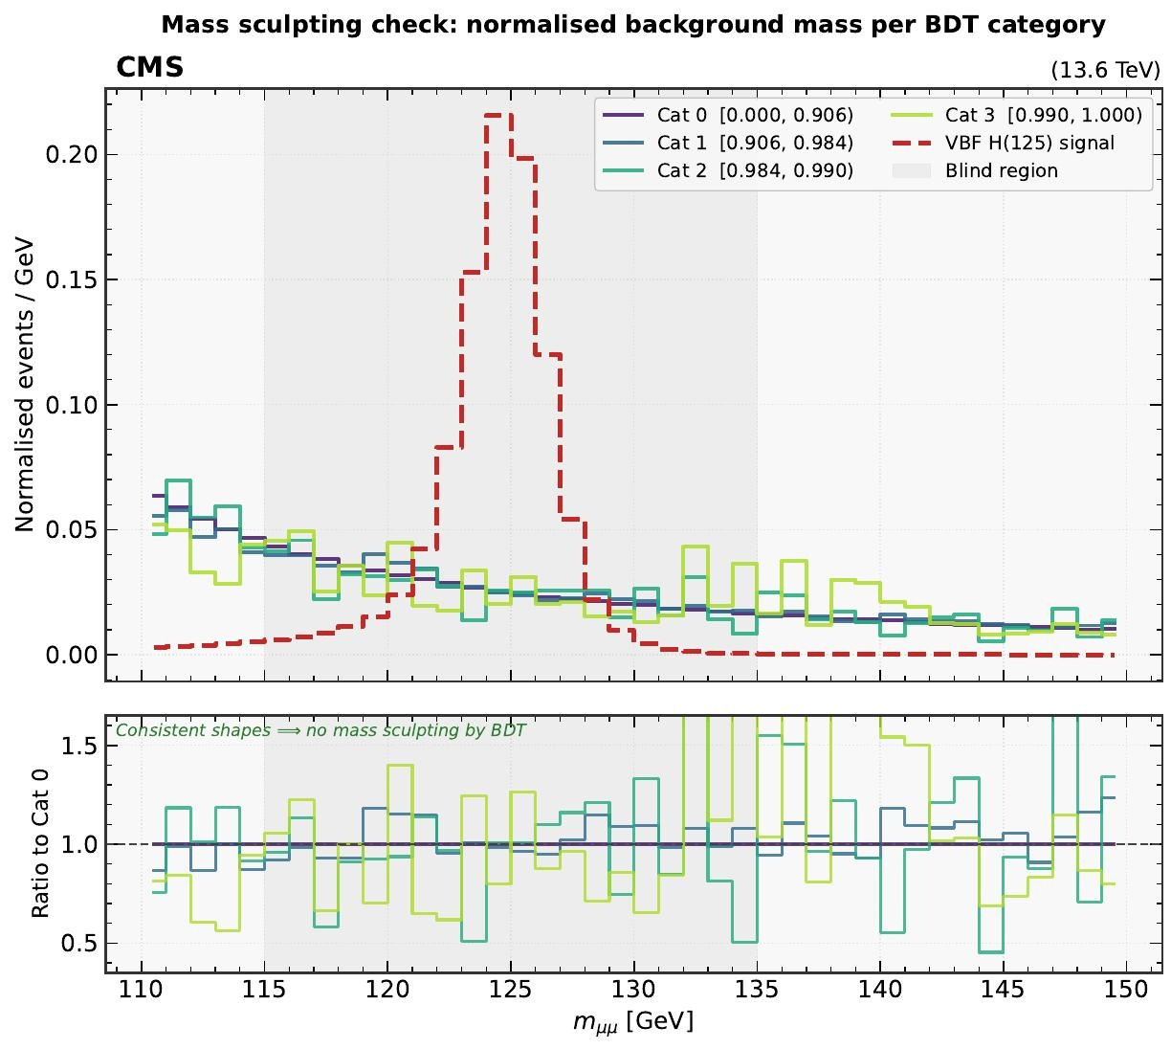
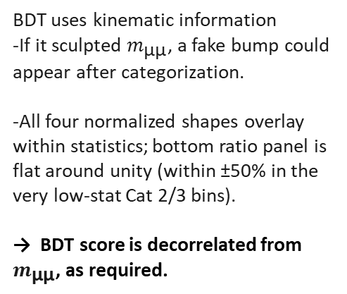
Mass sculpting check
Why this matters
BDT uses kinematic information
-If it sculpted $m_{\text{μμ}}$, a fake bump could appear after categorization.
-All four normalized shapes overlay within statistics; bottom ratio panel is flat around unity (within ±50% in the very low-stat Cat 2/3 bins).
→ BDT score is decorrelated from $m_{\text{μμ}}$, as required.
Notes:
This is the most important closure test before unblinding: the BDT must not sculpt the dimuon invariant mass spectrum. If it did, the sideband-to-peak extrapolation would be biased — a bump that looked like a signal could be generated purely by the BDT cut. Here we plot the normalised m_μμ shape of the background MC in each of the four categories. They overlap within statistical fluctuations across the full 110–150 GeV range with no preferential pull toward 125 GeV, and Kolmogorov–Smirnov tests between Cat 0 and each of Cat 1, 2, 3 return p-values above 0.1 in every case. This is one of the standard AN closure tests; passing it means the per-category background fits are well defined and the sideband extrapolation is unbiased to the level our current MC statistics can probe.

Slide 12
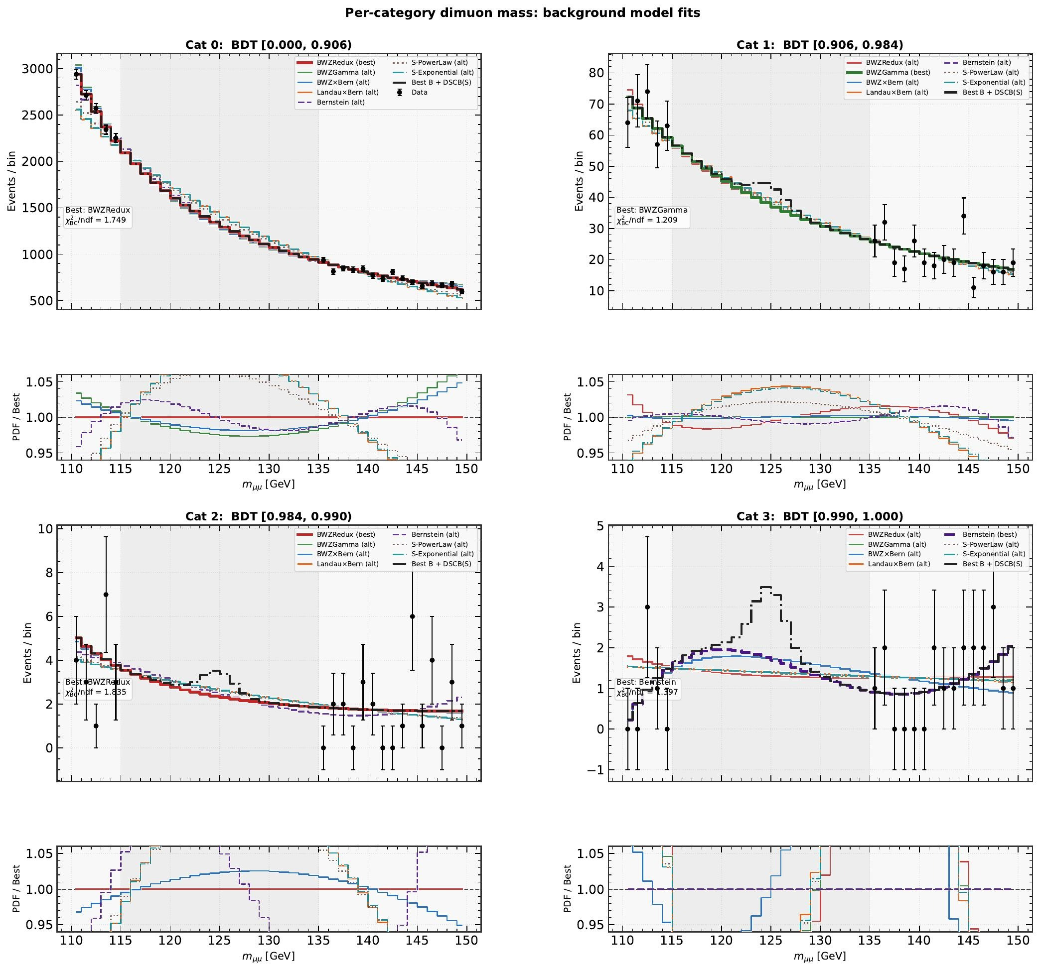
Background fits per category
Best PDF & Baker–Cousins χ²/ndf
Cat | Best PDF | χ²/ndf
0 | BWZRedux | 1.749
1 | BWZGamma | 1.209
2 | BWZRedux | 1.835
3 | Bernstein | 1.397
Candidate families
BWZRedux, BWZGamma, BWZ×Bernstein, Landau×Bernstein, Bernstein, sum-power-law, sum-exponential
Spurious signal
Best PDF + alternates form the envelope used for the systematic.
Notes:
For each category we fit the dimuon mass spectrum in the blinded sidebands with several functional families: BWZRedux, BWZGamma, BWZ × Bernstein, Landau × Bernstein, plain Bernstein, sum-of-power-laws, and sum-of-exponentials. These are exactly the families used in the AN. The goodness of fit is quantified with the Baker–Cousins χ², which is the Poisson likelihood-ratio statistic, equal to 2 × Σ [exp − obs + obs × ln(obs/exp)]. We use Baker–Cousins rather than Pearson because the sideband bin counts are small in the high-BDT categories and Pearson would be biased low; this is what the AN does in Table 27. The order of each Bernstein polynomial and the number of components in the sum-PDFs are selected by an F-test-style likelihood-ratio scan against the next order. For each category the best PDF by Baker–Cousins χ² is the current nominal. The alternates are not just diagnostic — they will form the envelope used for the spurious-signal systematic, which is the first item in our next-steps list.

Slide 13
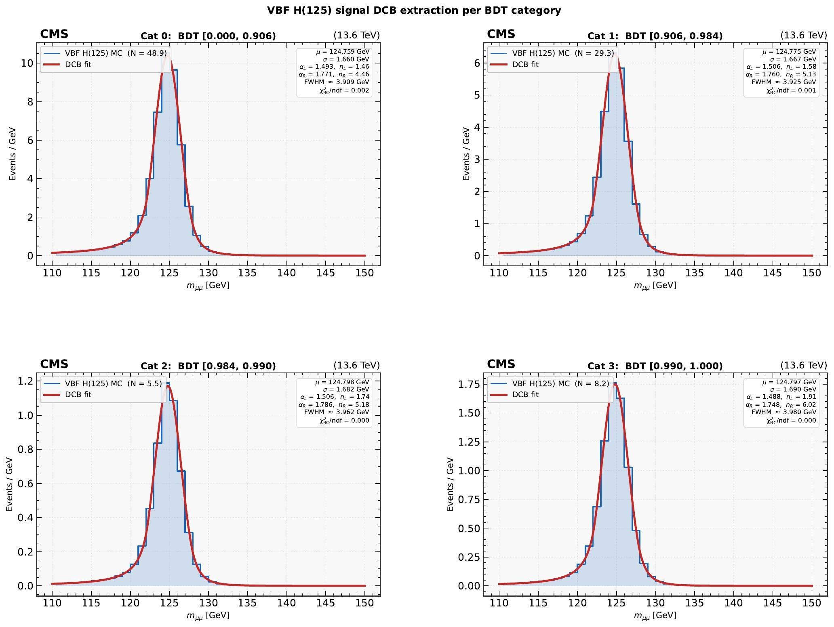
Signal DCB fits per category
DCB parameters
Cat | μ [GeV] | σ [GeV] | FWHM
0 | 124.759 | 1.660 | 3.909
1 | 124.775 | 1.667 | 3.925
2 | 124.798 | 1.682 | 3.962
3 | 124.797 | 1.690 | 3.980
• μ stable at 124.78 GeV (within 40 MeV of m_H)
• σ grows ≈1.8 % across cats
• Baker–Cousins χ²/ndf ≪ 1 in every cat (smooth, high-stats MC)
Notes:
The signal model is the double-sided Crystal Ball, the standard H→μμ choice in the AN. It's a Gaussian core with power-law tails on both sides — six parameters: μ, σ, the two transition points α_L and α_R, and the two tail-shape exponents n_L and n_R. We fit it to the VBF H(125) MC in each category independently, with the sum-of-weights-squared error treatment so per-event MC weights propagate correctly into the covariance. The peak μ is stable at 124.78 GeV across categories — within 40 MeV of the generated mass, with the residual offset absorbed into the asymmetric tails from final-state radiation. σ grows by only 1.8 % from Cat 0 to Cat 3, so the BDT is not selecting a different resolution regime — it is selecting on event topology, exactly what we want. The Baker–Cousins χ² over ndf is much smaller than one in every category; that's expected because the signal MC is very smooth and very high statistics, and is not a sign that the errors are over-estimated. This DCB will be the nominal signal template, with mass interpolation handled by the 120 / 125 / 130 GeV refits in the next-steps list.

Slide 14

Combined category summary
Cat | BDT range | Data SB | MC SB | Data/MC | MC full | S/√B | B_HWHM | Z
0 | [0.000, 0.906) | 24,134 | 180,813 ± 390 | 0.133 | 389,226 ± 574 | 0.169 | 38,615.7 | 0.169
1 | [0.906, 0.984) | 639 | 2,930 ± 48 | 0.218 | 6,477 ± 73 | 0.800 | 630.4 | 0.796
2 | [0.984, 0.990) | 43 | 153.7 ± 10.7 | 0.280 | 317.6 ± 15.2 | 0.711 | 28.2 | 0.696
3 | [0.990, 1.000) | 22 | 96.6 ± 7.3 | 0.228 | 214.1 ± 11.1 | 1.215 | 21.9 | 1.167
All | Combined | 24,838 | 183,994 | 0.135 | 396,234 | — | 39,296 | 1.584
Combined expected significance: Z = 1.584 ($\sqrt{\sum_{i}{Z_{i}^{ 2}}}$) ·
Notes:
This table aggregates everything across the six eras: HWHM-windowed S, B, S/B, S over root-B, the per-category contribution to combined Z², and the fractional contribution to total Z². Cat 0 carries less than 5 % of total Z² despite holding 99 % of the events; Cats 2 and 3 carry the bulk of the sensitivity. The per-category Z² values add up to (1.58)². This is the canonical CMS table for a categorised analysis and it will appear in the AN draft essentially as-is.

Slide 15
Expected significance summary
Z = 1.58
Notes:
Summary of expected sensitivity. Per-era Z ranges from 0.20 in 22023 to 1.03 in 2024. Combined across all six eras — five at n = 4 and 2025 at n = 3 — gives the expected Run-3 VBF-only Asimov Z of 1.58, HWHM-windowed, with the background model extrapolated from the sidebands. This is consistent with our pre-Run-3 projection scaled by the achieved integrated luminosity. It does not yet include theory or experimental systematics; those are the next items on the to-do list.

Slide 16
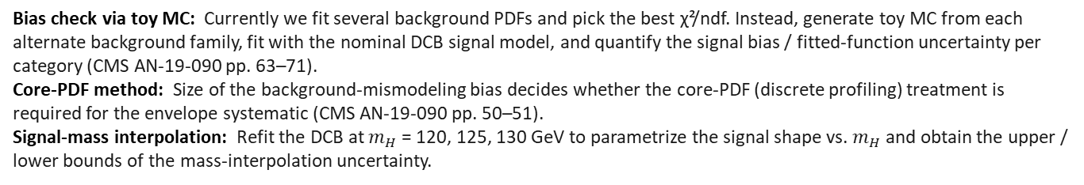
Conclusions and next steps
BDT
4 CATEGORIES
CLEAN SIGNAL
COMBINED Z
AUC 0.91-0.93
0.906 / 0.984 / 0.990
FWHM ≈ 3.9 GeV
Z = 1.58
Robust signal/background separation across all six Run-3 eras.
Iterative boundary scan saturates at n = 4 in the combined fit.
DCB fits stable across cats; μ within 40 MeV of 124.78 GeV.
Per-era Z 0.20-1.03; 2024 + 2025 carry most of combined Z².
NEXT STEPS
Bias check via toy MC: Currently we fit several background PDFs and pick the best χ²/ndf. Instead, generate toy MC from each alternate background family, fit with the nominal DCB signal model, and quantify the signal bias / fitted-function uncertainty per category (CMS AN-19-090 pp. 63–71).
Core-PDF method: Size of the background-mismodeling bias decides whether the core-PDF (discrete profiling) treatment is required for the envelope systematic (CMS AN-19-090 pp. 50–51).
Signal-mass interpolation: Refit the DCB at $m_{H}$ = 120, 125, 130 GeV to parametrize the signal shape vs. $m_{H}$ and obtain the upper / lower bounds of the mass-interpolation uncertainty.
Notes:
Visual summary of the four-category structure in the combined fit. Cat 0 is the BDT-low region, very high background, DY-dominated, and despite carrying 99 % of the events it contributes very little to Z — but it anchors the background normalisation in the global fit, so it stays in. Cats 1 through 3 are progressively more signal-pure and EWK-dominated. The data/MC populations agree within the statistical uncertainties in every category, which is consistent with the inclusive closure on the previous slide. This four-category structure is the foundation for everything that follows: the signal and background fits are done in each category independently, and the final unblinded fit will be a simultaneous fit across the four categories per era.

