Slide 1

HPI CPS Lab Figures
Acknowledgements:
Sebastian Wätzoldt, Stefan Neumann, Joachim Hänsel, and Falk Benke
System Analysis and Modeling Group
Notes:
We contribute:
Applied, adapted and evaluated an existing development methodology for the robotic system application domain
evaluated and adapted the combination soft and hard real-time at the application/component level using a MDE approach
An Methodology for robotic system should support:
Different development activities
Modeling, simulation, verification/ testing
Different Stages
Simulation, Prototyping, (Pre-)production
Supported tools
Supported libraries
Integrated toolchain
Reflect hard and soft real-time constraints
we just read the call for paper and many of these issues adressed there are already solved in other domains
We ask, why do not use these concepts in robotics to and than we try
We reflect HRT and SRT and the interaction between at modeling level
Adapt an existing methodology from the automotive domain to the robotic domain
Microwave example

Slide 3
evaluation_scenario_1

Slide 4
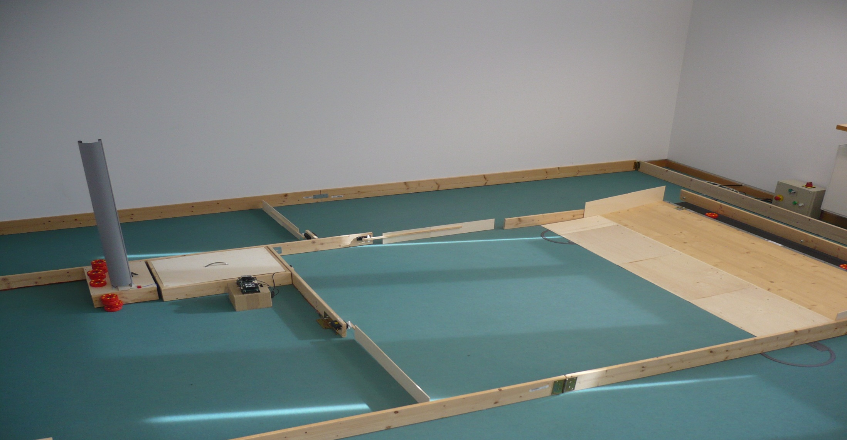
evaluation_scenario_2

Slide 5
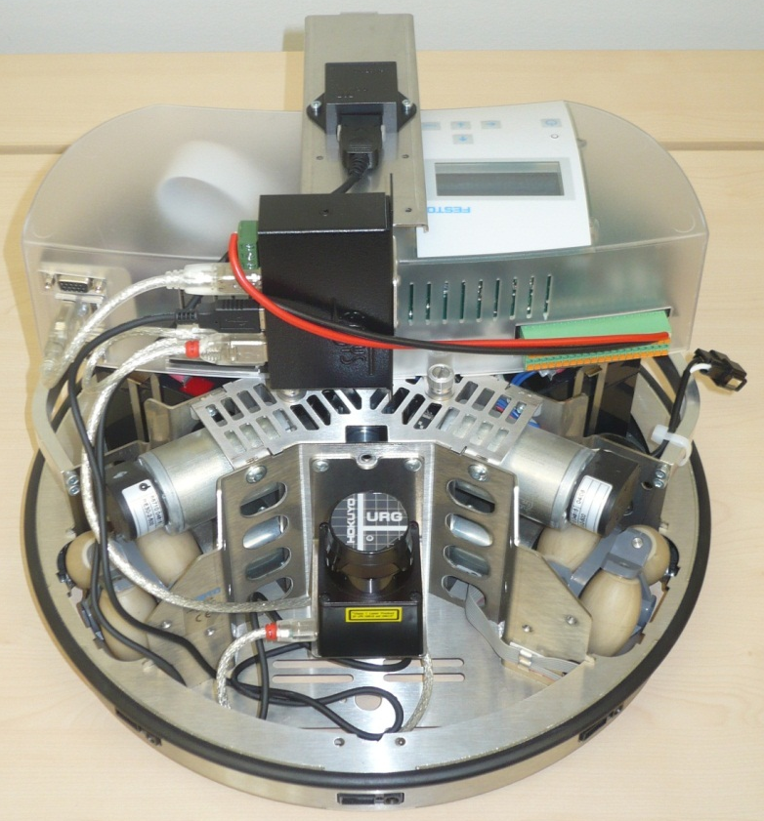
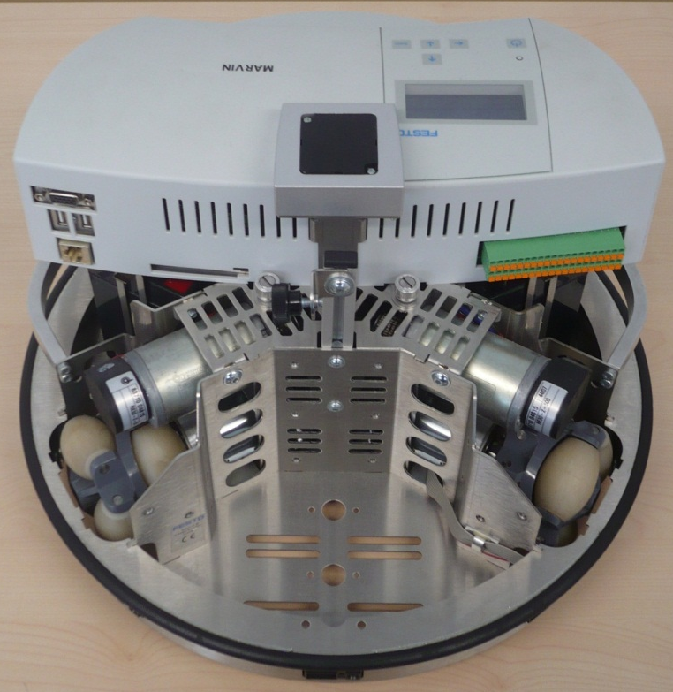
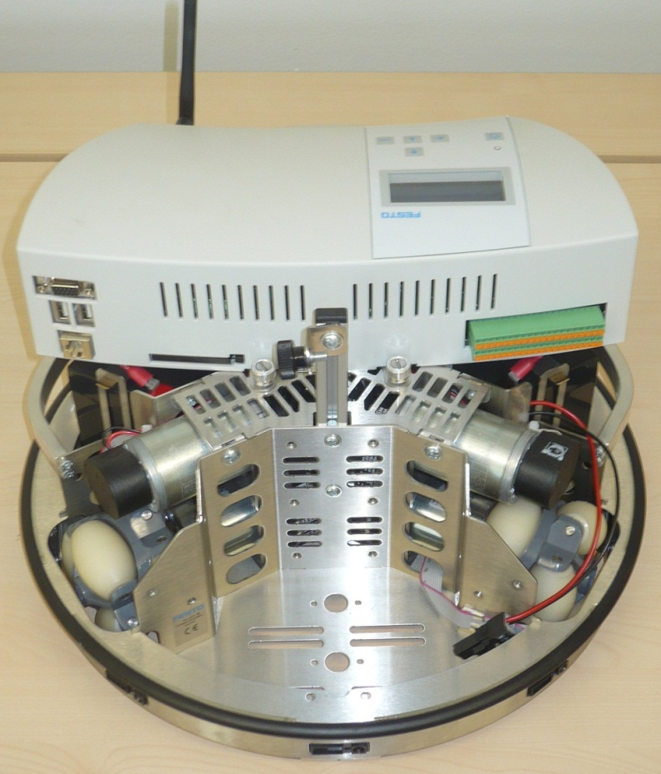
evaluation_scenario_3

Slide 7
methodology
MT/MiL
Simulation
stage
RP
SiL
Prototyping
stage
HiL
MT = model test
MiL = model-in-the-loop
RP = rapid prototyping
SiL = software-in-the-loop
HiL = hardware-in-the-loop
ST = system test
Pre-production
stage
ST
Notes:
[Broekman2003]
Broekman, B. and Notenboom, E.:
Testing Embedded Software,
Wesley, 2003.

Slide 9

Simulation Stage
MT/MiL
Focus model development
Functional development
Overall proof of the control laws
Ignore or simplify
Real sensor values
Specific communication interaction and messages
Sensor noise
Timing/ memory/ computation constraints
Scheduling
RP
+Extensions
Notes:
MATLAB + Extension e.g. Stateflow to model the dynamic behavior using statecharts
Built own block library

Slide 10
Simulation Stage
MT/MiL
RP

Slide 11
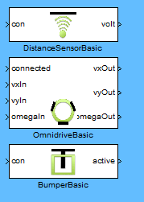

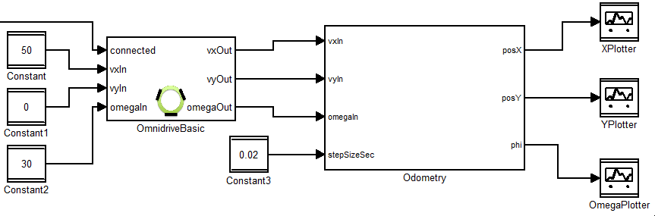
Simulation Stage
MT/MiL
RP
Notes:
Odemetry around 40 blocks

Slide 12
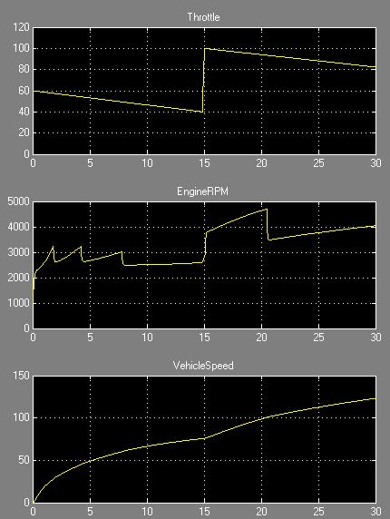

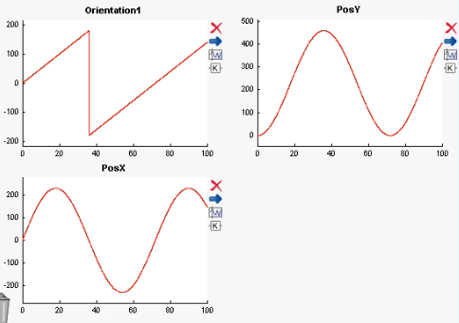
MT/MiL
RP
Notes:
mt
Verification: Model Testing (MT)
one-way / one-shot simulation
Stateflow -> Other formal Models -> MDE apply model checking
AUTOMATA, Finite State Machine…

Slide 13
MT/MiL
RP
Notes:
Mil
Verification: model-in-the-loop (MiL) simulation
Simulation using feedback loops

Slide 14
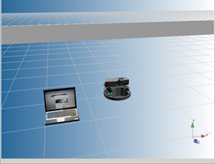
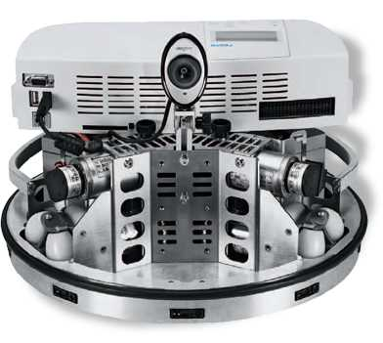
MT/MiL
RP
Notes:
rp
Verification: model-in-the-loop (MiL) simulation
Simulation using feedback loops
Simulate using the real robot
Other simulators:
GAZEBO
Morse (Wednesday MORSE)

Slide 16
Prototyping Stage
MT/MiL
Focus changes from model to implementation
Individual function
System architecture
Discretization effects become visible
Simulation
stage
RP
SiL
Prototyping
stage
HiL
Pre-production
stage
ST

Slide 17
SiL
Notes:
Prototyping Stage
Software-in-the-loop simulation
Function development slide (code generation or hand coded integration)
Simulation stage -> prototyping stage

Slide 18

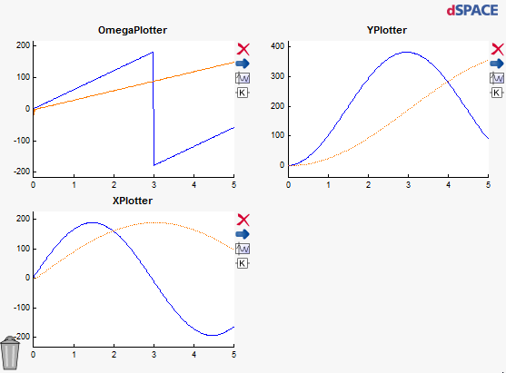
SiL
Code
Generation
Notes:
Prototyping Stage
Software-in-the-loop simulation
Function development slide (code generation or hand coded integration)
Simulation stage -> prototyping stage
Function development slide (code generation or hand coded integration)
Prototyping Stage
code generation capabilities of MDE
Hand coded implementation

Slide 19
HiL
Code
Generation
Notes:
Function development slide (code generation or hand coded integration)
Prototyping Stage
code generation capabilities of MDE
Hand coded implementation

Slide 20
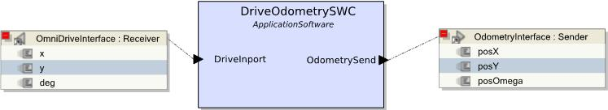
Prototyping Stage
SiL
Notes:
ROS
RT-Middleware

Slide 21
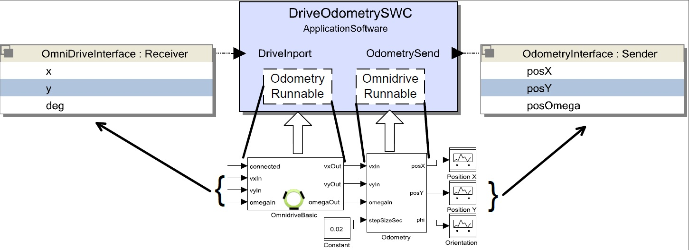
Prototyping Stage
SiL
Notes:
System architecture slide
First interfaces
Mapping of functional parts
Component composition

Slide 22
Prototyping Stage
SiL
Notes:
Define components
Communication mechanisms, port types
Messages, interfaces and data types
Map functionality
using existing models
Custom implementation files
Define:
overall architecture
Task specification
hardware configuration
System architecture slide
First interfaces
Mapping of functional parts
Component composition

Slide 24
Real-Time Consideration
MT/MiL
Consider real-time constraints
E.g. to guarantee safety constraints
Combination of hard and soft real-time at functional as well as architectural level
difference to the automotive domain is stronger coupling in robotics
Our Approach:
Preserves hard real-time constraints for basic functions
Communication between hard and soft real-time ensures consistent data exchange
Simulation
stage
RP
SiL
Prototyping
stage
HiL
Pre-production
stage
ST
Notes:
Microwave
Robot interact with humans

Slide 25
Real-Time Consideration
MT/MiL
Simulation
stage
RP
SiL
Prototyping
stage
HiL
Pre-production
stage
ST
Notes:
Future work
Show/ make visual HRT and SRT in the architecture or in the component models
+ limitations in communication by combining them

Slide 26
Real-Time Consideration
MT/MiL
Simulation
stage
RP
SiL
Prototyping
stage
Task description:
HiL
hard real-time
soft real-time
Task 1
Task 1
Pre-production
stage
ST
…
…
Task n
Task n

Slide 27
Real-Time Consideration
MT/MiL
Simulation
stage
RP
SiL
Preserves hard real-time constraints for basic functions
Prototyping
stage
Task description:
HiL
hard real-time
soft real-time
High priority
Task 1
Task 1
Pre-production
stage
ST
…
…
Low priority
Task n
Task n
Notes:
This is the not distributed case

Slide 28
Real-Time Consideration
MT/MiL
Simulation
stage
RP
SiL
Communication between hard and soft real-time ensures consistent data exchange
Prototyping
stage
Task description:
HiL
hard real-time
soft real-time
trigger via
data event
Task 1
Task 1
Pre-production
stage
ST
…
report
results
…
Task n
Task n
Notes:
Not distributed case

Slide 29
Task description:
hard real-time
soft real-time
trigger via
data event
Task 1
Task 1
…
report
results
…
Task n
Task n
High priority
Low priority
Notes:
Real-Time Consideration
Preserves hard real-time constraints for basic functions: high/low priority
Communication between hard and soft real-time ensures consistent data exchange: trigger ...

Slide 31
MT/MiL
Simulation
stage
RP
SiL
Prototyping
stage
HiL
Pre-production
stage
ST
Notes:
Pre-production Stage
Simulate overall architecture
Build real system and execute on real hardware
No simulation semantic
Hard real-time execution possible
Put more and more artifacts together and evaluate real behavior
For analyzing using real-time debugging

Slide 33
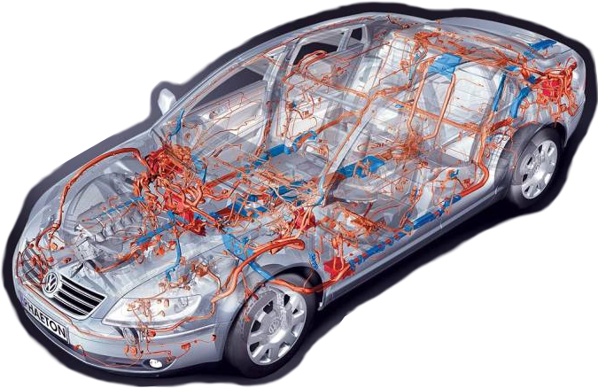
Summary
MT/MiL
Simulation
stage
RP
SiL
Prototyping
stage
HiL
Pre-production
stage
ST
Notes:
Methodology
Guidance due different focus in stages following MDE approach
Tool and library integration
Verification, simulation, testing support
Hard and soft real-time consideration

