Slide 1
Methodology
Requirements
1. Situation
2. Context Assumptions
Reach destination
Move an object
…..
Delay
No communication
….
3. Variables
4. Model
Number?
Kind of data? (continuous or discrete)
Standalone or Combined data?
Correlated? Seasonal? Trend? Multivariate? Independent? Parametric?
Formula?
Historical data?
Prediction/forecast?
Learning?
System model?
Surrogate model?
Uncertainty
5. Uncertainty Level
6. Uncertainty Type
Which levels we have?
Which is better? Single – composed
Kind of problems?
7. Uncertainty Model
8. Uncertainty Assumptions
Wanted output? (conf. , credibility)
Requirement of assumption? (prior)
Adaptaion Decision Making
9. Decision Making Level
10. Decision Making Mechanism
Mode switch (local vars)
Tradeoff (meta- vars)
Context/situation conflict?
Meta- vars: parameters
Correlation between parameters: 1zone, 3zones
Simulation/real-life

Slide 2
INERTIA Example
Requirements
1. Situations
2. Context Assumptions
Energy efficiency
Predicted Occupants
Separated sensors …..
3. Variables
4. Model
Occupants : 0/1. number, density
4 types of sensors (motion/presence sensors, Pressure sensors, environmental sensors and vision-based systems)
No formula for occupancy
Historical data
Prediction (forecast? – not in the example but it might be an option)
Learning
Discrete + Continuous
Surrogate model
predictive model
Uncertainty
6. Uncertainty Level
5. Uncertainty Type
Choose the best combination of sensors
Composite (fusion): confidence degree (the minimum error)
PIR: Ambiguity (imprecise)-deactivation
Door: Incompleteness (missing data)
CO2: Vagueness (ill-def.)
Acoustic: Ambiguity + Vagueness => Uncertainty
7. Uncertainty Model
Composite (fusion): probabilistic + learning combination => Bayesian
PIR: DSET
Door: Probability model
CO2: Fuzzy Set
Acoustic: Probability model
8. Uncertainty Assumptions
Requirement of assumption?(prior)
Discrete
Symmetric
No cluster
Uniform
Adaptation Decision Making
9. Decision Making Level
10. Decision Making Mechanism
Mode switch (local vars)
Tradeoff (meta- vars)
Context/situation conflict?
Meta- vars: parameters
Correlation between parameters: 1zone, 3zones
Real-life data

Slide 3
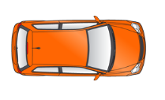
a)
Breaking Distance
minInacc
maxInacc
Hard boundaries
leader-Positioning Data: wireless
(one observation for each time step)
b)
Distance : Many Sensors
(many observations for each time step)
Sensors Readings
c)
Distance : Many Sensors
(many observations for each time step)
Soft boundaries
Sensors Readings
d)
Distance : Many Sensors
(many observations for each time step)
minInacc
maxInacc
Soft boundaries
leader-Positioning Data: wireless
(one observation for each time step)
Hard boundaries
Sensors Readings

Slide 4
Control
Cooperative Adaptive
Cruise Control (CACC)
Platooning
Functions
Short Range Radar, Lidar,
Camera, Long Range Radar, and
Communication (V2V,V2I,V2X)
Assist
Adaptive
Cruise Control (ACC)
Degree of Autonomy
Short Range Radar, Lidar,
Camera, and Long Range Radar
Autonomous
Warning System
Information / Warning
Sensors
combination
Short Range Radar, Lidar
Degree of Cooperation

Slide 5
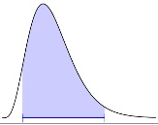
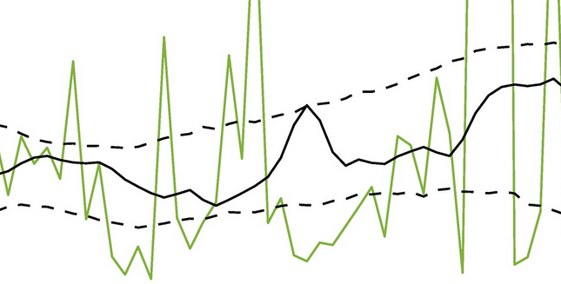
Output of Uncertainty Models, PID controllers and Plant
Dependent variable - Creditable Interval for random variable
for time t
Historical Creditable Intervals in time period [ti,tj]
Compare model parameters - Probability of outliers
Sensor Groups related to situations
Wi-Fi
CACC
UM
CACC
PID-Plant
Camera
Model Selection
LiDAR
ACC
UM
ACC
PID-Plant
Radar
new Location values, which are dependent on each other since the sensors involved in the readings are shared
Sensors
Uncertainty Models
Control Loop
Bayesian Model
Historical Model
Objective Function
Objective function:
Uses the distribution of all locations which are not independent and its creditable interval. Historical creditable intervals can be used to measure the amount of noise in each model.
In case of having many Bayesian models: It defines how the historical models can be compared. The metric to compare could involves:
Mean - *Credible interval : something similar to ANOVA when comparing variance of distributions - Outliers
Model2 is bad …
*The figure is originally for real values and bayes model, but I used the different lines as different models to demonstrate the idea the creditable interval is the same.
Threshold
outliers
Control loop 1
Control loop 2
Handling uncertainty in input/sensors
Credible interval
Handling uncertainty in output/actuators
H
History
Assumption
Outliers history and
Model Selection
Bayesian Model
H
H
Objective function
Parameters
Belief Inaccuracy
sensors
inaccuracy
Wi-Fi
H
Hypothesis Testing
exponential
Linear Regression
CACC controller
delays
noise
Plant
location
H
Camera
Lidar
Radar
normal distribution
Linear Regression
Hypothesis Testing
ACC controller
noise
noise

Slide 6
requirements
performance
safety
situations
CACC
ACC
execution
prediction
planning
Uncertainty
models
Inaccuracy
interpolation
Linear regression
analysis
Last value
history
Uncertainty
types
delay
Missing information
Noise
monitoring
Shards
WiFi
Camera
LiDAR
Radar
sensors

Slide 7
Output of Uncertainty Models, PID controllers and Plant
Dependent variable - Creditable Interval for random variable
for time t
Historical Creditable Intervals in time period [ti,tj]
Compare model parameters - Probability of outliers
Sensor Groups related to situations
UM1-PID1-Plant
Wi-Fi
Camera
UM2-PID2-Plant
Model Selection
LiDAR
Radar
new Location values, which are dependent on each other since the sensors involved in the readings are shared
UM3-PID3-Plant
Sensors
Control Loop
Bayesian Model
Historical Model
Objective Function
Objective function:
Uses the distribution of all locations which are not independent and its creditable interval. Historical creditable intervals can be used to measure the amount of noise in each model.
In case of having many Bayesian models: It defines how the historical models can be compared. The metric to compare could involves:
Mean - *Credible interval : something similar to ANOVA when comparing variance of distributions - Outliers
Threshold
outliers
Control loop 1
Control loop 2
Credible interval
Model2 is bad …
*The figure is originally for real values and bayes model, but I used the different lines as different models to demonstrate the idea the creditable interval is the same.
Handling uncertainty in input/sensors
inaccuracy
Bayesian Model-Credible intervals history
noise
Objective function
Output
Headway Policy
Handling uncertainty in output/actuators
Input: location
H
History
WiFi, Camera, Lidar, Radar
H
Inaccuracy
controller1
sensors
Camera, Lidar, Radar
H
H
Plant
location
Linear Regression
controller2

Slide 8
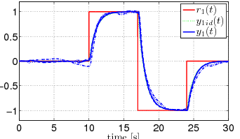
- What is the contribution? Working Bayesian over difference of errors … what it gives me?
- Ranking? Relation to the property and there physical representation (e.g. performance / efficiency by keeping small distance between people)
pipeline: functions
Input + scenario : real data (from the simulation)
Evaluation: separate , hybrid
----------------------------------------------------------------------
Not producing error in the controller?
What is the error? If there is an error so it is not random …
It does not need prediction? Since it is safety critical
Model Ranking
Wi-Fi
CACC
UM-PID-Plant
Camera
Models & Errors
LiDAR
ACC
UM-PID-Plant
Radar
CACC output
Smooth SWITCH
Real input
Final Output
*GB || BG -> best model
*GG -> less errors impact
*BB -> default fixed switch
CACC
CACC->ACC
ACC
Handling uncertainty in input/sensors
Bayesian Linear Regression
Outliers history and
Model Selection
Handling uncertainty in output/actuators
Smooth switch
H
H
History
Assumption
Adjustment Mechanism
Reference Model
sensors
Wi-Fi
H
CACC controller
exponential
Belief Inaccuracy
delays
inaccuracy
switch
Plant
location
H
Camera
Lidar
Radar
normal distribution
Linear Regression
Hypothesis Testing
ACC controller
noise
noise

Slide 9
Works similar to gain-scheduled MPC: implementing the switching algorithm
Vehicle
Safety distance: mass*speed
CACC String stability: 2m.
Join Platoon
CACC
Depend on WiFi more
String stability > predicted Safety distance
Stable string
flat road
errDelayRange < errNoiseRange
Stable string
Down hill road
Depend on Camera more
errDelayRange > errNoiseRange
Oscillated traffic
Fluctuated string
flat road
Still CACC
Oscillated traffic
Fluctuated string
Down hill road
String stability < predicted Safety distance
ACC
Leave Platoon
Different states and constraints

Slide 10
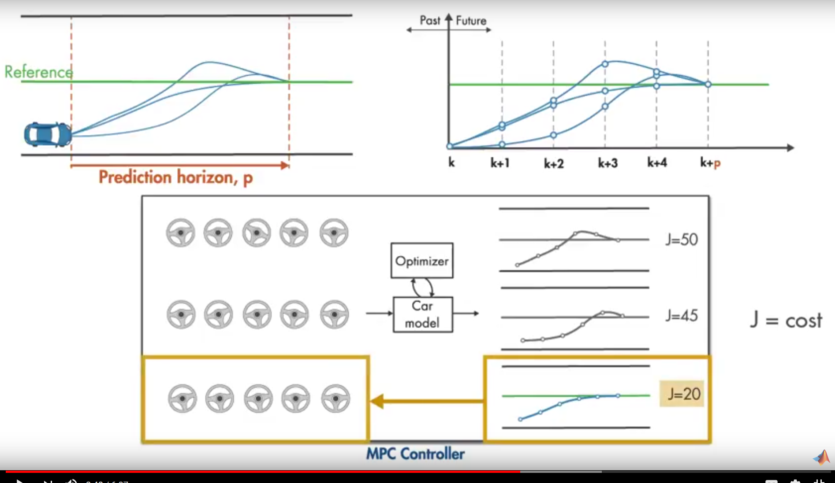
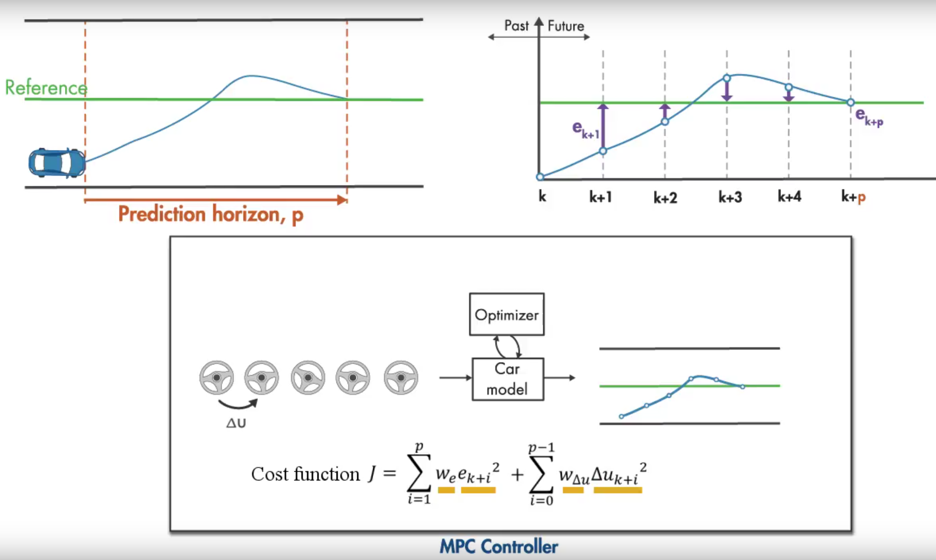
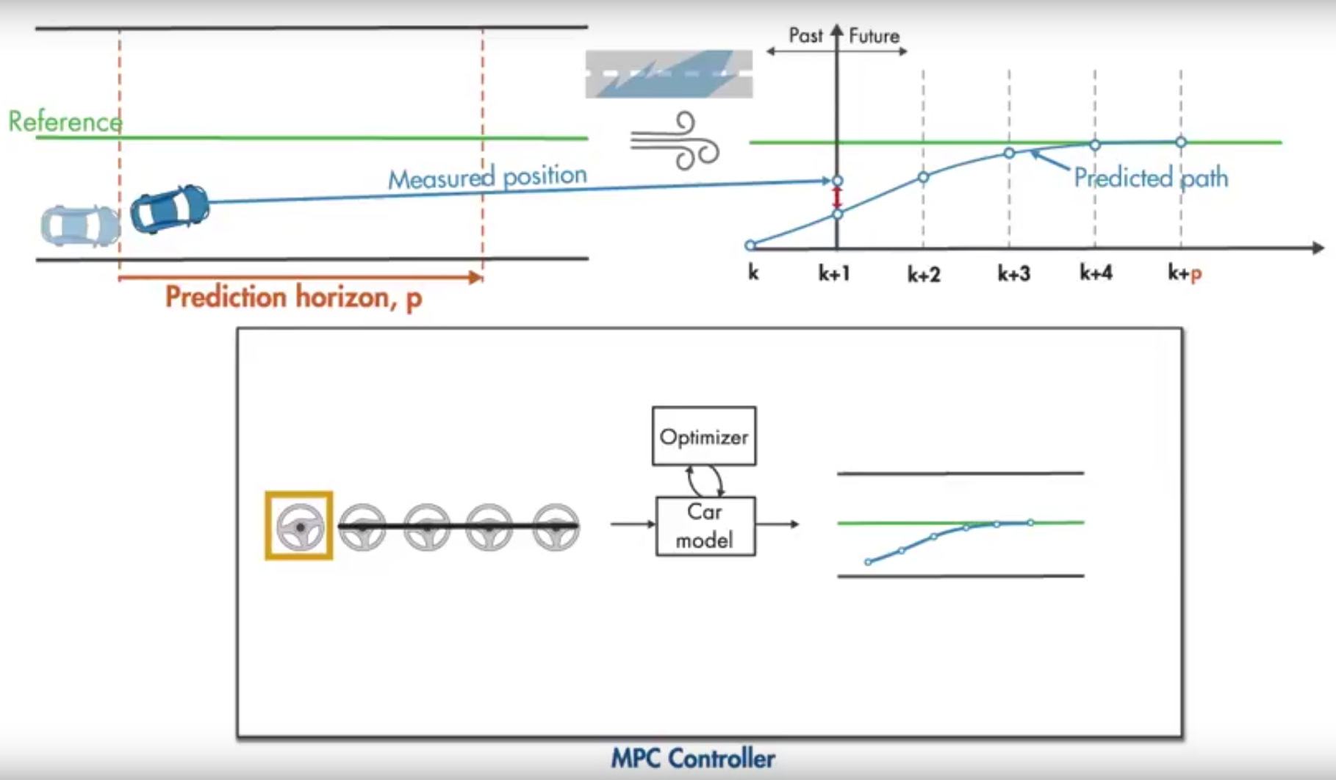
Minimize the error between the reference and predicted value of car
Minimize the change in the steering wheel angle from one time step to another
Both stay in prescribed limits

Slide 11
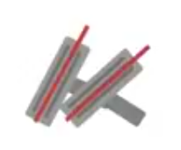
Predicted sensor data … Error between predicted data and reference
=>
Predict the pedal angle (for the error) … Error between predicted pedal angle (range?) and the reference
Position error
sensor
estimator
pedal
Pedal error
position
Model assumptions impacts the estimation => impact the predicted pedal angle
sensor error
pedal error
Design Parameter:
Sample time (Ts): between 10 and 20 of the rise time Tr/20 <= Ts <= Tr/10
rise time (Tr): time it takes for the response to rise from 10% to 90% of the steady-state response
Prediction horizon (p): 20-30 samples that cover the system response
Tsettling: time it takes for the error |y(t)-yfinal| to fall to within 2% of yfinal
Control horizon (m): 2-4 samples (0.1p<=m<=0.2p)
Constraints: (what is input rate constraints?)
Input: usually hard (in our case the first input is the readings from sensors-> dynamic set of sensors)
Output: usually soft (but in our use case could be hard=safety critical)
Weights:
between safety(safety distance error) and performance(string stability error)
Between different sensors (sensitivity of the pedal for each input )

Slide 12
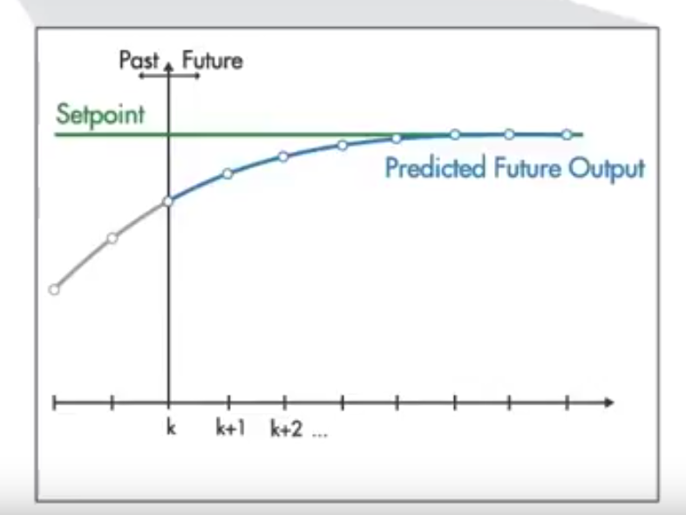
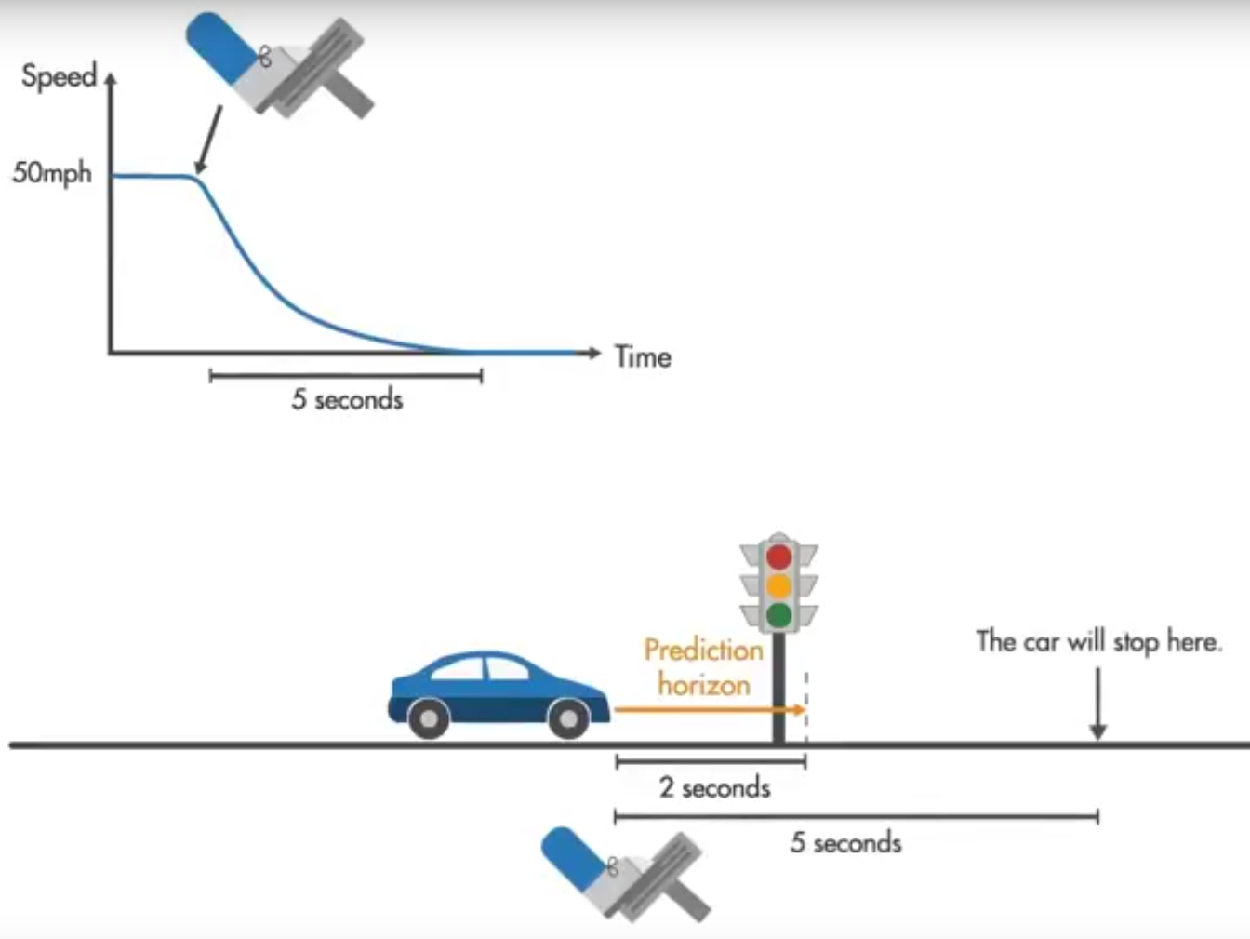
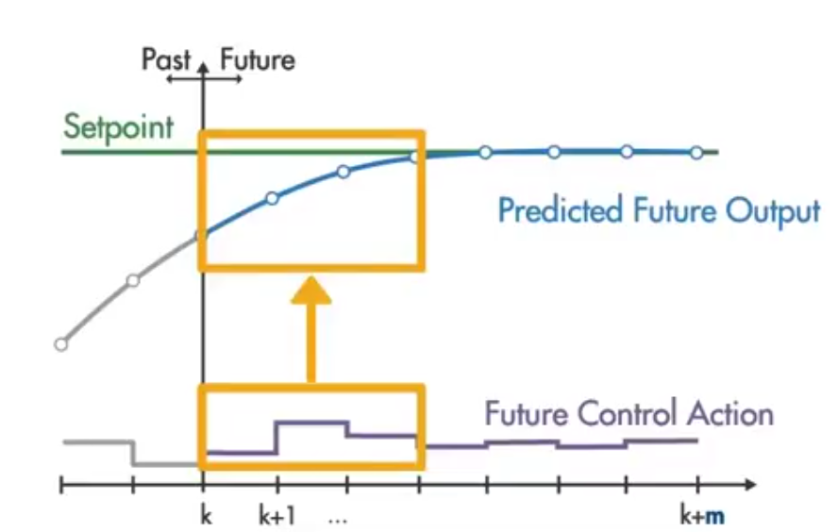
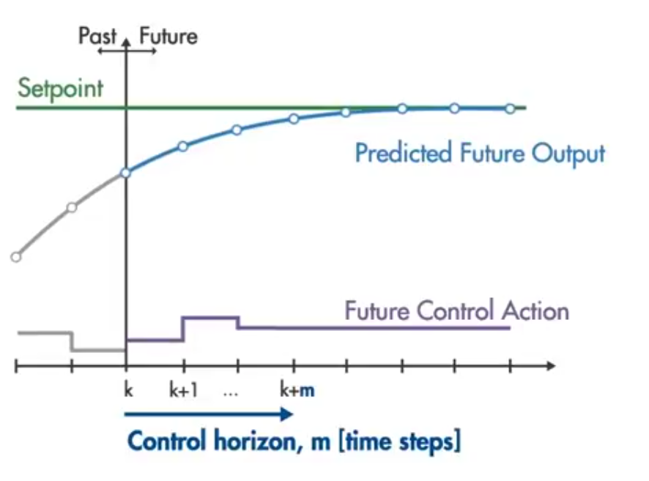
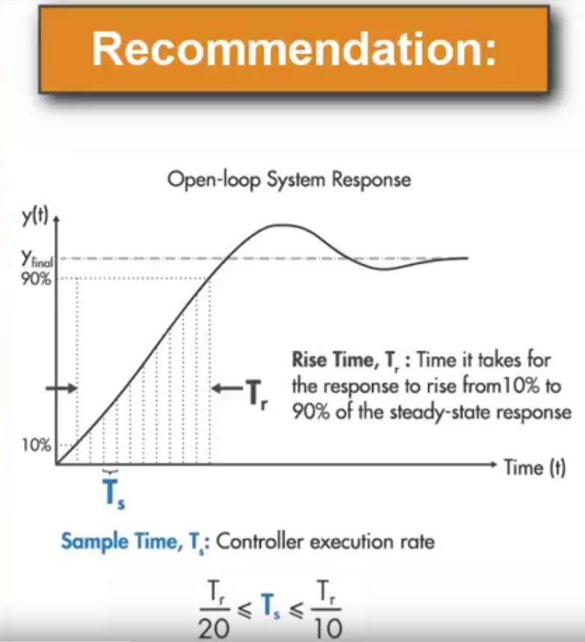
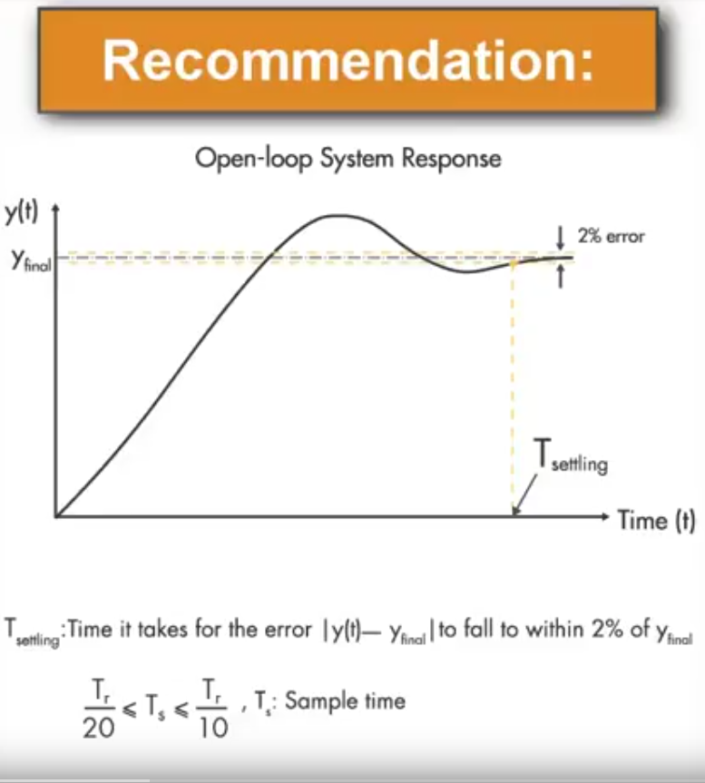
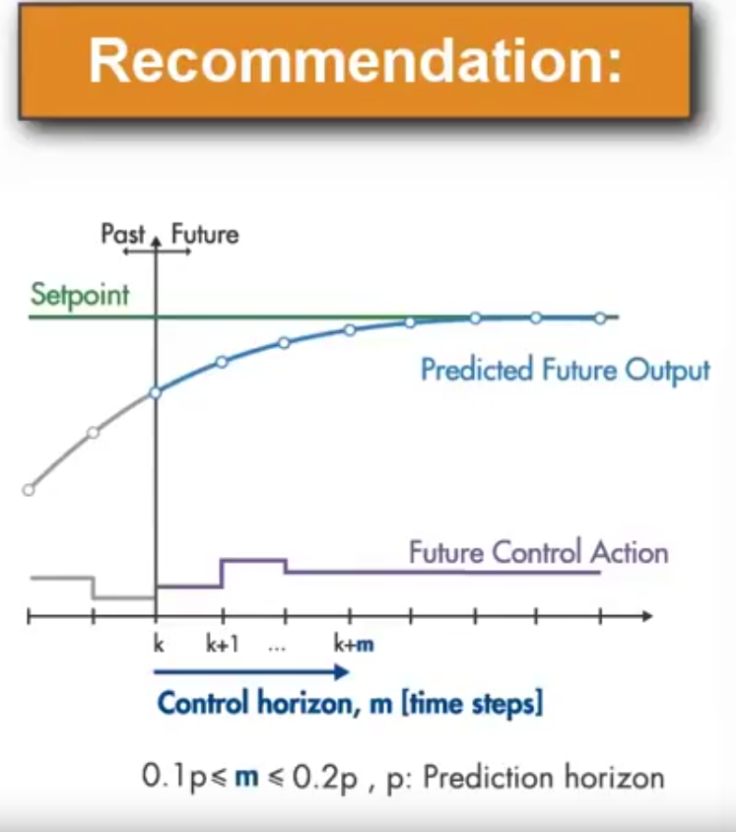
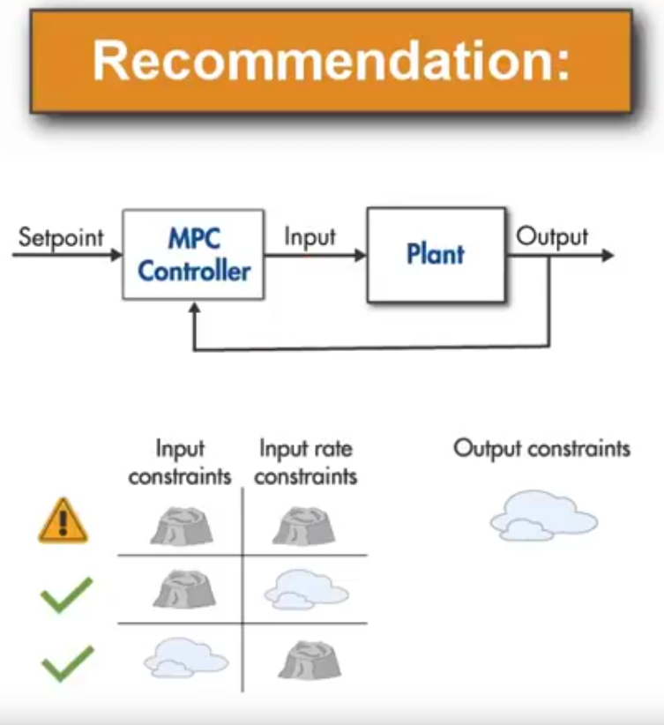
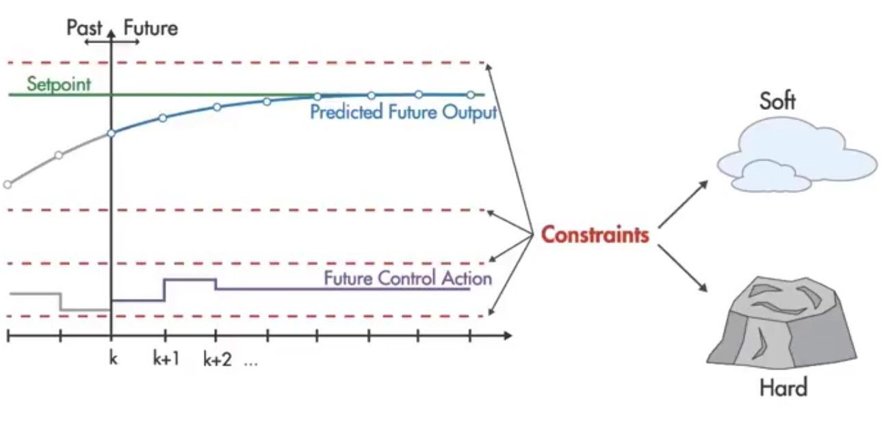
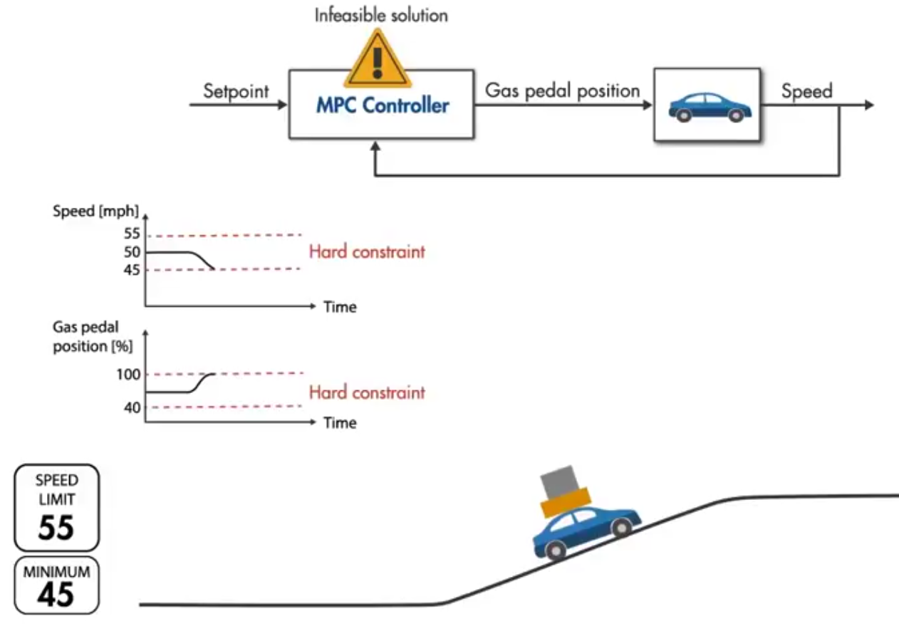
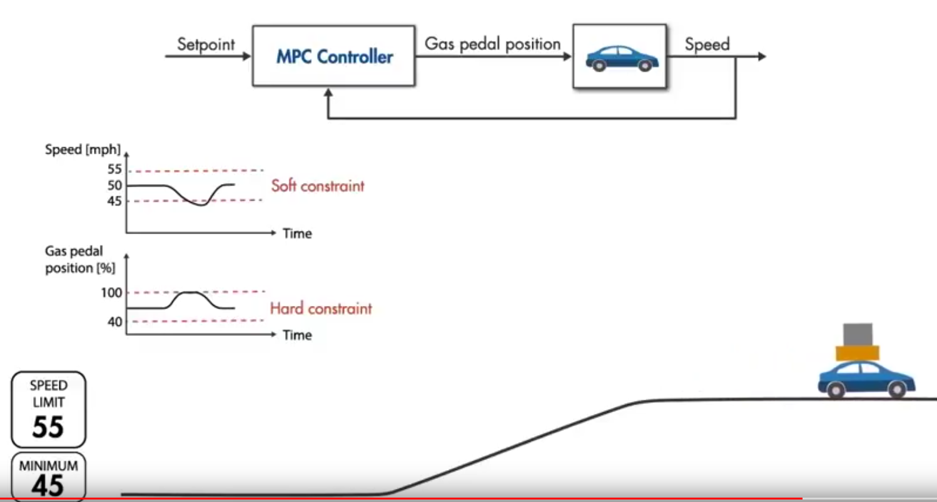
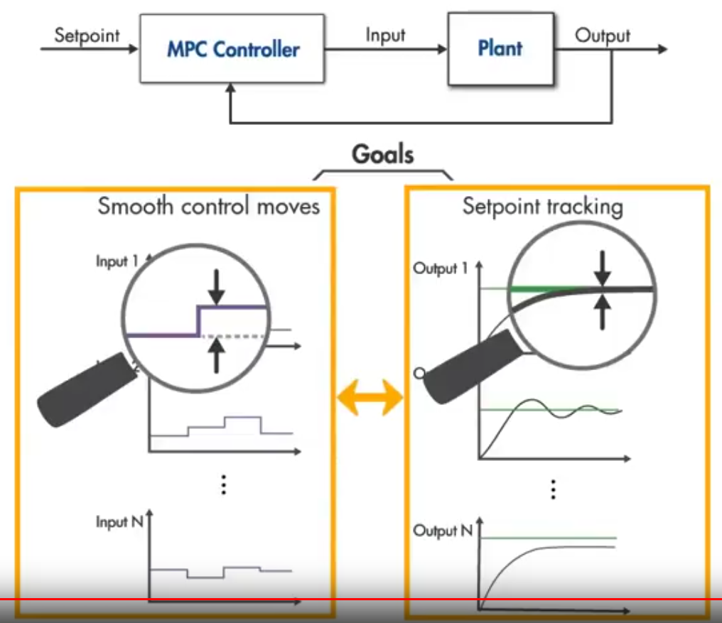
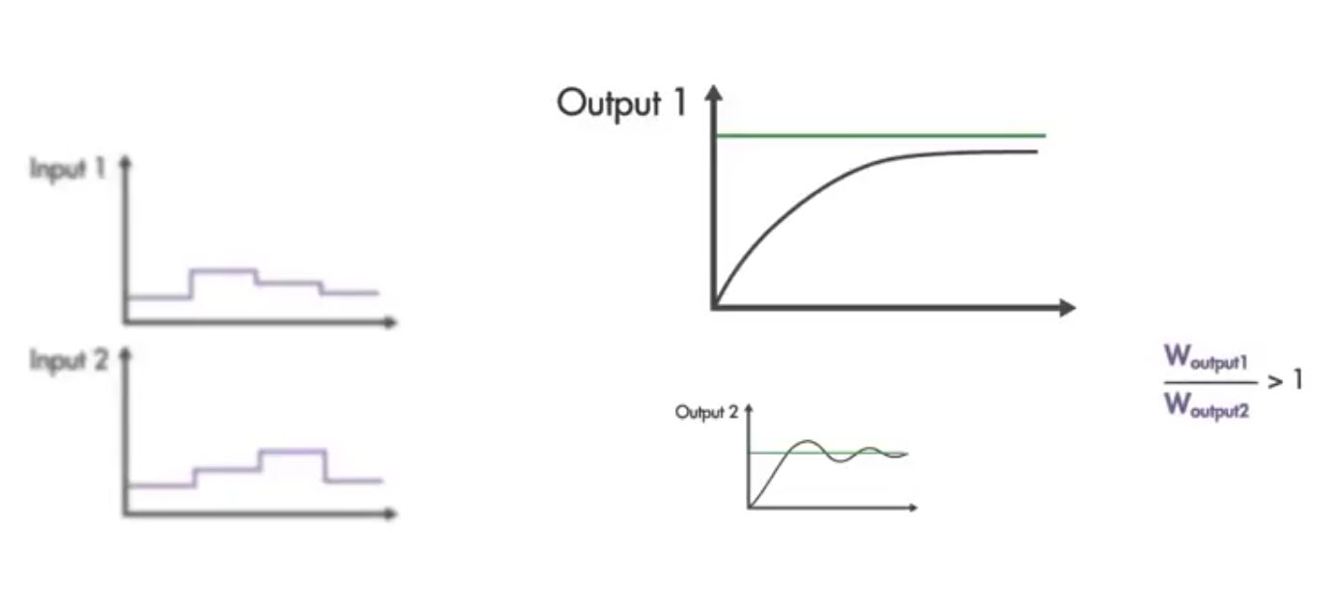
Weights are applied between the goals or between the same set

Slide 13
Analyze
Plan
Evaluate and learn from the output of each shade
adapt
evaluation
Selected output
output1
output2
output3
Monitor?
Or analyze
Check dom. paper
Select situation
Select situation
Select set of sensors
Select set of sensors
Select situation
Define uncertainty Types
Execute
Define uncertainty Types
output3
Runtime selection of the suitable MAPE-K
(refine the situations change – smooth change)
Select uncertainty model
Select set of sensors
output2
Select uncertainty model
output1
Relate to shard
Relate to shard
Relate to shard
Selected output
Define MAPE-K for shard
Define uncertainty Types
Define MAPE-K for shard
Select uncertainty models
Define corresponding MAPE-K for the shard
sensors
actuators

