Slide 1
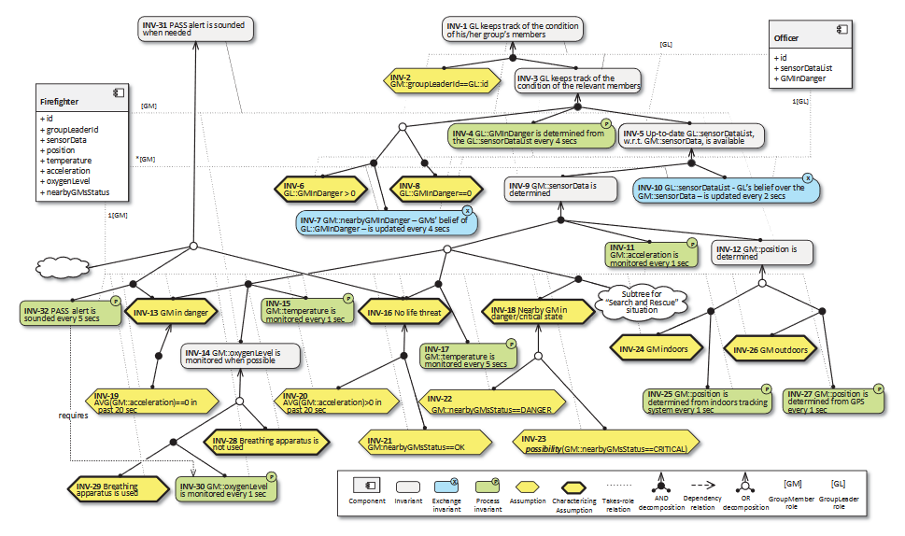
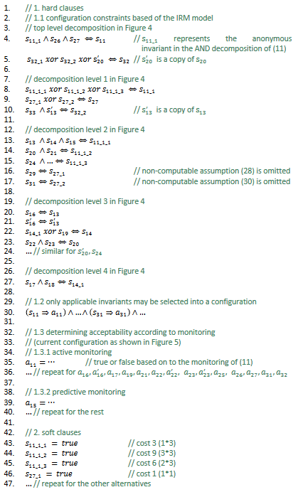
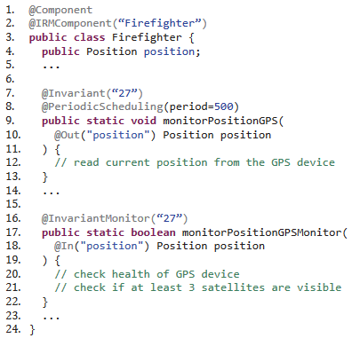

Slide 2
Requirements
transformation
Design
Instantionation
Self-Adaptation
Runtime
Analysis
Composition
Simulation
Integrations

Slide 3
Requirements
IRM-(SA) Model (i.e. Ecore)
Natural Language
Design
generate
Invariants and CNF
Ecore
EDL File
generate
DEECo Design Model
compile
Modes and transactions
Boundary
Runtime
Self-Adaptation (MAPE-K)
Z3 SMT Solver
SAT solver
DEECo Runtime Model
State-Machine
Fitness
Statistical Model
ODE
Model
Gossiping Boundary
Analysis
Ensemble Composition
Simulation
Veins LTE
MATSim
OMNeT++
ROS
Stage
Hardware
STM32F4 DISCOVERY board

Slide 5
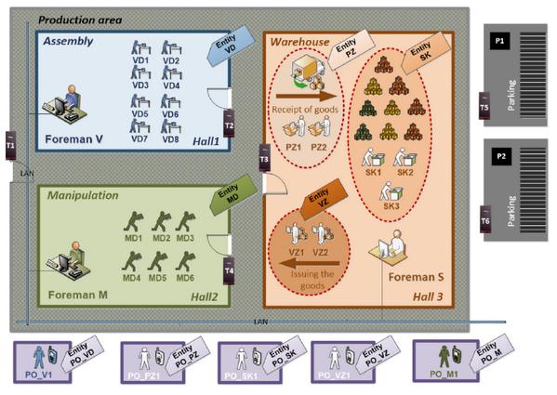
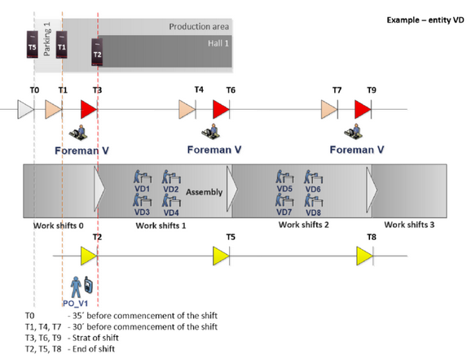

Slide 6
IRM tree
jDEECo code
Fitness / Boundary
jDEECo Runtime
SAT solver
ODE / Statistical Mode-Switch
ROS
OMNET++
MATsim
Stage

