Slide 1
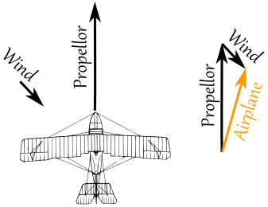
VECTORS
Topic 3
Contents:
3.1 Vectors in two and three dimensions
3.2 Unit vectors
3.3 Dot product
3.4 Cross product
3.5 Equations of Lines and Planes

Slide 2
SUBTOPICS:
3.1.1 Geometric Vectors
3.1.2 Vectors in a 2-dimension
3.1.3 Vectors in a 3-dimension
3.1.4 Properties of Vector
3.1.5 Properties of Vector Operations
3.1.6 Norm of a Vector
3.2.1 Unit Vector in the Direction of v
3.2.2 Standard Unit Vector
3.3.1 Component Form of the Dot Product
3.3.2 Properties of the Dot Product
3.4.1 Definition of Cross Product
3.4.2 Properties of Cross Product
3.4.3 Relationship Involving Cross Product and Dot Product
3.4.4 Cross Product and Angle of Vectors
3.5.1 Lines in 3-Space
3.5.2 Planes in 3-Space

Slide 3
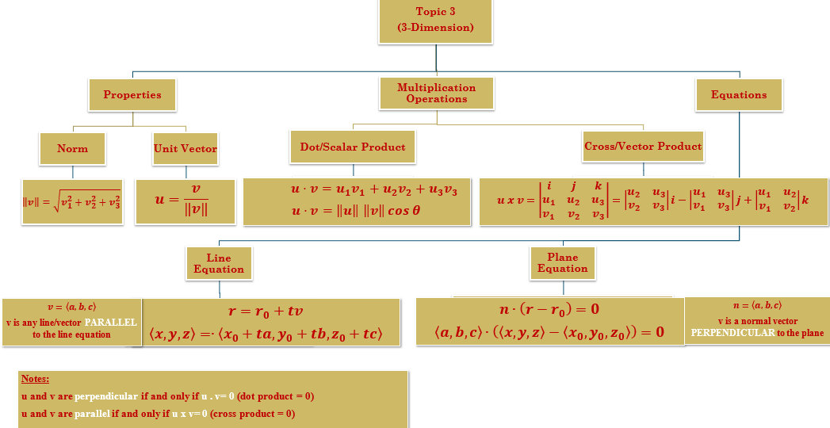

Slide 4
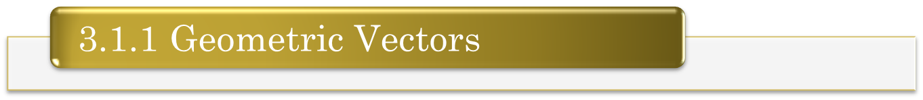
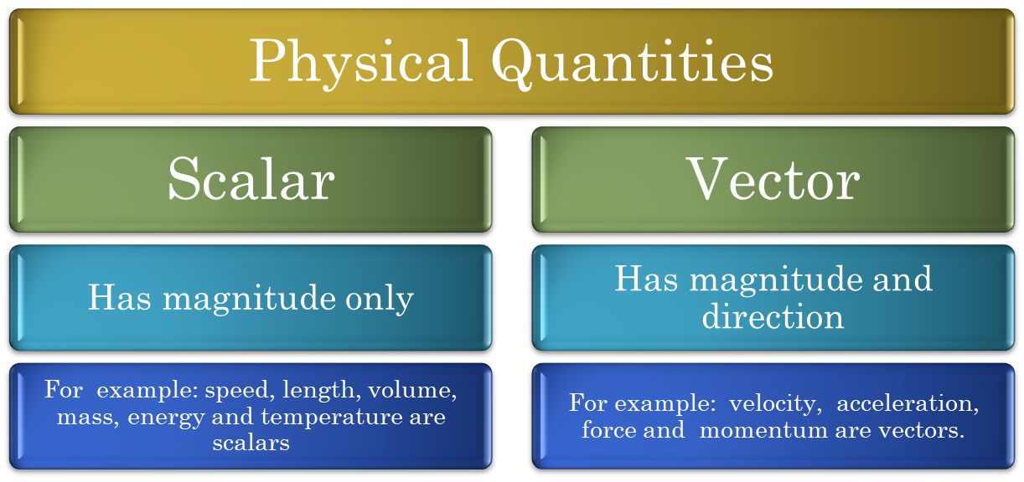
3.1 VECTORS IN TWO AND THREE DIMENSIONS

Slide 5
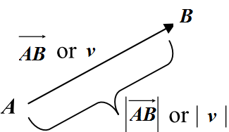
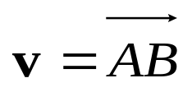
3.1 VECTORS IN TWO AND THREE DIMENSIONS
Vectors are usually represented geometrically as directed line segments or arrows.
The tail of the arrow is called the initial point of the vector, and the tip of the arrow the terminal point.
The initial point of a vector v is A and the terminal point is B, we write .
Vector’s notation
Vector magnitude’s notation

Slide 6

3.1 VECTORS IN TWO AND THREE DIMENSIONS
Two vectors are regarded as equal (or equivalent) if both vectors are of the same direction with equal magnitude, regardless of the position of the
initial points.
The vector of length zero is called the zero vector or null vector and is denoted by
whose magnitude is zero and whose direction is indeterminate.

Slide 7
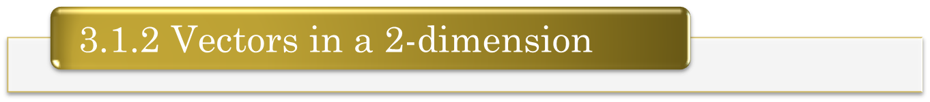

3.1 VECTORS IN TWO AND THREE DIMENSIONS
If v is a vector in the plane whose initial point is the origin and terminal point is (v₁, v₂), then the coordinates (v₁, v₂) of the terminal point of v are called the component of v and we write
A vector denoted by angle bracket
v₁ and v₂ are component
y
(v₁, v₂)
A point is denoted by parenthesis
v
x

Slide 8

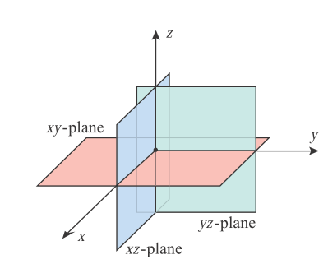
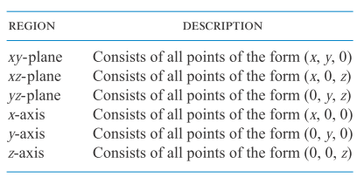
3.1 VECTORS IN TWO AND THREE DIMENSIONS
There are three planes: xy-plane, xz-plane and yz-plane. These three planes form eight octants; the first octant consists of all positive numbers (+x, +y,+z). The remaining seven octants have different combinations of positive and negative numbers: (-x, +y, +z), (-x, -y, +z), (+x, -y, +z), (+x, +y, -z), (-x, +y, -z), (-x, -y, -z) and (+x, -y, +z).

Slide 9
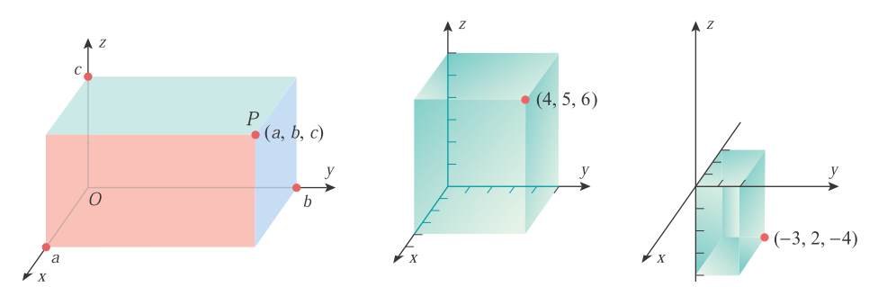
3.1 VECTORS IN TWO AND THREE DIMENSIONS
P
P
P = <a, b, c>
P = <4, 5, 6>
P = <-3, 2, -4>

Slide 10
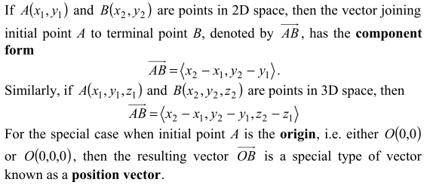
3.1 VECTORS IN TWO AND THREE DIMENSIONS

Slide 11

3.1 VECTORS IN TWO AND THREE DIMENSIONS
Example:
Example:
Solution:
Solution:

Slide 12
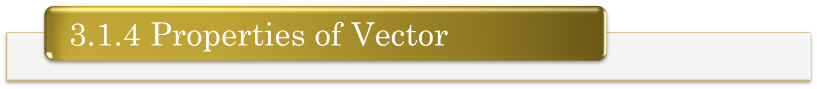









3.1 VECTORS IN TWO AND THREE DIMENSIONS
If and are equivalent, then v₁=w₁, v₂=w₂ and v₃=w₃.
.
where k is any scalar.
If the vector has initial point and terminal point , then the component form of the vector v represented by is

Slide 13
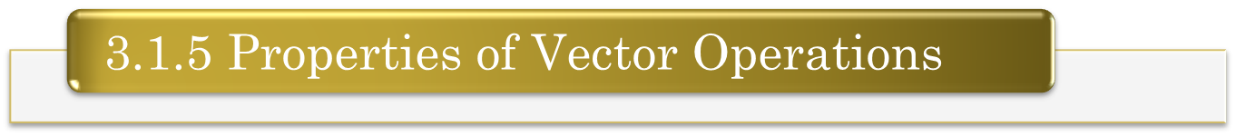
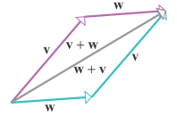
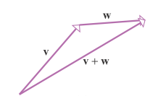
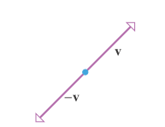
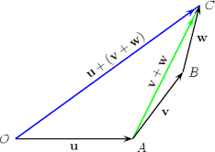
3.1 VECTORS IN TWO AND THREE DIMENSIONS
If u, v, and w are vectors in 2 or 3-space and k and l are scalars, the following relationships hold.
u + v = v + u
(u + v)+ w = u + (v + w)
u + 0 = 0 + u = u
u + (-u) = 0
k(lu) = (kl)u
k(u + v) = ku + kv
(k + l)u = ku + lu
1u = u

Slide 14
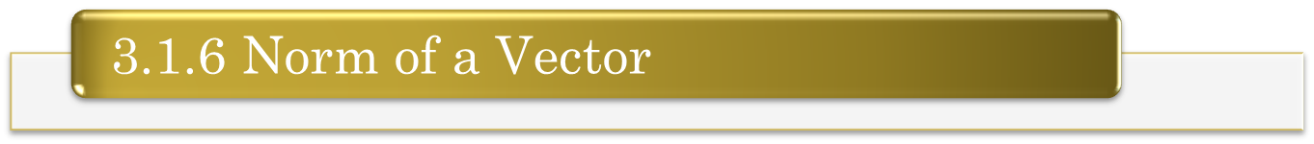



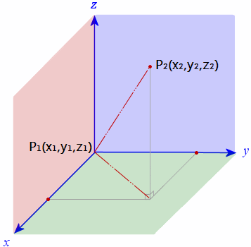
3.1 VECTORS IN TWO AND THREE DIMENSIONS
The length of a vector v is often called the norm of v and is denoted by where
in 2-space and
in 3-space

Slide 15


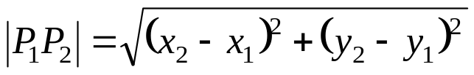
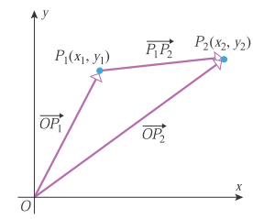
3.1 VECTORS IN TWO AND THREE DIMENSIONS
Distance Formula in Two Dimensions with initial point not at origin
The distance between the points and is

Slide 16


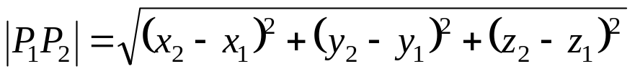
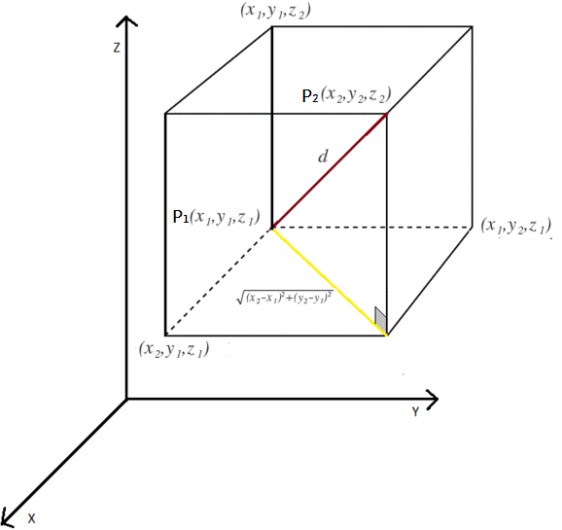
3.1 VECTORS IN TWO AND THREE DIMENSIONS
Distance Formula in Three Dimensions with initial point not at origin
The distance between the points and is

Slide 17



3.1 VECTORS IN TWO AND THREE DIMENSIONS
Example:
Given points and , find the norm of the vector v represented by
Solution:

Slide 18
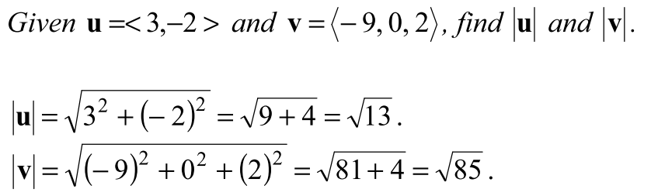
3.1 VECTORS IN TWO AND THREE DIMENSIONS
Example:
Solution:

Slide 19
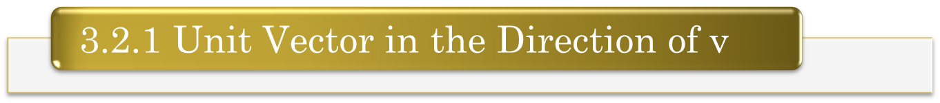
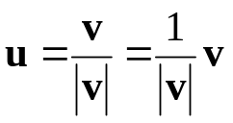
3.2 UNIT VECTORS
If v is a nonzero vector in the plane, then the unit vector u is defined as
and has magnitude (or length) 1 and the same direction as v.

Slide 20

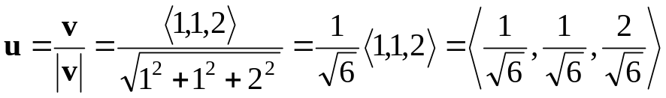
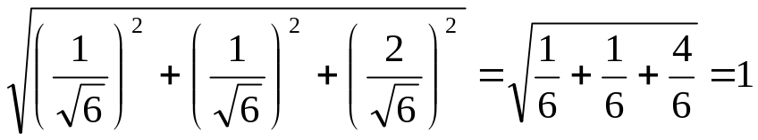
3.2 UNIT VECTORS
Example:
Find a unit vector in the direction of and verify that the result has length 1.
Solution:
The unit vector in the direction of v is
The vector has length 1, because

Slide 21
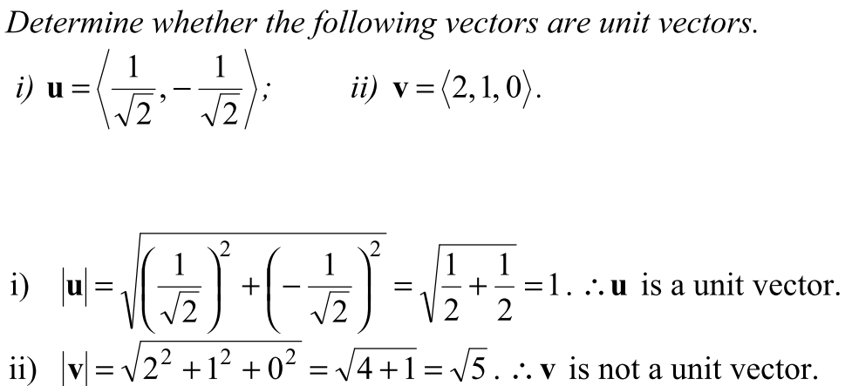
3.2 UNIT VECTORS
Example:
Solution:

Slide 22
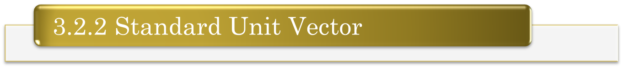




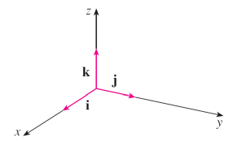
3.2 UNIT VECTORS
The unit vectors , and are called the standard unit vectors in the plane and we can write
For example,
in components form
in standard basis vectors (i, j and k terms)

Slide 23
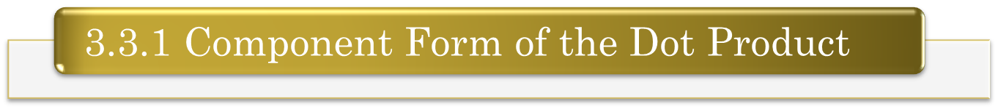






3.3 DOT PRODUCT/ SCALAR PRODUCT
Let and be two vectors in 2-space, then their dot product are as follows:
Let and be two vectors in 3-space, then their dot product are as follows:

Slide 24



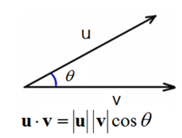
3.3 DOT PRODUCT/ SCALAR PRODUCT
If (where ) is the angle between u and v, then the dot product can also be defined as

Slide 25
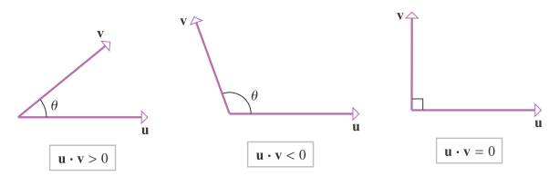
3.3 DOT PRODUCT/ SCALAR PRODUCT
Interpreting the sign of the dot product
the two vectors point in the same direction
the two vectors point in the opposite direction
if two vectors are orthogonal/ perpendicular/ normal

Slide 26


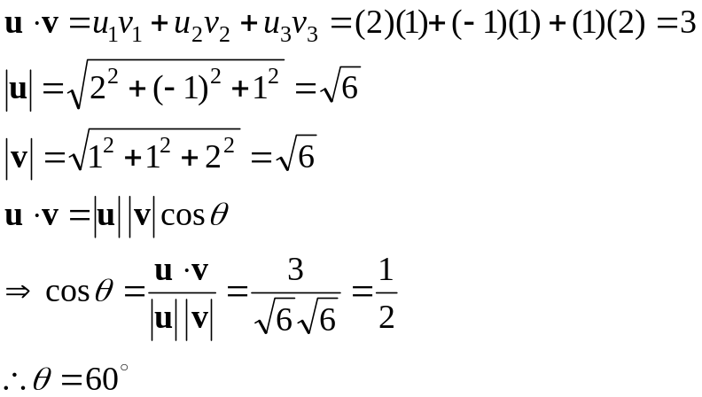
3.3 DOT PRODUCT
Example:
Consider the vector and , find their dot product and determine the angle between u and v.
Solution:

Slide 27



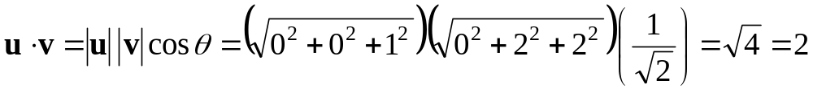
3.3 DOT PRODUCT
Example:
Find the dot product of and where
Solution:

Slide 28



3.3 DOT PRODUCT
Example:
Show that and are perpendicular
If u and v are perpendicular, then
Solution:

Slide 29
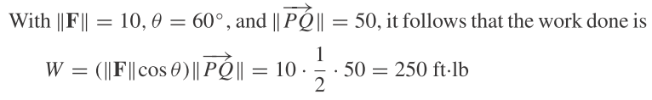
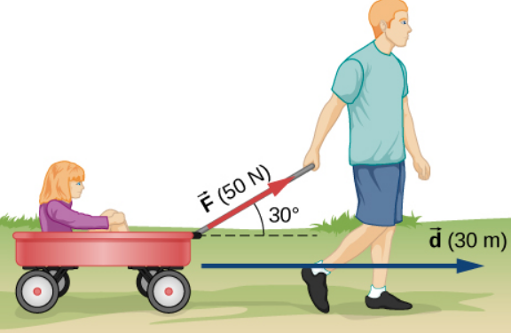
3.3 DOT PRODUCT
Solution:
F=10lb
50ft
P
Q

Slide 30
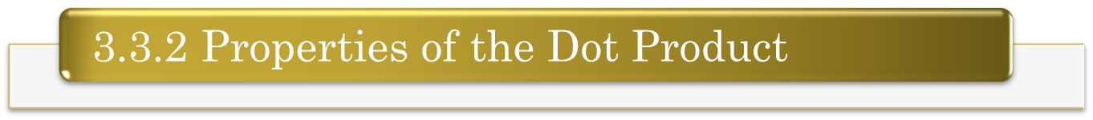
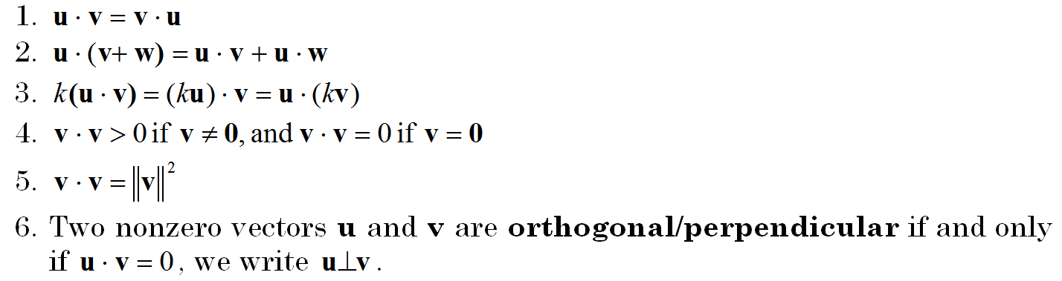
3.3 DOT PRODUCT
Properties of the Dot Product
If u, v and w are vectors in 2- or 3-space and k is a scalar, then

Slide 31
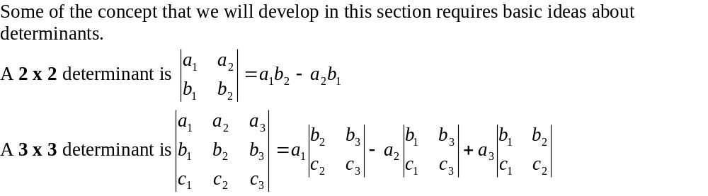
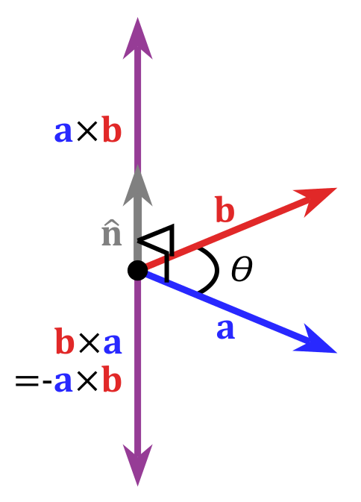
3.4 CROSS PRODUCT/ VECTOR PRODUCT

Slide 32
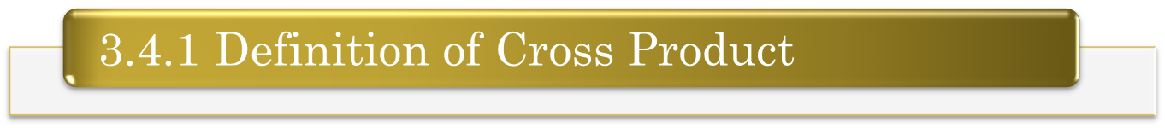
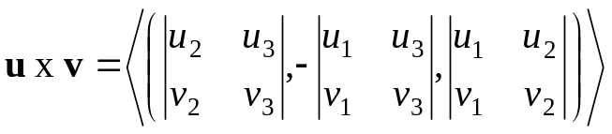
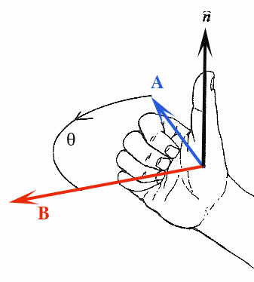
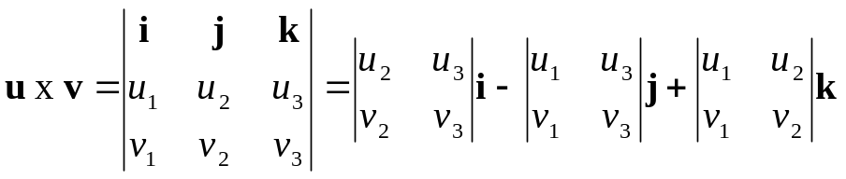
3.4 CROSS PRODUCT
If and be two vectors in 3-space, then their cross product u x v is the vector defined by:
or in the determinant notation,
The cross product can be calculated as follows:

Slide 33


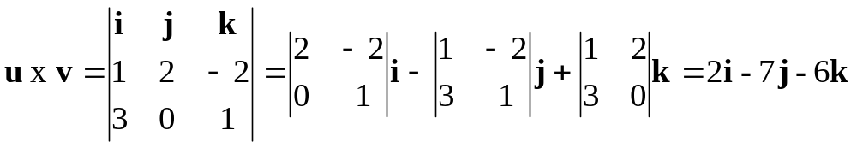
3.4 CROSS PRODUCT
Example:
If and , find the cross product of u and v.
Solution:

Slide 34
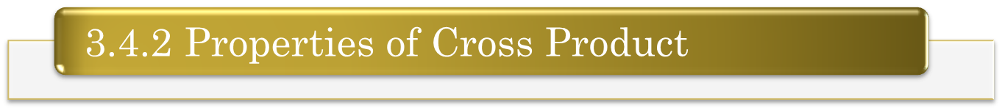
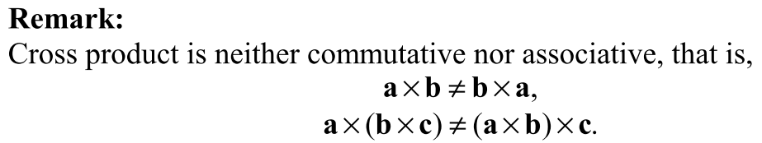
3.4 CROSS PRODUCT
If u, v and w are any vectors in 3-space and k is a scalar, then:
u x v = - (v x u)
u x (v + w ) = (u x v) + (u x w)
(u + v ) x w = (u x w) + (v x w)
k(u x v) = k(u) x v = u x (kv) = (u x v) k
u x 0 = 0 x u = 0
u x u = 0
u and v are parallel if and only if u x v= 0

Slide 35
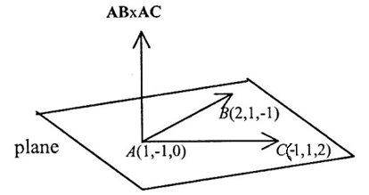
3.4 CROSS PRODUCT
Example:

Slide 36

3.4 CROSS PRODUCT
Solution:

Slide 37

3.4 CROSS PRODUCT
Example:
Solution:

Slide 38


3.4 CROSS PRODUCT

Slide 39



3.4 CROSS PRODUCT
If u and v are vectors and is the angle between u and v, then
where

Slide 40




SUMMARY:

Slide 41







3.5 EQUATIONS OF LINES AND PLANES
If L is a line in 3D-space through the point P₀(x₀, y₀, z₀) and parallel to the nonzero vector , then this line L is represented by the vector equation
where t is scalar
based on the vector addition using Triangle Law
If , the vector equation becomes
a given point, P_{o}
direction(parallel) from a given vector, v

Slide 42





3.5 EQUATIONS OF LINES AND PLANES
Parametric Equations of a Line in Space
It can be written in scalar equations,
which are called parametric equations
Symmetric Equations of a Line in Space
If a vector is used to describe the direction of a line L, then the numbers a, b, and c are called direction numbers of L.
If the direction numbers a, b and c are all nonzero, then we can eliminate the parameter t to obtain the symmetric equations of a line.

Slide 43





3.5 EQUATIONS OF LINES AND PLANES
Example:
Find the parametric equations and symmetric equations of the line that pass through the points (1,2,-3) and parallel to the vector
The parametric equations are :
The symmetric equations are :
Solution:

Slide 44


3.5 EQUATIONS OF LINES AND PLANES
Example:

Slide 45

3.5 EQUATIONS OF LINES AND PLANES
Example:
Solution:

Slide 46

3.5 EQUATIONS OF LINES AND PLANES
Example:
Solution:

Slide 47






3.5 EQUATIONS OF LINES AND PLANES
The plane containing the point P₀ (x₀,y₀,z₀) and having a normal vector is perpendicular /orthogonal to every vector in the given plane, in particular to
, so by the dot product of orthogonal vectors, we have
which can be written as
is called the vector equation of the plane.
a given point, P_{o}
normal vector (direction)

Slide 48




3.5 EQUATIONS OF LINES AND PLANES
By writing , and in component form, we have
To obtain for the scalar equation, we can expand the dot product becomes
Theorem:
If a, b, c and d are constants and a, b and c are not all zero, then the equation of the plane can be rewritten as ax+by+cz+d=0 having the normal vector .

Slide 49


3.5 EQUATIONS OF LINES AND PLANES
Example:
Find an equation of the plane passing through the point (3, -1, 7) and perpendicular to the vector
Solution:

Slide 50

3.5 EQUATIONS OF LINES AND PLANES
Solution:

Slide 51

3.5 EQUATIONS OF LINES AND PLANES

Slide 52



3.5 EQUATIONS OF LINES AND PLANES

Slide 53
REFERENCES
Stewart, J., Redlin, L., & Watson, S. (2012). Precalculus: Mathematics for Calculus (6th ed.) Brooks/Cole, Cengage Learning.
Howard Anton, Irl C. Bivens, Stephen Davis (2012). Calculus. (10th ed.) John Wiley & Sons, Inc.

