Slide 1
ENGI 301 GuitarHero Proposal
February 19, 2024
Brian Mercado

Slide 2
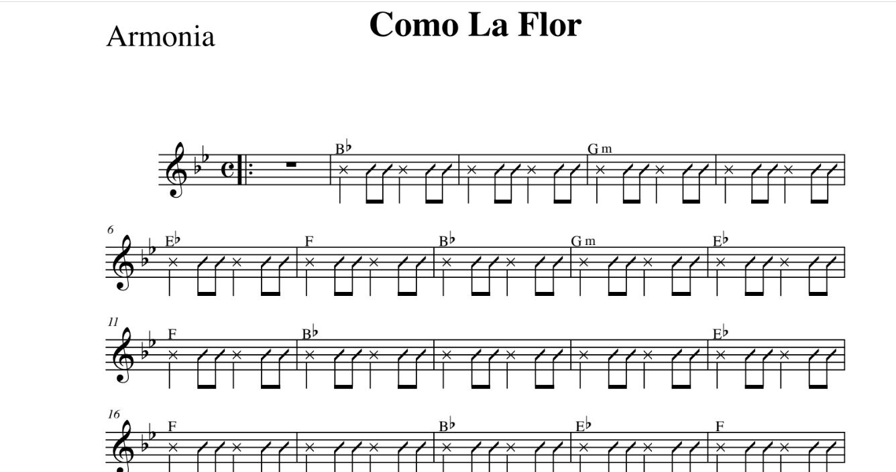
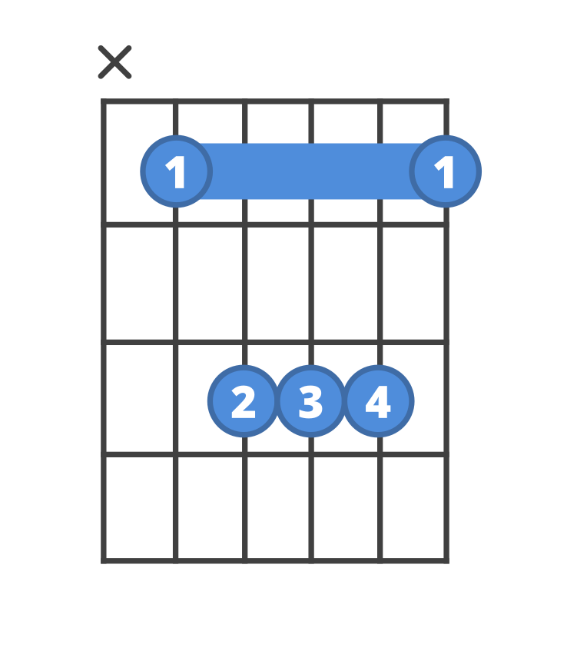
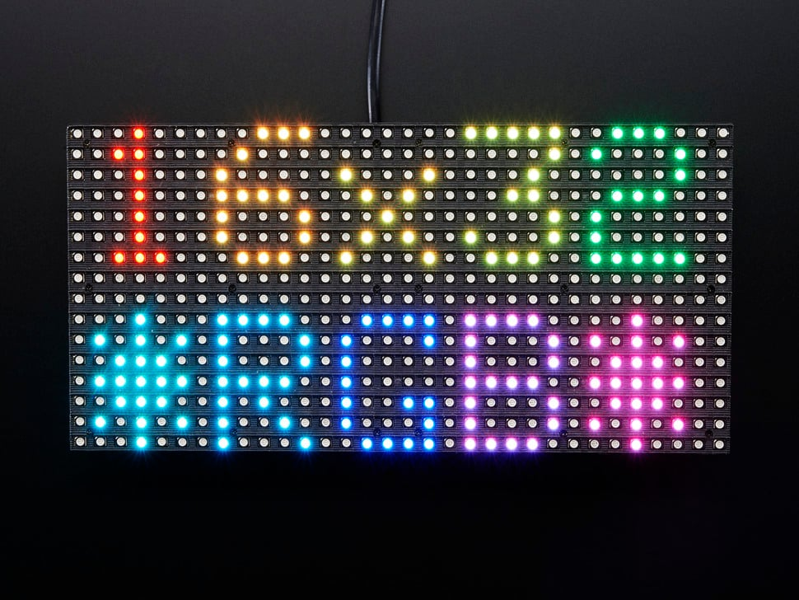
Background Information
An embedded system that reads guitar music PDF’s and displays the TAB of each chord of the song on an 16x32 LED panel
Sheet Music PDF Reader: https://github.com/aashrafh/Mozart
Additions:
Will read name of guitar chords and BPM
Will code array of LED’s that will represent the guitar tab for each chord
Will display detected chord name with its LED representation
I recently joined the Mariachi Luna Llena and am a guitarist. However, I have not played guitar in an ensemble setting and need to learn new chords. This will greatly help me learn necessary chords

Slide 3
System Block Diagram
IS-P6-8S-SMD3528
16x32 LED Matrix Panel
Cape Headers
Potentiometers
LED
OSD335x-SM SiP contains: AM3358 TPS65217C TL5209 EEPROM
GND
µUSB Host Connector
µSD Card Connector
USB0
MMC0
5 volts

Slide 4
Power Block Diagram
5V 4A (4000mA) switching power supply
Female DC Power adapter - 2.1mm jack to screw terminal block
OSD335x-SM SiP contains: AM3358 TPS65217C TL5209 EEPROM
5 volts
16x32 LED Matrix Panel
Up to 2.5A max
5V
LED
3.3V
µUSB Host Connector
USB0
5 volts

Slide 5
Components / Budget
Component | ENGI301 to Buy? | Cost
16x32 LED Matrix Panel https://www.adafruit.com/product/420 | Yes | 24.95
5V 4A (4000mA) switching power supply https://www.adafruit.com/product/1466 | Yes | 14.95
Female DC Power adapter - 2.1mm jack to screw terminal block https://www.adafruit.com/product/368 | Yes | 2.00
Potentiometers | No
LED’s | No
Potentiometer | No
Button | No
See Next Slide for Instructions

Slide 6
Software Block Diagram
Display guitar string represented as lines
Run on startup and check repository of music for new music
Power up
Update Song List
Press button to start
Run new music through pdf -> music program
Browse through songs
Blinks tempo using LED
> 3s
Button press
Add to list of music ready to play
Select song
Displays chords according to music sheet and tempo
Display song title
Select tempo
Pause/Resume
Button press
> 3s
< 3s
Cycle through songs with potentiometer
Play through song
Displays “End”
Button Press
Display BPM
> 3s
< 3s
Use potentiometer to change BPM

Slide 7
