Slide 1


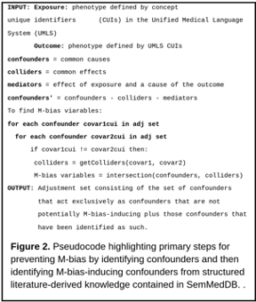
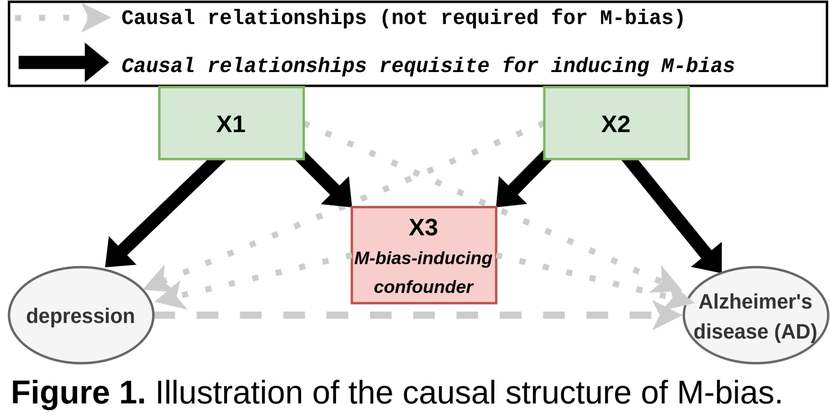
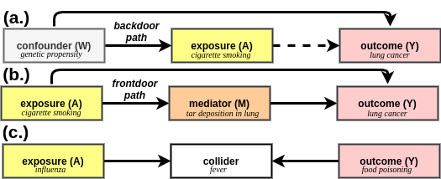
Using structured knowledge to identify and prevent potential M-bias
Scott Alexander Malec, PhD¹, Steven M. Albert, PhD, MPH²
¹Department of Biomedical Informatics (School of Medicine) ² Behavioral and Community Health Sciences (School of Public Health), University of Pittsburgh, Pittsburgh, PA
Motivation
Results
Algorithm
M-bias is a type of selection or collider bias that distorts measures of association or effect by inducing non-causal associations.
Sample potential M-bias scenarios
M-bias variable | confounder | confounder
impaired cognition | homocysteine, chronic kidney failure | scopolamine
coronary arteriosclerosis | NSAIDs | vitamin D deficiency
Preventing M-bias requires knowledge of relationships between covariates.
Discussion
There are many relationships between confounders, a lot of potential for M-bias.
Feasibility assessment is daunting and relies on multidisciplinary expertise
We have designed a workflow that can be used to evaluate other causal associations for potential M-bias variables
More work is required
depression -> Alzheimer’s disease
which variables are “safe” for conditioning?
Predicates: treat/prevent /predisposes/disrupts/augments
Future work
Select References
Work with content-matter experts on epi studies with RWD to empirically test the effect of adjusting for M-bias variables
Adapt methods for searching Knowledge Graph
* Livingston et al. Lancet Commission Report on Dementia * Greenland.Quantifying biases in causal models: classical confounding vs. collider-stratification bias
* Ding, Miratrix. To adjust or not to adjust? Sensitivity analysis of M-bias and butterfly-bias.
No previous methods exist to attempt to identify these from structured knowledge.
Working code is available at: http://www.github.com/dbmi-pitt/mBiasPrevention
This work is funded by the NLM K99/R00 grant 1K99LM013367-01A1..
Notes:
“In previous work, we adapted causal criteria for identifying third-factor variables including confounders, colliders, and mediators to identify a confounders that were free of undesirable behaviors, e.g., were not also colliders or mediators. Conditioning on these variables induces bias by distorting measures of association and effect.

