Slide 1

AMSTERDAM AIRBNB ANALYSIS
ALY6140 70584 ANALYTICS SYSTEMS TECHNOLOGY
Professor: Prof. Richard He Capstone_Group: 10
Project Members: Sakshi Grover, Durga Bhanu Nayak, Rohith Mallula, Abhay Somani

Slide 2
TABLE OF CONTENT
Introduction
Dataset and Data Dictionary
Goals
Data Preprocessing
Exploratory Data Analysis
Data Visualisation
Prediction Models
Conclusion
References

Slide 3
INTRODUCTION
Data is precious and will last longer than the systems themselves." Tim Berners-Lee once quoted. Data is on overdrive, generated at a breakneck pace, flooding out of the dozens of devices we use every day.
The purpose of this presentation is to explore a public dataset from Airbnb for Amsterdam city location.
Cleaning of dataset by dropping unused variables, converting the variables as per the required data types, checking for null values etc. are some of the processes that are included in the data cleaning process.
After the data cleanup we will try to understand the cleaned data more by applying the visualization techniques and plot graphs to answer our questions to the dataset.

Slide 4
DATASET AND DATA DICTIONARY
We had multiple options like AirDNA, Airbnb, web scraping Airbnb website, InsideAirbnb.
We chose to use data from insideairbnb.com since to free-to-use while others require subscription or credit card details to access the core API.
Upon the scope of the subject and timeline we have limited our study to Airbnb listings data related to the Amsterdam area.

Slide 5
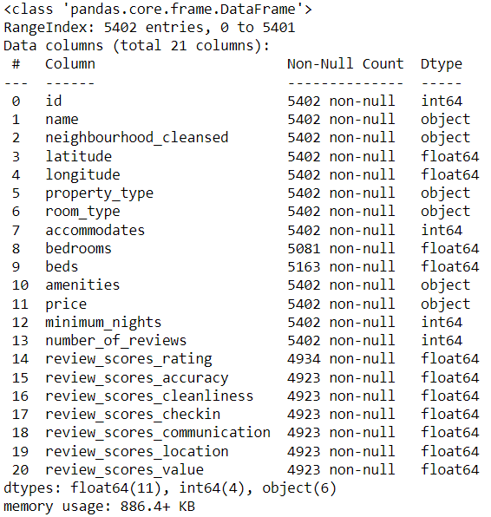
These are few of the key features that are present in our dataset.
Categorical variables: 3
Numerical variables: 15

Slide 6
GOALS
Goals of this presentation is to: -
Cleaning the data set as part of data preprocessing.
Perform various aggregations to understand the dataset better to understand the top listings of airbnbs available in this dataset.
Visualise the preferences room types, Prices vs Accommodates, Number of bookings, revenue and average booking per month of the listings given in the dataset.
Predicting price of the listings based on Neighborhood, type of room, accommodates, bedrooms and beds using various prediction models
Prediction Models used are K Nearest Neighbours, Linear Regression, Gradient Boosting Regressor, Decision Tree Regression and Random Forest

Slide 7
DATA PREPROCESSING
Checked for null values in variables and removed them from the dataframe.
Imputed null values for required variables
Removed outliers from the dataset for variables to retain normality.
Cleaned and converted variables like ‘Price’ and ‘Date’ to appropriate format.
Selected and proceeded with the necessary columns from the dataset.
Created new variable based on the required groupings.

Slide 8
EXPLORATORY DATA ANALYSIS
TOP FIVE LISTINGS WITH HIGHEST ESTIMATED REVENUE
 | listing_id | number_of_reviews | minimum_nights | accommodates | bedrooms | beds | estimated_revenue
8008 | 19183967 | 103 | 300 | 4 | 1.0 | 2.0 | 4511400.0
7818 | 18816109 | 24 | 1001 | 4 | 2.0 | 1.0 | 2906904.0
2846 | 7332860 | 333 | 180 | 1 | 1.0 | 1.0 | 2697300.0
2868 | 7382264 | 321 | 180 | 2 | 1.0 | 1.0 | 2600100.0
352 | 853645 | 70 | 30 | 4 | 3.0 | 2.0 | 1680000.0

Slide 9
Top five listings with highest estimate revenue listings with minimum_nights 7 or less
 | listing_id | number_of_reviews | minimum_nights | accommodates | bedrooms | beds | estimated_revenue
353 | 854328 | 330 | 7 | 4 | 3.0 | 3.0 | 678608.0
154 | 510836 | 110 | 7 | 7 | 5.0 | 8.0 | 561330.0
320 | 785432 | 804 | 2 | 4 | 2.0 | 3.0 | 325600.0
448 | 1044452 | 286 | 7 | 2 | 1.0 | 1.0 | 300300.0
666 | 1601408 | 224 | 4 | 4 | 2.0 | 2.0 | 273600.0

Slide 10
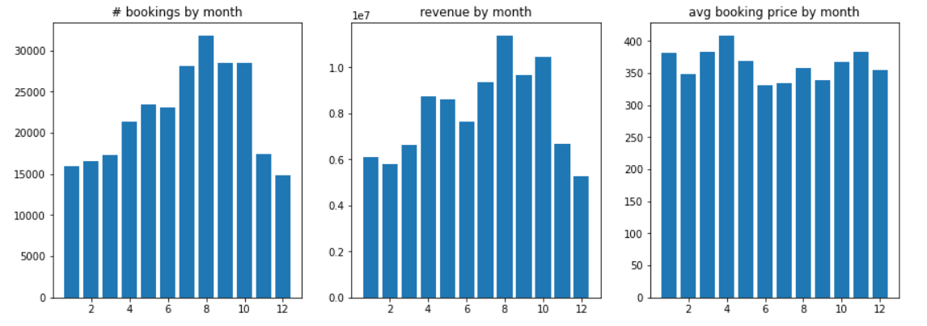
DATA VISUALISATION

Slide 11
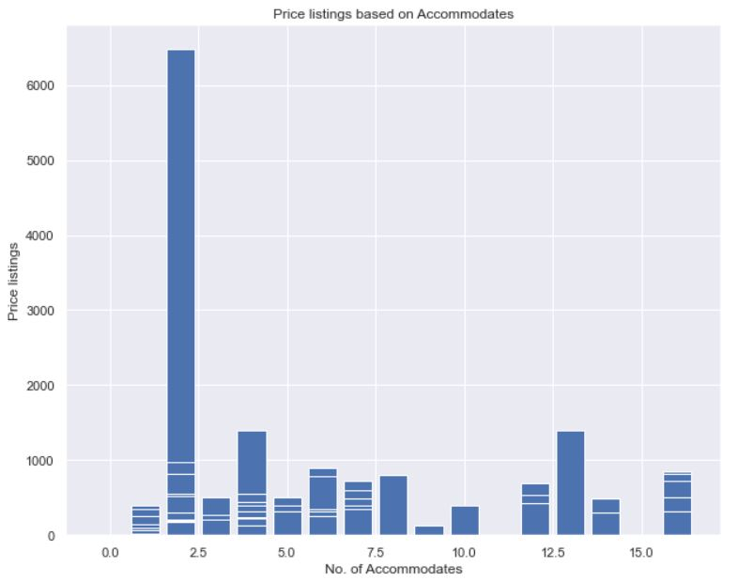
Prices vs No. of Accommodates
Most customers comes in pair to rent out rooms or properties in Amsterdam.
Larger group of people coming to Amsterdam are preferring properties with cheaper prices.

Slide 12
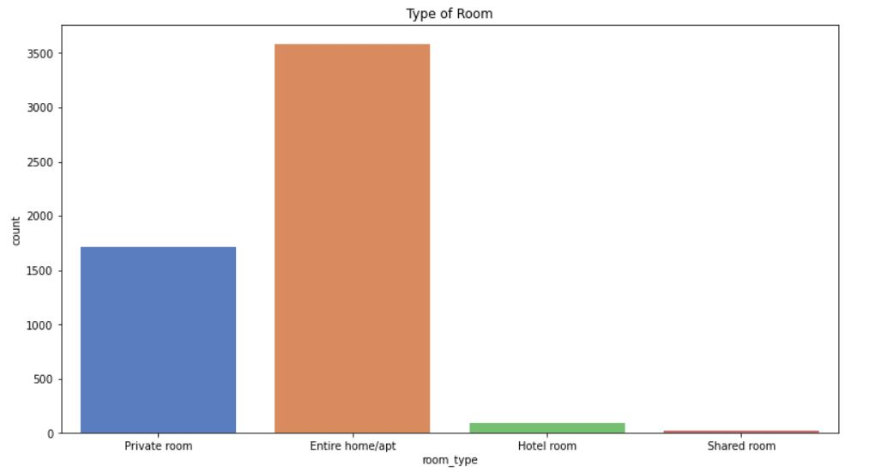
Preferred Room Types
Most people prefer to rent out entire apartments or private rooms for their stay.
Shared rooms or hotel rooms are not very popular choices

Slide 13
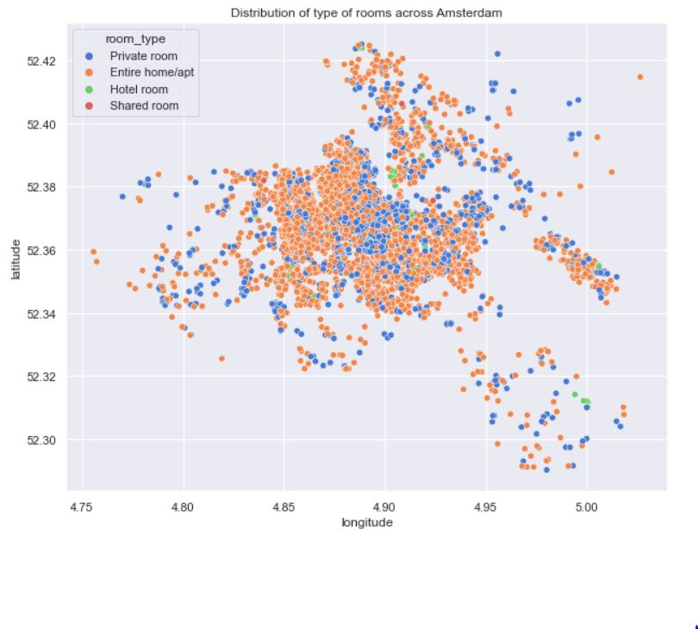
Airbnb affiliated properties spread across Amsterdam

Slide 14
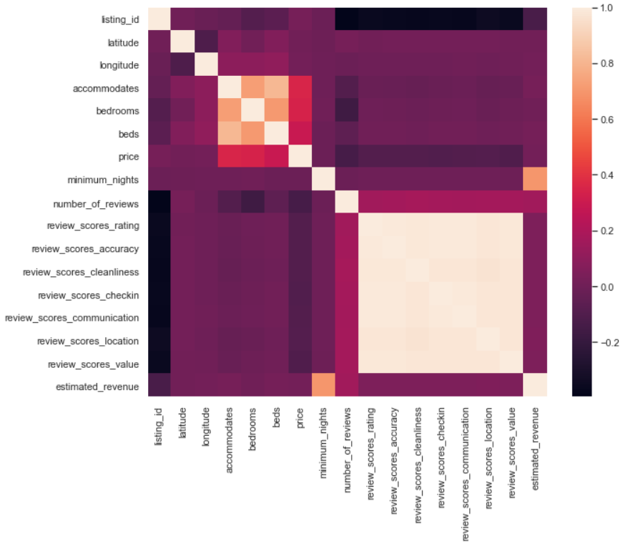
Matrix of Correlation

Slide 15
PREDICTION MODELS
Predictor Variables: Neighbor_Group, room_type, accommodates, bedrooms, beds
Response Variable: Price
Models Employed:
K Nearest neighbors Regression
Linear Regression
Gradient Boosting Regression
Decision Tree Regression
Random Forest Regression

Slide 16
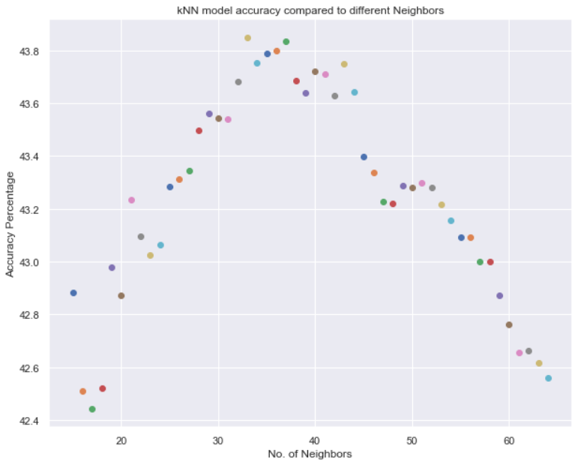
K Nearest Neighbors
Neighbors Chosen: 15 to 65
Maximum r2_score achieved: 0.4384
Root Mean Square Error: 53.27
Model accuracy %: 43.8

Slide 17
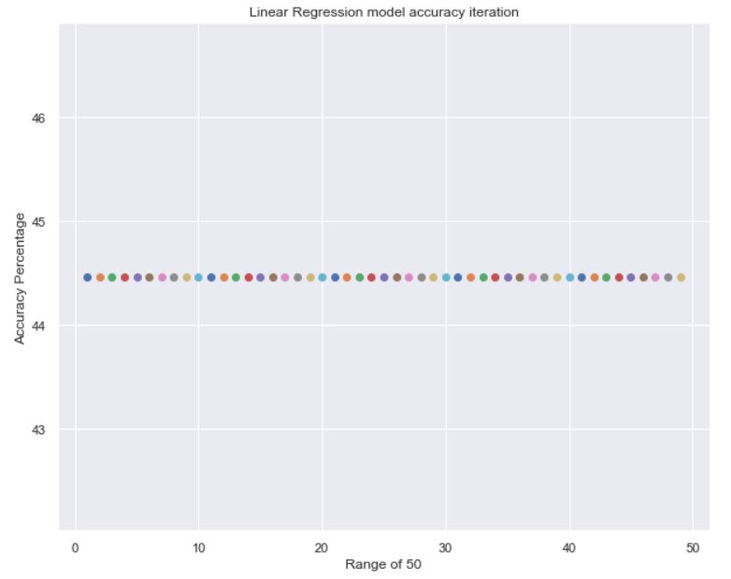
Linear Regression Model
Model tested upto 50 times
Maximum r2_score achieved: 0.4446
Root Mean Square Error: 52.38
Model accuracy %: 44.5

Slide 18
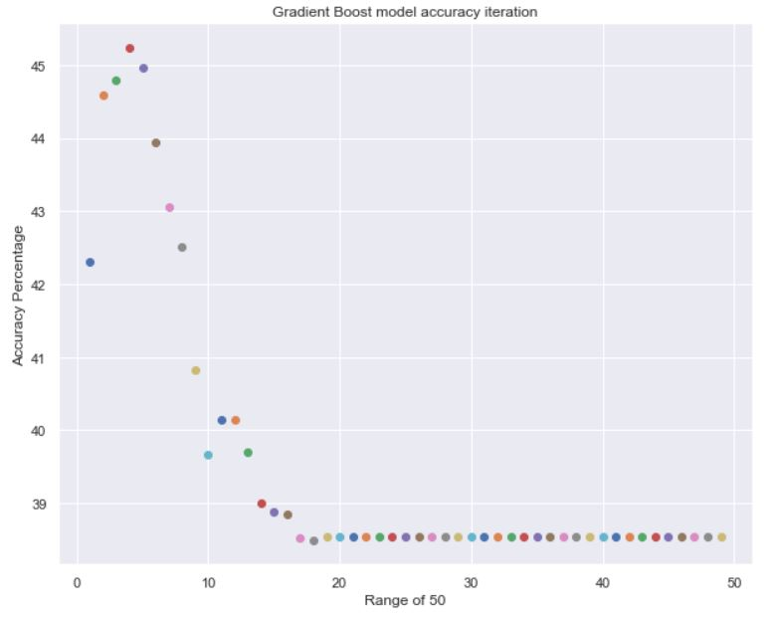
Gradient Boosting Regressor
Model tested upto 50 times
Maximum r2_score achieved: 0.4523
Root Mean Square Error: 55.10
Model accuracy %: 45.2

Slide 19
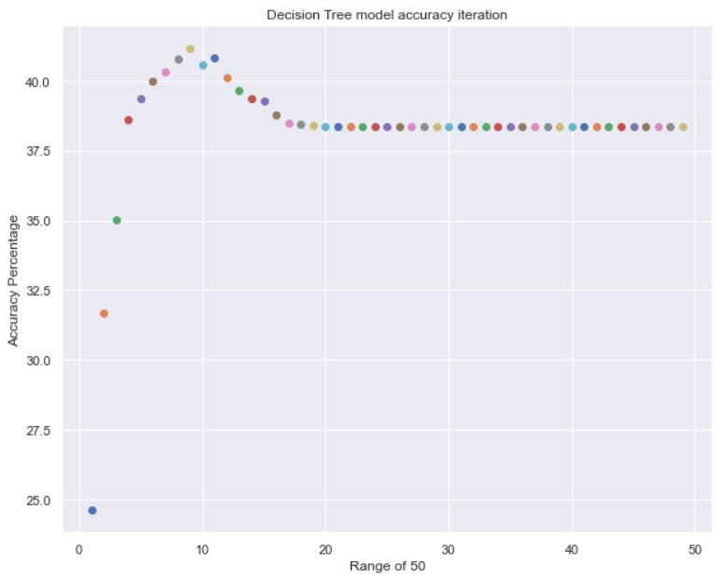
Decision Tree Regression
Model tested upto 50 times
Maximum r2_score achieved: 0.4114
Root Mean Square Error: 55.17
Model accuracy %: 41.1

Slide 20
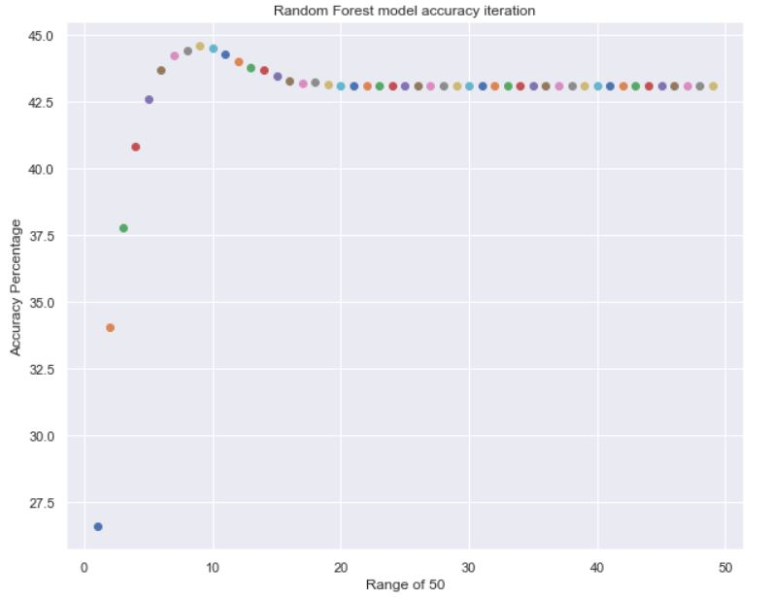
Random Forest Regression
Model tested upto 50 times
Maximum r2_score achieved: 0.4458
Root Mean Square Error: 55.17
Model accuracy %: 44.6

Slide 21
CONCLUSION
We have successfully answered the key business questions through exploratory data analysis. Like peak months of booking will help airbnb plan when to renovate the unit and perform key maintenances/ seasonal overhauls accordingly to maximize profits.
Preferred room type will help Airbnb to potentially buy new lands/houses and convert them into Airbnbs in the long run thereby generating additional streams of revenue.
Identifying the key features that affect the listing price would help Airbnb narrow and finetune their model of listing price prediction
Our prediction model is a lightweight example of how machine learning models can be used to solve real business problems.

Slide 22
REFERENCES
Inside Airbnb. Adding data to the debate. (n.d.). Inside Airbnb. http://insideairbnb.com/get-the-data.html
Howarth, D. (2021, May 25). Airbnb rebrand by DesignStudio aims for visual consistency. Dezeen. https://www.dezeen.com/2014/07/16/airbnb-rebrand-designstudio-logo-belo/
1.6. Nearest Neighbors. (n.d.). Scikit-Learn. https://scikit-learn.org/stable/modules/neighbors.html
sklearn.linear_model.LinearRegression. (2007). Scikit-Learn. Retrieved 2021, from https://scikit-learn.org/stable/modules/generated/sklearn.linear_model.LinearRegression.html

