Slide 1


ANALYSIS OF BOARD OF DIRECTOR'S CONTRIBUTION
Guided By: Prof. Roy Wada
Presented By: GROUP 6 Amryta Panda
Durga Bhanu Nayak
Sneha Prabhu
Date: 21st Jun 2023

Slide 2
AGENDA
Introduction
Business Questions
Understanding diversity
Factor Analysis
Performance analysis
Deliverables

Slide 3

Introduction
FreeFloatMedia is a Connecticut-based organization started in the year 2019.
Aim: To make investing and business news reach wider audience.
Their vision is to empower investors by providing them with insights into the world of finance and corporate governance.
They strive to break down barriers and demystify the board room, making investing and business news more transparent and relatable.

Slide 4

Business Questions
What are the core factors that are responsible for driving any Director’s Influence?
Can we have a unified platform to observe the current standings of individual Companies and their Directors

Slide 5
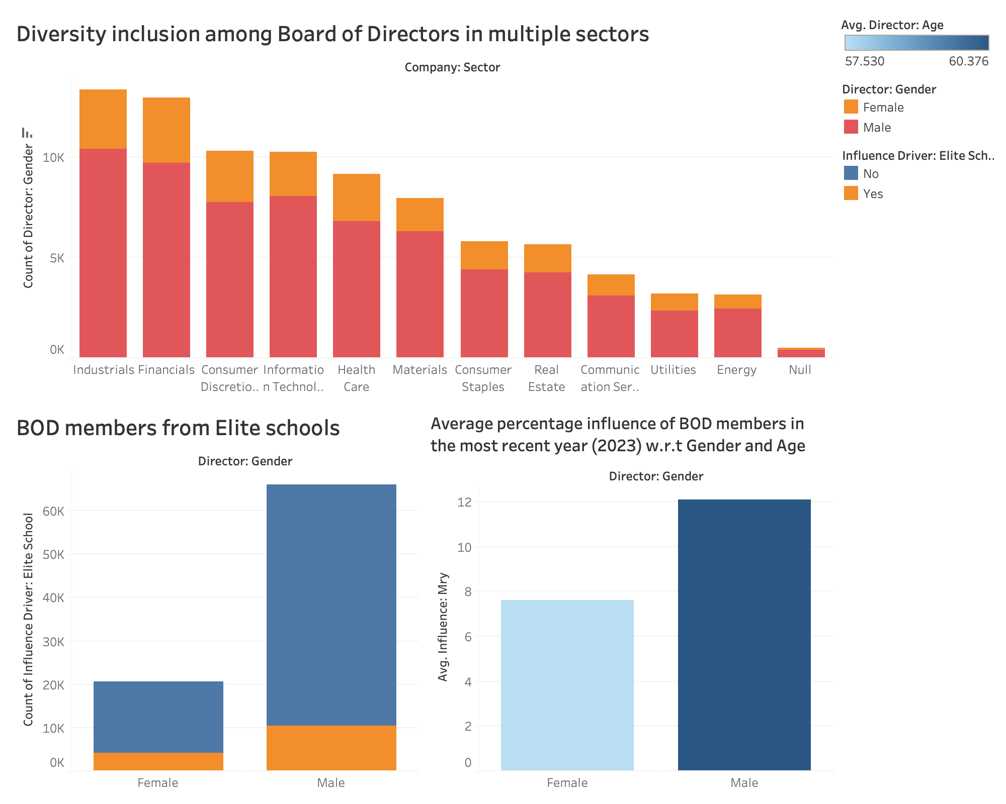
Diversity Inclusion among Board of Directors

Slide 6
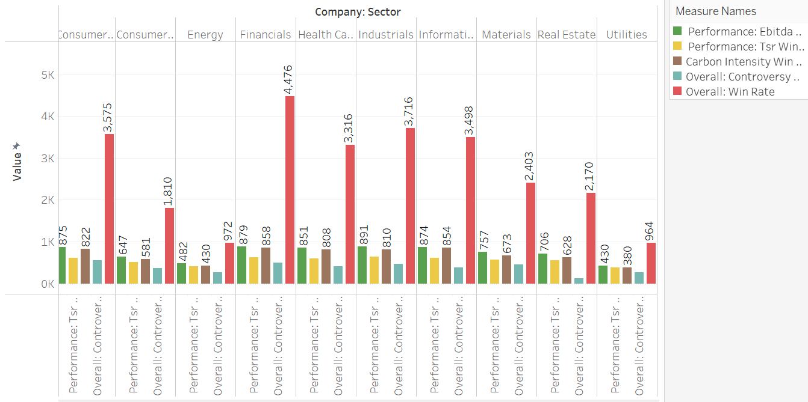
Average performance for each performance category for each sector
Financials sector has the highest performance win rate, indicating strong overall performance within this sector.
The Financials sector also demonstrates the highest win rate for carbon intensity, showcasing their commitment to sustainability.
Energy sector has the lowest win rate in several performance categories, suggesting challenges or underperformance within the sector.
Industrial sector stands out with the highest EBITDA win rate, highlighting its strong earnings and operational efficiency.

Slide 7
Drivers affecting Influence of Board Members
Positive Impact:
Factors like Structural Advantage, being a family member of Founder or CEO is driving influence the most.
Having just the Chair or Committee role tends to negatively impact the influence score.
Structural Advantage
Family of CEO/Founder
CEO Experience
Elite School
Negative Impact:
Chair Role
Committee Role
Board Connections

Slide 8
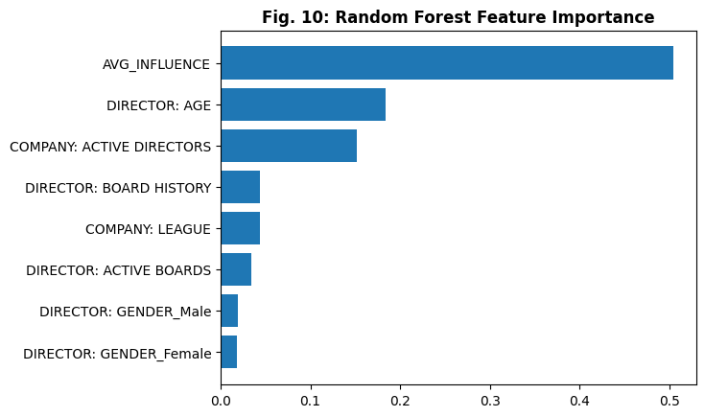
Performance Factors
Influence has been found as direct factor affecting EBITDA performance
Gender is of least importance while assessing the Performance

Slide 9
Deliverables
We have built a comprehensive Tableau dashboard that offers a holistic view of company’s investment portfolio.
The dashboard highlights the performance of individual directors and provide insights into the standings of different companies in the current market.
We have collaborated our individual analysis to that showcases the overall, company-wise and Director-wise performance analysis.
To gain a deeper understanding of our portfolio, we recognize the need for more thorough factor analysis.
This dashboard focuses on attributes such as diversity, skillsets, and performance traits.

Slide 10
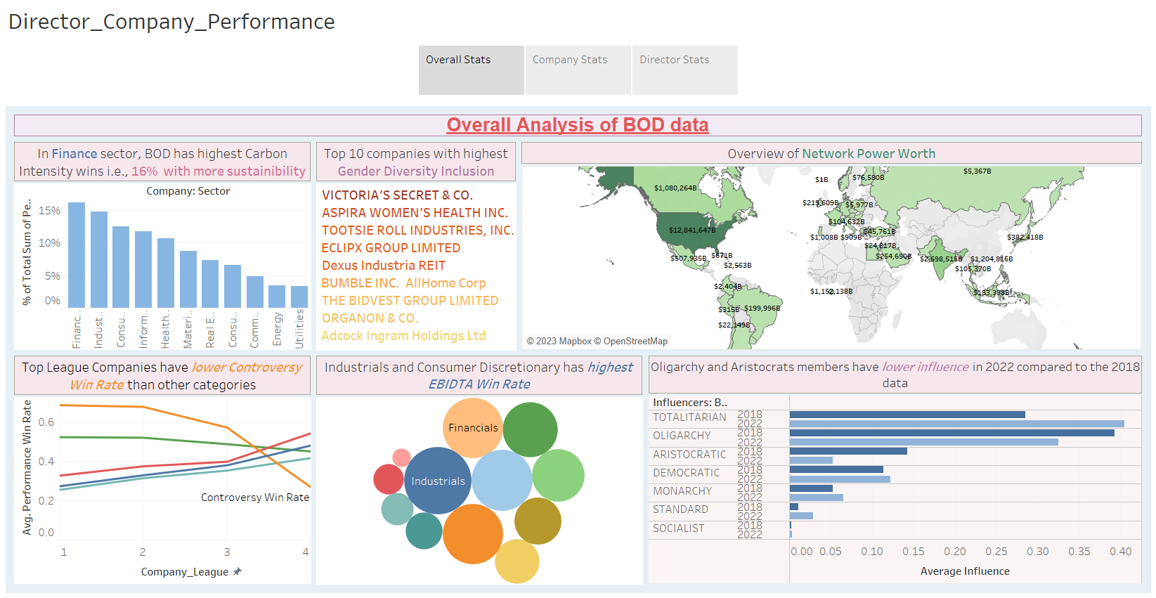

Slide 11
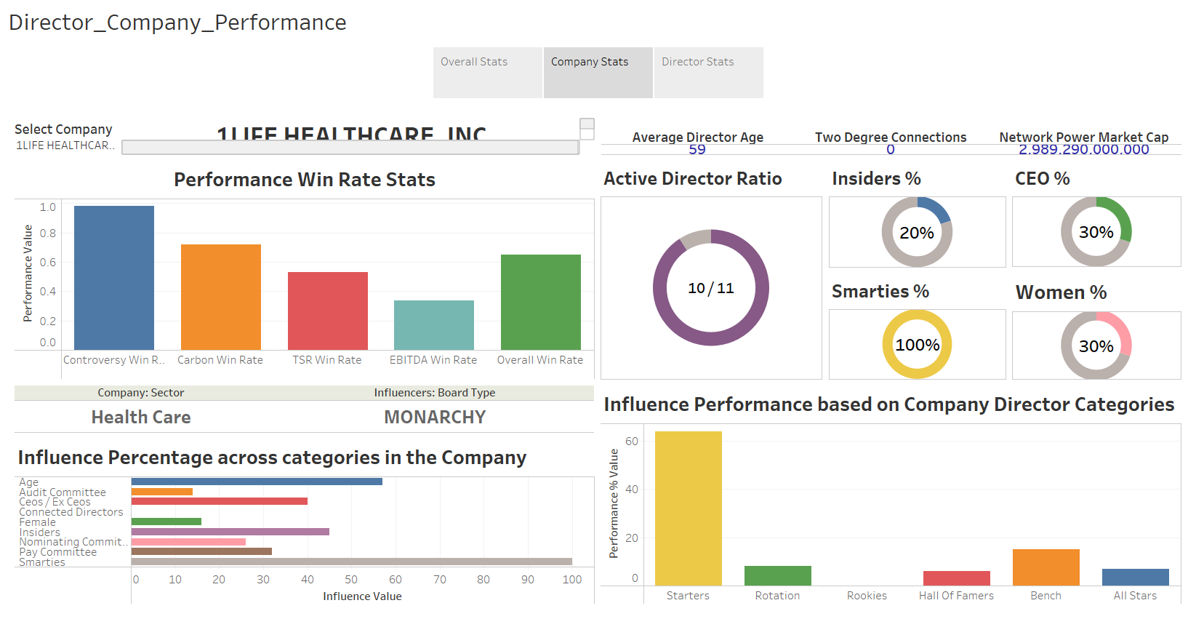

Slide 12
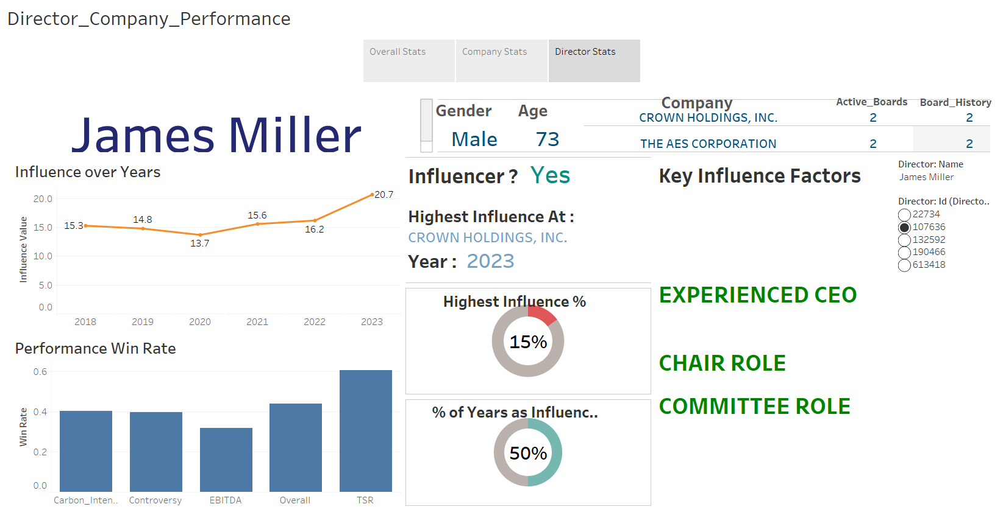

Slide 13
Conclusion & Findings
Higher average Influence, elder board members and having intellectual peers is found to be driving factors of higher EBITDA performance win rate.
With higher company league, higher performance in EBITDA, TSR, Carbon-Intensity win rate can be expected.
Board members having Structural Advantage and CEO experience or belong to such family (Insiders) are having higher influence over others.
Average Influence of Totalitarian regime has shown huge growth in past six years

Slide 14


