Slide 1
GLOBAL SUICIDE RATE ANALYSIS
ALY6010 - 70516: PROBABILITY AND STATISTICS
CPS, Northeastern University
Presented By:
Durga Bhanu Nayak
Professor: Amin Karimpour

Slide 2
Introduction
According to World Health Organization 2021 statistics, there are more than 700,000 people suicide each year and 77% of suicides happen in the countries with low or middle income ("Suicide", 2021). Especially among young people whose age are between 15 and 29, suicide is the second main factor to (World Health Organization, 2014). Every country is concerned about the suicide rate as it is directly proportional to the mental health of any individual.
Purpose of this analysis:
Explore the suicide trends globally, in different generation, each gender group and specific continent.
Find out the factors which correlate with suicide.
Check whether there exist linear relationship between those factors and suicide rate and whether suicide rate could be precisely predicted.

Slide 3
Description of dataset
The data set considered for the analysis contains the details of suicide rates globally from the year 1985-2014.
The data has been compared using parameters such as HDI(Human Development Index), GDP of the country, suicide rates per 100K, etc.
There are 27,820 rows and 12 columns (variables) in this data set.
6 Categorical variables:
2 Discrete variables:
4 Continuous variables:
Country
Year
Sex (Gender)
Age (range)
Year Group
Generation
Suicide Number
Population
Suicide per 100k population
HDI for Year
GDP for Year
GDP per Capita

Slide 4
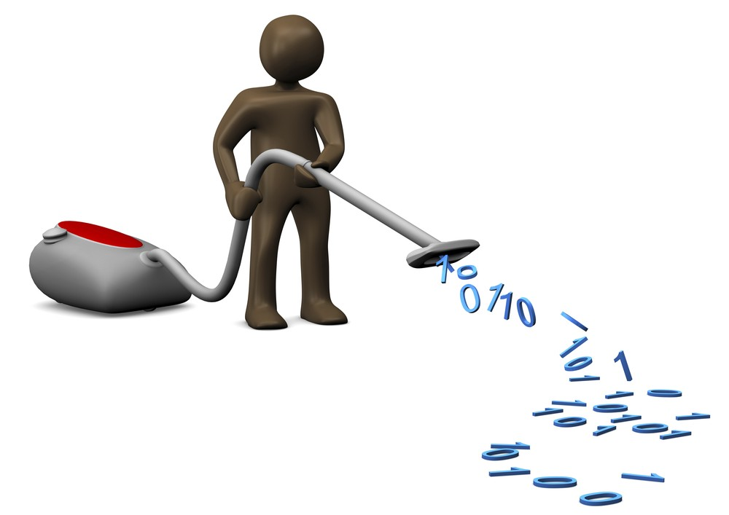
Data Cleaning
Removed unwanted variables or columns
Cleared the null values for HDI_for_year field
Renamed required fields
Converted the variables to appropriate types such as numeric, factors etc.
Added ‘Continent’ variable based on the countries listed using ‘countrycode’ package
Added ‘Year_Group’ variable to categorize the year distribution
Modified fields like ‘sex’, ‘gdp_for_year_100M’ to appropriate formats for data processing.

Slide 5
Human Development Index & GDP
Long and Healthy Life
Knowledge
A Decent Standard of Living
Life expectancy at birth
Expected years of schooling
Mean years of schooling
*GNI per capita ($)
Life expectancy index
Education index
GNI index
Human Development Index (HDI)
GDP: measures the total output of an entire economy
GDP per Capita: reflects the standard of living
*GNI: gross national income converted to international dollars using purchasing power parity rates.
Source: 1. United Nations Development Program; 2. World Health Organization

Slide 6
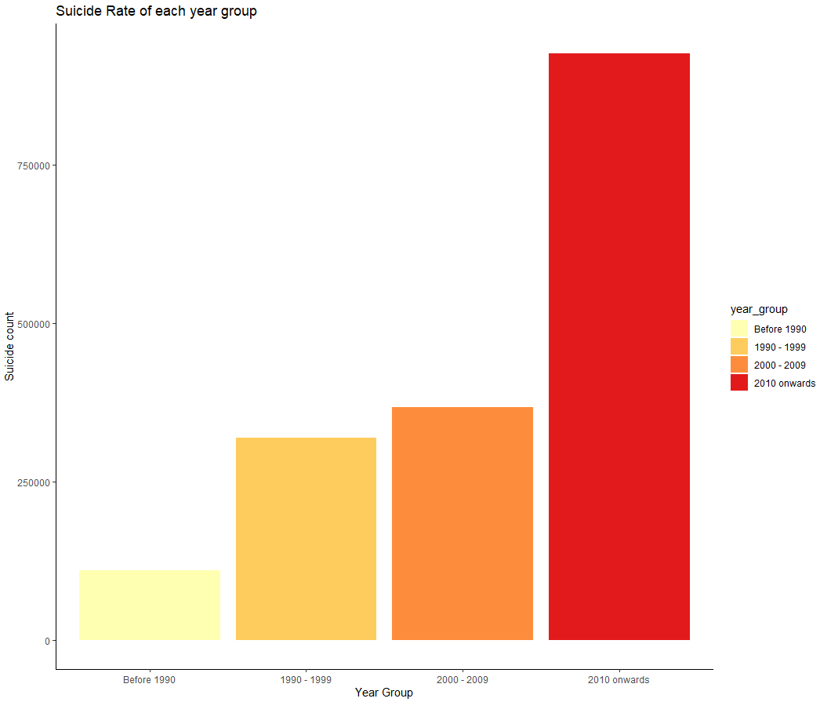
Suicide : Rising or Declining?
Number of suicides is increasing across each decade.
All generation people are getting affected from it.
Suicide rate has been increased alarmingly after 2010
Concerning situation for Government to handle the rate

Slide 7

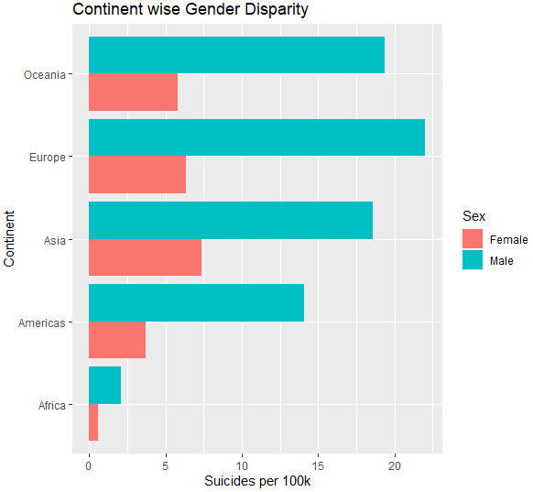
Global suicides across Continents
Europe is having the highest recorded suicides
Asian female have commited more suicides than other continents
Africa is having the least suicides across all genders
Male suicide > Female suicide

Slide 8
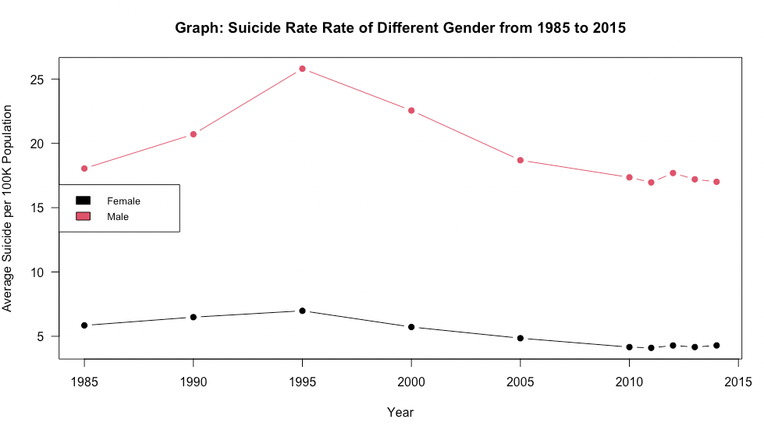
Male has higher suicide rate than Female?
Male have higher suicide rate than female
H0: mean male suicide rate = mean female suicide rate
H1: mean male suicide rate > mean female suicide rate
Two-sample t-test p-value < 0.00001

Slide 9
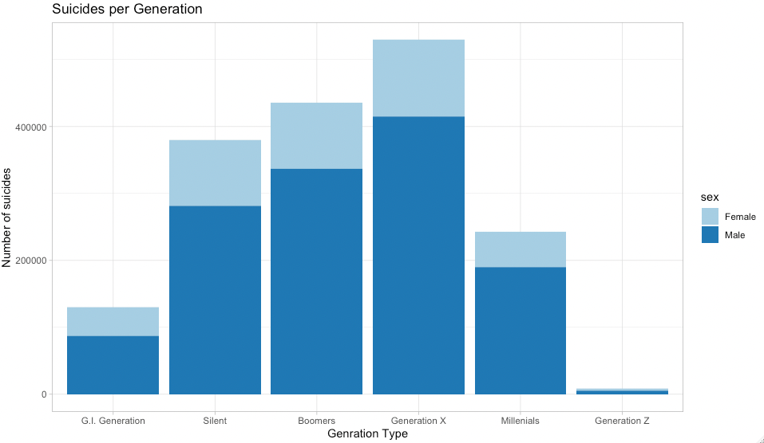
Which generation have more suicide number?
Generation
Generation X has the highest suicide number from 1985 to 2014, followed by Boomers.
Generation Z has the lowest suicide number from 1985 to 2014.
Male always have higher suicide number than female
Born Year: GenZ: 1997 - 2012, Millennials: 1981 - 1996, GenX: 1965 - 1980, Boomers: 1946 - 1964, Silent: 1928 - 1945, GI: 1901-1927

Slide 10
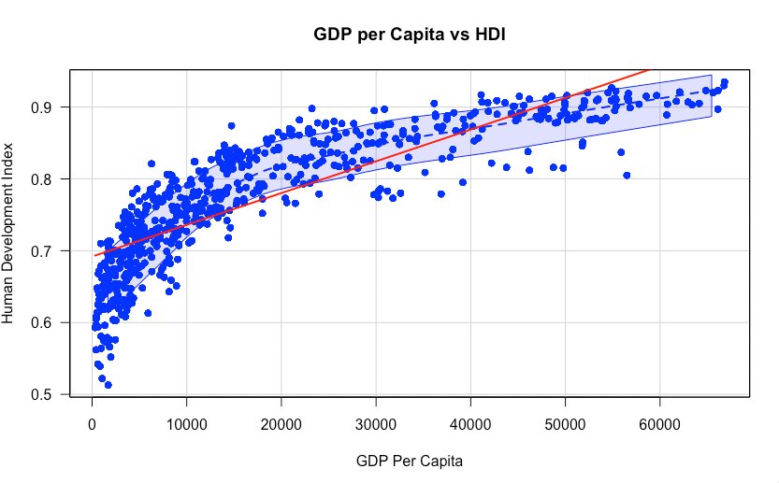
Will high GDP per Capita contribute to better Human Development?
GDP per Capita and HDI has a significant positive linear correlation.
correlation coefficient = 0.831
F-Statistic p-value <0.00001
Regression Model:
Y = 0.000004X + 0.692
R^2 = 0.6914
69.14% of the variability of HDI could be explained by the changes of GDP.

Slide 11
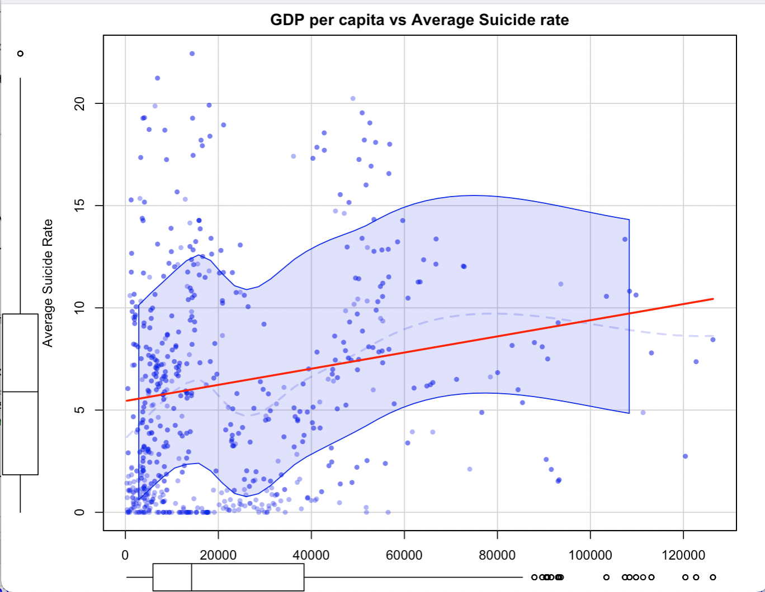
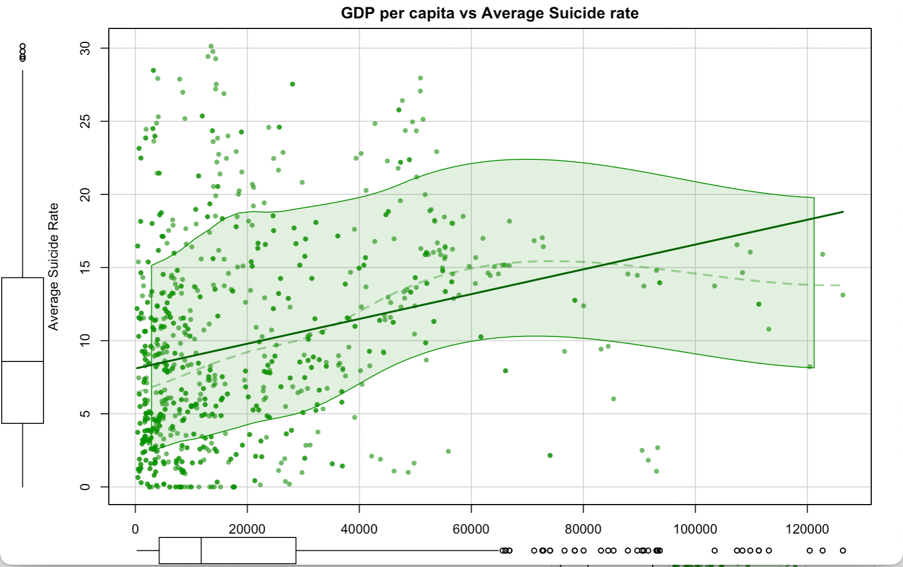
Does Generation X suicide rate gets affected with GDP?
The Generation X represents the senior working professional and Millennials represent the young working professional
Both the graph shows a positive correlation between GDP and suicide rate.
Cor: 0.1879212
p-value: < 0.0001
Cor: 0.2664062
p-value: < 0.0001
Although there is a positive correlation, but the value is very small as we have a larger scope considering suicide rate in all the countries.

Slide 12
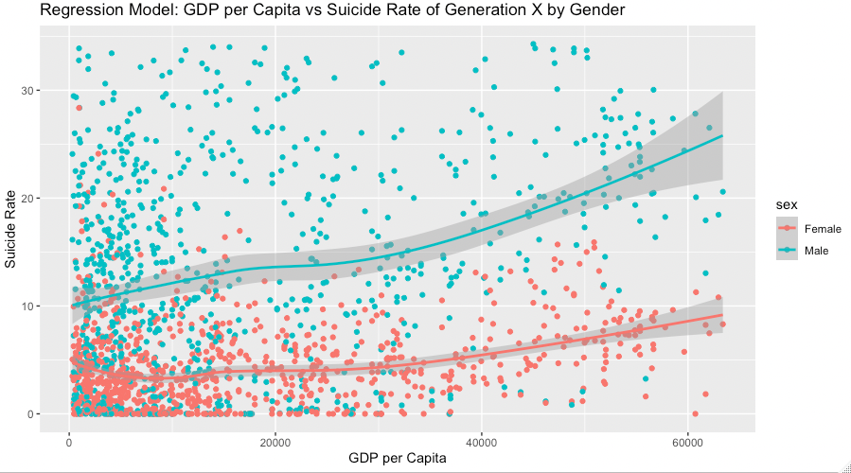
Will the result change for GenX when in gender group?
GenX: Female vs Male
There is significant correlation between GDP per capita and suicide rate in both gender among GenX
However, the relationships are not linear: we could not use linear regression model to precisely predict the suicide rate based on the value of GDP per Capita
Ymale = 0.00006 X GDP + 5.03
F-statistic p-value < 0.0001, R^2 = 0.028, cor = 0.17
Yfemale = 0.00006 X GDP + 2.745
F-statistic p-value < 0.0001, R^2 = 0.103
cor = 0.32

Slide 13
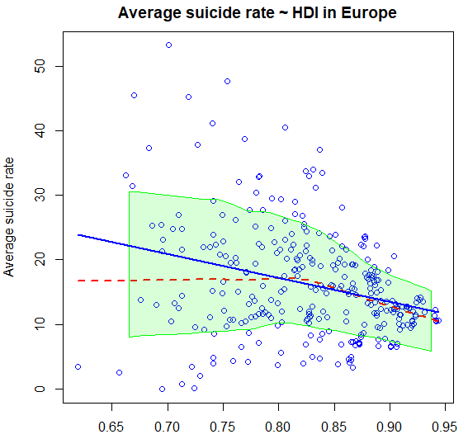
Can Europe tackle suicide rate with it’s development?
cor = -0.28
R-squared: 0.08391
Regression Equation:
Y’ = 46.76 + (-36.918)*HDI
F-statistic p-value < 0.0001
Suicide rate decreasing when Human Development Index is increasing.
Linear Regression model shows ~8% efficiency as the data is vast.

Slide 14
Conclusion
Male population has shown higher suicide rates as compared to female.
Europe has the highest number of suicide rates from year 1985-2014.
As GDP increases, Human Development Index(HDI) also increases.
Among the generation the highest suicide number has been from the primary work force followed by the senior workforce with the increase in GDP.
GDP per Capita has strong correlation with Suicide rate in both Generation X Male and Female Group, while the linear regression could not explain the variability.
Suicide rate in Europe is also displaying a negative correlation with its HDI.

Slide 15
References
Suicide. World Health Organization. (2021). Retrieved 15 November 2021, from https://www.who.int/news-room/fact-sheets/detail/suicide
Home | The World Happiness Report. (2021, March 31). WHR. https://worldhappiness.report/
Contributer, G. (2021, December 14). Linear Models in R: Plotting Regression Lines. The Analysis Factor. https://www.theanalysisfactor.com/linear-models-r-plotting-regression-lines/
Regression Analysis: Step by Step Articles, Videos, Simple Definitions. (2021, October 6). Statistics How To. https://www.statisticshowto.com/probability-and-statistics/regression-analysis/
Plotting with ggplot: : adding titles and axis names. (2016). Environmental Computing. http://environmentalcomputing.net/plotting-with-ggplot-adding-titles-and-axis-names/

Slide 16
Thank You
For being a Great Audience
Any Queries?

