Slide 1

Outland Adventures
CSD 320: Module 11.2
Professor Sue Sampson
12/8/2022
Blue Team
Oscar Acheampong
Abraham Caban-Rios
Isaac Frett
Ryan Hoover
Bethany Mehring

Slide 2

Who we are
We are the Blue Team, comprised of software development students working together to help Blythe Timmerson and Jim Ford. We strive to create reports that will assist them in making the best business decisions for Outland Adventures.
Members: Oscar, Abe, Isaac, Ryan, Beth

Slide 3
Description of the case study
Outland Adventures was created to cater to people who enjoy hiking and camping in far-off places. They offer arranged guided trips with equipment rental and purchases. The creators, Blythe Timmerson and Jim Ford, need assistance with the following business decisions:
Do enough customers buy equipment to keep sales?
Trips include Africa, Asia, and Southern Europe. Has there been a decline in booking to any of these locations?
Is there inventory older than 5 years old?

Slide 4
Business Rules
A department can have many jobs
A department has many employees.
An employee can take many orders.
A customer can place many orders.
A customer can have many rentals.
A customer can place many purchases.
A customer can have many trips.
An order can have many trips.
An order can have many rentals.
An order can have many purchases.
A piece of equipment can be rented many times.
A piece of equipment can be purchased once.
A trip may need a visa.
A trip has one airfare.
A destination can have many trips.

Slide 5
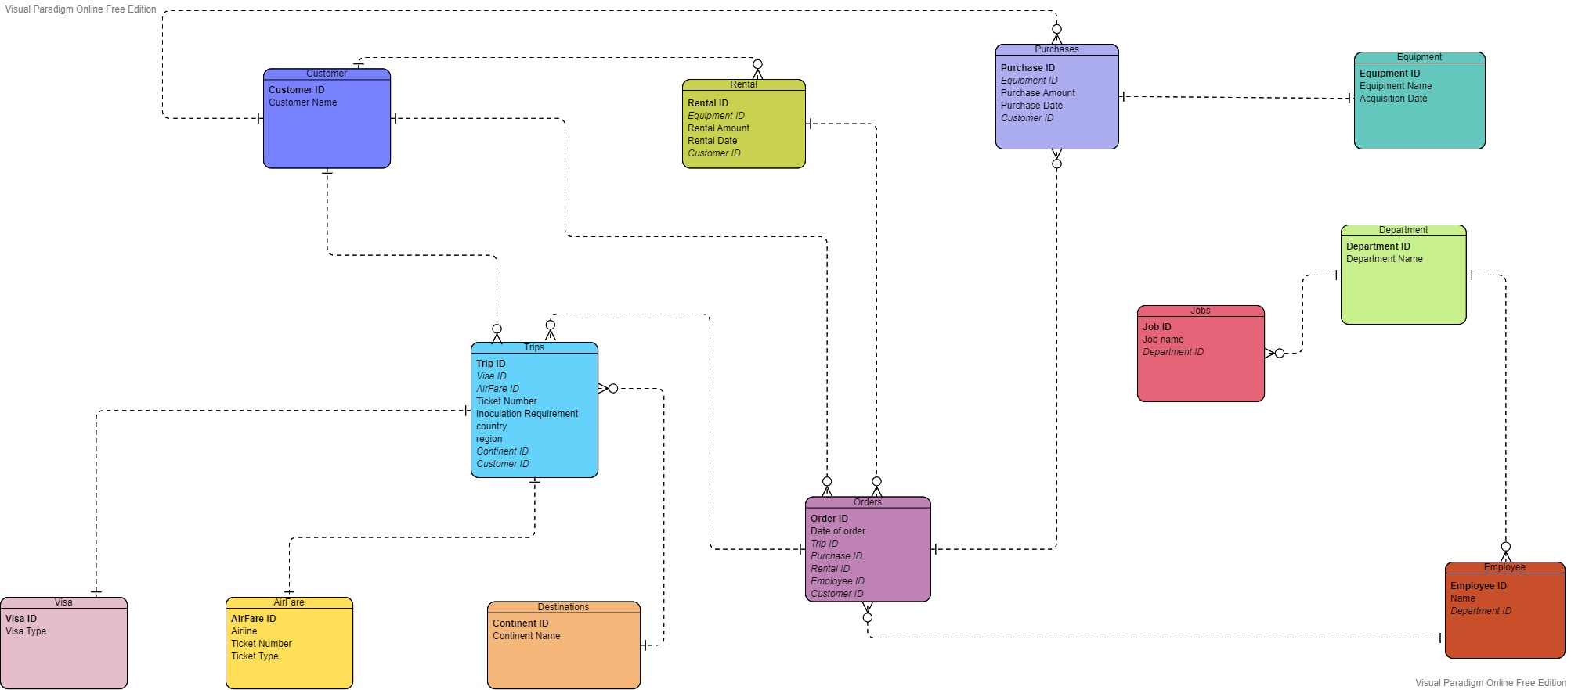
Finalized ERD

Slide 6
Description of the reports
Report 1: This allows us to see how many customers have purchased equipment from, when the report is run.
Report 2: Allows us to view how many trips have been booked to each continent within the last 90 days from when the report is run.
Report 3: Allow us to view the equipment with an acquisition date older than 5 years from reports date.

Slide 7
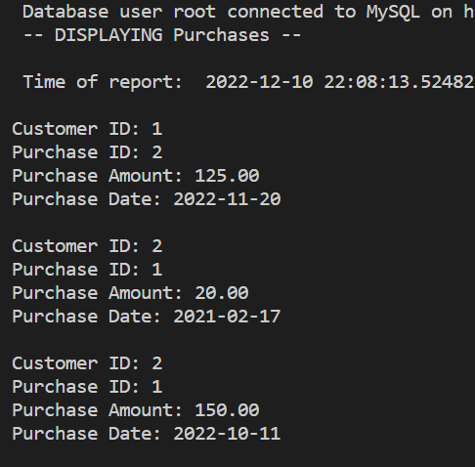
Report 1
This report shows each transaction made, how much they were worth, and the date of purchase. From the report we can see that enough customers (including repeat customers) buy equipment to keep equipment sales.

Slide 8
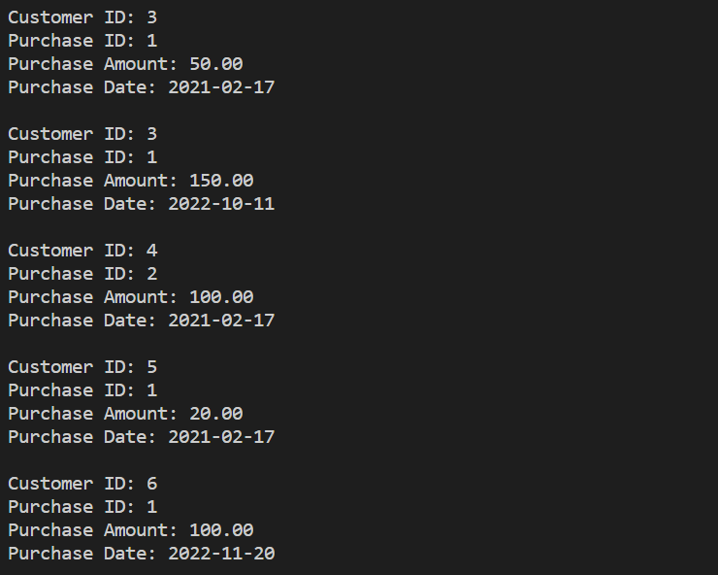
Report 1
This report shows each transaction made, how much they were worth, and the date of purchase. From the report we can see that enough customers (including repeat customers) buy equipments to keep equipment sales.

Slide 9
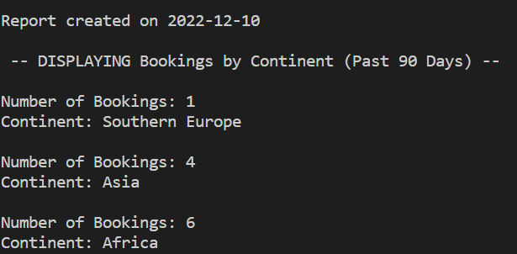
Report 2
Africa has been the most booked continent in the past 90 days. Followed by Asia, then only one trip booked to Southern Europe. We can see that Southern Europe is the least booked in the last 90 days and we should consider whether it is worth the cost.

Slide 10
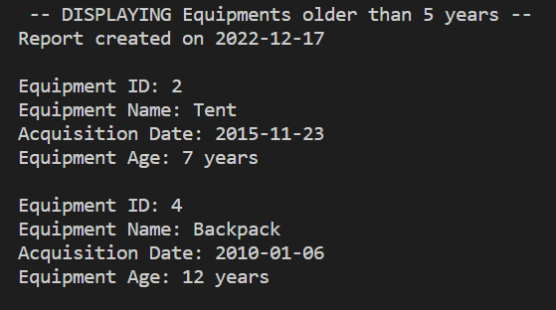
Report 3
This report shows that we have two pieces of equipment older than 5 years old in the inventory. We have a tent that is 7 years old and a backpack that is 12 years old. All other inventory has an acquisition date less than 5 years ago.

Slide 11

All trips are international.
Assumptions:

