Slide 1

Made Alive in Christ
IIT Bible Club Outreach Event
March 24, 2011

Slide 2

Agenda
Who is the IIT Bible Club?
Why the Bible?
Message: Made Alive in Christ
Why we meet
What we do
Contact Information
Questions

Slide 3
Who is the IIT Bible Club?
A Christian student organization on campus with an emphasis on studying the Bible
Members are students and alumni of IIT
Associated with the University Bible Fellowship (UBF), a church organization dedicated to campus ministry
Since 2001

Slide 4
Why the Bible?
We believe that the Bible is inspired by God; that it is the truth; that it is the final authority in faith and practice.
Reveals God is
Reveals who man is
It is self-validating
It is practical, useful and applicable

Slide 5
Made Alive in Christ
Ephesians 2:1-10, NIV
Key verses 4,5 “But because of his great love for us, God, who is rich in mercy, made us alive with Christ even when we were dead in transgressions – it is by grace you have been saved.”

Slide 6
Who is God?
God is the Creator
God is three in one
  “…And now the Sovereign Lord has sent me, with his Spirit.” – Isaiah 48:16
God is holy
Notes:
God is the Creator
“In the beginning God created the heavens and the earth.” –Genesis 1:1
God is three in one
“Come near me and listen to this: ‘From the first announcement I have not spoken in secret; at the time it happens, I am there.’ And now the Sovereign Lord has sent me, with his Spirit.” – Isaiah 48:16
He is the Father, the Son - Jesus Christ, and the Holy Spirit
God is the Creator
“In the beginning God created the heavens and the earth.” –Genesis 1:1
God is three in one
“Come near me and listen to this: ‘From the first announcement I have not spoken in secret; at the time it happens, I am there.’ And now the Sovereign Lord has sent me, with his Spirit.” – Isaiah 48:16
He is the Father, the Son - Jesus Christ, and the Holy Spirit

Slide 7
What is sin? (Eph 2:1-3)
“As for you, you were dead in your transgressions and sins”
All of us lived among those who are disobedient.
“We were by nature, objects of wrath”
Notes:
“As for you, you were dead in your transgressions and sins, in which you used to live when you followed the ways of this world and of the ruler of the kingdom of the air, the spirit who is now at work in those who are disobedient.” –Eph 2:1-2
“All of us also lived among them at one time, gratifying the cravings of our sinful nature and following its desires and thoughts. Like the rest, we were by nature objects of wrath.” –Eph 2:3

Slide 8
Made Alive in Christ
“But because of his great love for us, God, who is rich in mercy, made us alive with Christ even when we were dead in transgressions – it is by grace you have been saved.”–Eph 2:4-5
Notes:
“But because of his great love for us, God, who is rich in mercy, made us alive with Christ even when we were dead in transgressions – it is by grace you have been saved.” –Eph 2:4-5

Slide 9
The Riches of His Grace
God raised us up with Christ
Grace – the gift of God
Not from ourselves, not by works
No one can boast
Notes:
“And God raised us up with Christ and seated us with him in the heavenly realms in Christ Jesus, in order that in the coming ages he might show the incomparable riches of his grace expressed in his kindness to us in Christ Jesus.” –Eph 2:6-7
“For it is by grace you have been saved, through faith – and this is not from yourselves – it is the gift of God – not by works, so that no one can boast.” –Eph 2:8-9

Slide 10
Made Alive in Christ - conclusion
“For we are God’s workmanship, created in Christ Jesus to do good works, which God prepared in advance for us to do.” – Eph 2:10
Give God glory, honor, praise
Worship God
Enjoy God
Grow in a relationship with God
Walk with God

Slide 11
A Call to Repentance
“For you were once darkness, but now you are light in the Lord. Live as children of light… for it is light that makes everything visible. This is why it is said:
  ‘Wake up, O sleeper,
  rise from the dead,
  and Christ will shine on you.’
  Be very careful then, how you live – not as unwise but wise.” –Eph 5:8,14-15

Slide 12
Why we meet
Study God’s word together
Grow together in Christ
Encourage one another
Nurture our friendship
To worship together
To know God more and to make God known to IIT, and to the world.
Notes:
Study God’s word together
Grow together in Christ
Encourage one another
Nurture our friendship

Slide 13
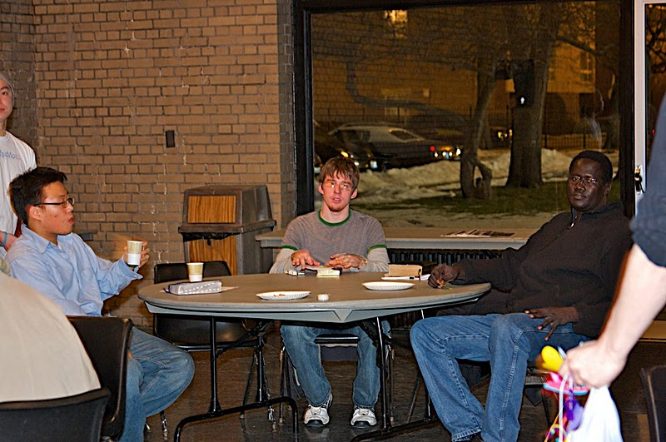
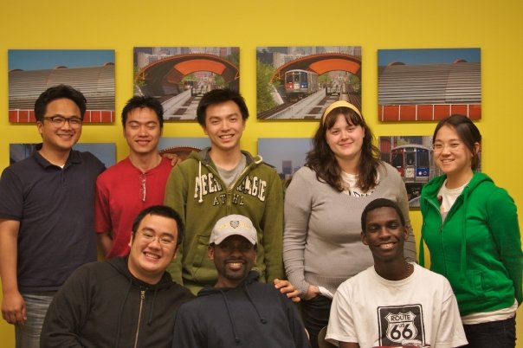
What we do
Group Bible Study
  Studying foundational Christian truths as a group through selected passages of the Bible.
  MTCC Yellow Room
  Thursdays
  7pm

Slide 14
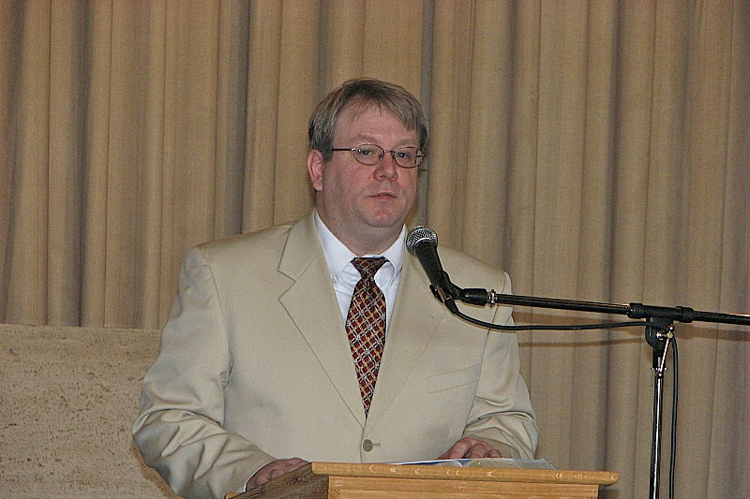
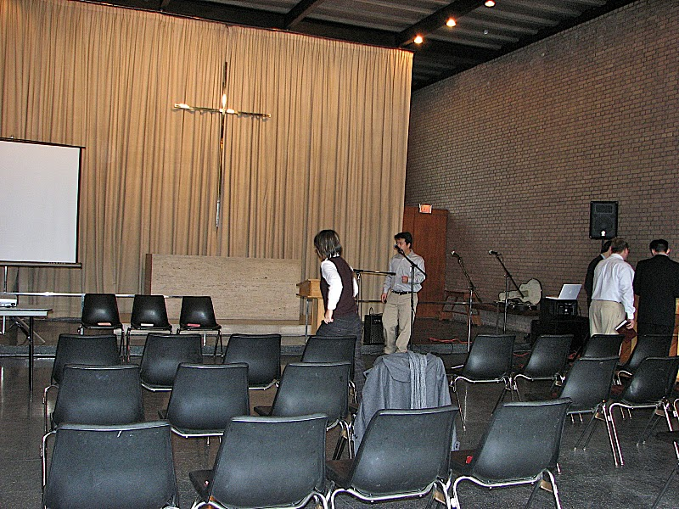
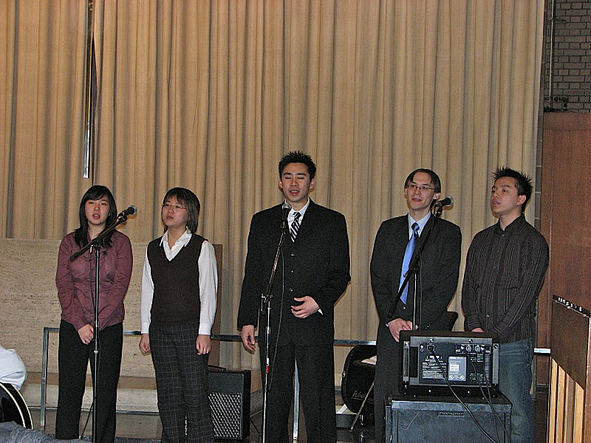
What we do
Sunday Worship Service
  Worshipping the Lord through singing and learning through Bible messages
  We are currently going through the book of 2 Samuel – about the reign of King David.
  Sundays
  10am
  Chapel @ IIT

Slide 15
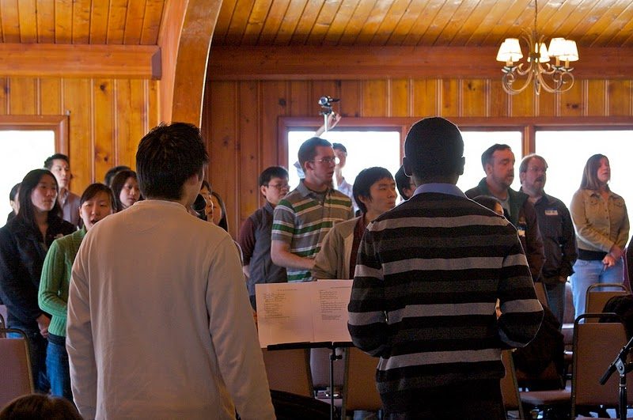
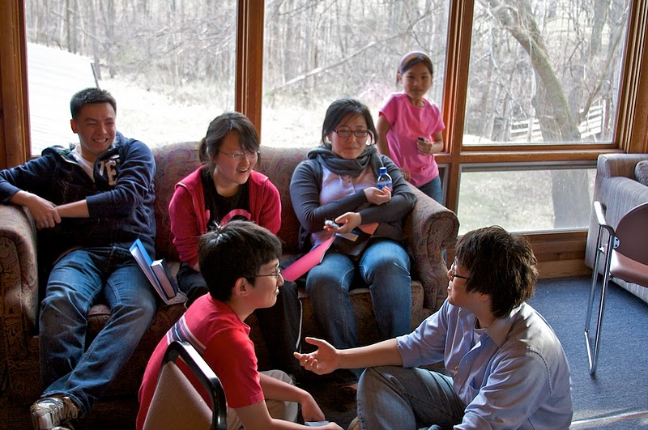
What we do
Retreats
  Spend a few days devoted to meditation on God’s word and fellowship
  Easter –
    Coming up! Friday, April 15-17, 2011, with the theme “Redeemed”
  Summer

Slide 16
Please Join Us!
You’re invited to everything we do!
We want to share our lives in Christ together with you!

Slide 17


Contact Information
Email:
  iitubf@gmail.com
Website:
  iitubf.org
Facebook:
  www.facebook.com/iitubf
Twitter:
  www.twitter.com/iitubf

Slide 18

Questions

