Slide 1


Slide 2
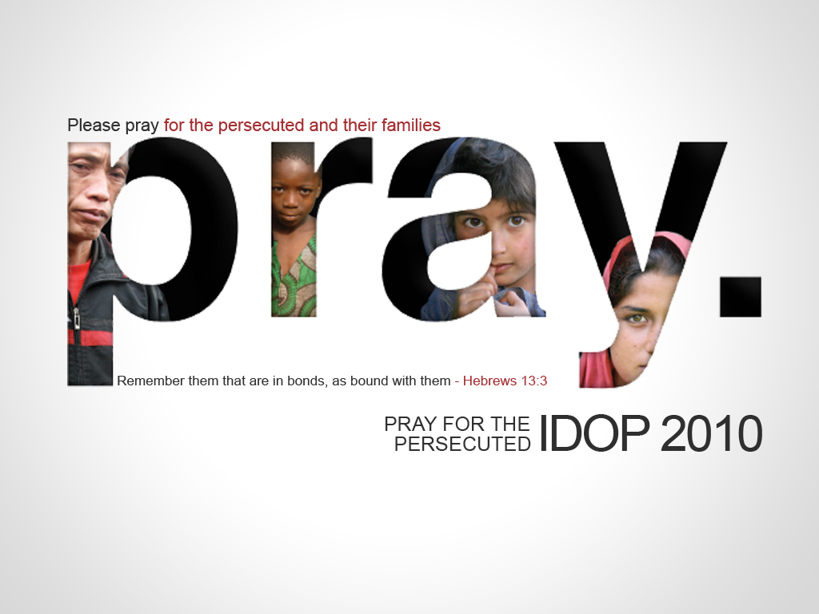

Slide 3
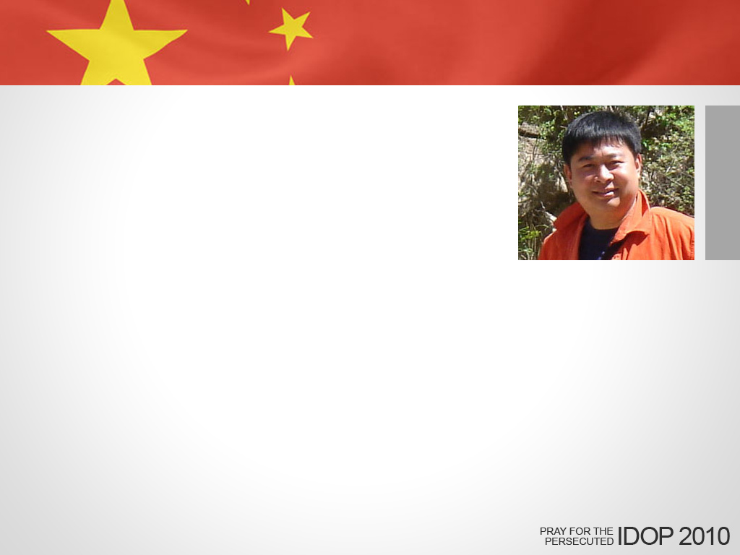
china
Shi Weihan is scheduled to be released in November after three years in prison for printing Bibles without the government’s permission.
PRAY he will be released on schedule; and pray for his family.

Slide 4
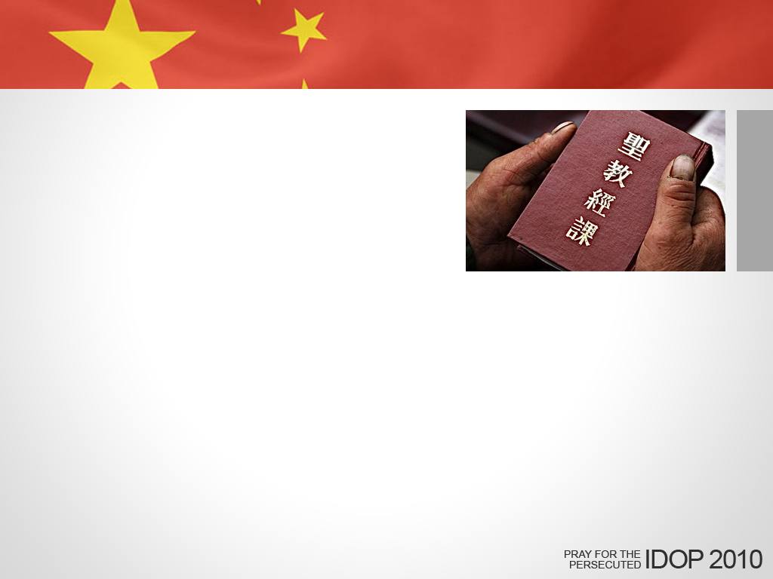
china
VOM will distribute more than 98,000 Bibles in China this year, as well as thousands of New Testaments and other Christian literature.
PRAY for safe delivery of these materials, and that hearts will be touched with the gospel message.

Slide 5

north korea
VOM is launching helium-filled balloons loaded with gospel tracts into the world’s most-closed country, where the people are told their dictator is a god.
PRAY for North Koreans to receive the gospel and believe in Jesus.

Slide 6

north korea
There are around 200,000 people in North Korean prison camps, 50,000 to 70,000 of which are Christian. Prisoners are tortured, executed, and used of humans for weapons testing. Many die from starvation and overwork. Yet Christians meet together in secret for Bible studies and training courses.
PRAY that they would be a witness to their fellow-prisoners and that the camps would be closed down.

Slide 7

pakistan
Asia Bibi has been in prison for 18 months for allegedly speaking against the Muslim prophet, Mohammed.
PRAY Asia will be released from prison, and for her husband and two daughters as they are separated from her.

Slide 8
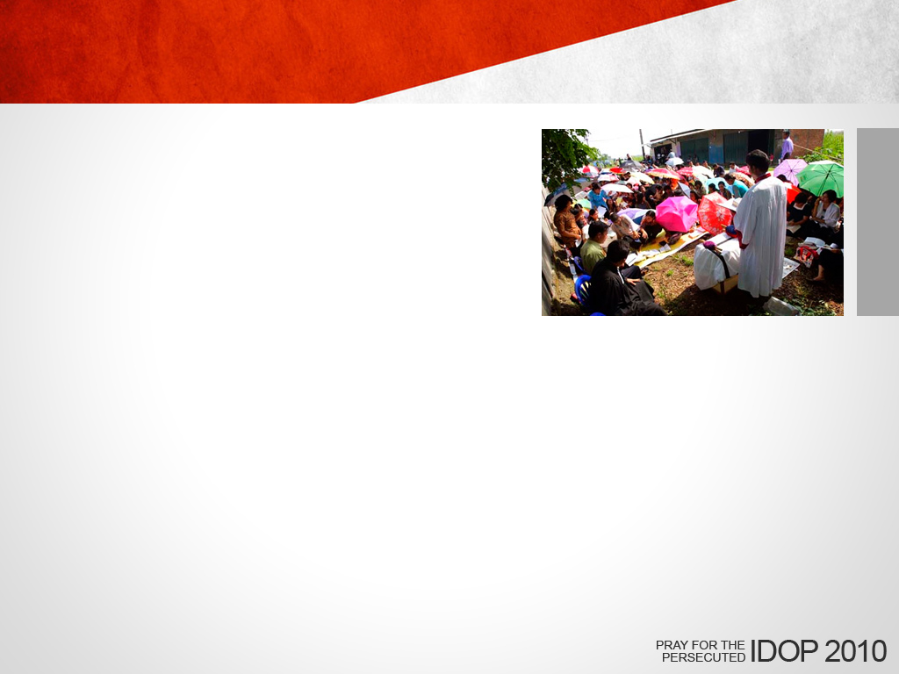
indonesia
A congregation in Bekasi has been forbidden to meet on their property by local government officials.
PRAY that the attention given to their case will give these Christians a platform to share Christ’s love.

Slide 9
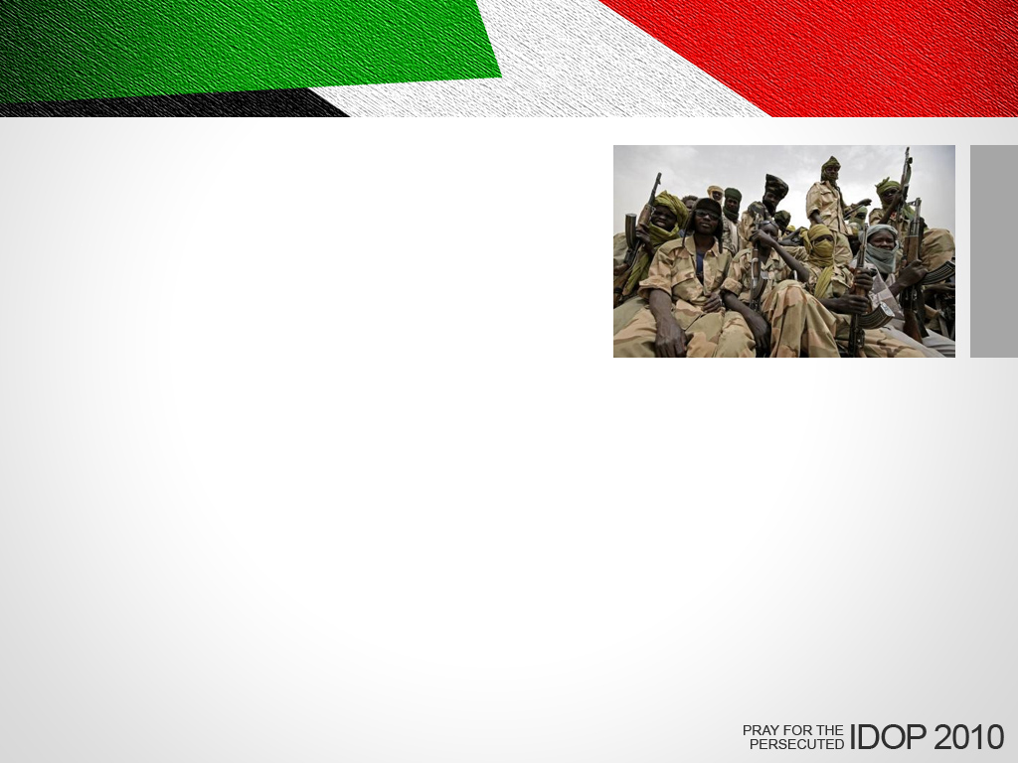
sudan
There has been war between the Muslim southern part of Sudan fighting with the northern Christian part. The country may split due to the fierce fighting. Philip Angelo and his newly married bride are going to start a ministry in Malatal City which is in a dangerous southern part of Sudan.
PRAY for their safety and to have courage sharing the gospel being isolated and alone in a hostile environment.

Slide 10
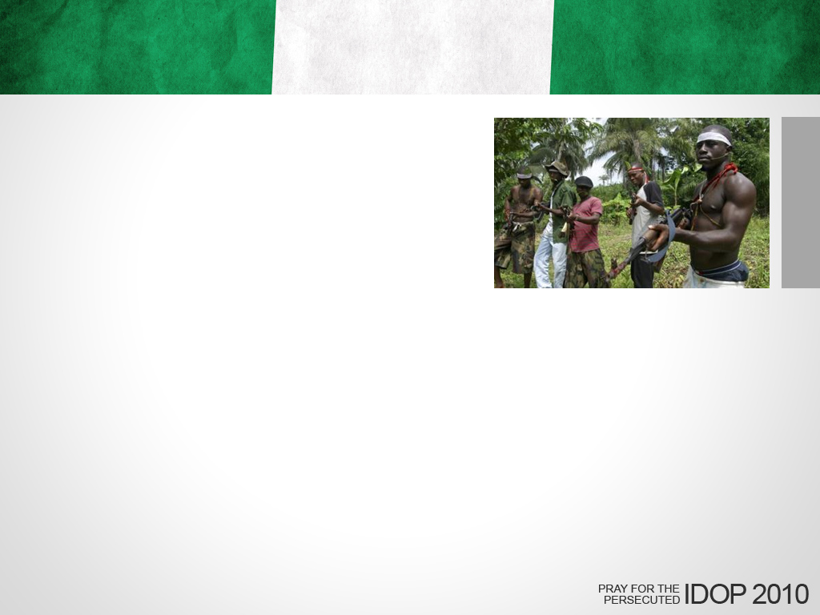
nigeria
It is estimated that many more thousands of Christians have been killed in northern Nigeria.
PRAY that the violence would subside.

Slide 11
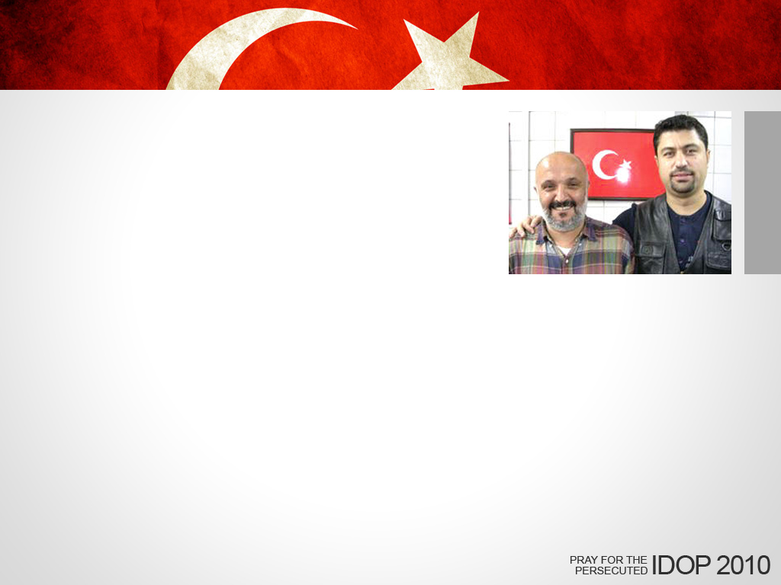
turkey
Four years after being accused of insulting Turkey and its people by spreading their faith, two Christians, Turan Topal and Hakan Tastan were acquitted of the charge due to lack of evidence.
THANK GOD for answering their prayers. PRAY that their testimony will strengthen the faith of other believers and draw unbelievers to Christ.

Slide 12
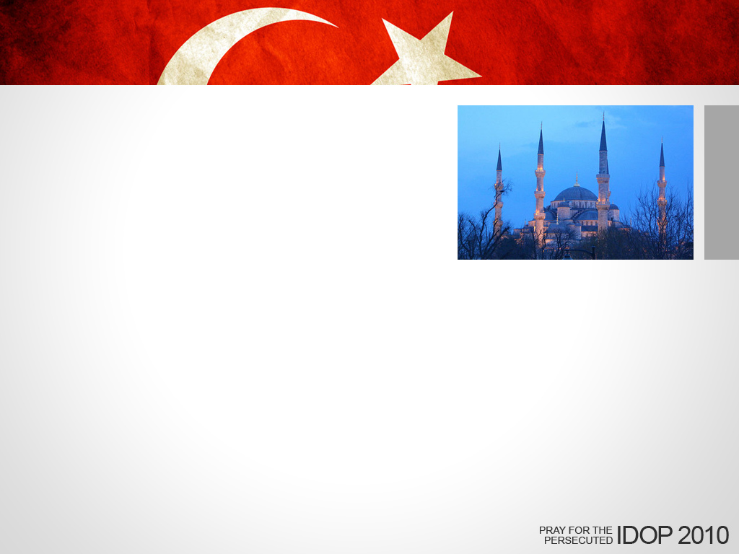
turkey
Turkish government threatens Vladimir Point because a Muslim girl student, Narisa, converted to Christianity. The government follows him and has warned them not to convert Muslims.
PRAY for their ministry to have courage and continue to share the gospel even in the face of persecution.

Slide 13
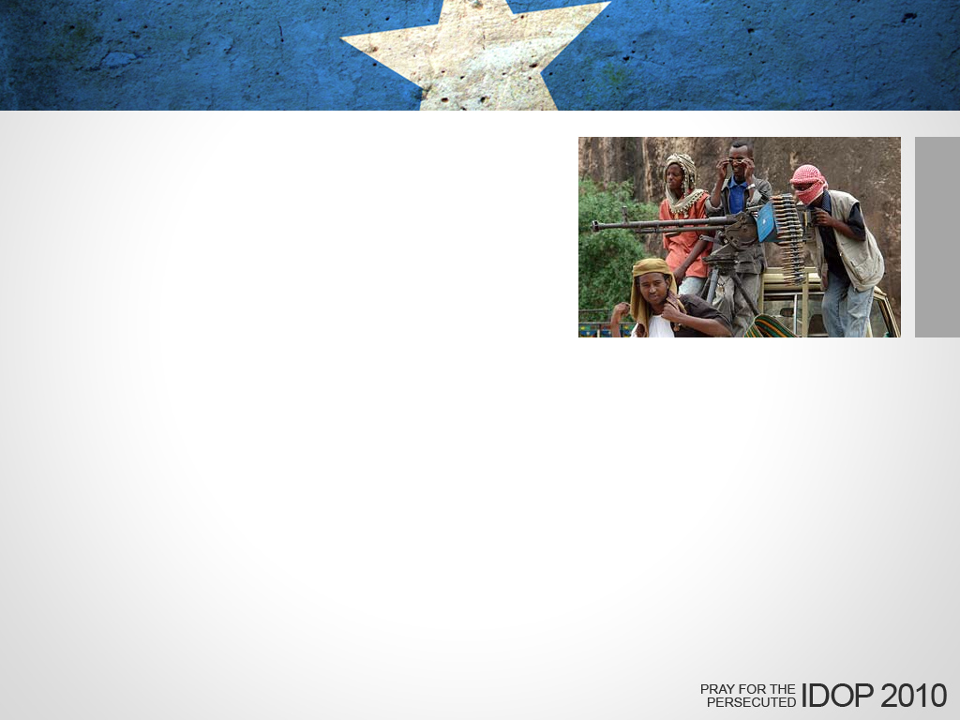
somalia
Christian Osman Abdullah Fataho was shot and killed in front of his wife and four children last July by Al Shabaab rebels, who have stated their goal of killing every Christian in Somalia. Fataho’s four children were abducted by the rebels to be trained as jihadists.
PRAY for Ali (5), Fatuma (7), Sharif (10) and Nur (15) to remain strong in their faith and be reunited with their mother.

Slide 14
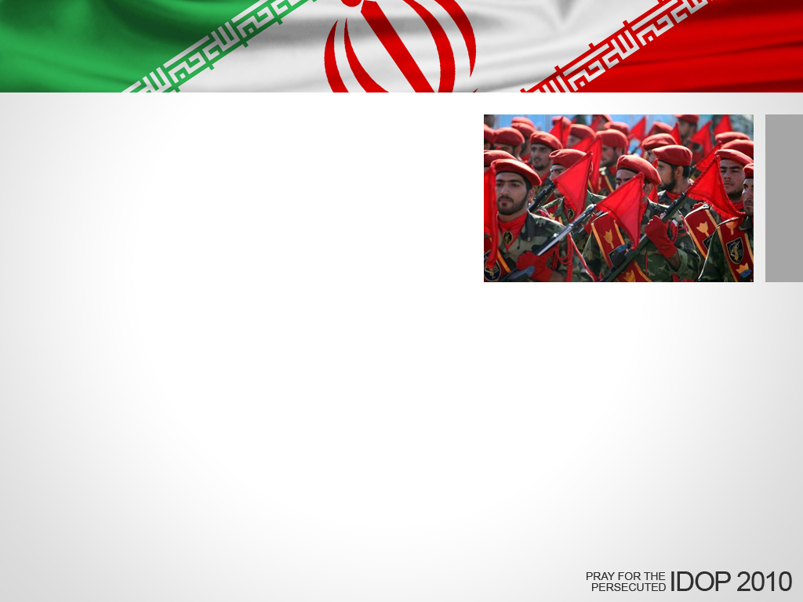
iran
Revolutionary Guards have used political upheaval in Iran as a pretext to harass and arrest Christians.
PRAY for opportunities to witness to Muslims in Iran, and for open hearts to hear the gospel message.

Slide 15
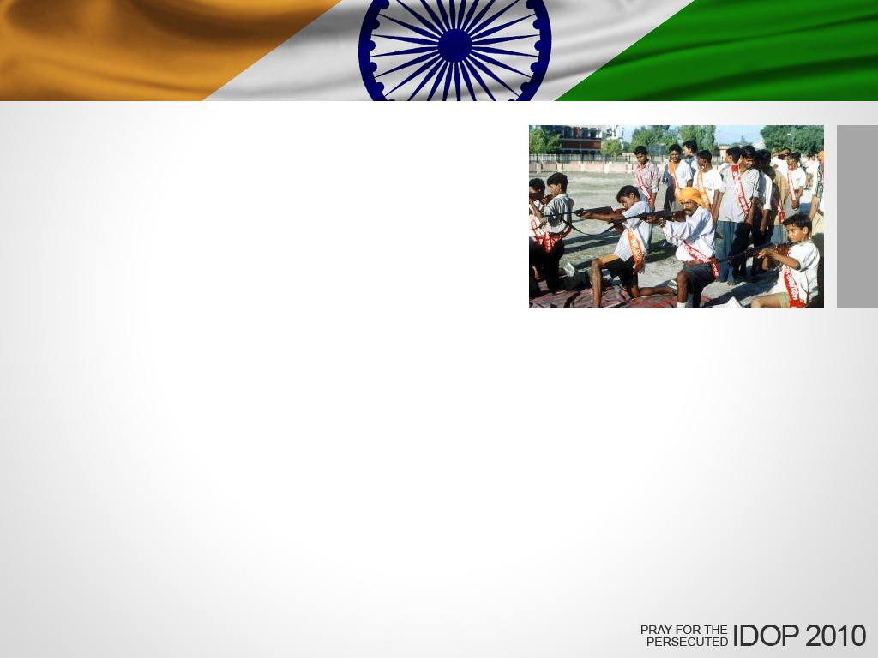
india
Hindu extremists attack evangelists and other Christians to prevent them from spreading the gospel.
PRAY that God will protect and empower our Indian brothers and sisters as they face persecution.

Slide 16
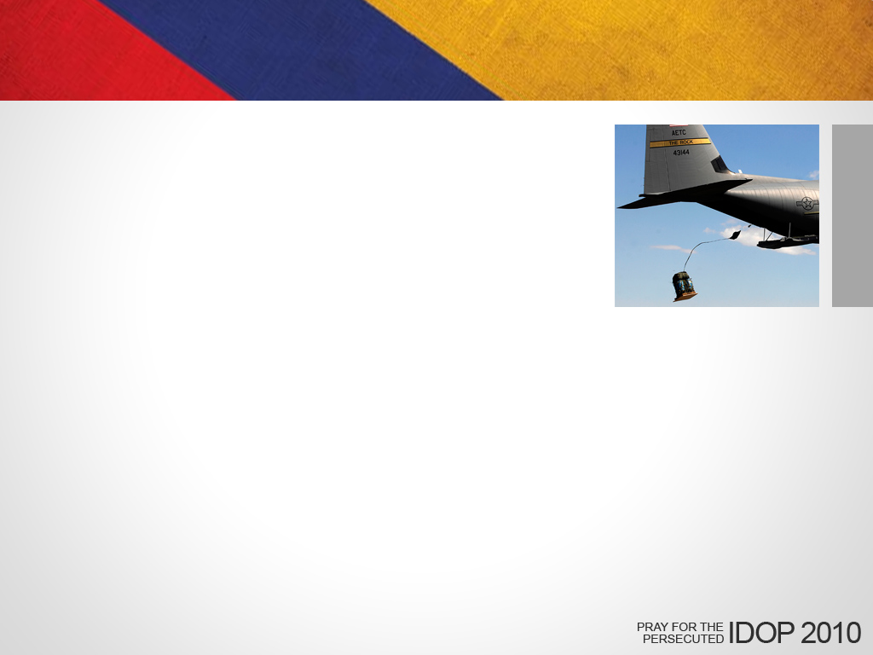
colombia
VOM helps Christians in Colombia drop Christian materials out of airplanes into FARC guerrilla controlled areas.
PRAY members of the FARC movement will come to know Jesus Christ personally.

Slide 17

egypt
Oyor Moses shares the gospel with Egyptian students. He receives persecution because he is black from Sudan.
PRAY for him to remain faithful and to share the good news of Jesus even if he is being humiliated.

Slide 18
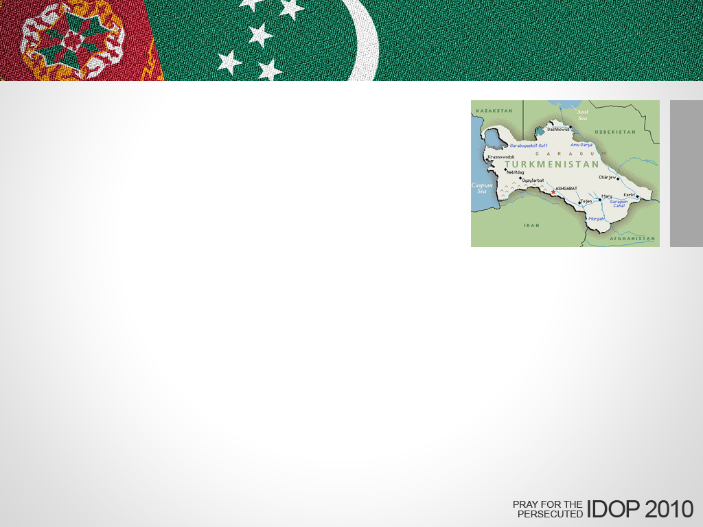
turkmenistan
Pastor Ilmurad Nurliev was sentenced to four years in prison on October 21 and will be sent to a labor camp.
PRAY that God will grant Pastor Nurliev the strength to endure his imprisonment and that the truth surrounding his conviction will come to light.

Slide 19
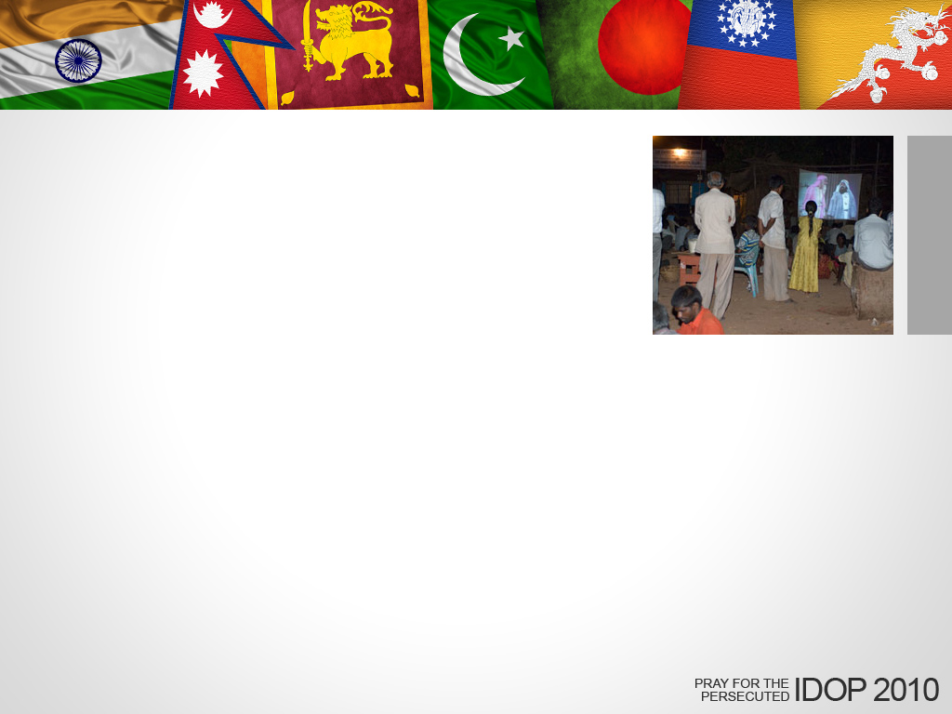
south asia
On October 2, four extremists attacked to missionaries as they showed a movie about Jesus to a group of villagers. When the police arrived, they arrested one missionary instead of the attackers.
PRAY that the missionary will recover and be strengthened to continue in the good works that the Lord has prepared for him.

