Slide 1
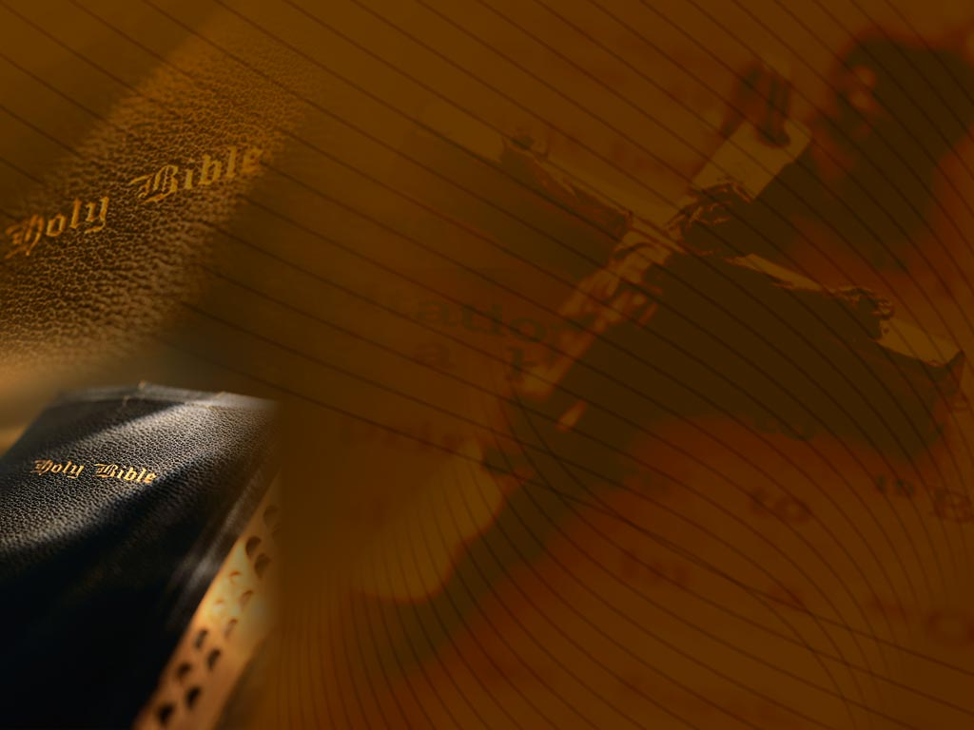
Book Review: Tortured for Christ
Pastor Richard Wurmbrand

Slide 2
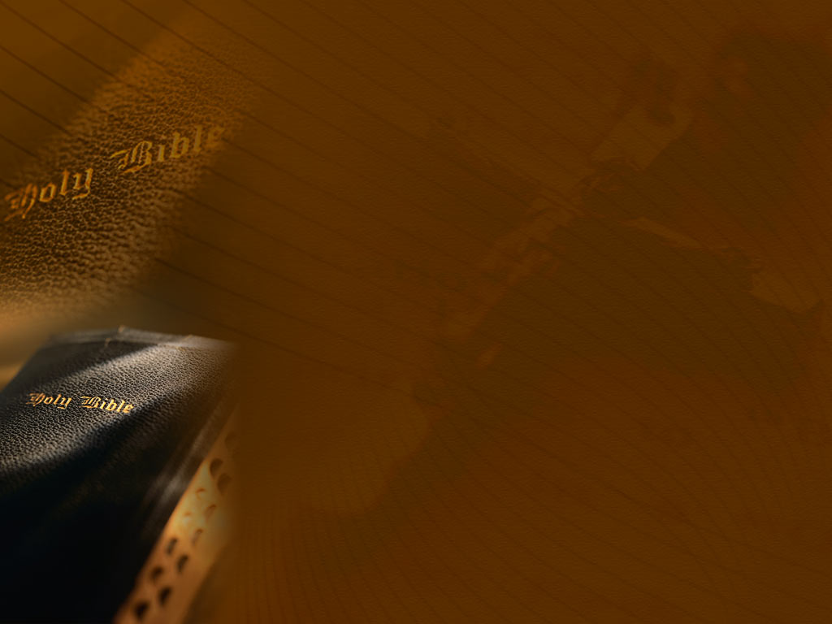
About the Author
Evangelical Minister
Endured 14 years of Communist imprisonment and torture
Arrested in 1948 in hometown Romania
Spent 3 years in solitary confinement, his wife was force into slave labor
Founder of the Christian Mission – The Voice of the Martyrs

Slide 3
Purpose of the Book
To bring to light the human tragedy of the persecuted church under Communism, and the power of God through faith in suffering for His name.

Slide 4
Message of the Book
Everyone is hungering for God and the gospel
Satan is desperately at work
Love
Love your enemies
In Christ, there is absolutely nothing that cannot be overcome
Pray for the persecuted church
Help the persecuted church

Slide 5
4 Main Points
The Thirst for Christ in Russia
The Suffering for Christ under Communism
The Power of Christ through the Underground Church
A Plea for Help

Slide 6
The Thirst for Christ in Russia
Pastor Wurmbrand’s peculiar attraction to the church
  An atheist who challenged God
  Conversion through conviction
The Seduction of the Church
  Bishops, Pastors: “Communism and church can coexist!”
  His wife’s protest: “I don’t wish to have a coward as a husband.”
  A forbidden underground church formed
Notes:
Conviction that he was a sinner and had done horrible things towards God
Protest: stand up to the heresies by the official church

Slide 7
The Thirst for Christ in Russia
Deprived of the true gospel, a deeper thirst develops
Ministry to Russian Soldiers
  A Russian officer gets the gospel
  The Word is served for dinner
  Every soul won for Christ must be made to be a soul-winner(p27)
Ministry to the enslaved
  Prisoner thankful to meet Jesus
  Random street preaching
Notes:
-Russian officer was joyful when he first learned about Christ. Then really sad when he heard about his death. Then was joyful again when he heard about his resurrection.
-Officers stopped eating after prayer to ask about Christ
-Piotr – converted when he learned Jesus was so polite on the road to Emmaus. Jesus respects freedom, and so Jesus has won me. Piotr eventually smuggled Christian literature and was imprisoned.
-When asked if he had regrets for Wurmbrand converting him, thus getting him thrown into jail, the prisoner said he had no regrets “No, you brought me to my Savior – I would have it no other way”
-Street preaching, sang hymns in the streets, preached and disappeared before the police could come. One factory was preached to. The next day the factory workers were gunned down for unrelated reasons, but thank God that they got to hear the gospel before they died.

Slide 8
The Suffering for Christ Under Communism
On Feb 29, 1948, Pastor Wurmbrand was kidnapped on his way to church by secret police
Unspeakable tortures for P. Florescu
  Red hot iron pokers
  Knives
  Hungry rats for 2 weeks
  “Father, don’t do me the injustice of having a traitor as a parent. Withstand! If they kill me, I will die with the words, ‘Jesus and my fatherland.’”
Notes:
- Pastor Florescu had a son, Alexander. He was 14. When he was beaten, his father said, Alex, I want to say what they want so they will stop whipping you. To that Alex replied with the quote above. He was beaten to death in front of his father. But such a faith was instilled in such a young boy. The faith of the family has major impacts.

Slide 9
The Suffering for Christ under Communism
Handcuffs with sharp nails
Christians hung upside down on ropes and beaten
Ice box refrigerator cells
“Not against flesh and blood.”
  Atheism strips men of morality
Brainwashing: “Communism is good!” “Christianity is stupid!” “Give up!”
The Love of Jesus enables one to resist
Notes:
-Communists thinking: everything is just matter, eggs, wood – you have to break them to be useful. This led to moral emptiness.
-Torturers: “I can be evil to my hearts content!” “I am the devil!”
-When one loves Jesus, he cannot be broken, he cannot be brainwashed – he won’t deny him.

Slide 10
The Suffering for Christ under Communism
“We Preached They Beat”
  Anyone caught preaching to prisoners received a severe beating.
  A number of preachers accepted the terms – we preached, they beat, everyone was happy.
Reck, Grecu and the divine nature.
Lesson learned: The spirit is the master of the body
“You must know one thing before I die…”
Notes:
Reck and Grecu:
-Reck, a comm. Soldier: “I am your God – I have the power of life and death over you.”
-Grecu: You were meant for better. You were not meant to kill, you were not meant to torture. Like how a caterpillar was meant to become a butterfly, you were meant for much, much better. You were meant to be God like. You were meant to partake in God’s divine nature. Not this, not a torturer.
Husband to Wife:
-Husband to wife: I want you to know one thing – I die loving those who torture me. They don’t know what they are doing. My last request is that you love them too. Don’t be bitter. I will see you in heaven!
-after his executioners heard this plea to his wife, they later became saved and jailed for their conversion.

Slide 11
Pastor Wurmbrand’s wife and son
Only after many years did he learn that Sabina had been put in prison too.
  Had to eat grass to stay alive
  Thrown into the Danube several times
Mihai, his son, was converted as he wept seeing his mother dragged away.
  If Christ can be loved under these circumstances, he is a savior.
  I believe, because my mother believes.
  He publicly rebuked a professor in school for leading people astray.
Notes:
-The power of a mother’s faith. Truly, a holy household (house church) can raise up godly children.

Slide 12
The Power of Christ through the Underground Church
  God loves all people
  We are partakers of the divine nature, we fight Comm. on a human and spiritual level
  Even those tortured by Communist pray for them in the midst of torture.
Joy in Prison
  Luke 10:23. They saw the Savior. They understood the true life.
  They saw a “Paul” in every “Saul”
  2 Cor 4:17. Light afflictions.
Notes:
-Jewish legend: after God drowned the Egyptians in the Red Sea, the angels celebrated, but God rebuked them. He said, “Of all beings, you should know better. I do not take joy in punishing the wicked.” This was meant to illustrate God’s unconditional love for all of his creation – so even though communists mistreat Christians, they too are to be loved regardless.
-The battle against communism must also be fought with love.

Slide 13
The Power of Christ through the Underground Church
Simple Faith, simple apologetics
  How has nature given us such plentitude and variety?
  An embryo and the purpose of life
  Even newspapers testify to Jesus!
Turning the tables
  “Jesus the magician”
  The testimony of the chair
Fearless demonstrations
  Exhorted each other: 1 Thes 3:3
Notes:
-Simple apologetics:
-Tomatoes, milk, honey, eggs, these are such wonderful things. If nature is blind, then who provides these things? How can nature provide such an abundance of the things we love? Surely there is a loving force behind it.
-An embryo has arms and legs and eyes – but for what? Suppose it thought to itself. I have eyes, but I cannot see in here. Here my hands are folded across my chest, and my legs tight against my body. For what reason do I have these things? It must be for a life outside the womb. Out there I will use my eyes to see, my hands to work, my legs to walk. In the same way, our trials, our sufferings, things we cannot explain that happen to us, are meant to equip us for the life to come. We will use these the things we learn on earth in heaven.
-Look at your newspapers, what is the date? 1946. That is 1946 years after our Lord’s birth – even your newspapers testify to him!
-Someone tried to prove Jesus was a magician by coloring water with powder. Then he colored it clear with another powder, and back to purple again with a powder. When asked to drink it, he said he couldn’t, it was poison. So someone replied, that’s the difference between you and Jesus. You give us poison by your miracles, and Jesus gives us joy.
-A teacher said that all life is just chemicals and matter, so a student threw a chair against the floor. Then he went to slap the teacher. The teacher said, why did you do that? The student replied, the chair did not complain when it was thrown to the floor, because it is just matter. Then, why do you object when I treat you the same way? If everything was just chemicals and matter, why did you hurt?
-The demonstrations were held at the Communist headquarters in Russia – about 500 brethren stood together, amidst rain, until the communist party came in a bus and beat the demonstrators, yet they exhorted each other with 1 Thes 3:3: “That no man should be moved by these afflictions: for yourselves know that we are appointed thereunto.” We were appointed to suffer for Christ, they cannot disturb or harm us.

Slide 14
A Plea for Help
Hypocritical Church Leaders Criticized
  “Official church leaders praised at International conferences, while martyrs they had betrayed were suffering.”
  There is much unconcern in the West for the suffering brethren.
  The West is dying from humanism (p77).
Notes:
Humanism: riches, wealth, abortions, freedoms – these were the signs of the downfall of Rome and Greece, we are heading the same way.

Slide 15
A Plea for Help
Pastor Wurmbrand was sent here to be the “Voice of the Underground Church.”
How you can help:
  Leading a life of fellowship with the invisible God
  Lead a life of sacrifice
  Pray for the salvation of the persecutors
  Bibles urgently needed: send Bibles
  Financial help and support is needed
  “Don’t abandon us!”

Slide 16
Personal Impressions/Conclusion
Moved by the beauty and courage of those who have been faithful to Christ. Saw the impact of faith on families.
Moved by the love the persecuted had even for their persecutors! And realized how petty I can be in my pride.
Communism isn’t the only enemy, it’s all manner of humanism, atheism and Godlessness that strips humanity from us all. People are hungering for God!!
Pray for the persecuted church, do not forget or abandon them.

