Slide 1

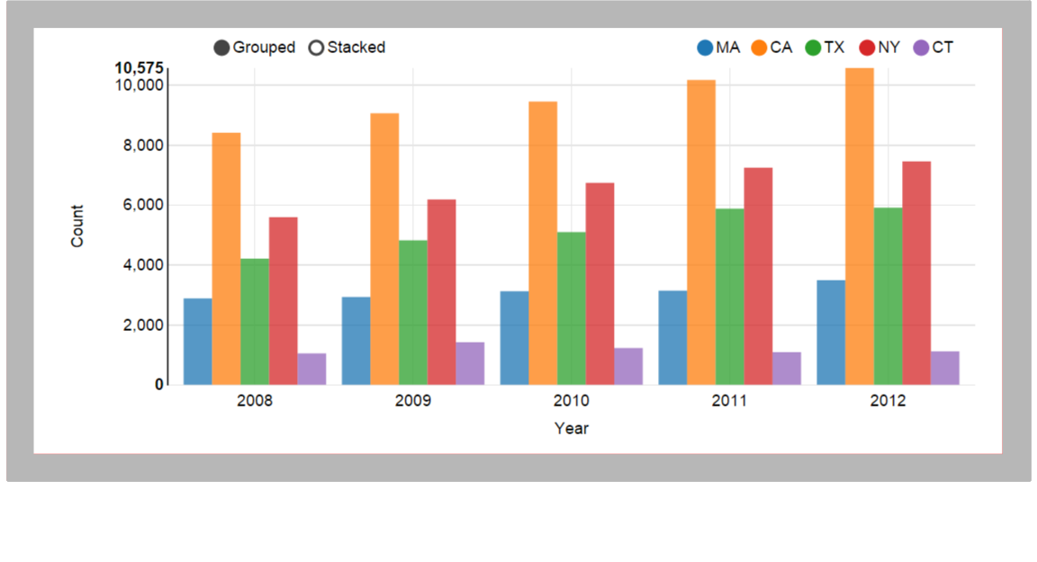
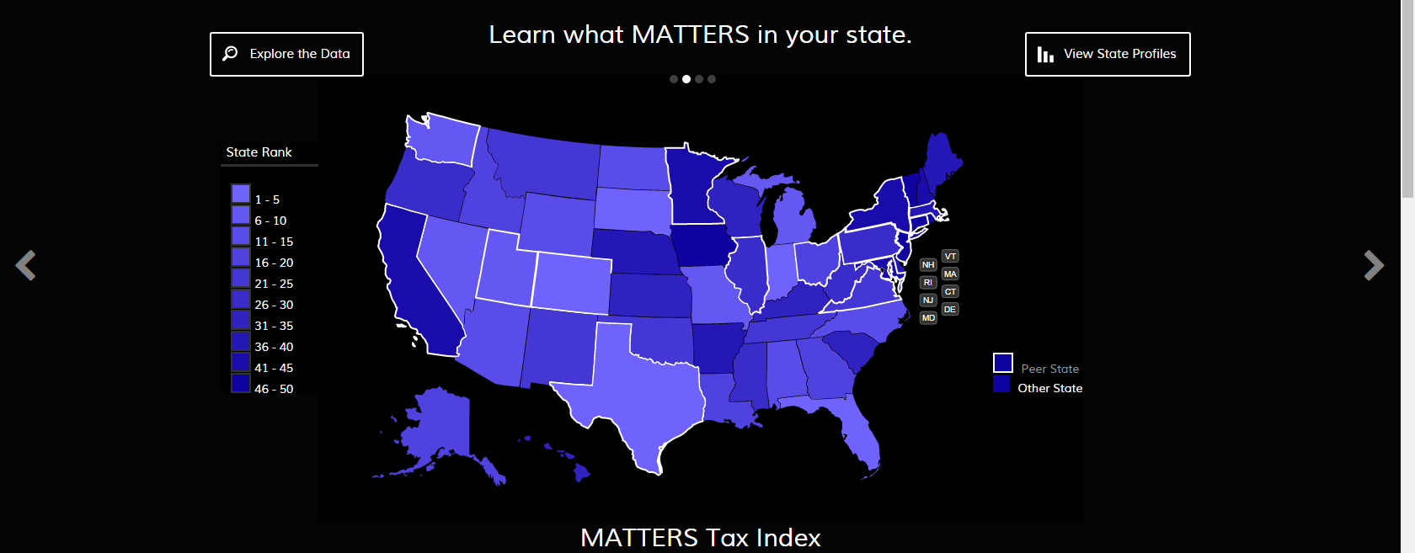
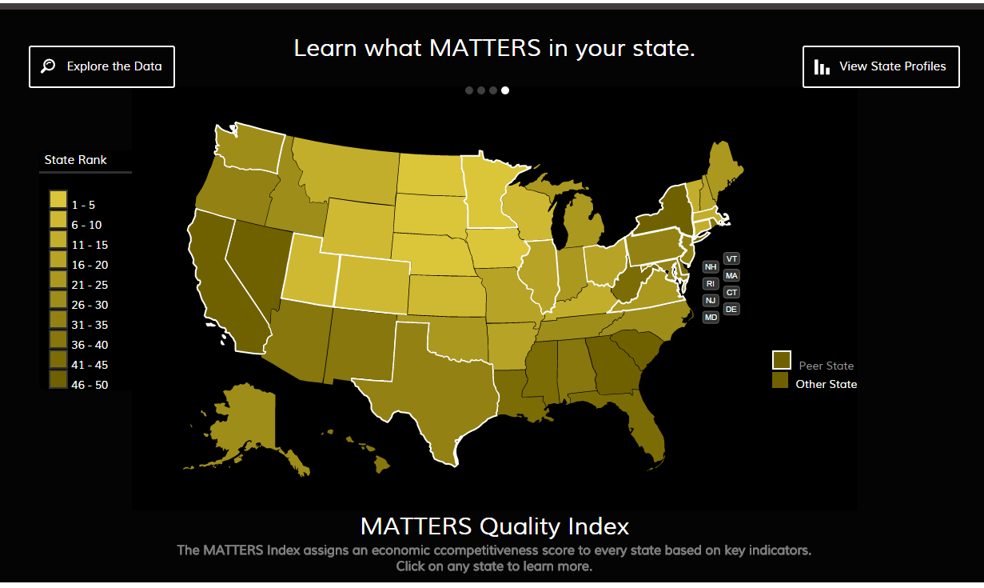
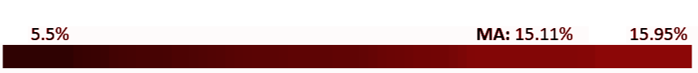
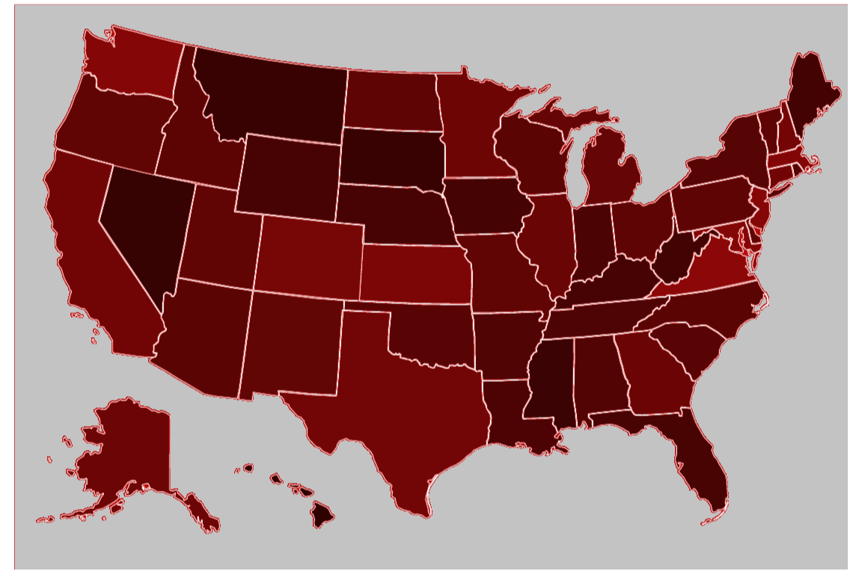

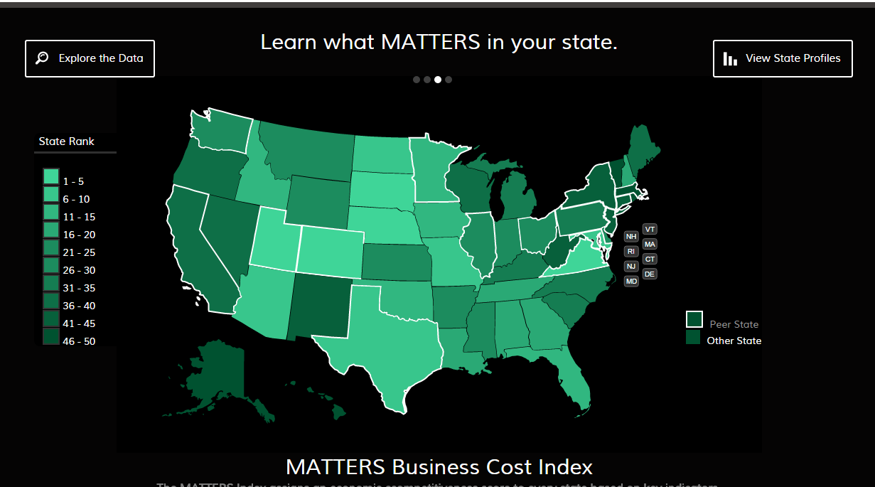
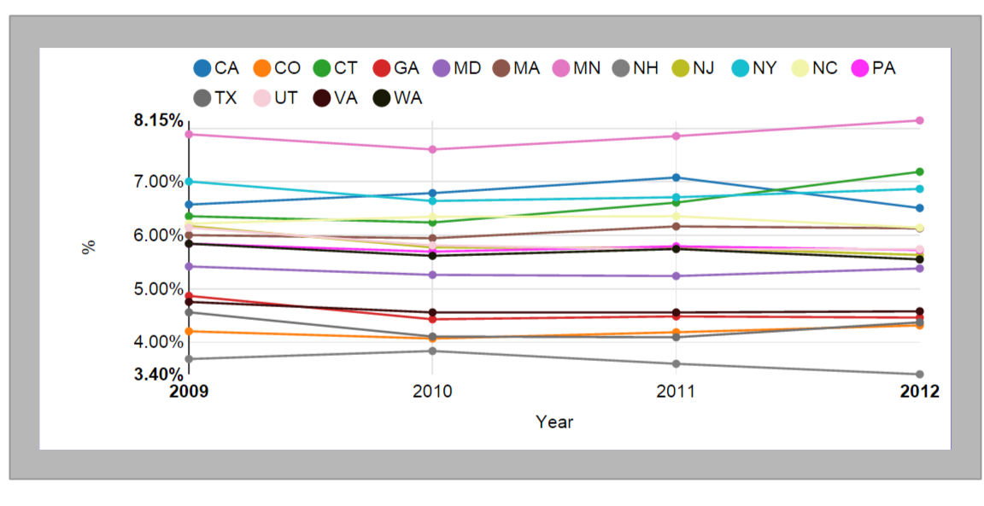
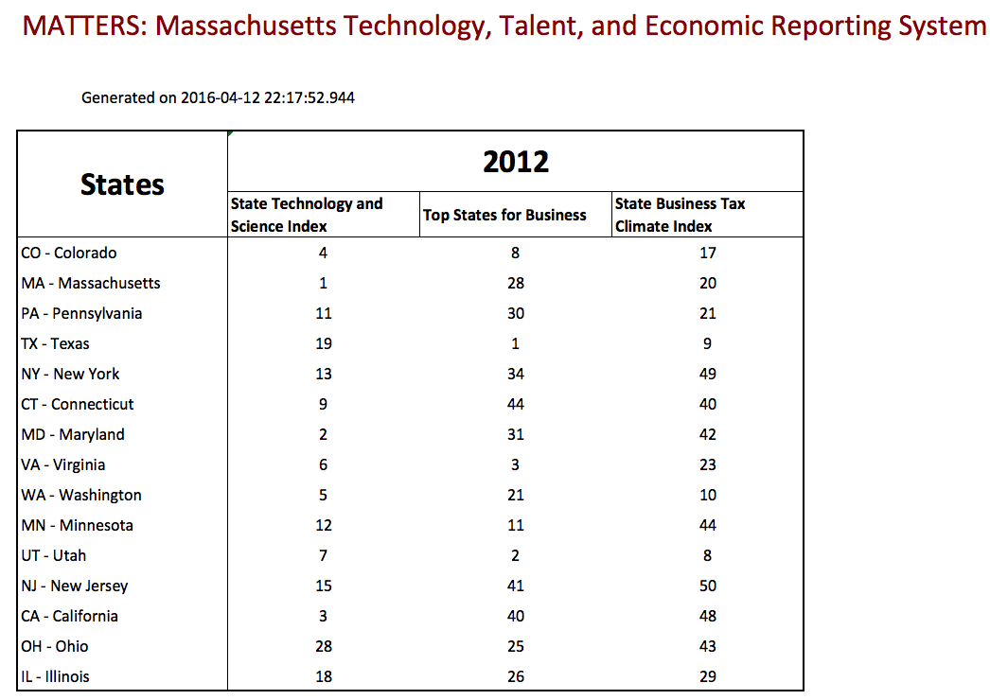
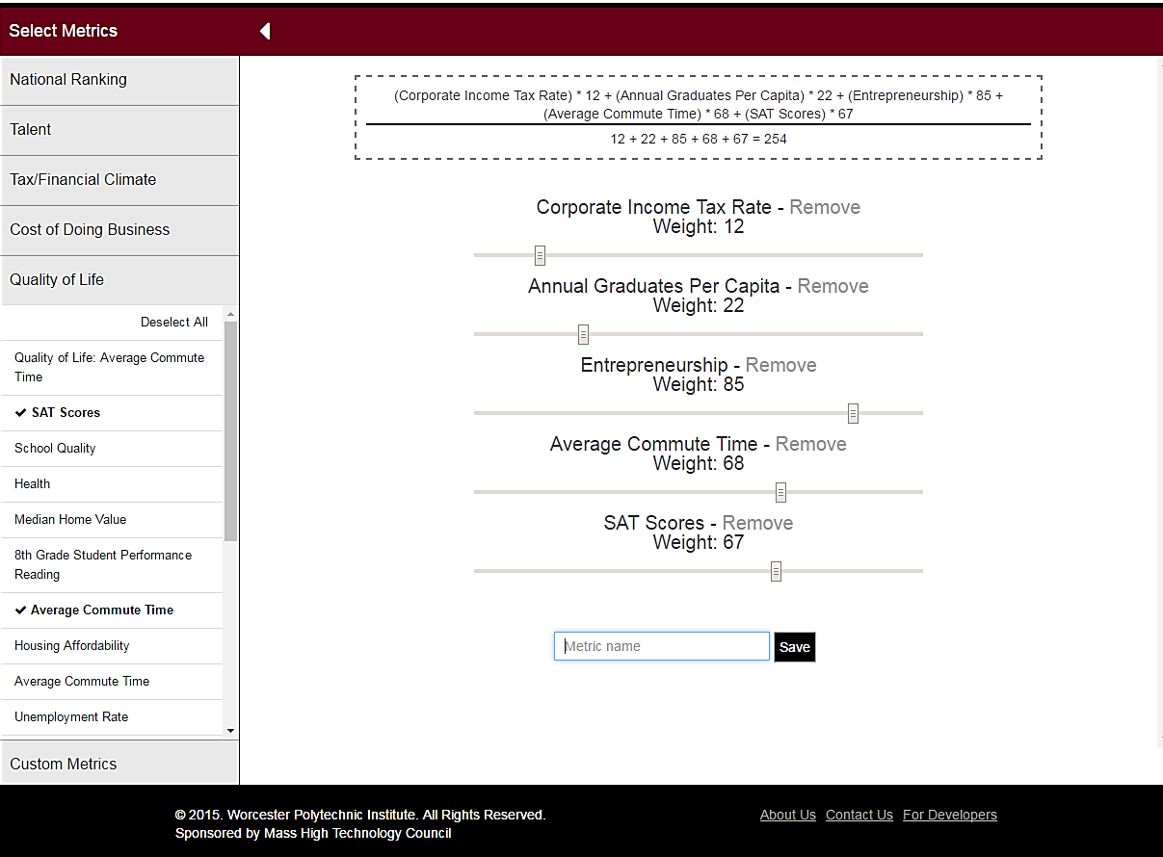
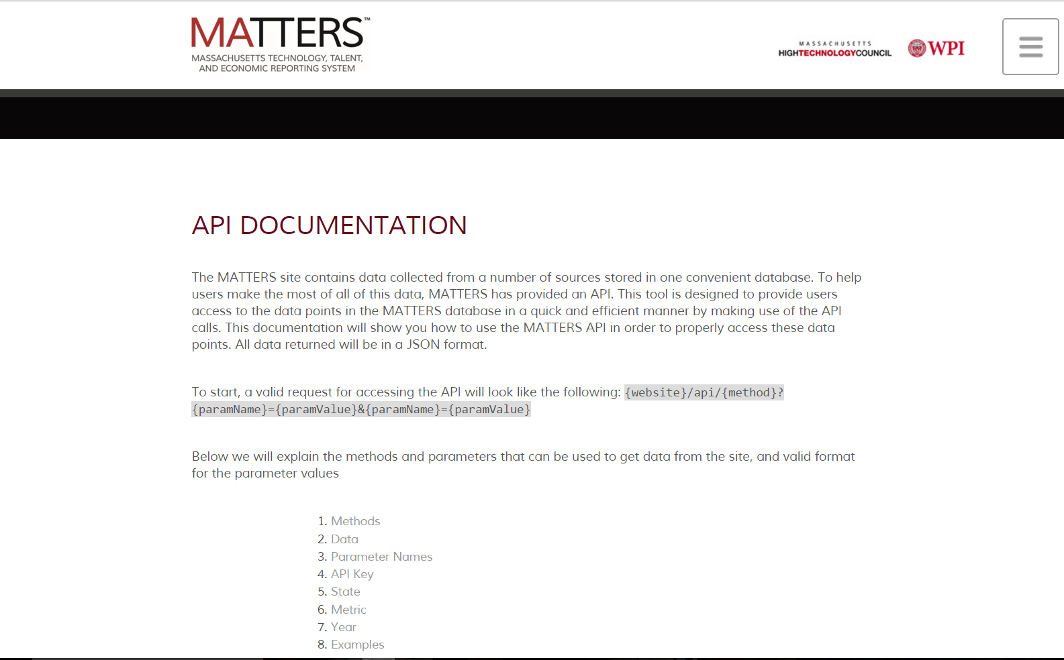
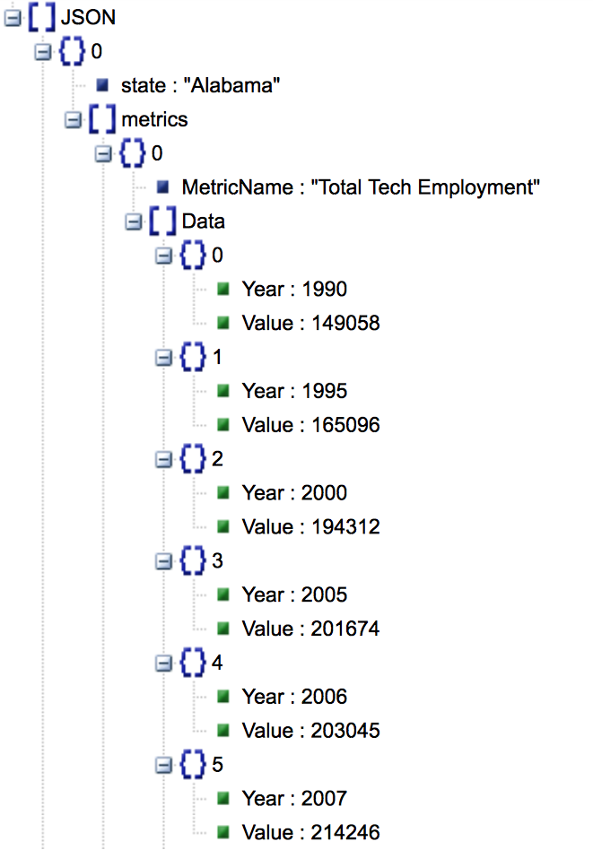
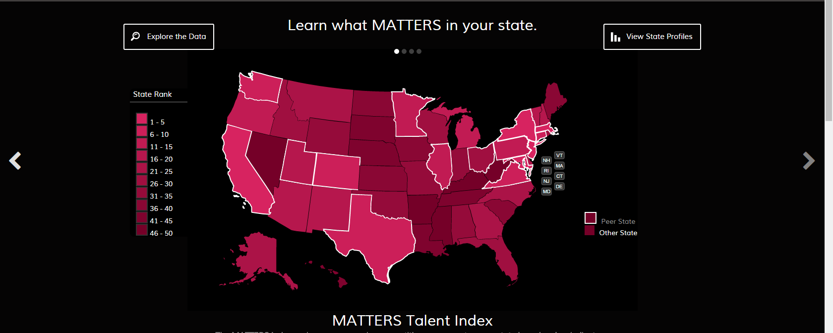
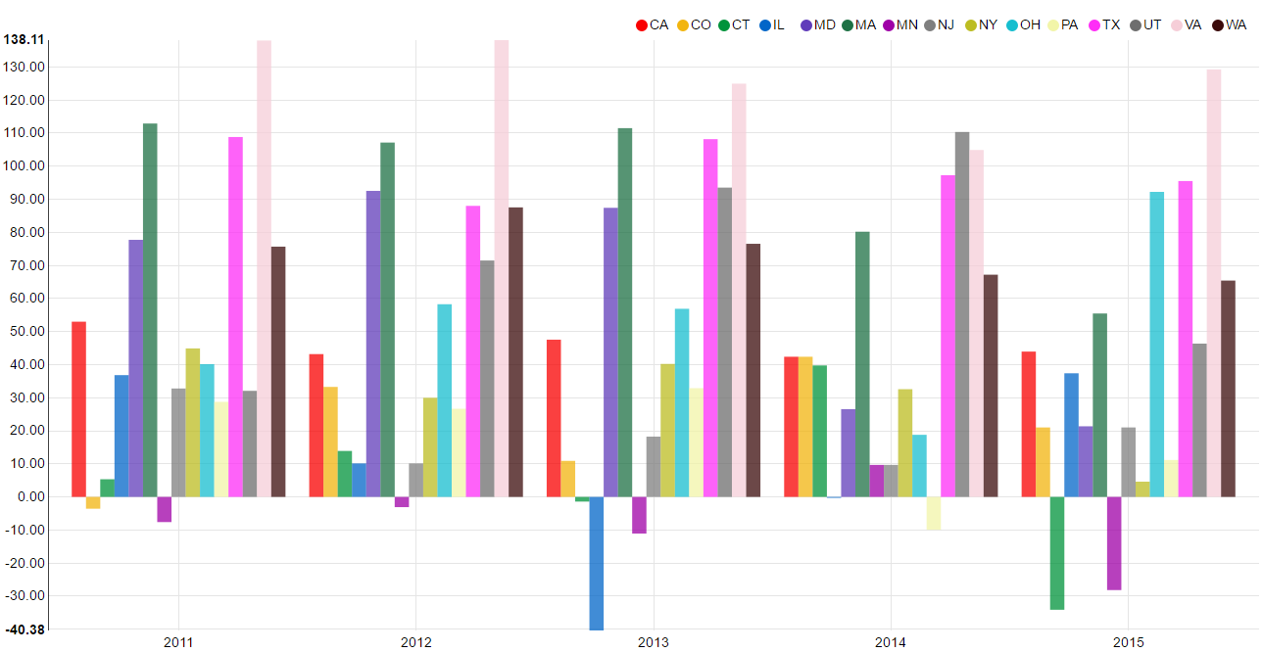
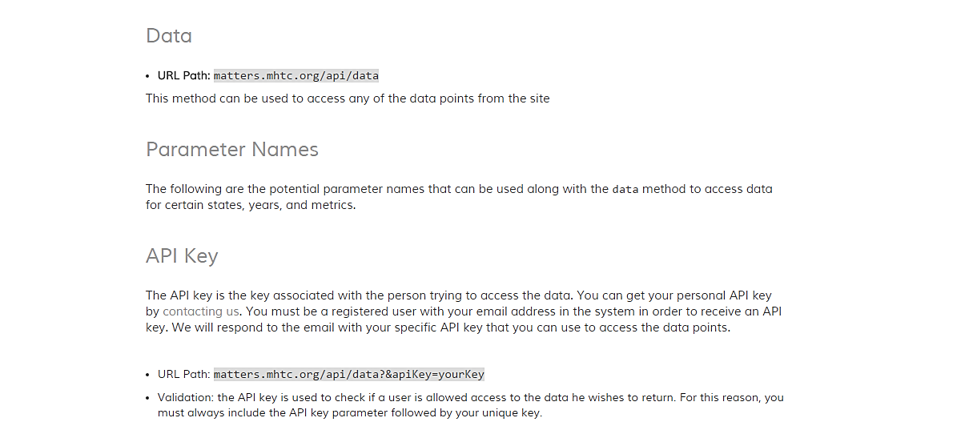









Data MATTERS: Customizing Economic Indices to Measure State Competitiveness Dmytro Bogatov and Jillian Hennessy Advisor: Professor Elke Rundensteiner Department of Computer Science
MOTIVATION
DATA EXPLORATION
PUBLIC FACING API
Number of Master’s Degrees awarded in STEM fields across selected states
Data that impacts Massachusetts’ economic health
Incorporate data from across many diverse online sources into one platform for extraction, exploration, visualization and analytics.
Provide access to high fidelity cost, talent and economic metrics, as well as independent national rankings and be able to use these metrics as a part of their own economic indicators.
Help business leaders and policy makers evaluate
the competitive position of Massachusetts among
top technology states in the nation.
APIs are tools that allow other programs to interact with the software program that the API belongs to without having to give someone complete access to your code base. In a sense they expose some of the internal workings of software to the public but in a way that is limited by what the API chooses to provide.
The MATTERS API allows specific users who are kept track of through their specific API key, to access the data that MATTERS holds in it’s data warehouse
Percentage of High Tech in Total Employment
across the United States
MATTERS’ custom talent index displayed on home page
METRIC BUILDER
Outputting extracted data
API DOCUMENTATION
Create custom metrics using pre-existing metrics
Assign weights to metrics
Edit or delete your metric
Save your metric
Access your custom metric on the data explorer page
EVALUATION
Visualizing custom made metrics in the Data Explorer
ACKNOWLEDGEMENTS
Metric Builder and API Documentation User Studies
14 WPI students took part in a user study to test both the Metric Builder and API Documentation
Students rated the ease of use of both features through a survey and provided additional feedback
As a result of the user feedback, the API Documentation link was put in an easier to locate place at the footer, and the way to edit a custom metric was made more clear
Overall our features were found to be highly intuitive
The Massachusetts High Technology Council for making this project possible and working with Worcester Polytechnic Institute to create and grow MATTERS
Professor Elke Rundensteiner from WPI for her assistance and guidance throughout the entire project
Caitlin Kuhlman from WPI for her help throughout the project and providing guidance and feedback on all aspects of the project
Online Sources
Database

