Slide 1

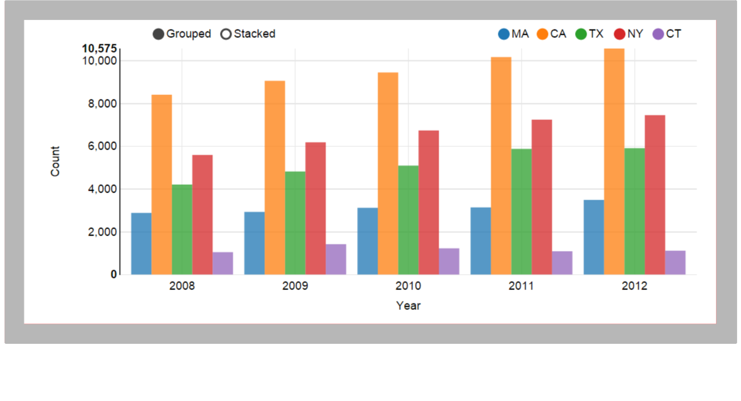
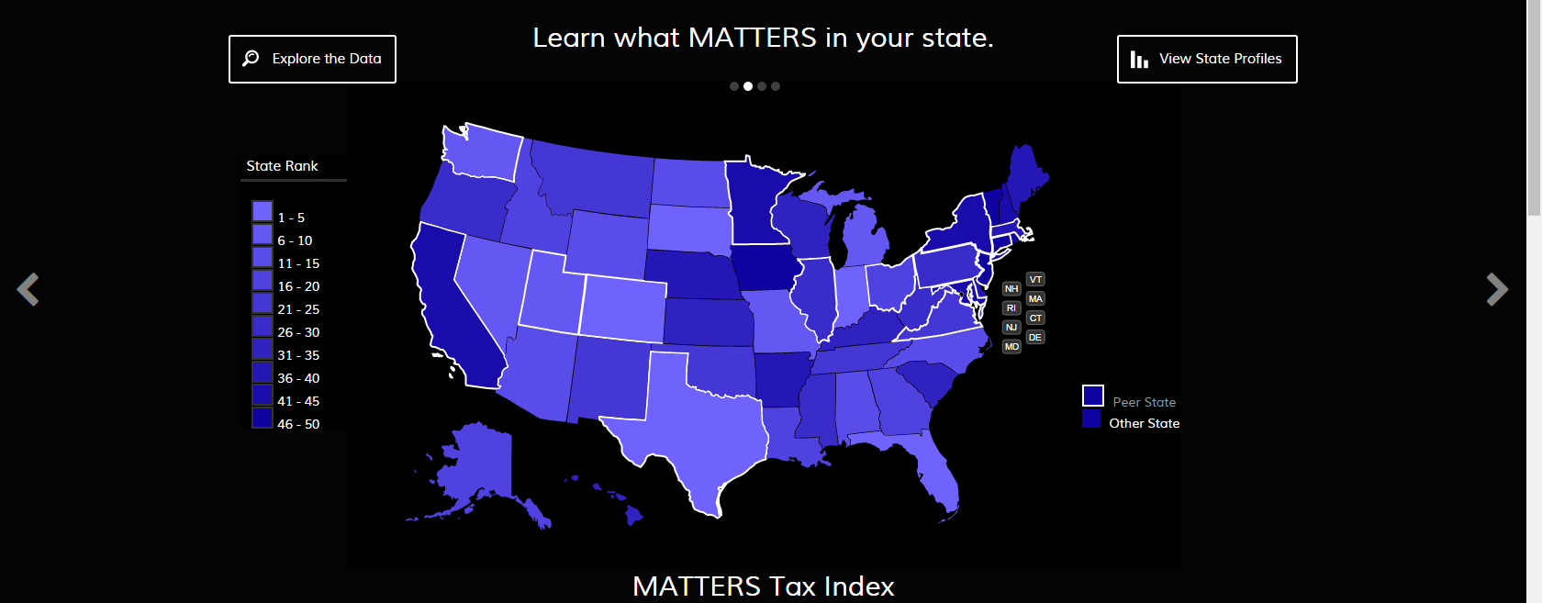
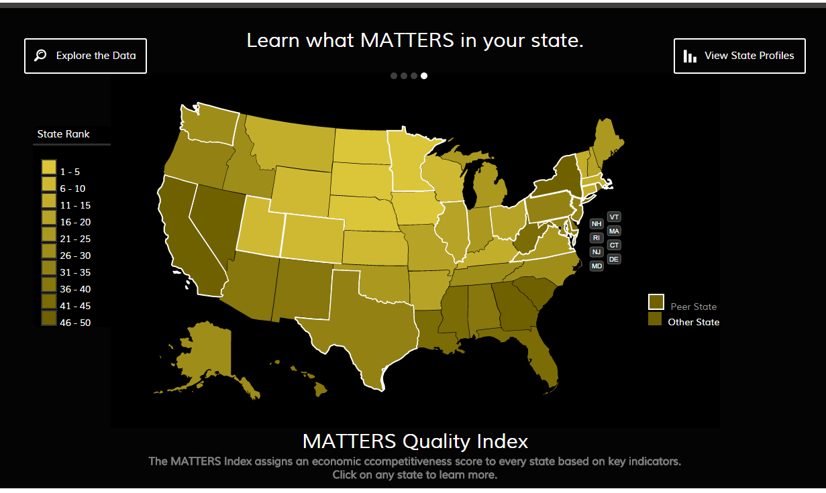
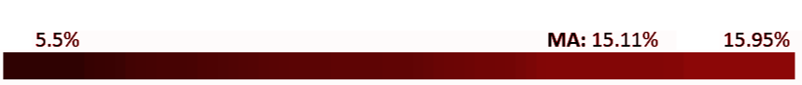
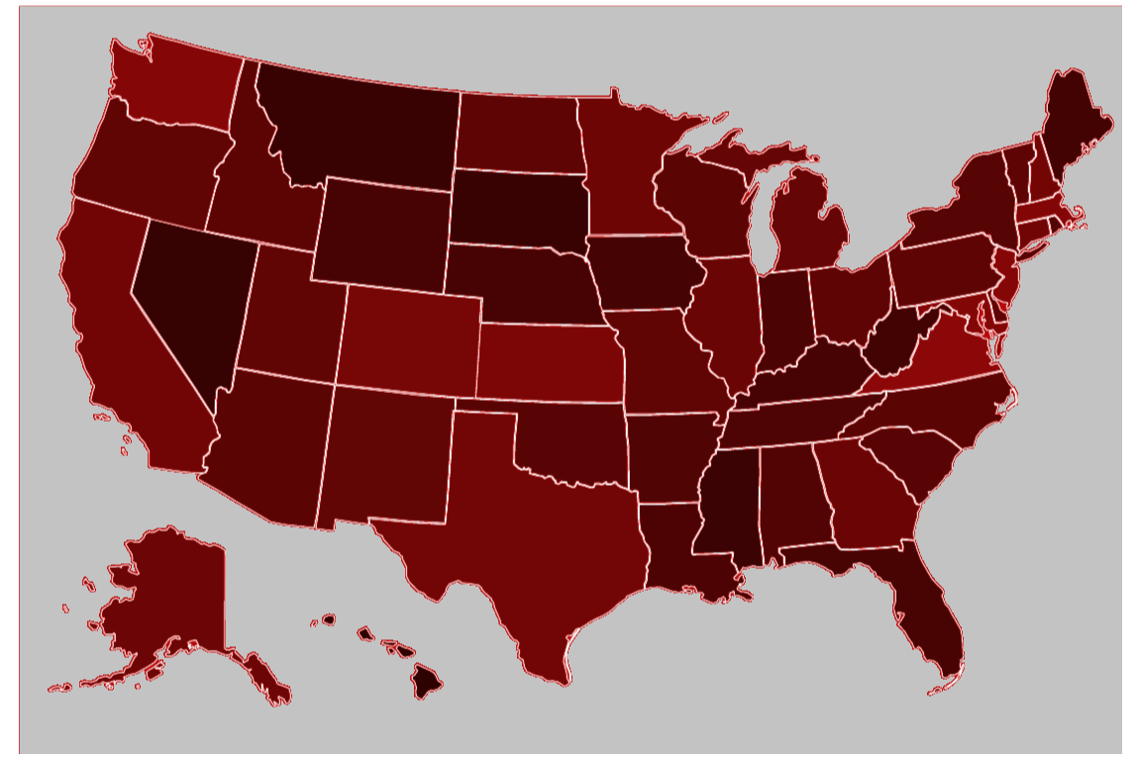

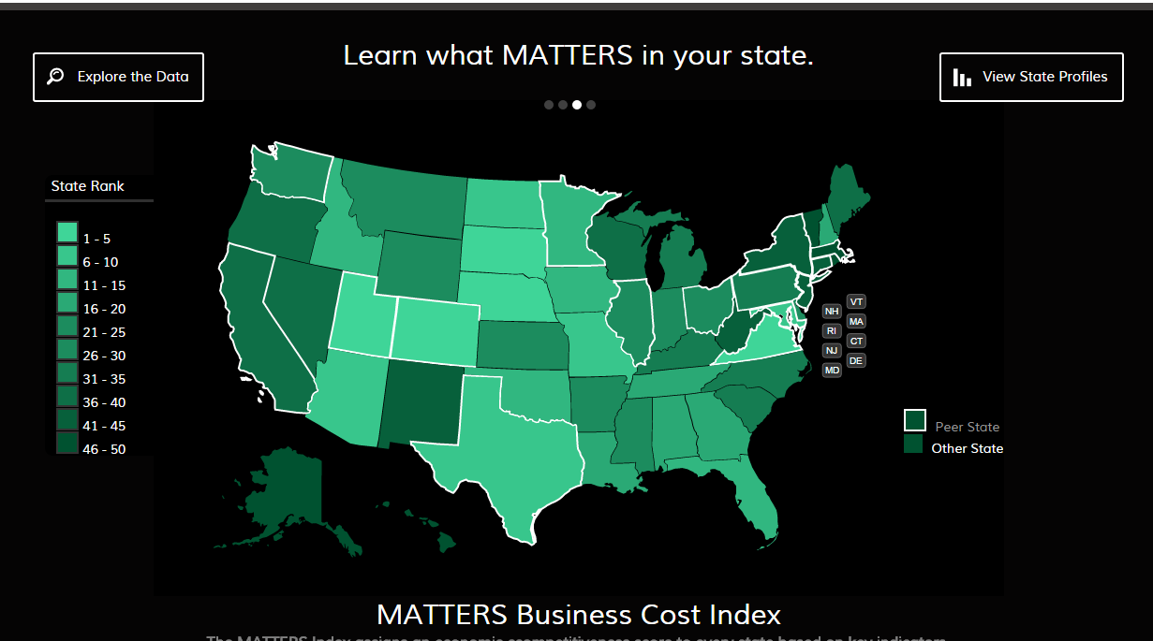
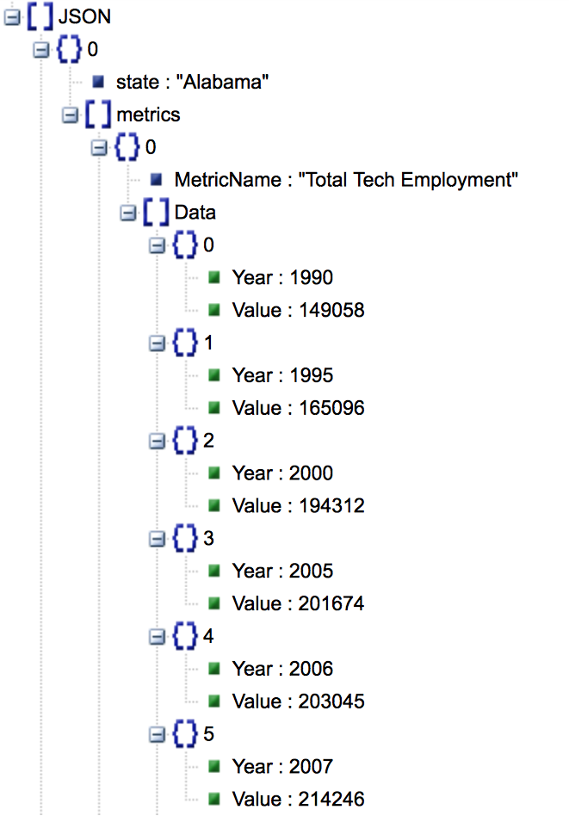
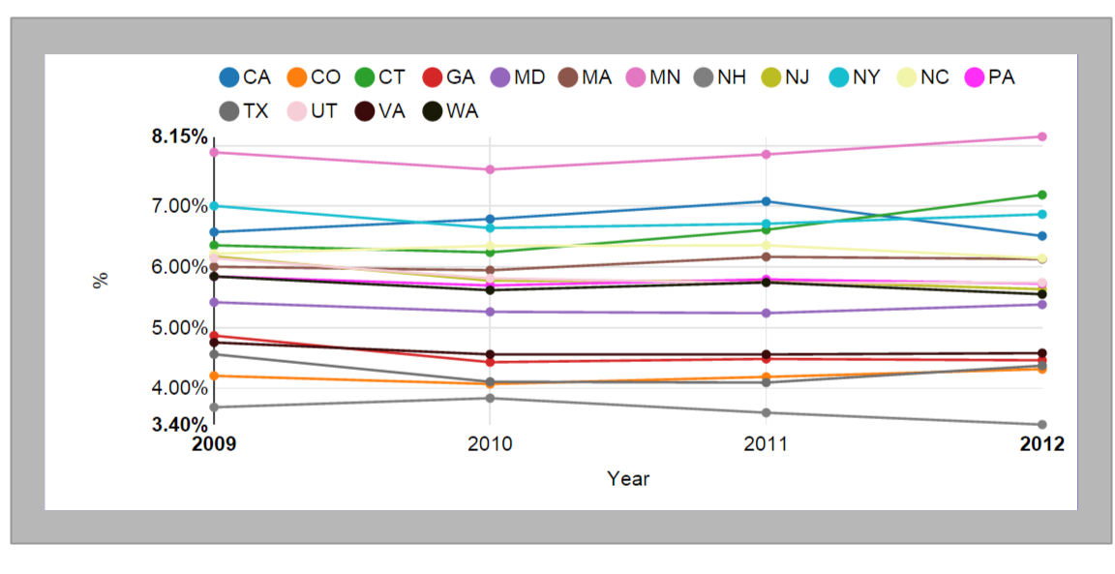
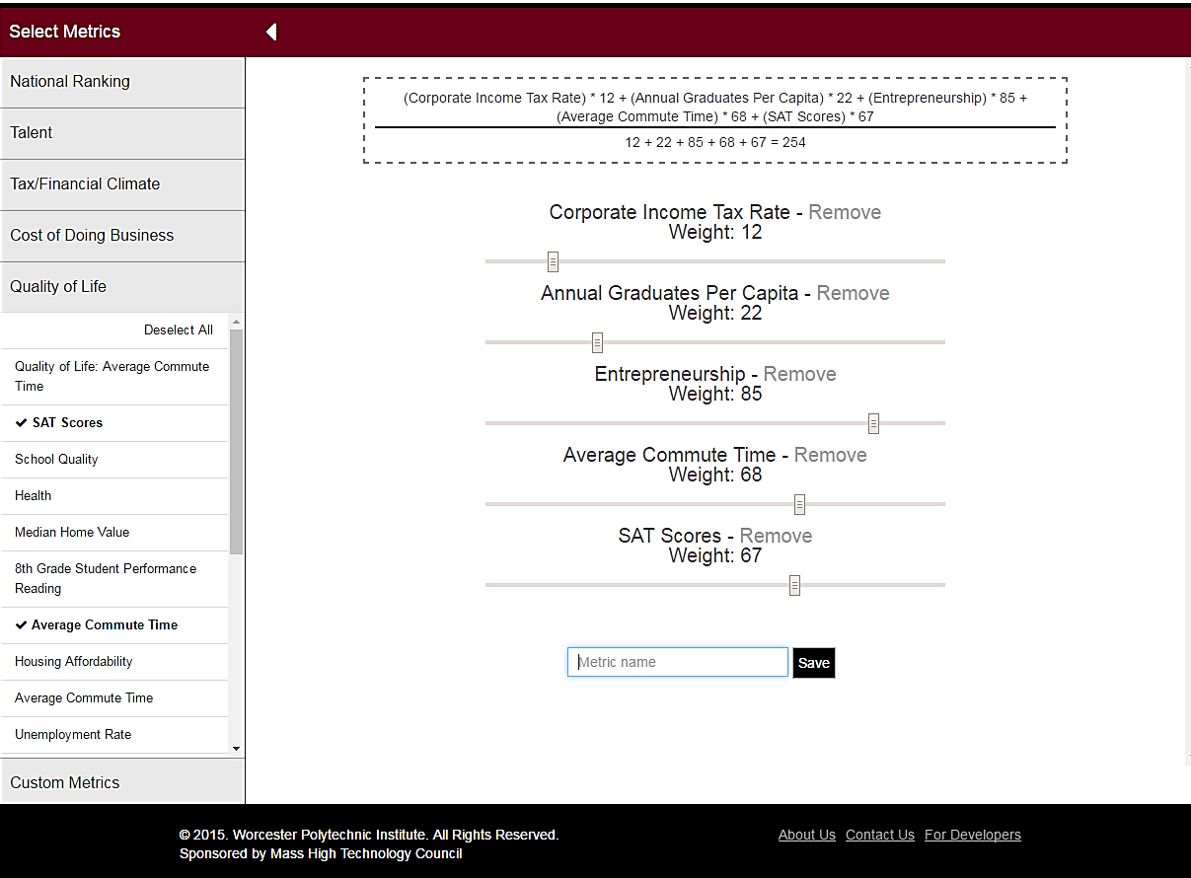
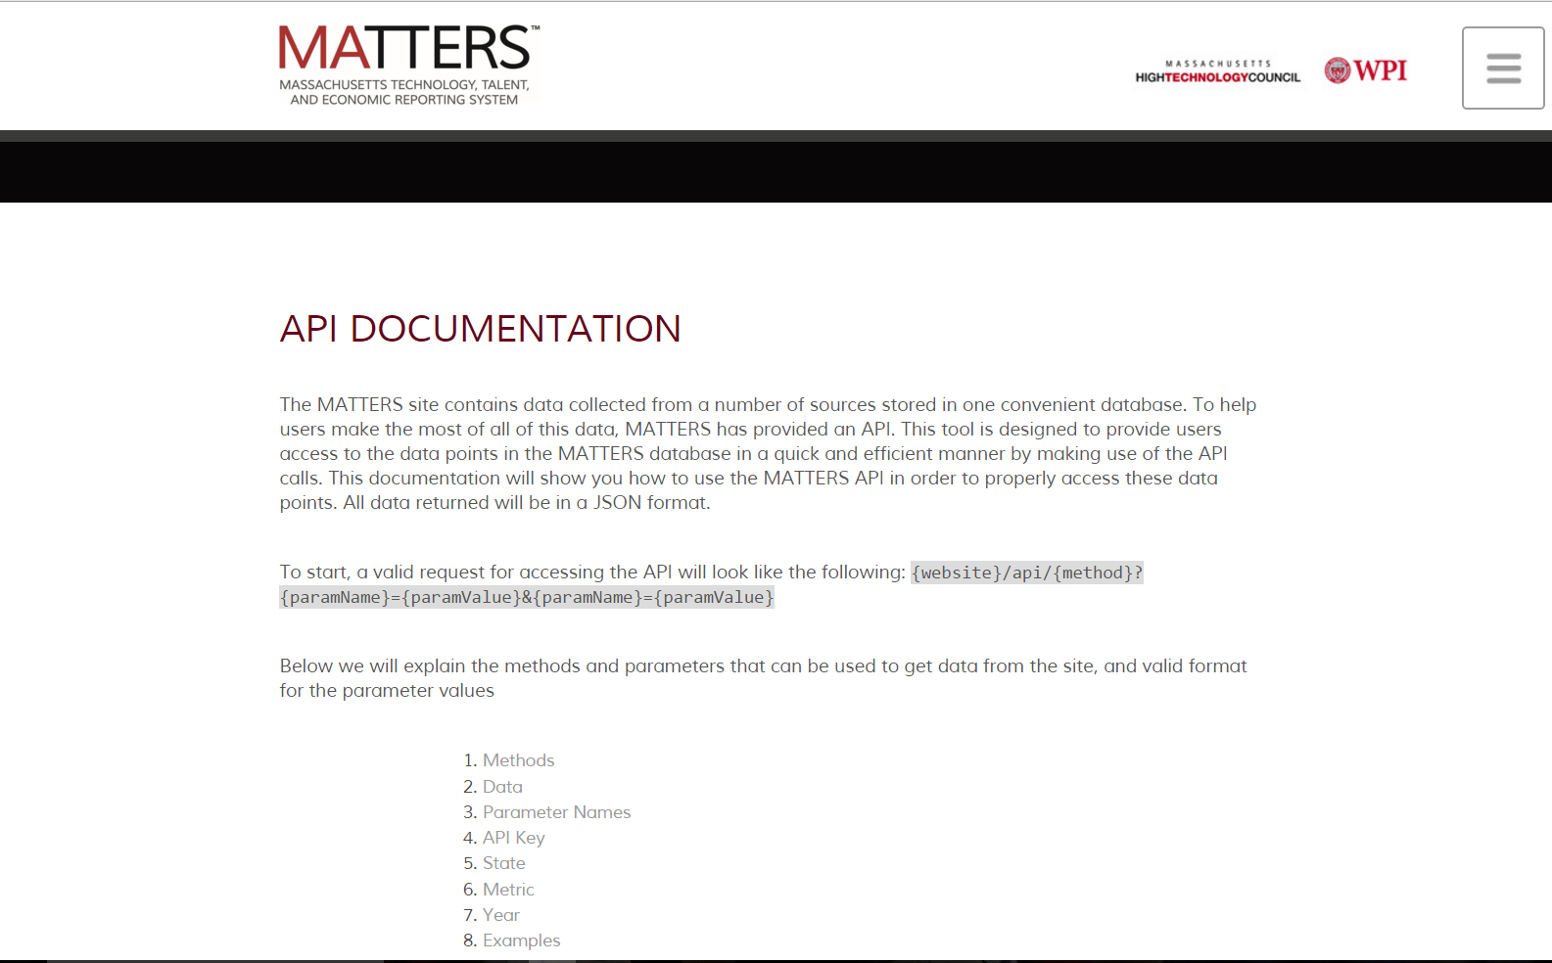
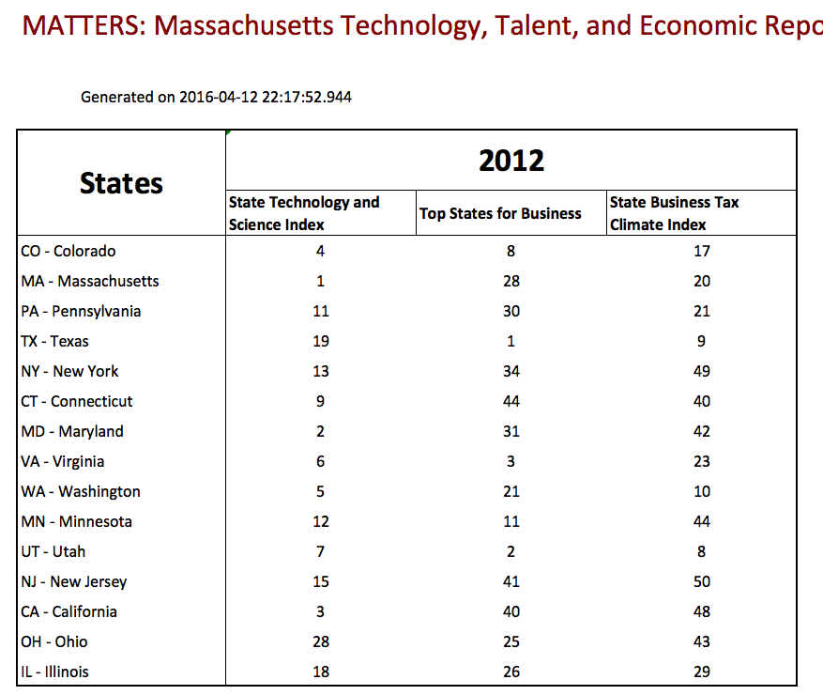
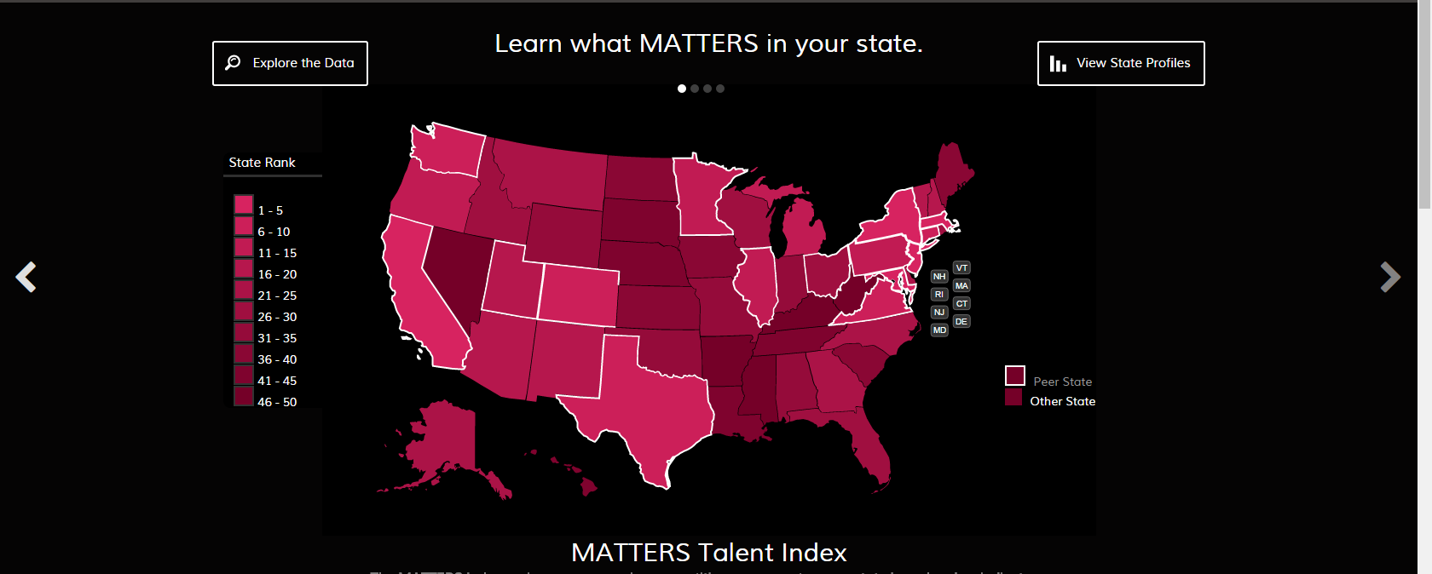
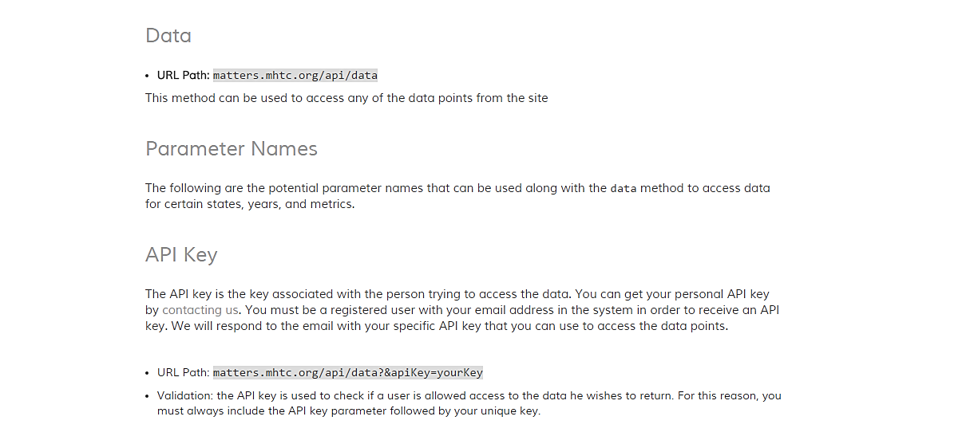









Data MATTERS: Customizing Economic Indices to Measure State Competitiveness Advisor: Professor Elke Rundensteiner Department of Computer Science
MOTIVATION
WEB-BASED DASHBOARD
DATA EXPLORATION
Number of Master’s Degrees awarded in STEM fields across selected states
Data that impacts Massachusetts’ economic health
Incorporate data from across many diverse online sources into one platform for exploration, visualization and analytics.
Provide access to high fidelity cost, talent and economic metrics, as well as independent national rankings.
Help business leaders and policy makers evaluate
the competitive position of Massachusetts among
top technology states in the nation.
Tools to find meaningful insights in data
APIs are tools that allow other programs to interact with the software program that the API belongs to without having to give someone complete access to your code base. In a sense they expose some of the internal workings of software to the public but in a way that is limited by what the API chooses to provide.
Percentage of High Tech in Total Employment
across the United States
METRIC BUILDER
PUBLIC FACING API
EVALUATION
ACKNOWLEDGEMENTS
The Massachusetts High Technology Council for making this project possible and working with Worcester Polytechnic Institute to create and grow MATTERS
Professor Elke Rundensteiner from WPI for her assistance and guidance throughout the entire project
Caitlin Kuhlman from WPI for her help throughout the project and providing guidance and feedback on all aspects of the project
Online Sources
Database

