Slide 1


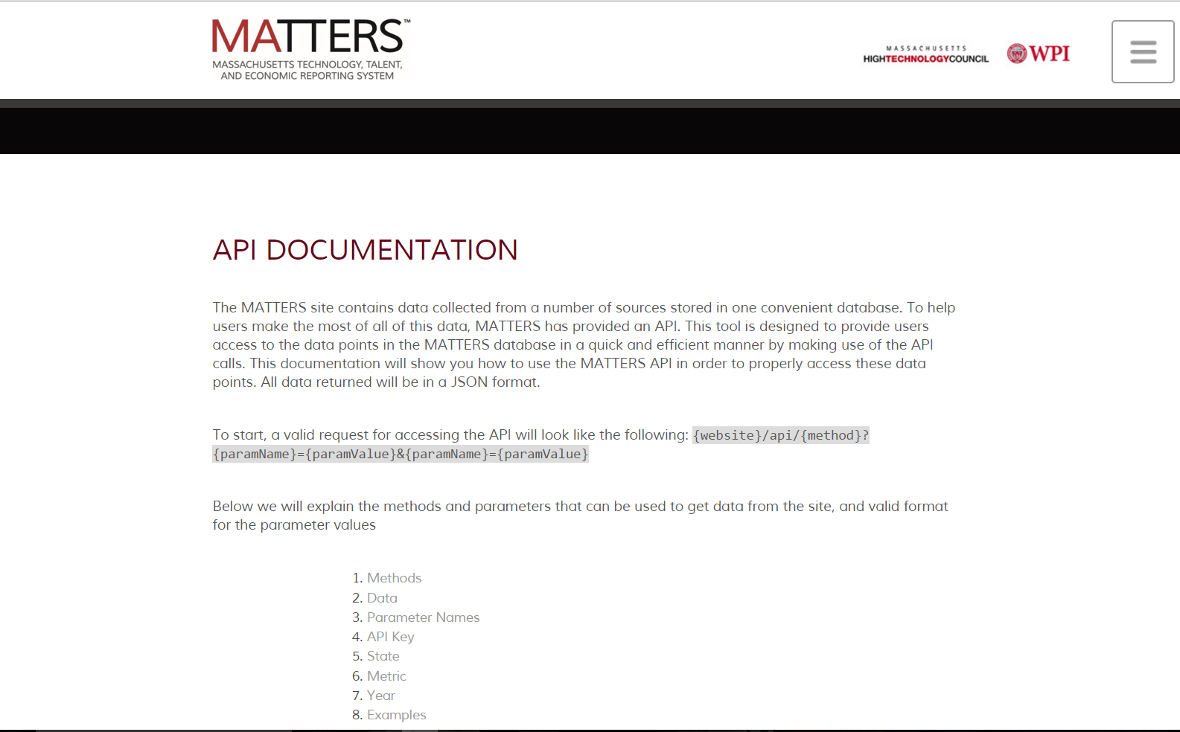
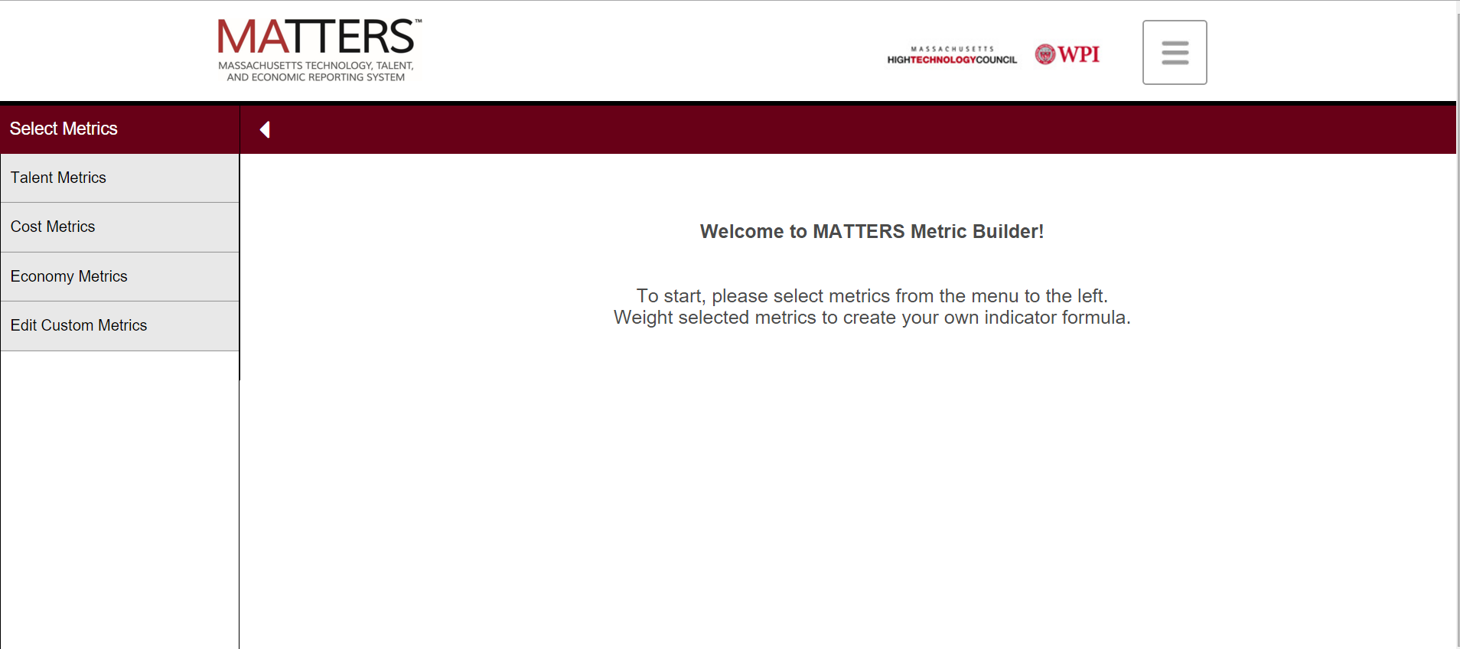
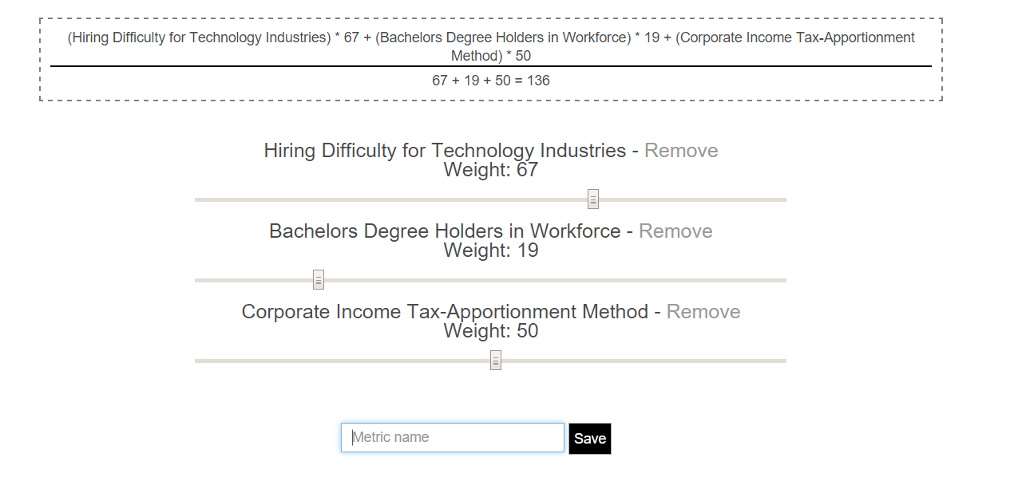
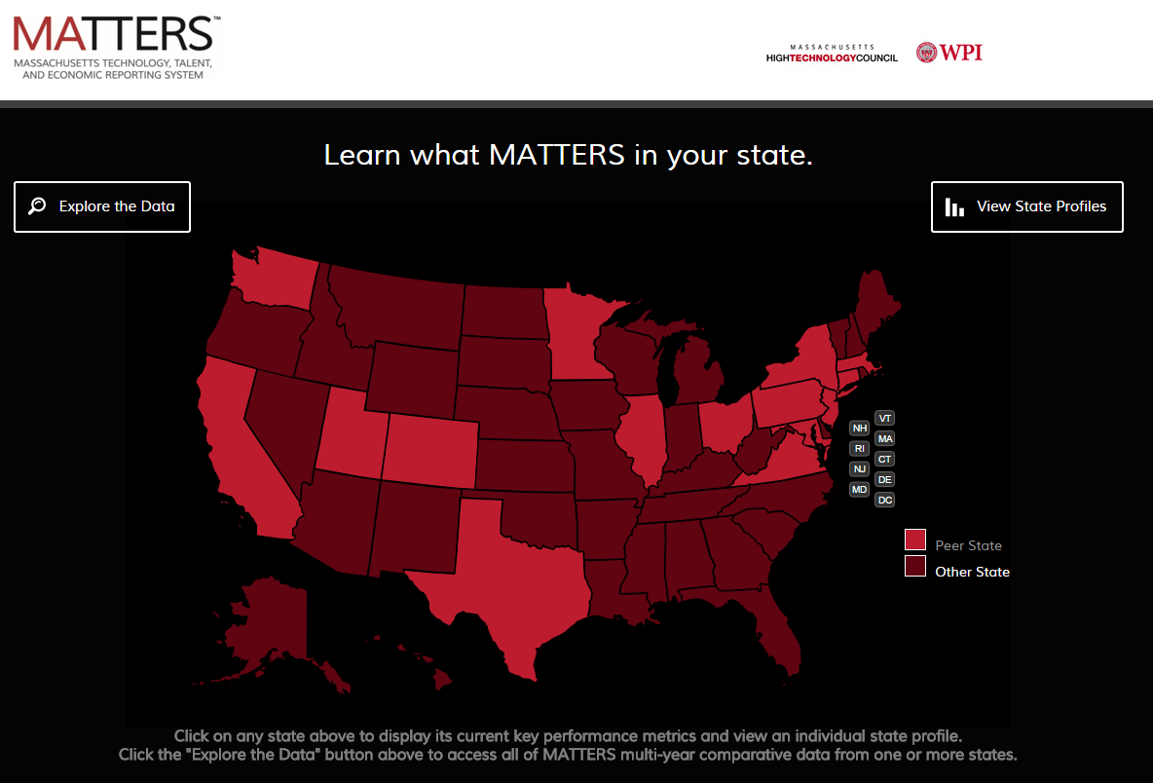
Expanding the Functionality of MATTERS
Dmytro Bogatov (Computer Science), Jillian Hennessy (Computer Science)
Advisor: Professor Elke Rundensteiner (Computer Science)
Abstract
Tables
Tables
Features
Queries
Testing Data
Normalization
Motivation
Acknowledgements
Motivation

