Slide 1


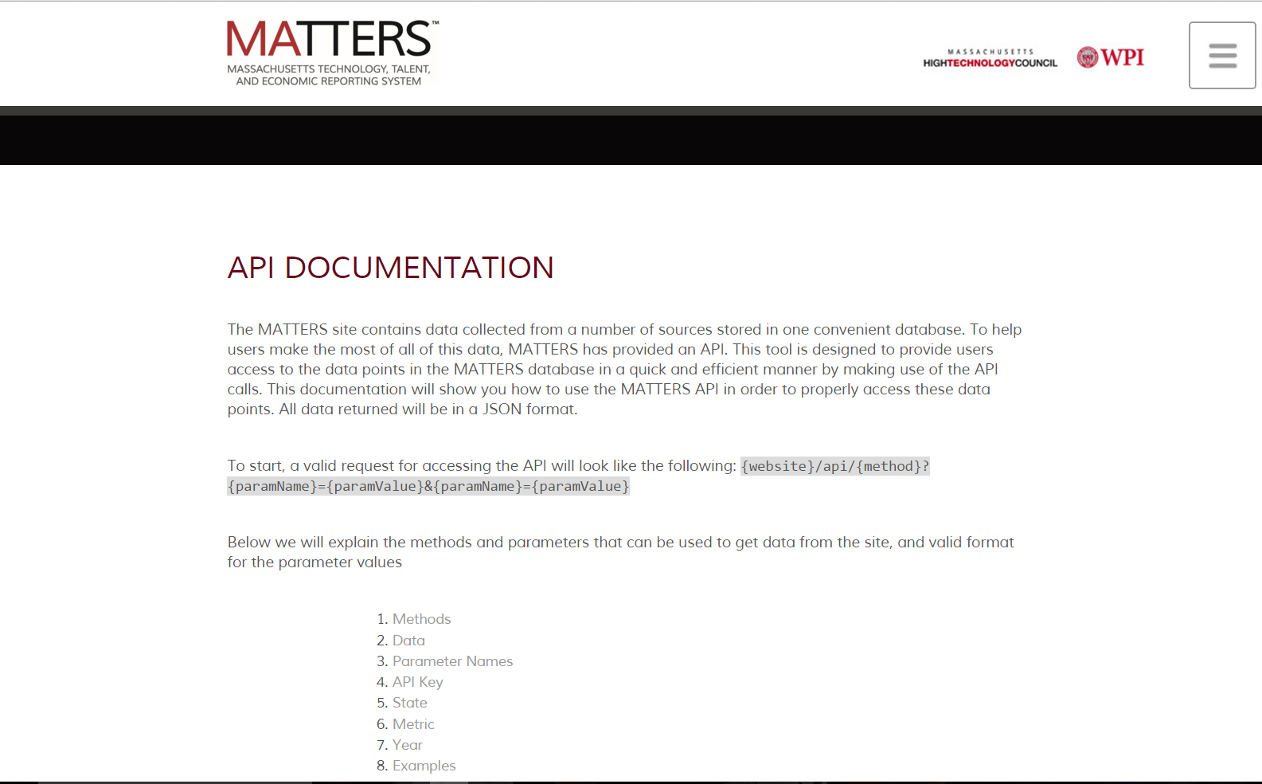
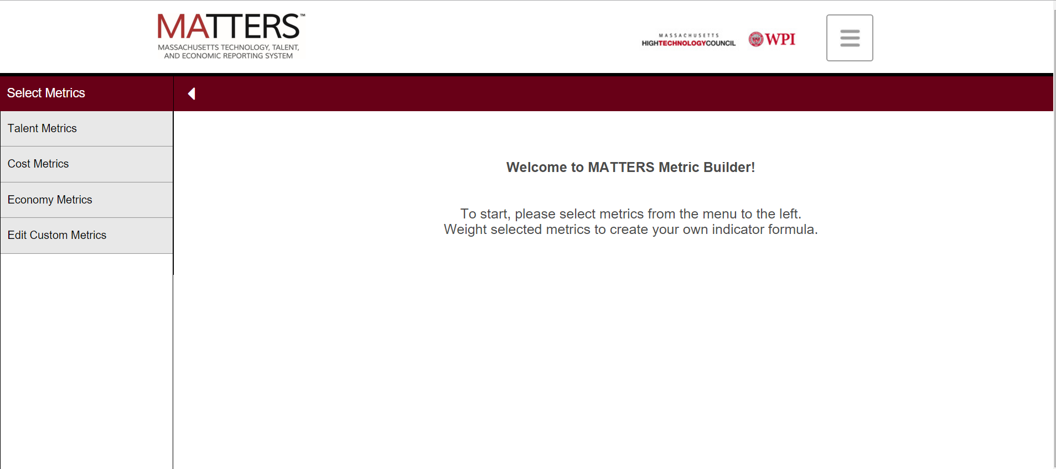
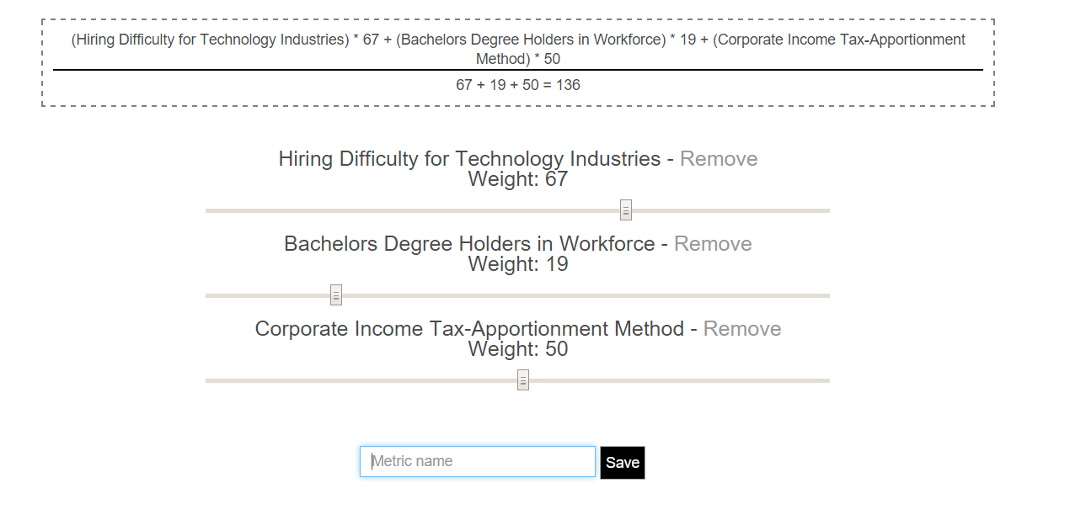
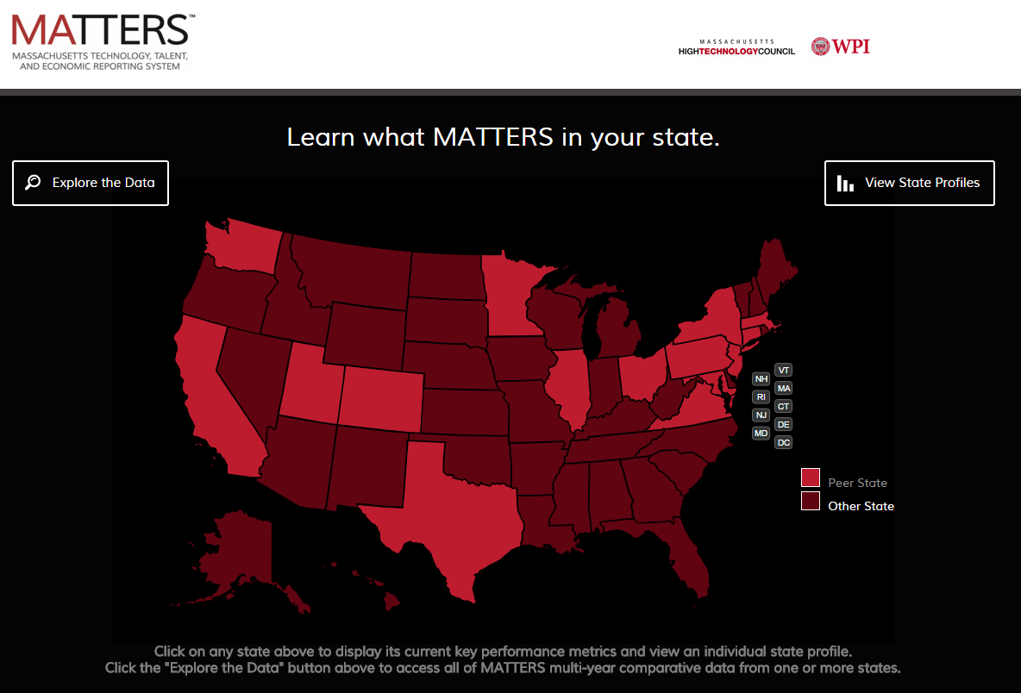
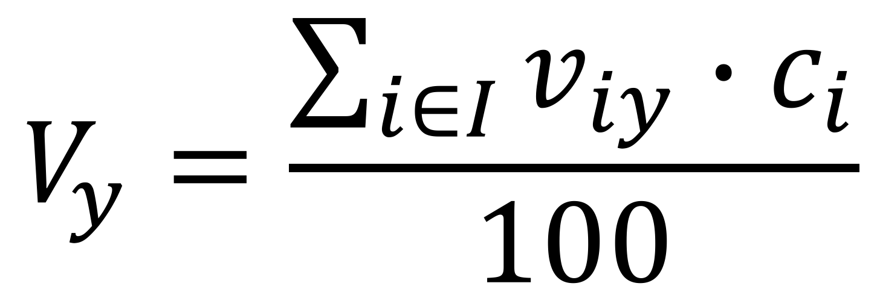
Expanding the Functionality of MATTERS
Dmytro Bogatov (Computer Science), Jillian Hennessy (Computer Science)
Advisor: Professor Elke Rundensteiner (Computer Science)
Abstract
The goal of this project was to expand the functionality of the Massachusetts Technology, Talent, and Economic Reporting System (MATTERS) for the Massachusetts High Technology Council (MHTC), a protechnology advocacy and lobbyist organization, with two new features - Application Program Interface (API) and Metric Builder. API defines a communication protocol between MATTERS and other computational-based systems. We also wrote an extensive API documentation. Metric Builder is a tool that lets users create own metrics with own rules out of existing MATTERS metrics. Users are now able to define their own indexes and track individual states’ performance.
Tables
Tables
Name | Type | Comment
Id | INT | Unique auto-incremented identifier
Name | VARCHAR | User metric’s title
Value | TEXT | JSON formatted list of metric id - coefficient
UserID | INT | Id of a user - author of the user metric (foreign key)
Name | Type | Comment
Id | INT | Unique auto-incremented identifier
Name | VARCHAR | API user’s name
ApiKey | VARCHAR(160) | Unique random string; used for authentication
Queries
User Study Testing Results (1-5 Scale)
Features
/api/data?metric={16,32}&state=MA&year=∗&apiKey=key
/api/metrics?apiKey=key
/api/states?apiKey=key
Select multiple metrics to create their own metric formula
Assign weights to metrics to indicate importance (0-100 scale)
Create custom metric name and save the metric to visualize in Explorer
Look at their created metric data in the form of a bar chart, line chart or table
Edit and delete custom metrics on the Metric Builder page
Table 1: Average ratings of Part 1 of the User Study, Metric Builder Feature (13 users)
How easy was it to find the Metric Builder? | 4.385
How easy was it to select the metrics "Unemployment Rate", "Corporate Income Tax Rate", and "Median Household Income" in the metric builder? | 4.308
How easy was it to weigh the metrics accordingly? | 4.615
How easy was it to name and save your metric? | 5
How easy was it to find “My Metric” on the data explorer page? | 4.231
How easy was it to edit “My Metric” to make the appropriate changes? | 3.846
How easy was it to remove “My Metric”? | 5
Motivation
Table 2: Average ratings of Part 2 of the User Study, API Documentation (12 users)
How easy was it to find the API Documentation? | 3.25
How useful is the API Documentation? | 4.167
Normalization
The goal was to develop the API and documentation for MATTERS to allow users to have an additional way to interact with the data that MATTERS stores. The API allows these users to extract desired data values from our site easily.
APIs not only encourage innovation and the ability to manipulate and extrapolate data by external collaborators, they provide a means to do so that is more secure for the group creating the API. They reduce the risk of how and what data is obtains and encourage good practice for how to properly manage the data available.
The documentation provides developers easy inntruction and guidance for interacting with the MATTERS API, allowing for communication with our system to be both intuitive and effective.
$$V_{y}=\frac{\sum_{i∈I}{v_{iy}∙c_{i}}}{100}$$
Acknowledgements
Massachusetts High Technology Council for making this project possible and working with Worcester Polytechnic Institute to create and grow MATTERS
Professor Elke Rundensteiner from WPI for her assistance and guidance throughout the entire project
Caitlin Kuhlman from WPI for her help throughout the project and providing guidance and feedback on all aspects of the project

