Slide 1


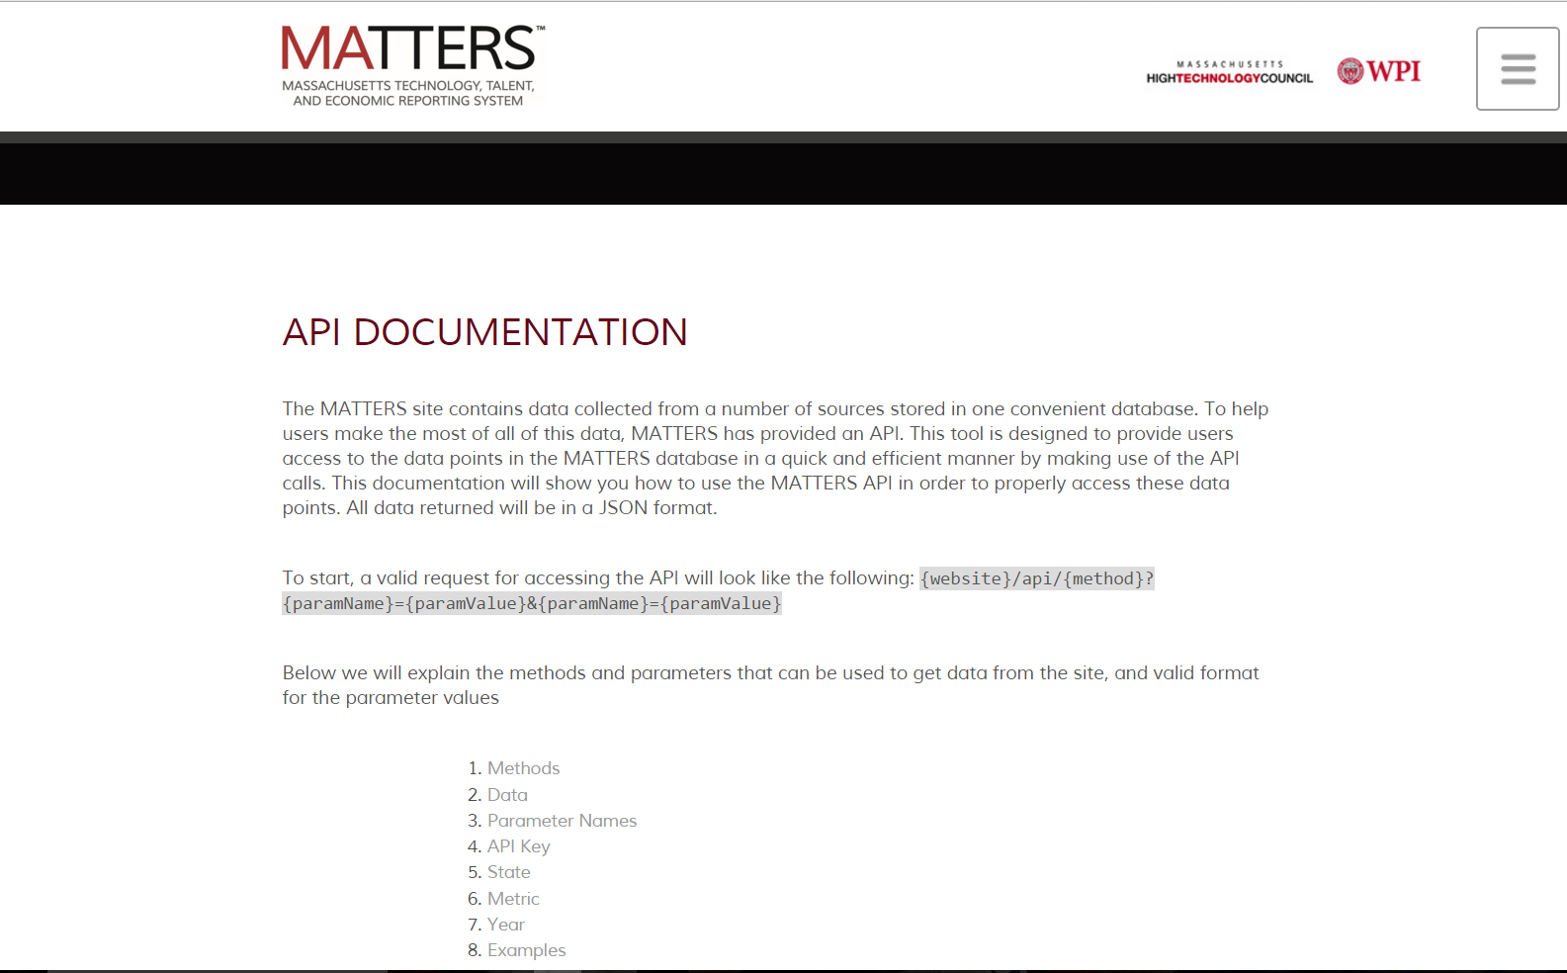
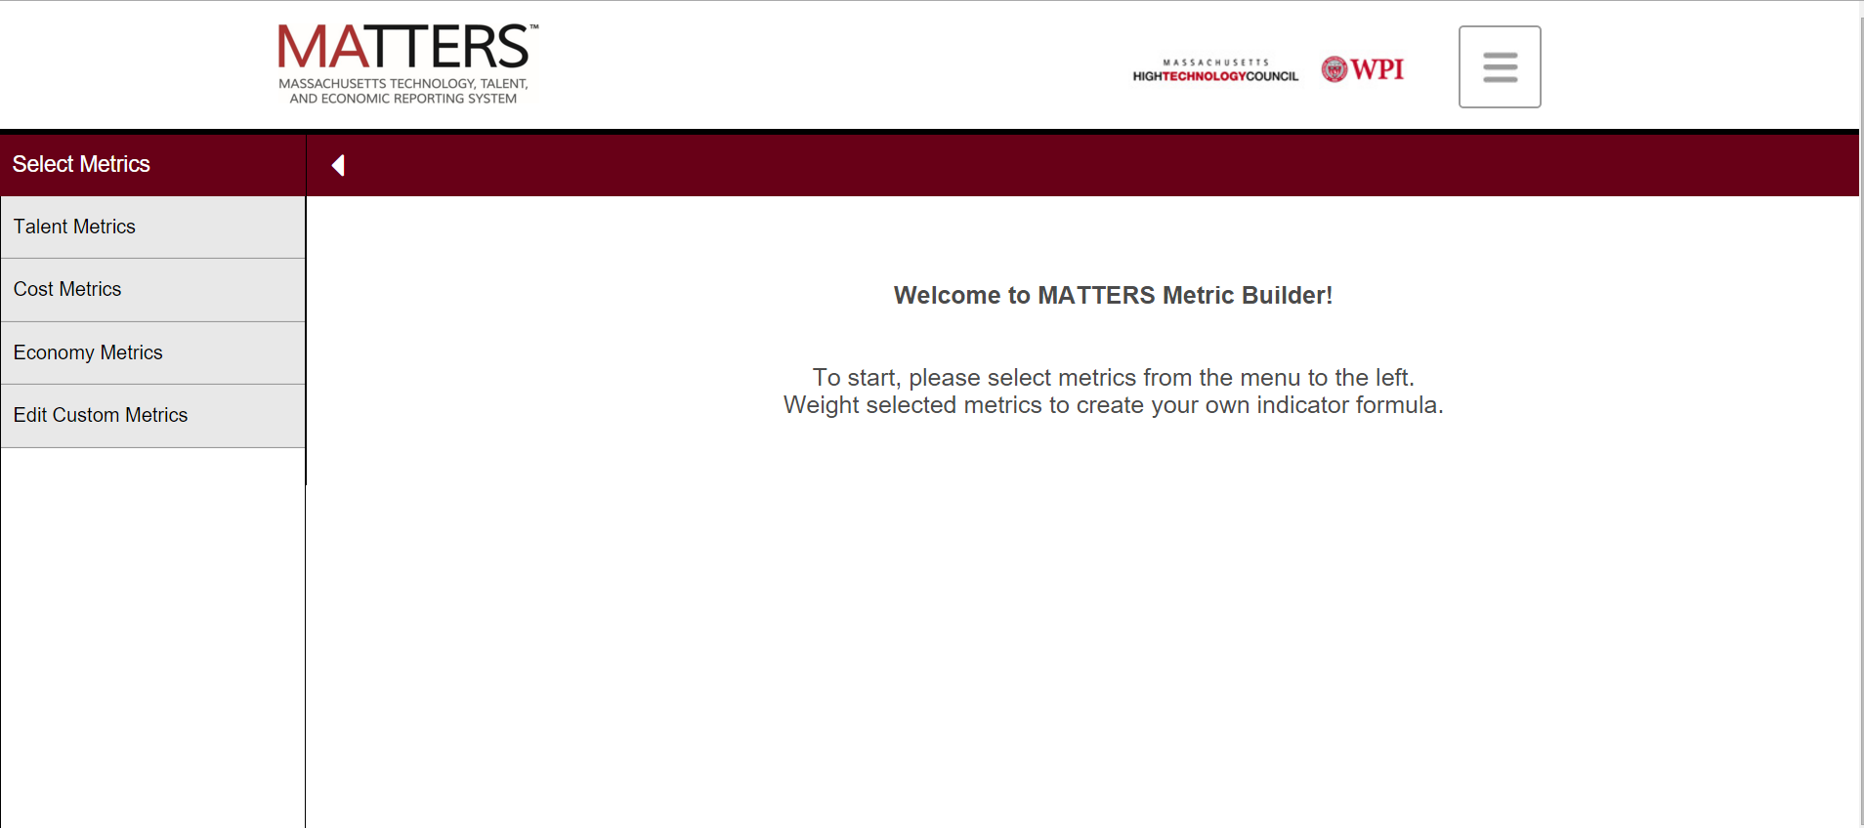
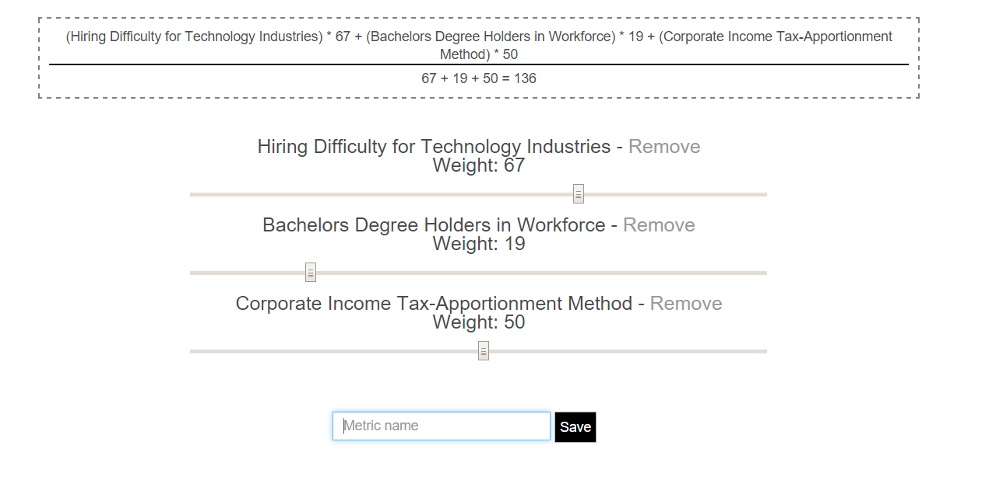
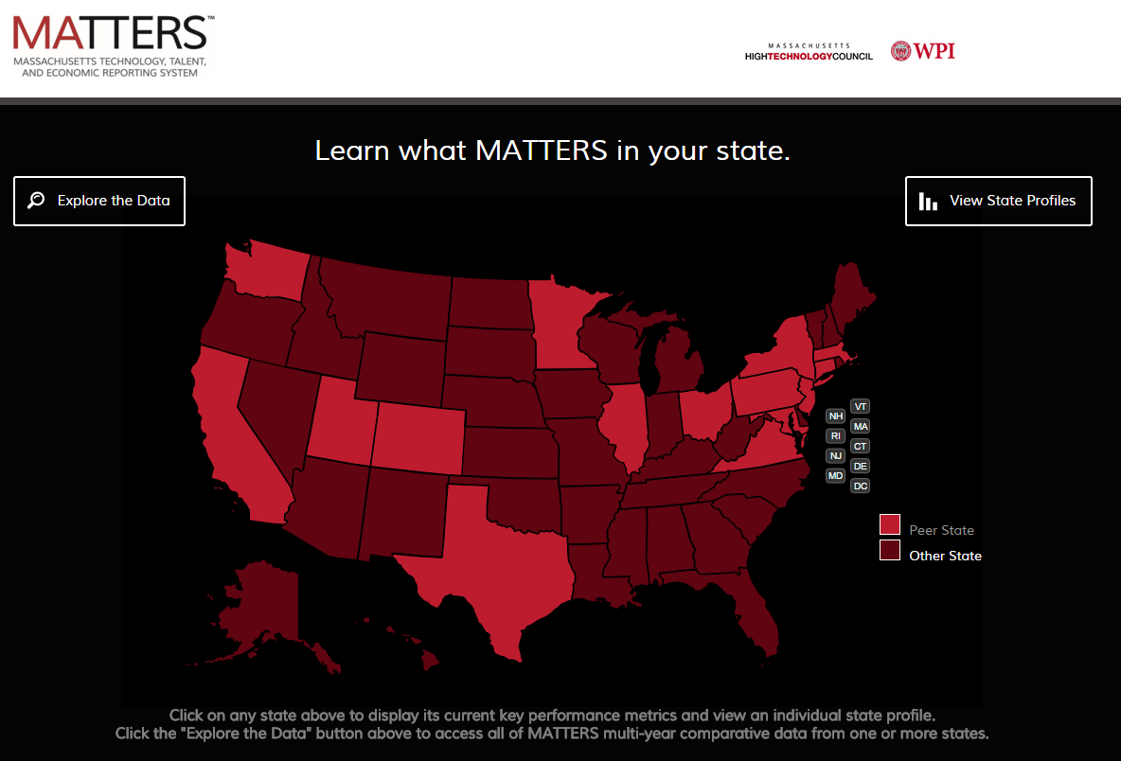
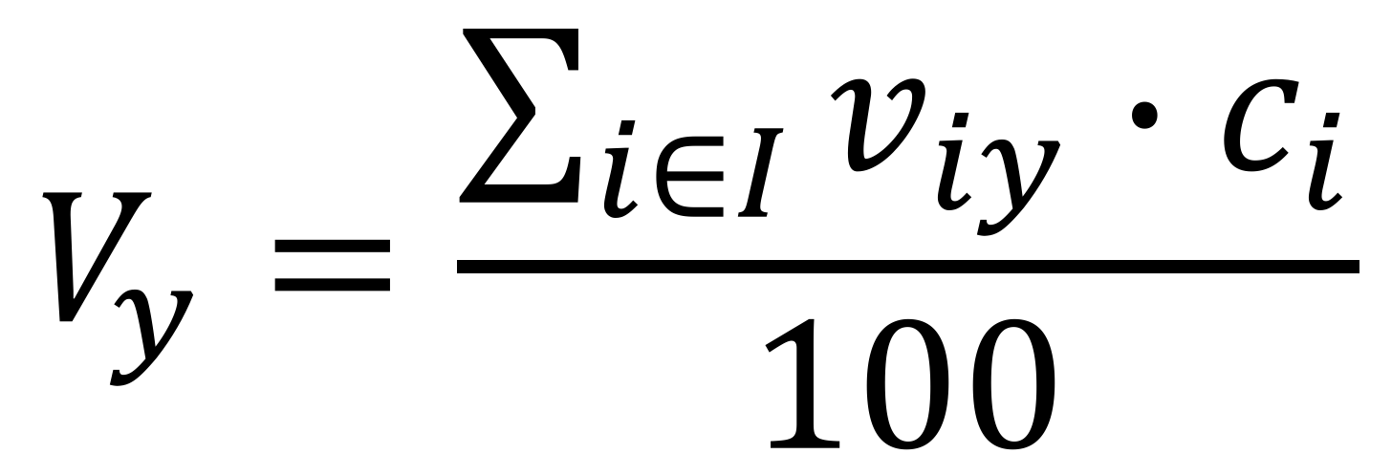
Expanding the Functionality of MATTERS
Dmytro Bogatov (Computer Science), Jillian Hennessy (Computer Science)
Advisor: Professor Elke Rundensteiner (Computer Science)
Abstract
The goal of this project was to expand the functionality of the Massachusetts Technology, Talent, and Economic Reporting System (MATTERS) for the Massachusetts High Technology Council (MHTC), a protechnology advocacy and lobbyist organization, with two new features - Application Program Interface (API) and Metric Builder. API defines a communication protocol between MATTERS and other computational-based systems. We also wrote an extensive API documentation. Metric Builder is a tool that lets users create own metrics with own rules out of existing MATTERS metrics. Users are now able to define their own indexes and track individual states’ performance.
Tables
Tables
Name | Type | Comment
Id | INT | Unique auto-incremented identifier
Name | VARCHAR | API user’s name
ApiKey | VARCHAR(160) | Unique random string; used for authentication
Name | Type | Comment
Id | INT | Unique auto-incremented identifier
Name | VARCHAR | User metric’s title
Value | TEXT | JSON formatted list of metric id - coefficient
UserID | INT | Id of a user - author of the user metric (foreign key)
Queries
/api/data?metric={16,32}&state=MA&year=∗&apiKey=key
/api/metrics?apiKey=key
/api/states?apiKey=key
Features
Testing Data
Motivation
Normalization
Acknowledgements
$$V_{y}=\frac{\sum_{i∈I}{v_{iy}∙c_{i}}}{100}$$

