Slide 1

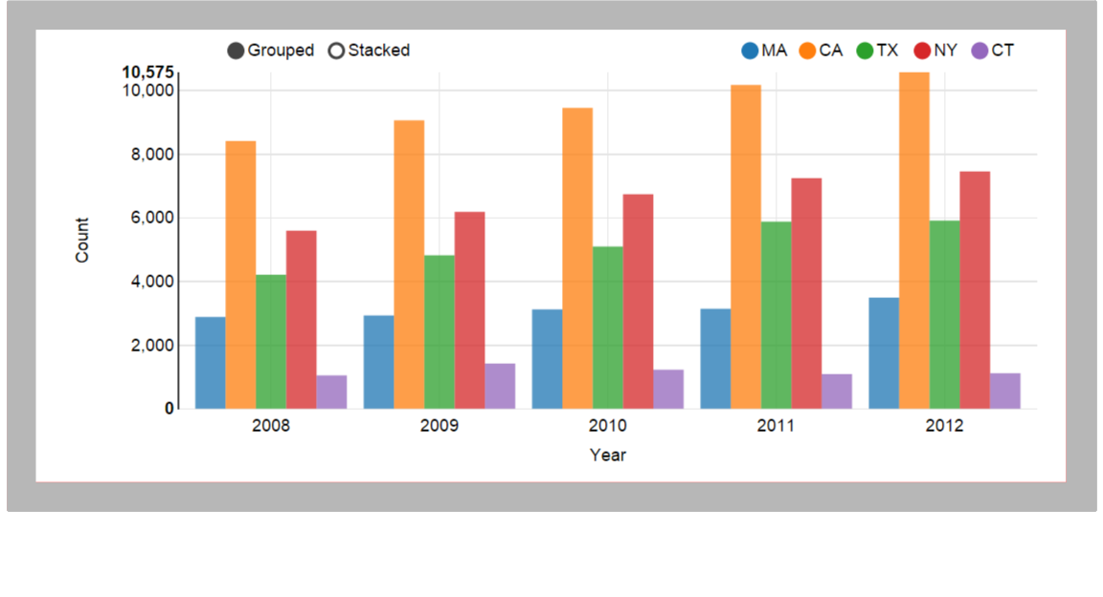
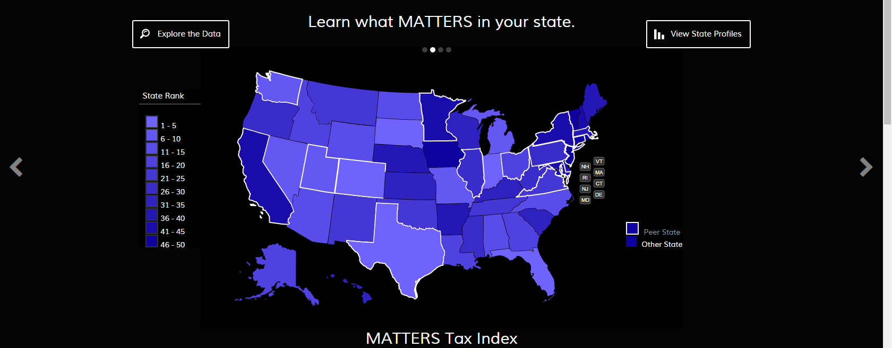
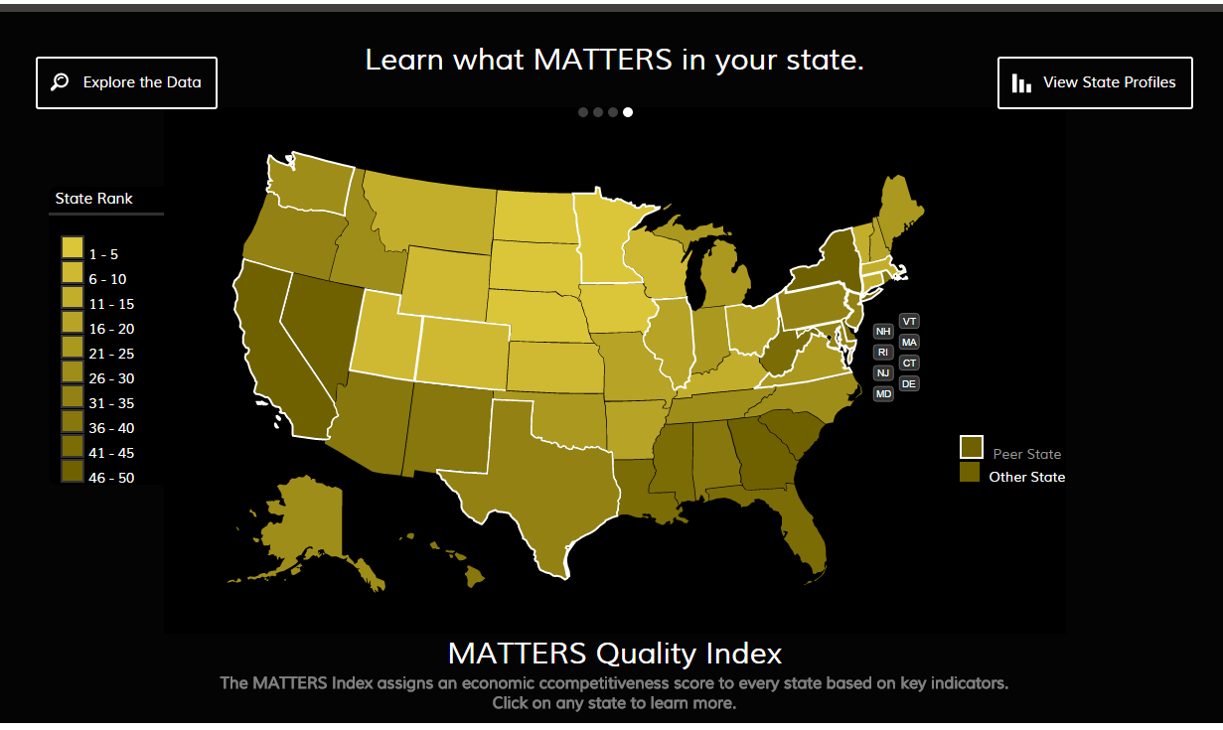
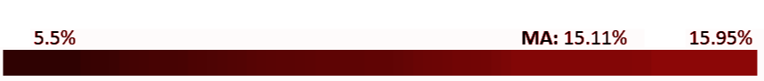
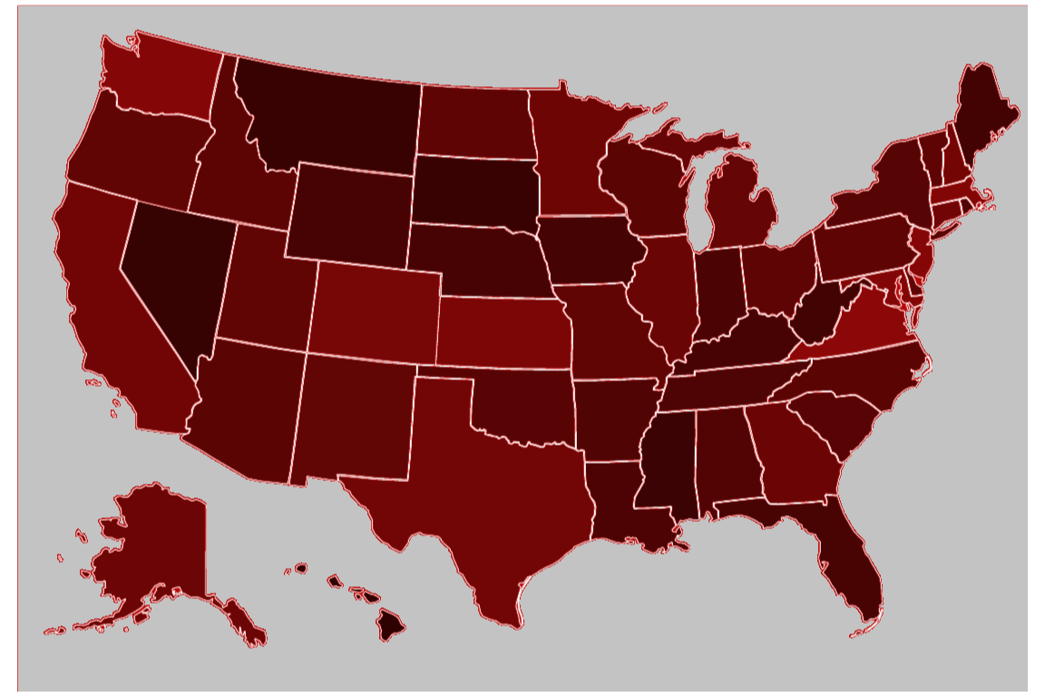
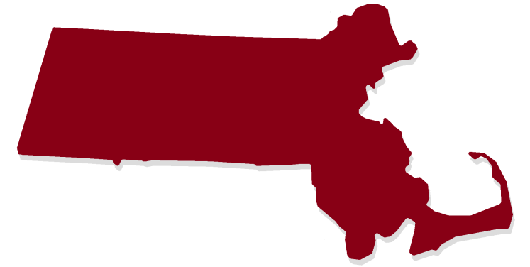
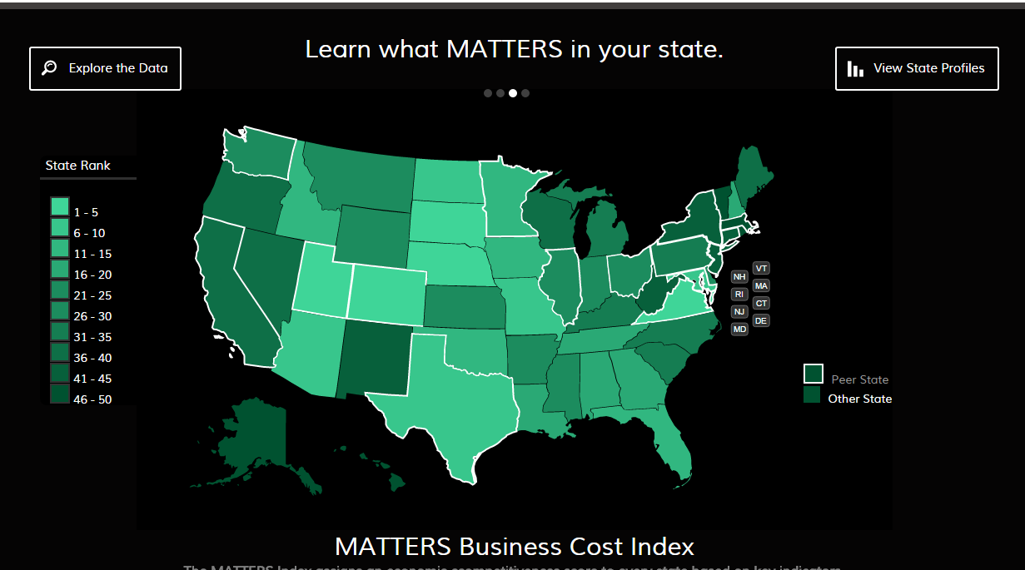
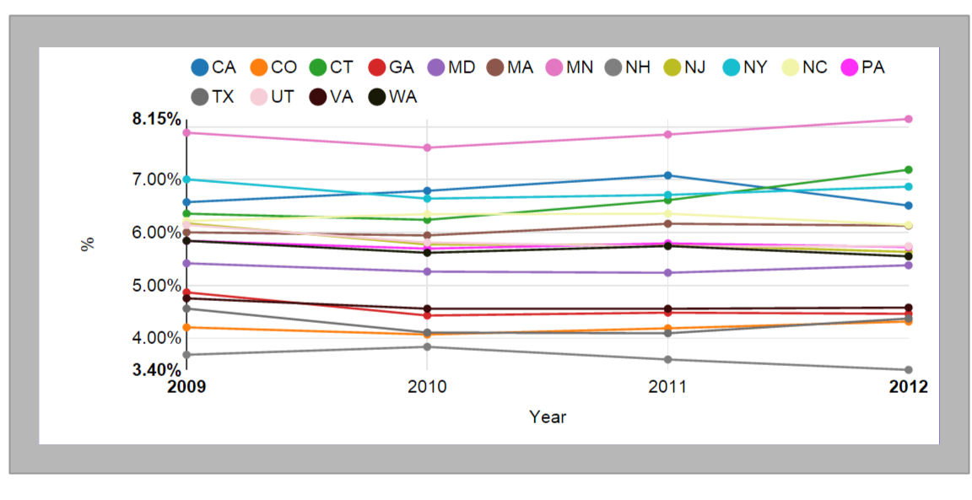
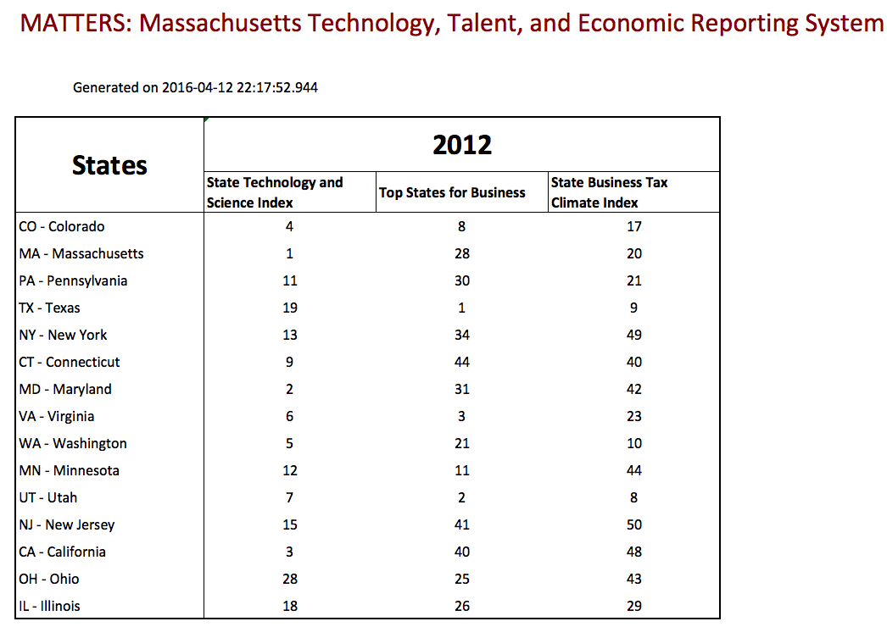
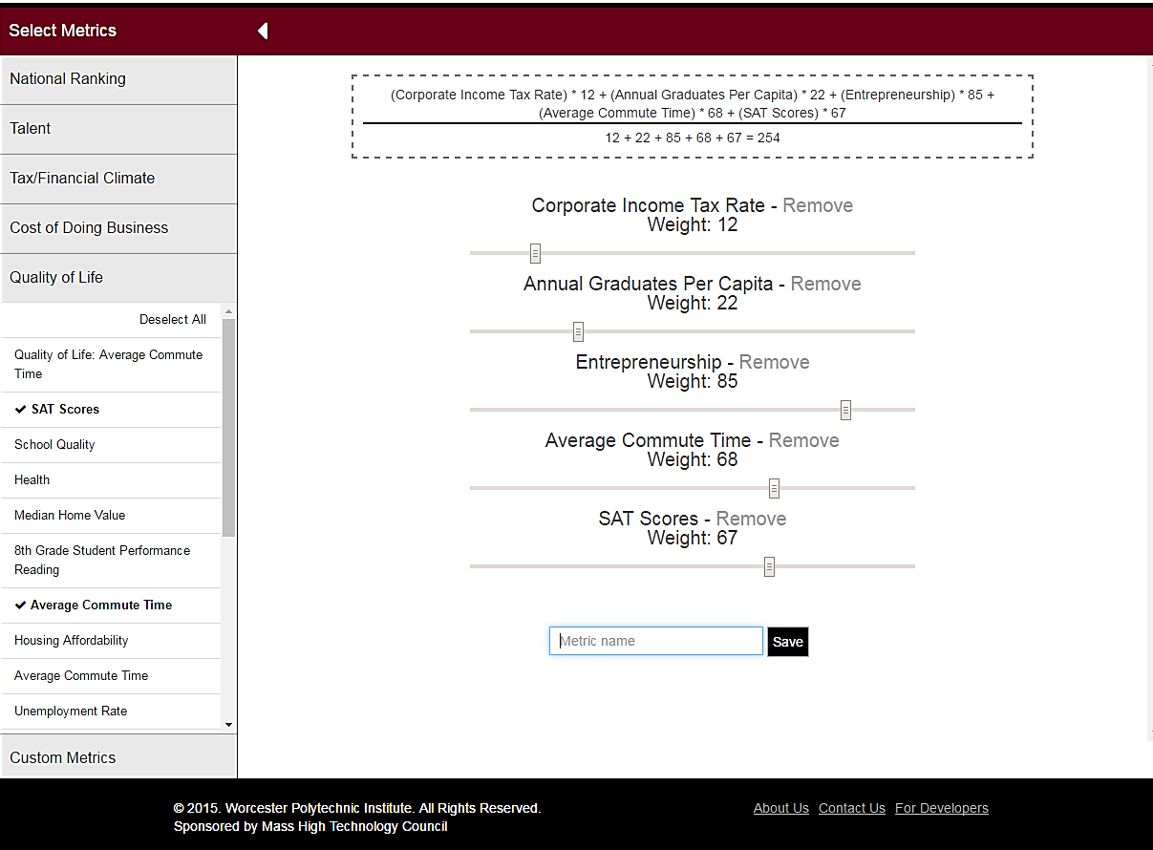
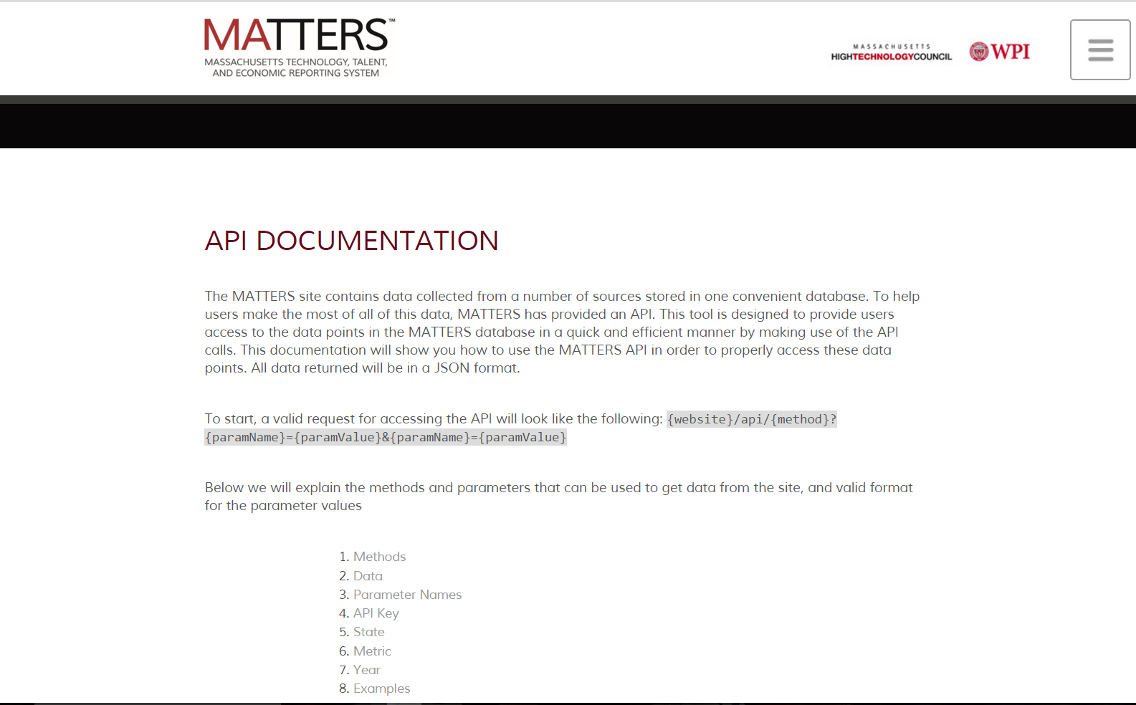
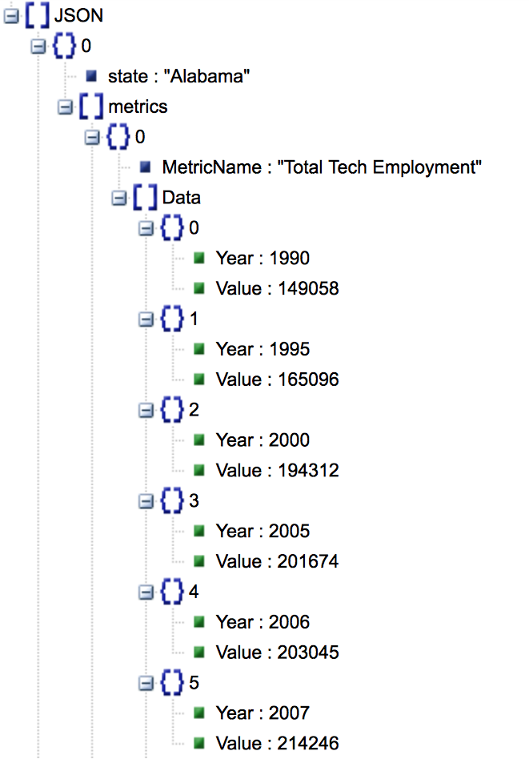
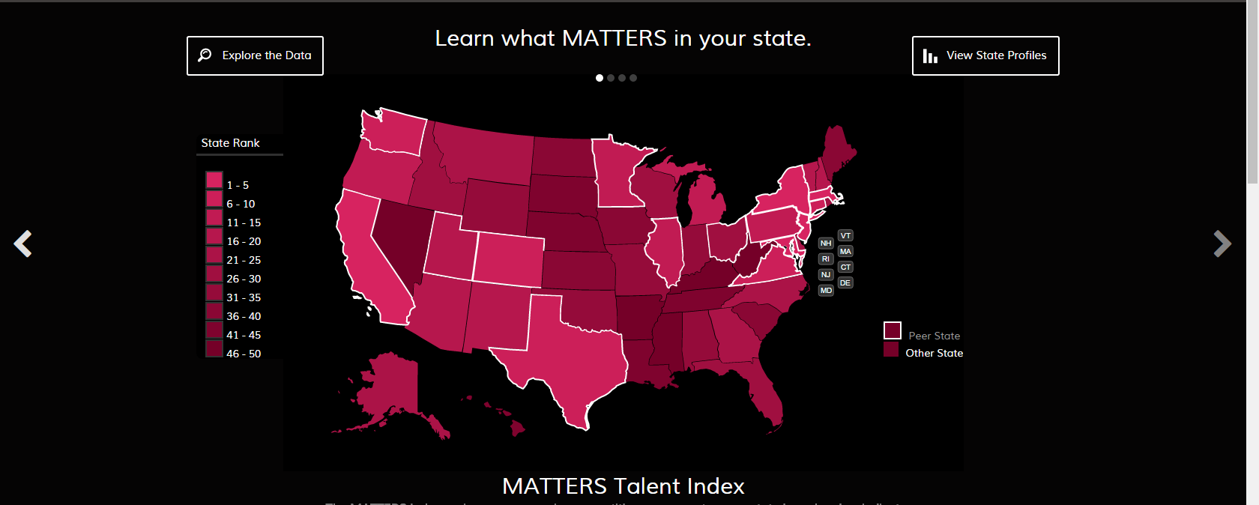
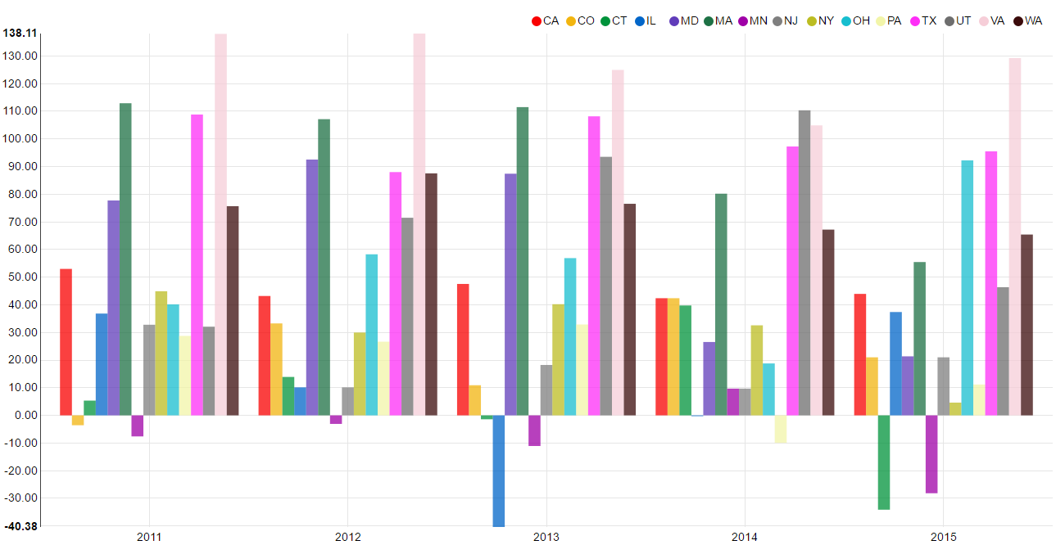
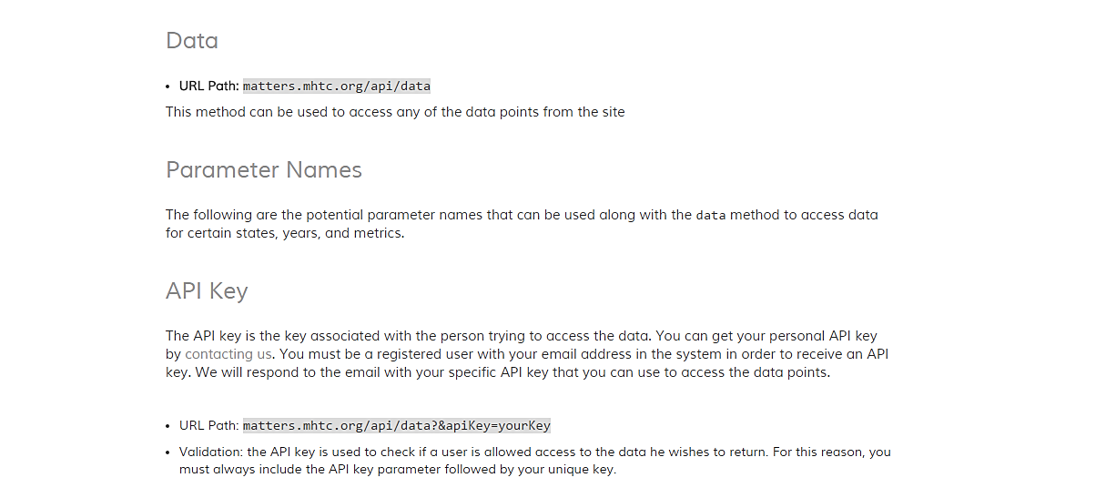









Data MATTERS: Customizing Economic Indices to Measure State Competitiveness Dmytro Bogatov and Jillian Hennessy Advisor: Professor Elke Rundensteiner Department of Computer Science
MOTIVATION
DATA EXPLORATION
PUBLIC FACING API
Data that impacts Massachusetts’ economic health
Incorporate data from across many diverse online sources into one platform for extraction, exploration, visualization and analytics.
Provide access to pre-existing metrics and be able to use these metrics as a part of their own economic indicators.
Help business leaders and policy makers evaluate
the competitive position of Massachusetts among
top technology states in the nation.
Application Program Interface (API) - code that allows two software programs to communicate with each other
Allows other software systems to make use of MATTERS data and analytics
API controller returns states and metrics information, as well as data for requested metrics, states and years.
End users are programmers – they can easily use MATTERS data in their software
Number of Master’s Degrees awarded in STEM fields across selected states
Percentage of High Tech in Total Employment
across the United States
MATTERS’ custom talent index displayed on home page
CUSTOMIZED METRIC BUILDER
Outputting extracted data
API DOCUMENTATION
Create custom indices using pre-existing metrics
Assign weights to components and normalize
Edit or delete your metric
Save your metric
Visualize your custom metric seamlessly
EVALUATION
Visualizing custom made metrics in the Data Explorer
IMPACT & ACKNOWLEDGEMENTS
Metric Builder and API Documentation User Studies
14 WPI students took part in a user study to test both the Metric Builder and API Documentation
Students rated the ease of use of both features through a survey and provided additional feedback
Results:
Overall, found to be very intuitive
API Documentation link was put in an easier to locate place at the footer
Edit feature of custom metric made easier to find from Explorer page
Impact:
MATTERS usability extended key features to be deployed to public domain as MATTERS 2.0
Acknowledgements:
Massachusetts High Technology Council for making this project possible by bringing stakeholders together and working with Worcester Polytechnic Institute as technology partner
Professor Elke Rundensteiner for her guidance throughout project
Caitlin Kuhlman PhD student from WPI for her assistance on all aspects of the project
Online Sources
Database

