Slide 1


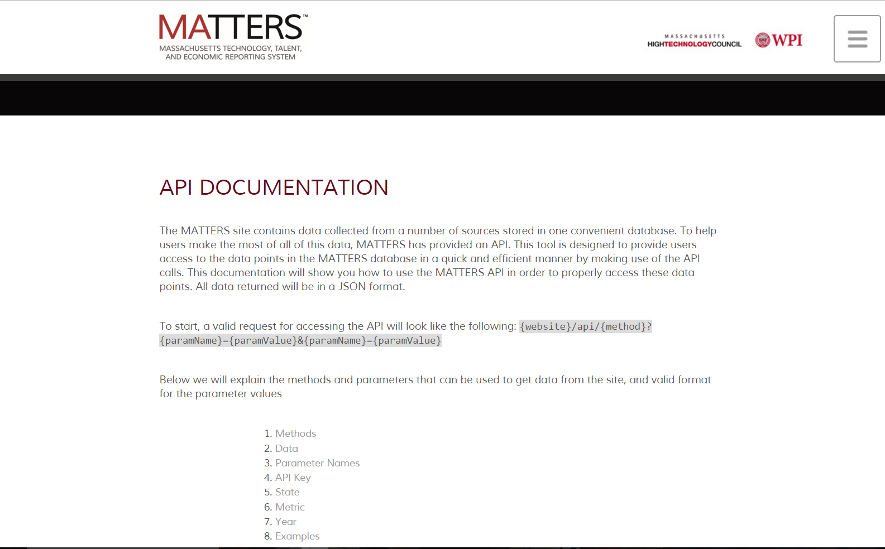
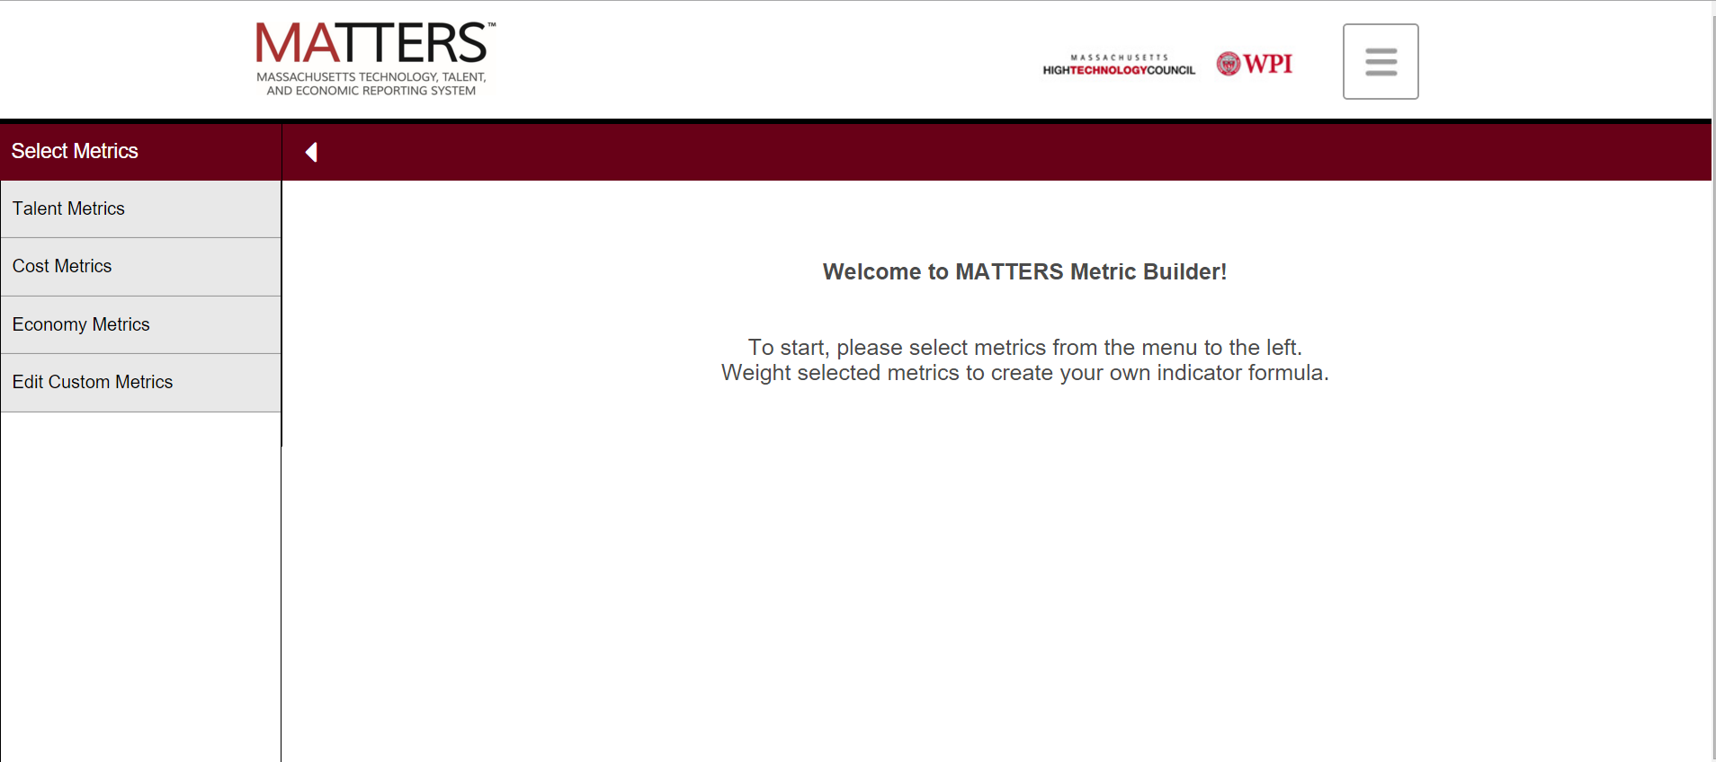
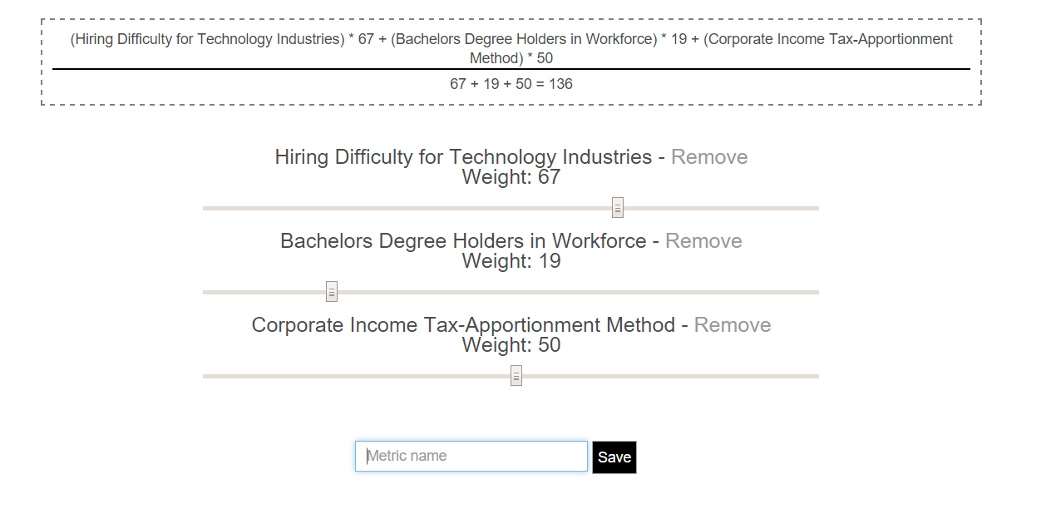
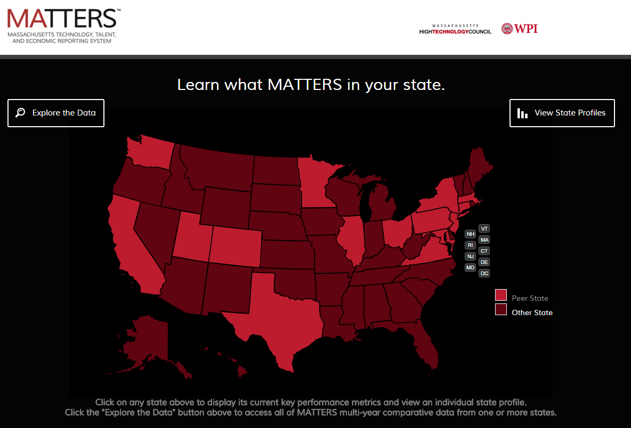
Expanding the Functionality of MATTERS
Dmytro Bogatov (Computer Science), Jillian Hennessy (Computer Science)
Advisor: Professor Elke Rundensteiner (Computer Science)
Abstract
The goal of this project was to expand the functionality of the MassachusettsTechnology, Talent, and Economic Reporting System (MATTERS) for the Massachusetts High Technology Council (MHTC), a protechnology advocacy and lobbyist organization, through the addition of two new features an Application Program Interface (API) and the Metric Builder. This API defines a communication protocol between MATTERS and other computational-based systems. We also wrote extensive API documentation. The Metric Builder is a tool that lets users create their own metrics with their own rules out of existing MATTERS metrics. Users are now able to define their own indexes and track individual states' performance.
Tables
Tables
Features
Queries
Testing Data
Normalization
Motivation
Acknowledgements
Motivation

