Slide 1

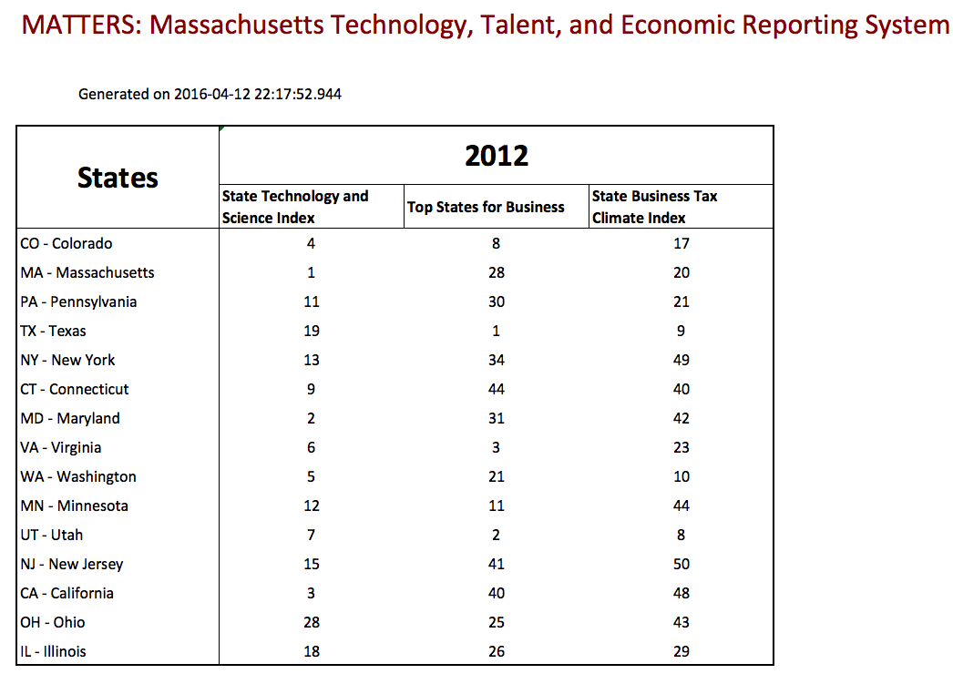
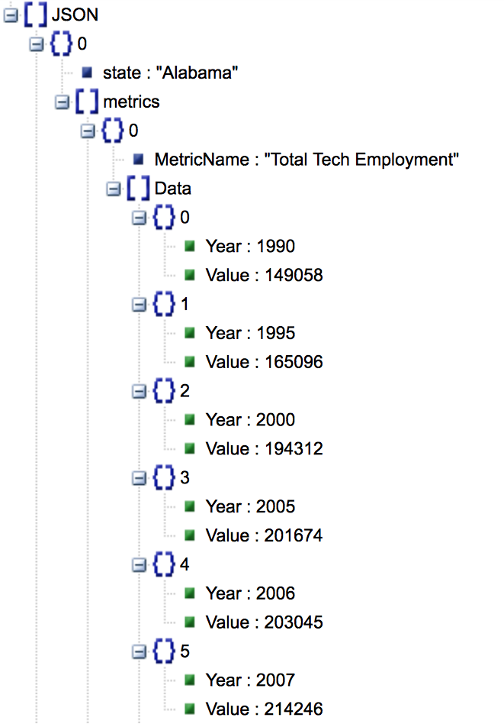

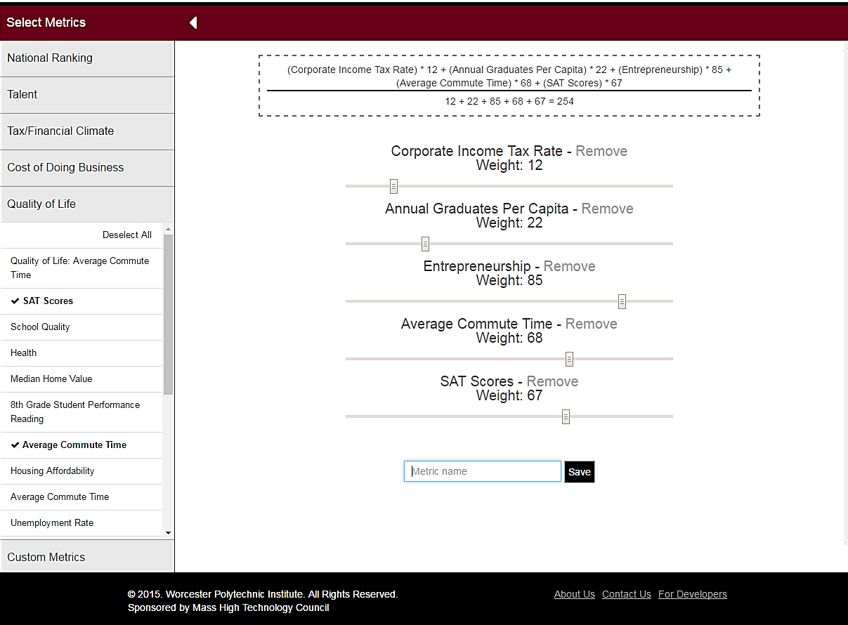
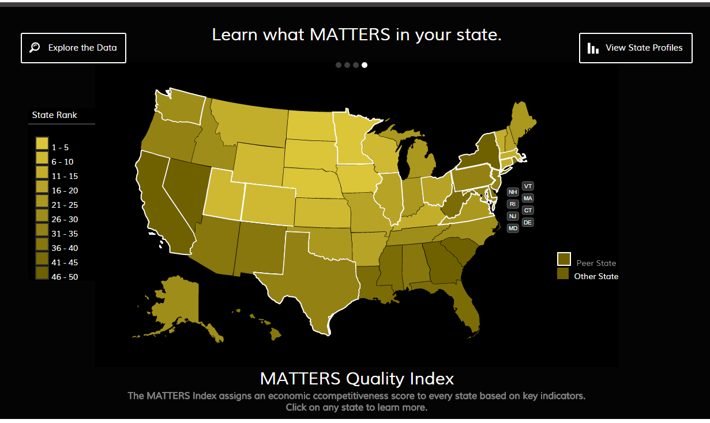
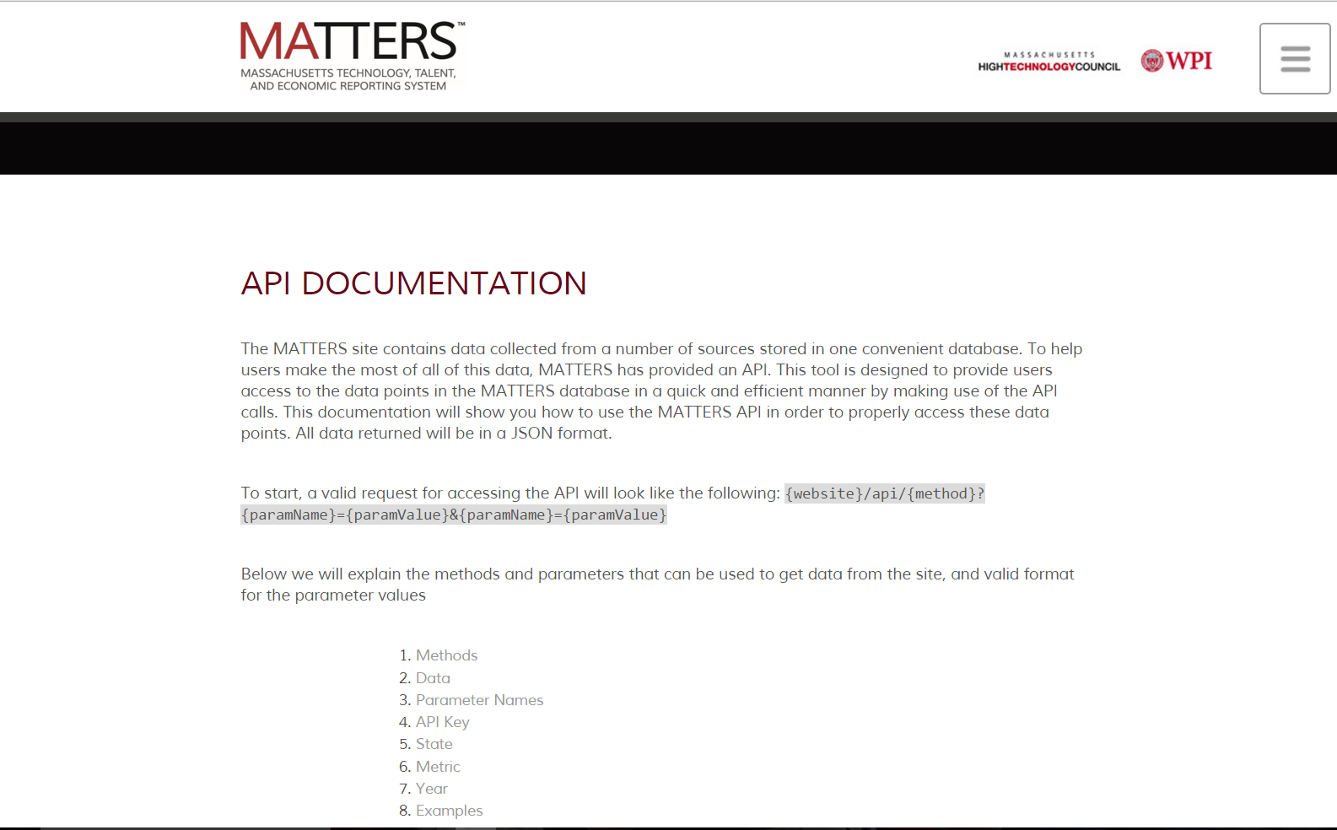
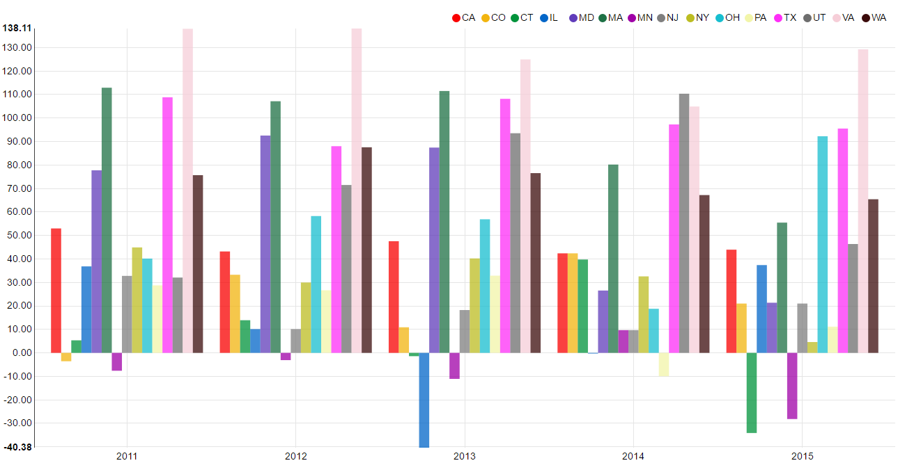

Data MATTERS: Customizing Economic Indices to Measure State Competitiveness Dmytro Bogatov and Jillian Hennessy Advisor: Professor Elke Rundensteiner Department of Computer Science
MOTIVATION
DATA EXPLORATION
PUBLIC FACING API
Data that impacts Massachusetts’ economic health
The Massachusetts Technology, Talent, and Economic Reporting System (MATTERS) incorporates data from across many diverse online sources into one platform for extraction, exploration, and visualization
Metric Builder tool provides users with the ability to use pre-existing metrics in the system as a part of their own economic indicators
Access to rich collection of data and tools for
exploration helps business leaders and policy makers
evaluate the competitive position of Massachusetts
among top technology states in the nation
Access to high fidelity data resource
Application Program Interface (API) - code that allows two software programs to communicate with each other
Allows other software systems to make use of MATTERS data and analytics
API controller returns states and metrics information, as well as data for requested metrics, states and years.
End users are programmers – they can easily use MATTERS data in their software
CUSTOMIZED METRIC BUILDER
Outputting data extracted via the MATTERS API
API DOCUMENTATION
Create custom indices using pre-existing metrics
Assign weights to components and normalize
Edit or delete your metric
Save your metric
Visualize your custom metric seamlessly
MATTERS custom quality index displayed on home page
EVALUATION
IMPACT & ACKNOWLEDGEMENTS
Metric Builder and API Documentation User Studies
14 WPI students took part in a user study to test both the Metric Builder and API Documentation
Students rated the ease of use of both features through a survey and provided additional feedback
Results:
Overall, found to be very intuitive
API Documentation link was put in an easier to locate place at the footer
Edit feature of custom metric made easier to find from Explorer page
Impact:
MATTERS usability extended key features to be deployed to public domain as MATTERS 2.0
Acknowledgements:
Massachusetts High Technology Council for making this project possible by bringing stakeholders together and working with Worcester Polytechnic Institute as technology partner
Professor Elke Rundensteiner for her guidance throughout project
Caitlin Kuhlman PhD student from WPI for her assistance on all aspects of the project
Visualizing custom made metrics in the MATTERS Data Explorer

