Slide 1
Information Dissemination With Gossiping Using The IoT-Lab
An introduction

Slide 2
Structure Of This Talk
Why Gossiping?
Principles of Gossiping
The IoT-Lab
Scope of the Thesis
Roadmap

Slide 3
Why Gossiping?
Communication protocol to distribute data in an ad-hoc network
Nodes are not aware of network topology
Suited for information dissemination in unreliable networks
Measuring the performance of algorithms using gossiping is difficult
Random decisions and redundancy make it very hard to observe the process of the algorithm

Slide 4
Principles of Gossiping
Node has three states:
Susceptible for new data
Infected with new data
Removed from dissemination
Node P randomly chooses neighbor node Q
Three strategies of data exchange:
Push: P sends it data unsolicited to Q
Pull: P asks Q for its data
Push/Pull: P pushes data to Q and Q responds with its own data

Slide 5
Principles of Gossiping – Design of a Node
wait (∆t time units)
p ← RandomPeer();
σ ← PrepareMsg();
send σ to p;
wait until receive(σp)
σ ← Update(σ,σp);
Each node is only allowed
to gossip every t time units
wait until receive(σp)
σ ← PrepareMsg();
send σ to sender(σp);
σ ← Update(σ, σp);
Randomly selects a
neighbor in the set of all
neighbors of the node
Select a data item from the
cache to be distributed to p
Decide whether to keep the
own data set or the received
one.
active thread
passive thread
Source: Bakhshi et al., 2011: A Modeling Framework for Gossip-based Information Spread

Slide 6

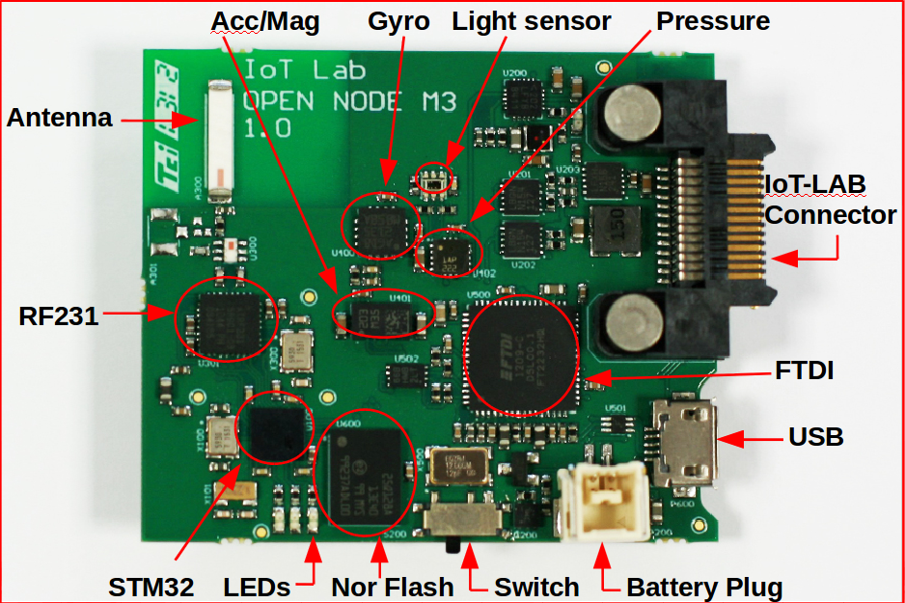
The IoT-Lab
Network of sensor nodes useable to test wireless communication protocols
Six testbeds across France
Web frontend offers control and deployment facilities
Nodes can be reserved for specific time frames and used freely for scientific experiments
An M3 Sensor Node

Slide 7
Scope of the Thesis
Implementation of a framework to test gossip strategies in the IoT-Lab
Collecting usable metrics like round duration, time
Provide tools to visualize the collected data
Test the framework with common gossiping strategies to distribute (large) data sets
Evaluate the possibilities and types of data that can be recorded

Slide 8
Roadmap
Collecting information about gossiping and deciding for relevant metrics (1 – 2 weeks)
Get in touch with the IoT-Lab (1 week)
Especially the topology and how to distribute information
Implement the gossiping framework (3 – 4 weeks)
Run tests (1 week)
Write the thesis (4 weeks)

