Slide 1
Information Dissemination With Gossiping Using The IoT-Lab
An introduction

Slide 2
Structure Of This Talk
Principles of Gossiping
The IoT-Lab
Scope of the Thesis
Roadmap

Slide 3
Principles of Gossiping
Node has three states:
Susceptible for new data
Infected with new data
Removed from dissemination
Node P randomly chooses neighbor node Q
Three strategies of data exchange:
Push: P sends it data unsolicited to Q
Pull: P asks Q for its data
Push/Pull: P pushes data to Q and Q responds with its own data

Slide 4
Principles of Gossiping – Design of a Node
wait (∆t time units)
p ← RandomPeer();
σ ← PrepareMsg();
send σ to p;
wait until receive(σp)
σ ← Update(σ,σp);
wait until receive(σp)
σ ← PrepareMsg();
send σ to sender(σp);
σ ← Update(σ, σp);
active thread
passive thread
Source: Bakhshi et al., 2011: A Modeling Framework for Gossip-based Information Spread

Slide 5

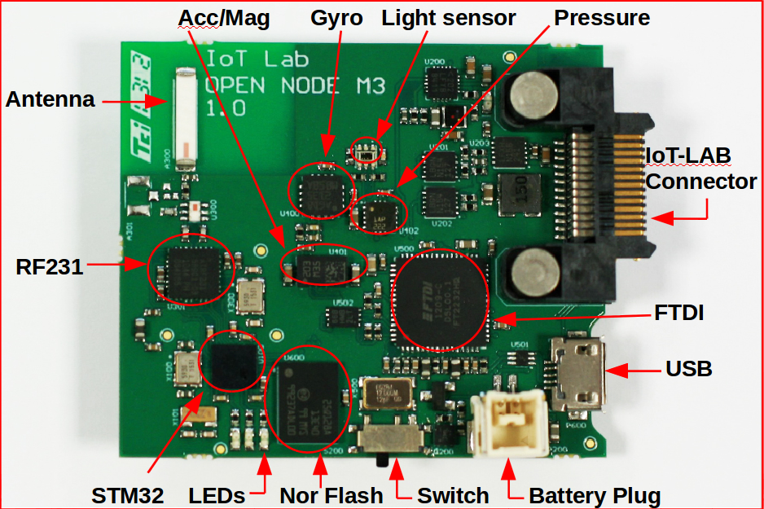
The IoT-Lab
Network of sensor nodes useable to test wireless communication protocols
Six testbeds across France
Web frontend offers control and deployment facilities
Nodes can be reserved for specific time frames and used freely for scientific experiments
An M3 Sensor Node

Slide 6
Scope of the Thesis
Implementation of a framework to test gossip strategies in the IoT-Lab
Collecting usable metrics like round duration, time
Provide tools to visualize the collected data
Test the framework with common gossiping strategies to distribute (large) data sets
Evaluate the possibilities and types of data that can be recorded

Slide 7
Roadmap
Collecting information about gossiping and deciding for relevant metrics (1 – 2 weeks)
Get in touch with the IoT-Lab (1 week)
Implement the gossiping framework (3 – 4 weeks)
Run tests (1 week)
Write the thesis (4 weeks)

