Slide 1
DATA PROCESSING
The total number of reservations made for each vehicle id are computed from ‘reservations’ dataset
This data is merged with ‘vehicles’ dataset using vehicle_id
Assumption: The vehicle_ids which are missing are from reservations are replaced with 0 assuming these vehicles haven’t been reserved during the timeframe mentioned
The final merged data frame is of the form :
 | vehicle_id | technology | actual_price | recommended_price | num_images | street_parked | description | hourly | daily | weekly | total_rentals
0 | 1 | 1 | 67.85 | 59 | 5 | 0 | 7 | 1 | 0 | 0 | 1
1 | 2 | 0 | 100.7 | 53 | 5 | 0 | 224 | 4 | 3 | 0 | 7
2 | 3 | 0 | 74 | 74 | 4 | 1 | 21 | 1 | 9 | 7 | 17
3 | 4 | 0 | 135 | 75 | 1 | 0 | 184 | 1 | 0 | 1 | 2
4 | 5 | 0 | 59.36 | 53 | 2 | 1 | 31 | 0 | 1 | 1 | 2
5 | 6 | 0 | 82.15 | 53 | 5 | 1 | 44 | 4 | 4 | 5 | 13
6 | 7 | 0 | 165.17 | 83 | 3 | 0 | 32 | 0 | 0 | 0 | 0
DATA PROCESSING
DATA EXPLORATION
MODEL BUILDING
MODEL SELECTION
RESULTS

Slide 2
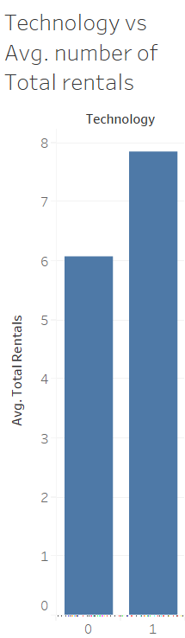
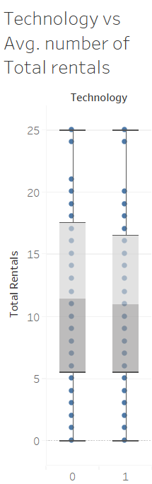
DATA EXPLORATION
On an average, total number of reservations is more when technology is installed in the vehicle rather than when it is not
But the boxplots do not show much significant variation in total rentals with respect to technology
DATA PROCESSING
DATA EXPLORATION
MODEL BUILDING
MODEL SELECTION
RESULTS

Slide 3
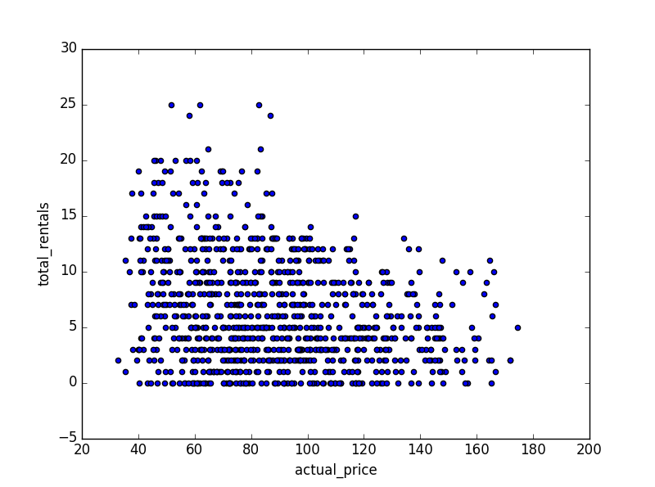
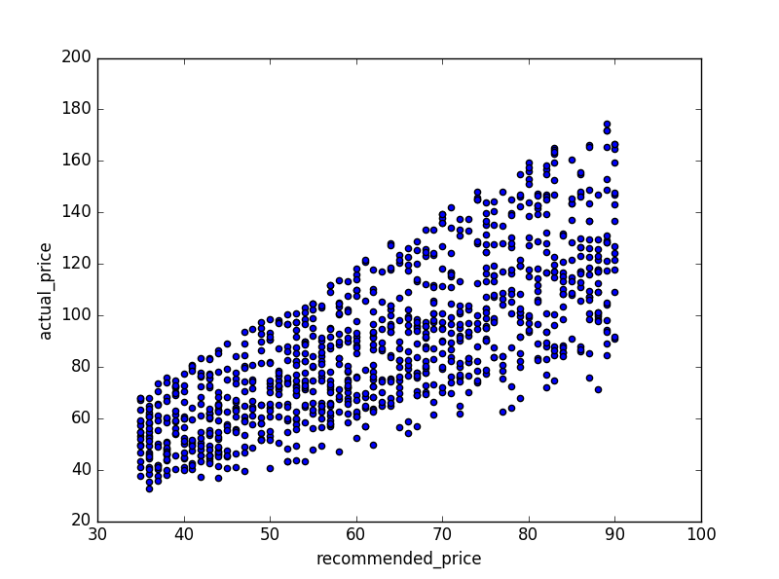
DATA EXPLORATION
Total rentals vs actual price
Actual price vs recommended price
There appears to be negative correlation between actual price and total number of rentals
There is a strong positive correlation between the variables actual price and recommended price
DATA PROCESSING
DATA EXPLORATION
MODEL BUILDING
MODEL SELECTION
RESULTS

Slide 4
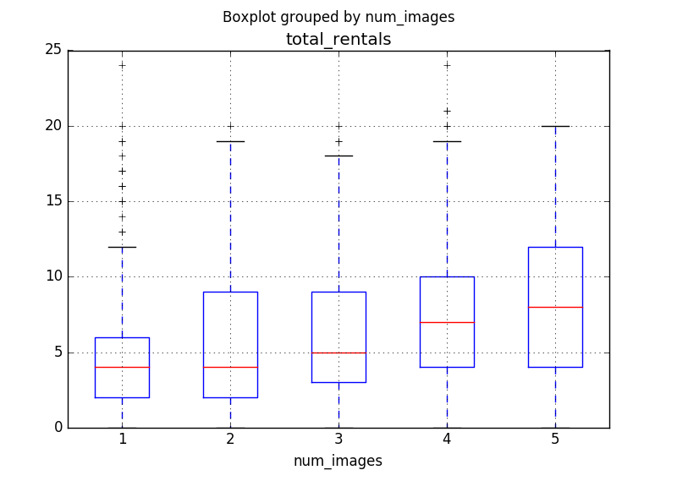
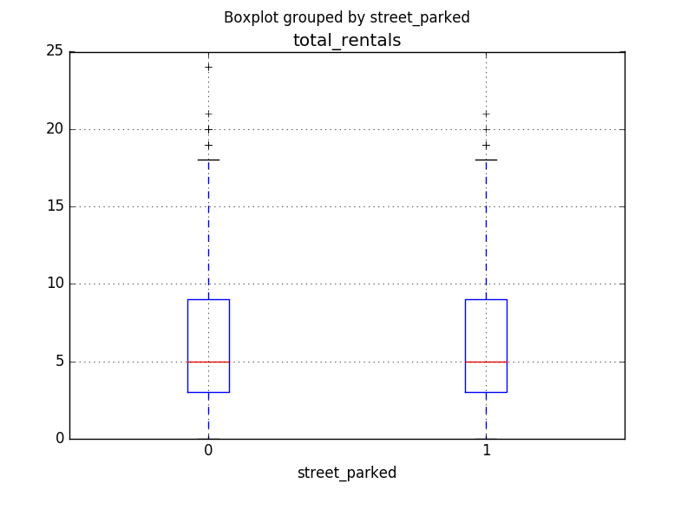
DATA EXPLORATION
The median of total number of rentals increases as the number of images of the car increases
There appears to be a positive relationship between total number of rentals and number of images of car
The two boxplots look identical suggesting that street parking might not be useful in predicting total number of rentals
DATA PROCESSING
DATA EXPLORATION
MODEL BUILDING
MODEL SELECTION
RESULTS

Slide 5
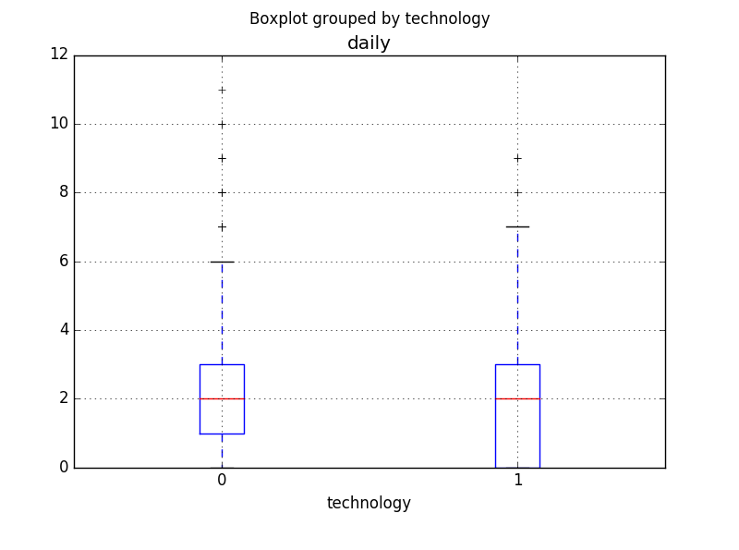
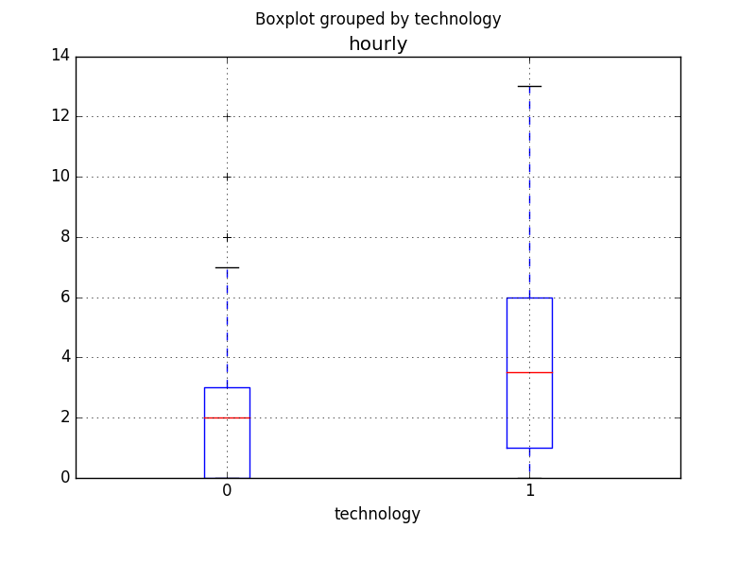
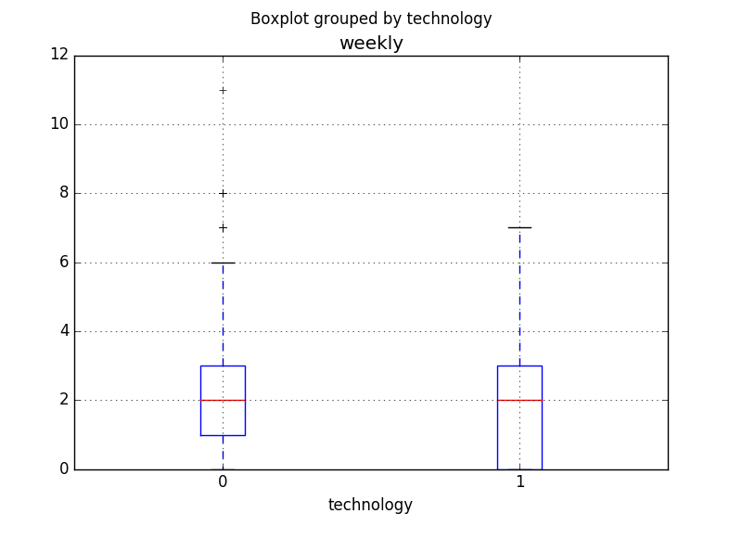
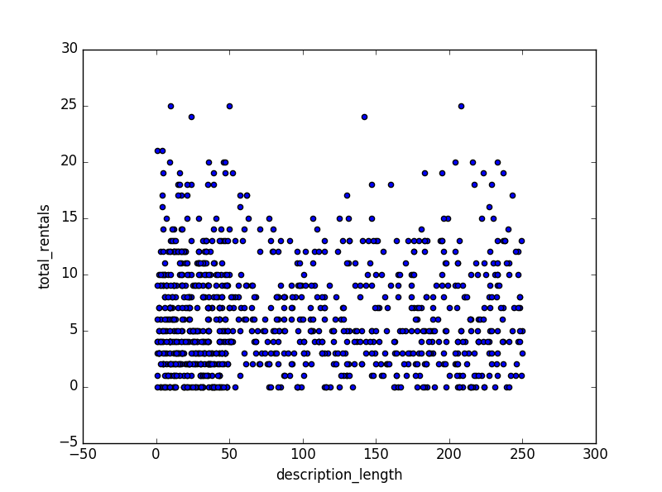
DATA EXPLORATION
Total rentals vs description length
The boxplots suggest that the total number of hourly rentals is more when the car has technology installed than when it doesn’t while the weekly and daily rentals appear to have almost same distributions of rentals
The scatter plot shows that description length might not be useful in predicting the response
DATA PROCESSING
DATA EXPLORATION
MODEL BUILDING
MODEL SELECTION
RESULTS

Slide 6
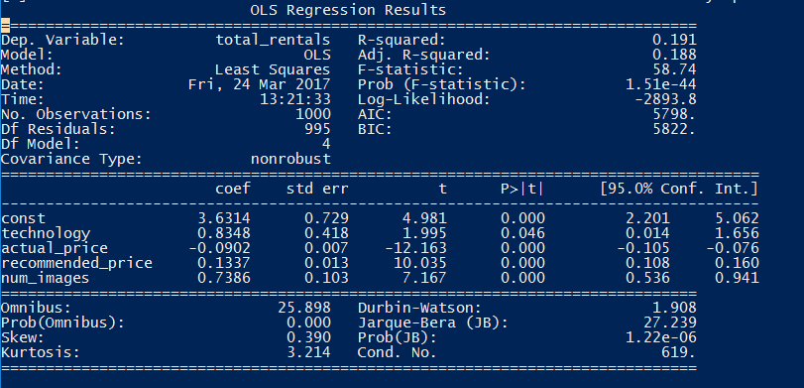
LEAST SQUARES REGRESSION MODEL
Assuming underlying data is linear, linear regression and ridge regression are fitted on the data
The results of Ordinary Least squares regression model is as follows:
R-square : 0.191
Adjusted R-square : 0.188
F-statistic : 58.74
Mean squared error is 19.099
Significant variables: actual_price, recommended_price, num_images, technology
The coefficient of technology in this model suggests that if the car has technology installed, keeping all other variables constant, on average total number of rentals will be 0.8348 more than that without technology
DATA PROCESSING
DATA EXPLORATION
MODEL BUILDING
MODEL SELECTION
RESULTS

Slide 7
RIDGE REGRESSION
Leave-One-Out Cross Validation is performed and alpha parameter is selected from the data (0.01)
R-square value of this model is 0.1912 while mean squared error is 19.096
The coefficients of this model are given as follows(after normalizing regressors) :
Technology and number of images variables seem to carry more weightage than others in this model
As actual price increases the response variable decreases
DATA PROCESSING
DATA EXPLORATION
MODEL BUILDING
MODEL SELECTION
RESULTS

Slide 8
DECISION TREE
Leave-One-Out Cross Validation is performed and following parameters are obtained after tuning the decision tree model
max_depth=5
min_samples_split=2
min_samples_leaf=19
The R-squared value of this model is 0.31758 while mean squared error is 16.1109, an improvement over previous two models
The importance of coefficients is given as follows:
In this model, we see that technology is not a significant predictor while actual_price, recommended_price and num_images are the most significant variables
DATA PROCESSING
DATA EXPLORATION
MODEL BUILDING
MODEL SELECTION
RESULTS

Slide 9
RANDOM FOREST
Leave-One-Out Cross Validation is performed and following parameters are obtained after tuning the random forest model
max_depth of tree=5
min_samples_split=16
min_samples_leaf=7
max_features = ‘auto’
The R-squared value of this model is 0.377258 while mean squared error is 14.702, an improvement over previous models
The importance of coefficients is given as follows:
In this model, we see that technology is not a significant predictor while actual_price, recommended_price and num_images are the most significant variables
DATA PROCESSING
DATA EXPLORATION
MODEL BUILDING
MODEL SELECTION
RESULTS

Slide 10
MODEL SELECTION
R-square value which is the measure of fit or goodness of fit is more for decision tree and random forest which suggests that the underlying data is non-linear
Selecting Gradient Boosting model because of high R-square value and less mean squared error value
The feature importance of the gradient boosting model is given as follows:
DATA PROCESSING
DATA EXPLORATION
MODEL BUILDING
MODEL SELECTION
RESULTS

Slide 11
MOST SIGNIFICANCE VARIABLES
The models Random forest and Gradient boosting are preferred as they explain the non-linear behavior of the data more accurately than the other models
The variables ‘actual_price’ and ‘recommended_price’ are most important features(feature importance metric sum is 70%) followed by variables ‘num_images’ and ‘description’(25% is feature importance metric sum).The higher the feature importance metric, the more important is the feature
The ‘street_parking’ variable is not significant in any of the models and it doesn’t help in predicting the response
Hence, the order of ranking of variables significance in predicting the total number of car rentals (according to random forest and gradient boosting models)is given as :
Actual price (42% - 44% important)
Recommended Price (26% - 34% important)
Number of images and description length of car (8% - 18% important)-less important
SIGNIFICANCE OF TECHNOLOGY VARIABLE
When the decision tree was trained with response variable as hourly, weekly, daily (one at a time) using all predictors, the models showed the importance of technology variable as 5%, 0% and 3% respectively
This indicates that this is not a significant variable for predicting either total number of rentals or hourly/weekly/daily rentals
However, it has an effect to very little extent while predicting hourly rentals (5%)
DATA PROCESSING
DATA EXPLORATION
MODEL BUILDING
MODEL SELECTION
RESULTS

Slide 12
FEATURE ENGINEERING
Adding following features to the data has improved the performance of the random forest model significantly
Hourly – 1 if the car has ever been rented on an hourly basis
Daily - 1 if the car has ever been rented on a daily basis
Weekly – 1 if the car has ever been rented on a weekly basis
For any car that hasn’t ever been rented on weekly basis, its value will be 0. Similarly, for hourly/daily basis
In this case, the results of the regression models will be as follows:
DATA PROCESSING
DATA EXPLORATION
MODEL BUILDING
MODEL SELECTION
RESULTS

Slide 13
The random forest model outperforms others with respect to the quality of fit to the data(R-squared value is more and mean square value is less) , hence, this model is selected for analysis
The most significant coefficients will be as follows in the order of their importance:
Hourly, daily, weekly
Actual_price
Recommended_price
Num_images, description (have very little importance)
DATA PROCESSING
DATA EXPLORATION
MODEL BUILDING
MODEL SELECTION
RESULTS

