Slide 1

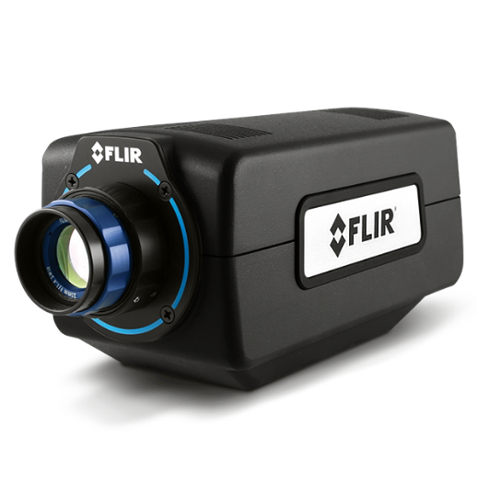
FLIR SC8000 HS Series, for 2.5~5.0 µm WL
FLIR A6261, for 0.6~1.7 µm WL
Raspberry Pi Camera
MATLAB
Import and display image in GUI
MATLAB
Import and display image in GUI
MATLAB
Numerical command
Numerical command
Display image
Raspberry Pi Computer
Relay
Relay
TTL signal
Capture image
TTL signal
Save image
Save image
Camera
Camera
Camera

Slide 2
Relay
IR camera
Numerical command
TTL-level signal
Import image, calculate spectral properties
Save image

Slide 3


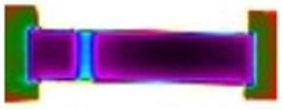
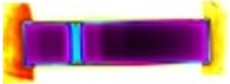




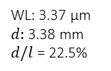

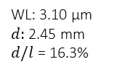

WL: 3.10 µm
$d:$2.45 mm
$d/l$ = 16.3%
WL: 3.37 µm
$d:$3.38 mm
$d/l$ = 22.5%
WL: 3.50 µm
$d:$3.75 mm
$d/l$ = 25.0%
WL: 3.60 µm
$d:$4.32 mm
$d/l$ = 28.8%
WL: 4.50 µm
$d:$7.70 mm
$d/l$ = 51.3%
WL: 4.70 µm
$d:$8.45 mm
$d/l$ = 56.3%

Slide 4
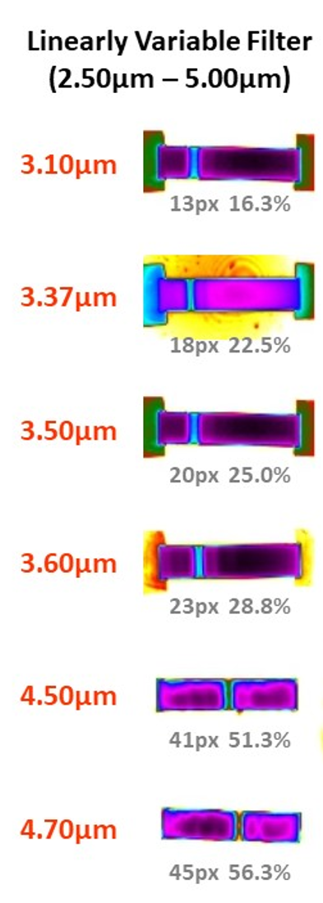
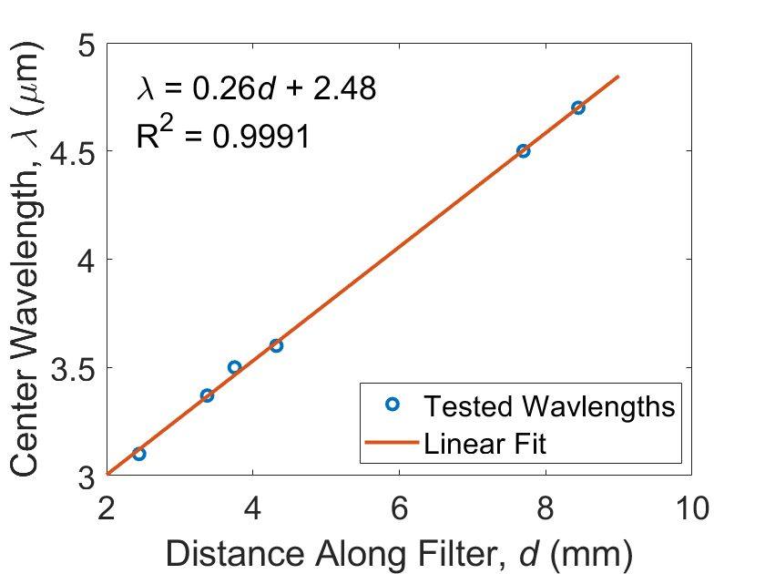
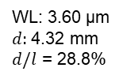
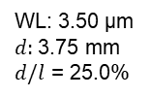
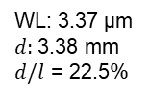
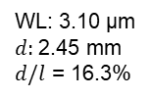
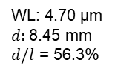
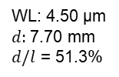
Linear Model Based on July 22 LVF Verification Test
WL: 3.10 µm
$d:$2.45 mm
$d/l$ = 16.3%
WL: 3.37 µm
$d:$3.38 mm
$d/l$ = 22.5%
The model predicts the 5 µm wavelength to be at 9.6 mm (63.8 % of full length).
The model predicts the 2.5 um wavelength to be at 0.09 mm, so essentially 0% of the full length.
WL: 3.50 µm
$d:$3.75 mm
$d/l$ = 25.0%
WL: 3.60 µm
$d:$4.32 mm
$d/l$ = 28.8%
WL: 4.50 µm
$d:$7.70 mm
$d/l$ = 51.3%
WL: 4.70 µm
$d:$8.45 mm
$d/l$ = 56.3%

Slide 5
3.10 µm
3.37 µm
3.50 µm
3.60 µm
4.26 µm
4.60 µm
4.70 µm

Slide 6

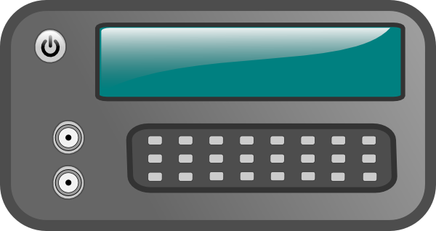
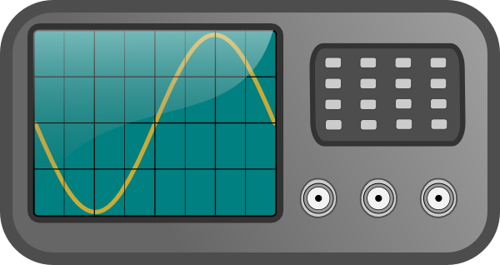
Power settings
Pulse timing
Laser Power Supply
Waveform Generator
Instrument settings
Laser output
Laser Head
Oscilloscope

