Slide 1


Slide 2
Apache HBase is an open-source, distributed, versioned, non-relational database modeled after Google's Bigtable
Apache HBase provides Bigtable-like capabilities on top of Hadoop and HDFS.

Slide 3
Features
Linear and modular scalability.
Strictly consistent reads and writes.
Automatic and configurable sharding of tables
Automatic failover support between RegionServers.
Convenient base classes for backing Hadoop MapReduce jobs with Apache HBase tables.

Slide 4
Features (cont)
Easy to use Java API for client access.
Block cache and Bloom Filters for real-time queries.
Query predicate push down via server side Filters
Thrift gateway and a REST-ful Web service that supports XML, Protobuf, and binary data encoding options

Slide 5
HBase Data Model
Table
An HBase table consists of multiple rows.

Slide 6
Row
A row in HBase consists of a row key and one or more columns with values associated with them.
Rows are sorted alphabetically by the row key as they are stored

Slide 7
Column
A column in HBase consists of a column family and a column qualifier, which are delimited by a : (colon) character.

Slide 8
Column Family
Column families physically colocate a set of columns and their values, often for performance reasons
Each column family has a set of storage properties

Slide 9
Column Qualifier
A column qualifier is added to a column family to provide the index for a given piece of data
Given a column family content, a column qualifier might be content:html, and another might be content:pdf

Slide 10
Cell
A cell is a combination of row, column family, and column qualifier, and contains a value and a timestamp, which represents the value’s version.

Slide 11
Timestamp
A timestamp is written alongside each value, and is the identifier for a given version of a value

Slide 12
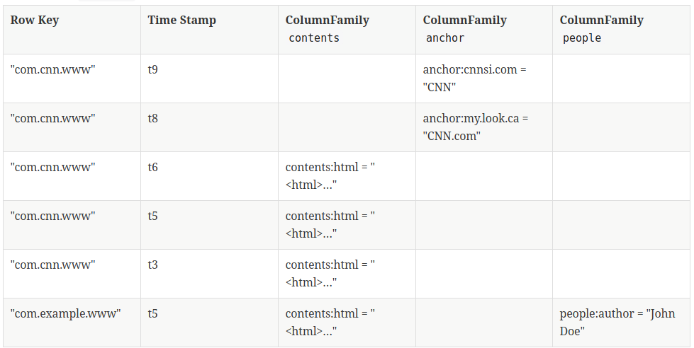

Slide 13
Although at a conceptual level tables may be viewed as a sparse set of rows, they are physically stored by column family
A new column qualifier (column_family:column_qualifier) can be added to an existing column family at any time.

Slide 14
A namespace is a logical grouping of tables analogous to a database in relation database systems
Full table name: namespace:table
Predefined namespaces: ‘hbase’ and ‘default’

Slide 15
Create a namespace
create_namespace 'my_ns'
Create my_table in my_ns namespace
create 'my_ns:my_table', 'fam'
Drop namespace
drop_namespace 'my_ns'

Slide 16
Primary data model operations are:
Get
Put
Scan
Delete

Slide 17
Versions
A {row, column, version} tuple exactly specifies a cell in HBase
It’s possible to have an unbounded number of cells where {row, column} are the same but the cell address differs only in its version dimension
While rows and column keys are expressed as bytes, the version is specified using a long integer

Slide 18
By default, i.e. if you specify no explicit version, when doing a Get, the cell whose version has the largest value is returned (which may or may not be the latest one written)
You can tune your get to retrieve several versions at the time or some specific version

Slide 19
byte[] CF = "cf".getBytes();
byte[] ATTR = "attr".getBytes();
Get get = new Get(Bytes.toBytes("row1"));
get.setMaxVersions(3);
Result r = table.get(get);
byte[] b = r.getValue(CF, ATTR); // current one
List<Cell> cells = r.getColumnCells(CF, ATTR);

Slide 20
Put always creates a new version of a cell, at a certain timestamp
By default the system uses the server’s currentTimeMillis, but you can specify the version yourself, on a per-column level
To overwrite an existing value, do a put at exactly the same row, column, and version as that of the cell you want to overwrite

Slide 21
Delete
Delete: for a specific version of a column.
Delete column: for all versions of a column.
Delete family: for all columns of a particular ColumnFamily

Slide 22
Deletes work by creating tombstone markers for specified version and all versons smaller than specified
Data is NOT deleted immediatelly, just masked
Actual deletion – on major compaction procedure

Slide 23
Sort Order
All data model operations HBase return data in sorted order
First by row, then by ColumnFamily, followed by column qualifier, and finally timestamp (sorted in reverse, so newest records are returned first).

Slide 24
Column Metadata
There is no store of column metadata outside of the internal KeyValue instances for a ColumnFamily
The only way to get a complete set of columns that exist for a ColumnFamily is to process all the rows

Slide 25
Joins: NO

Slide 26
ACID: Limited ways
(http://hadoop-hbase.blogspot.com/2012/03/acid-in-hbase.html)

Slide 27
HBase shell
General Commands
status - Provides the status of HBase
version - Provides the version of HBase
table_help - Provides help for table-reference commands.
whoami - Provides information about the user.

Slide 28
Data Definition Language
create - Creates a table.
list - Lists all the tables in HBase.
enable/disable/is_enabled/is_disabled – Enables/Disables a table.
describe - Provides the description of a table.
alter - Alters a table.
exists - Verifies whether a table exists.
drop/drop_all - Drops a table(s) from HBase.

Slide 29
Data Manipulation Language
put - Puts a cell value at a specified column in a specified row in a particular table.
get - Fetches the contents of row or a cell.
delete/deleteall - Deletes a cell value in a table.
scan - Scans and returns the table data.
count - Returns the number of rows in a table.
truncate - Disables, drops, and recreates a specified table.

Slide 30
This will create new table ‘emp’ with 2 column families:
create 'emp', 'personal data', 'professional data'

Slide 31
> put 'emp','1','personal data:name','raju'
> put 'emp','1','personal data:city','hyderabad'
> put 'emp','1','professional data:designation','manager'
> put 'emp','1','professional data:salary','50000'
> scan 'emp'
> get 'emp', 'row1', {COLUMN ⇒ 'personal data:name'}
> delete 'emp', '1', 'personal data:city', 1417521848375

Slide 32


Slide 33
Apache Phoenix enables OLTP and operational analytics in Hadoop for low latency applications by combining the best of both worlds:
the power of standard SQL and JDBC APIs with full ACID transaction capabilities and
the flexibility of late-bound, schema-on-read capabilities from the NoSQL world by leveraging HBase as its backing store

