Slide 1


Slide 2
Graph Database
Neo4j was built to efficiently store, handle, and query highly-connected data in your data model

Slide 3
A graph database stores nodes and relationships instead of tables, or documents
Data is stored without restricting it to a pre-defined model, allowing a very flexible way of thinking about and using it

Slide 4
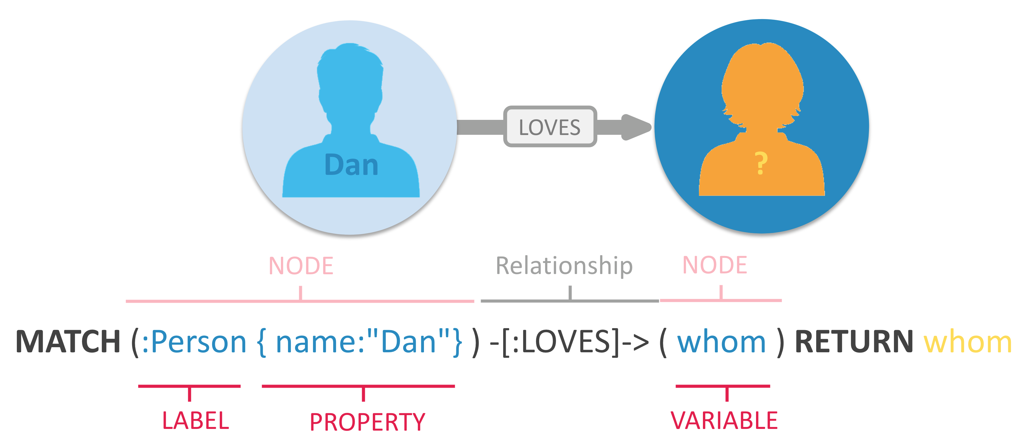
In Neo4j, information is organized as nodes, relationships, and properties

Slide 5
Nodes are the entities in the graph.
Nodes can be tagged with labels, representing their different roles in your domain. (For example, Person).
Nodes can hold any number of key-value pairs, or properties. (For example, name)
Node labels may also attach metadata (such as index or constraint information) to certain nodes.

Slide 6
Relationships provide directed, named, connections between two node entities (e.g. Person LOVES Person).
Relationships always have a direction, a type, a start node, and an end node, and they can have properties, just like nodes.
Nodes can have any number or type of relationships without sacrificing performance.
Although relationships are always directed, they can be navigated efficiently in any direction.

Slide 7
Components of the Neo4j Graph Platform
Neo4j Graph Database - core graph database that is built to store and retrieve connected data
Neo4j Desktop - application to manage local instances of Neo4j
Neo4j Browser - online browser interface to query and view the data in the database

Slide 8
Components of the Neo4j Graph Platform (cont)
Neo4j Bloom - visualization tool for business users that does not require any code or programming skills to view and analyze data
Neo4j AuraDB - database-as-a-service offering managed by Neo4j for graph databases in the cloud
Graph Data Science - officially-supported library for executing graph algorithms with Neo4j and optimized for enterprise workloads and pipelines

Slide 9
Cypher Query Language
Cypher is Neo4j’s graph query language that lets you retrieve data from the graph
It is like SQL for graphs, and was inspired by SQL so it lets you focus on what data you want out of the graph

Slide 10
Cypher uses an ASCII-art type of syntax where
(nodes)-[:ARE_CONNECTED_TO]->(otherNodes)
using rounded brackets for circular (nodes), and -[:ARROWS]-> for relationships
Cypher is designed to be human-readable, it’s construct is based on English prose and iconography to make syntax visual and easily understood

Slide 11
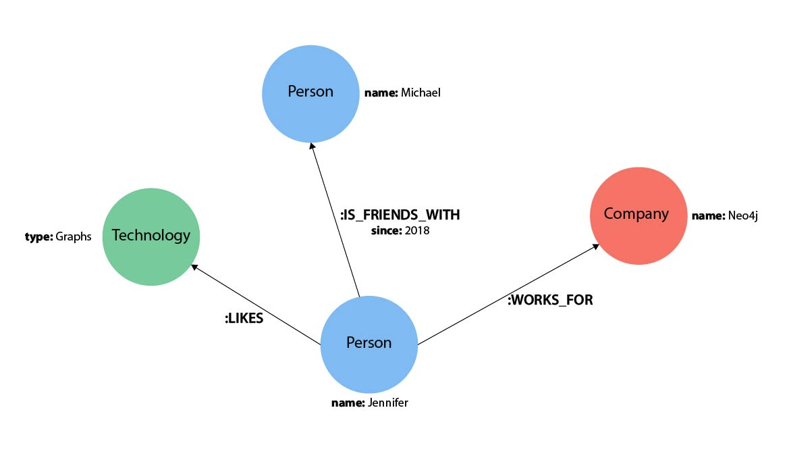

Slide 12
Nodes
To depict nodes in Cypher, we surround the node with parentheses, e.g. (person)

Slide 13
Node Variables
If we later want to refer to the node, we can give it a variable like (p) for person or (t) for thing
If the node is not relevant to your return results, you can specify an anonymous node using empty parentheses ()

Slide 14
Node Labels
You can also group similar nodes together by assigning a node label
In our example, Person, Technology, and Company are the labels.

Slide 15
() //anonymous node (no label or variable) can refer to any node in the database
(p:Person) //using variable p and label Person
(:Technology) //no variable, label Technology
(work:Company) //using variable work and label Company

Slide 16
Relationships
Relationships are represented in Cypher using an arrow --> or <-- between two nodes
Additional information, such as how nodes are connected (relationship type) and any properties pertaining to the relationship, can be placed in square brackets inside of the arrow
Undirected relationships are represented with no arrow and just two dashes --

Slide 17
//data stored with this direction
CREATE (p:Person)-[:LIKES]->(t:Technology)
//query relationship backwards will not return results
MATCH (p:Person)<-[:LIKES]-(t:Technology)
//better to query with undirected relationship unless sure of direction
MATCH (p:Person)-[:LIKES]-(t:Technology)

Slide 18
Relationship Types
Relationship types categorize and add meaning to a relationship, similar to how labels group nodes
[:LIKES] - makes sense when we put nodes on either side of the relationship (Jennifer LIKES Graphs)
[:IS_FRIENDS_WITH] - makes sense when we put nodes with it (Jennifer IS_FRIENDS_WITH Michael)
[:WORKS_FOR] - makes sense with nodes (Jennifer WORKS_FOR Neo4j)

Slide 19
Relationship Variables
Just as we did with nodes, if we want to refer to a relationship later in a query, we can give it a variable like [r] or [rel]
Also you can specify an anonymous relationship using two dashes --, -->, <--.
As an example, you could use either -[rel]-> or -[rel:LIKES]-> and call the rel variable later in your query to reference the relationship and its details.

Slide 20
Node or Relationship Properties
Properties are name-value pairs that provide additional details to our nodes and relationships
Node property:
(p:Person {name: 'Jennifer'})
Relationship property:
-[rel:IS_FRIENDS_WITH {since: 2018}]->

Slide 21
Patterns
Nodes and relationships make up the building blocks for graph patterns. These building blocks can come together to express simple or complex patterns
In Cypher, patterns can be written as a continuous path or separated into smaller patterns and tied together with commas.

Slide 22
Let us use our example of Jennifer likes Graphs
(p:Person {name: "Jennifer"})
-[rel:LIKES]->
(g:Technology {type: "Graphs"})
This block tells the pattern we want, but it does not tell whether we want to find that existing pattern or insert it as a new pattern

Slide 23
Cypher Keywords
The MATCH keyword in Cypher is what searches for an existing node, relationship, label, property, or pattern in the database
MATCH works pretty much like SELECT in SQL

Slide 24
The RETURN keyword in Cypher specifies what values or results you might want to return from a Cypher query
You can tell Cypher to return nodes, relationships, node and relationship properties, or patterns in your query results
RETURN is not required when doing write procedures, but is needed for reads.

Slide 25
Example: Find the labeled Person nodes in the graph
MATCH (p:Person) RETURN p LIMIT 1
Note that we must use a variable like p for the Person node if we want retrieve the node in the RETURN clause

Slide 26
Showcase: explore the Movies sample database

