Slide 1
Web Development
Internet Fundamentals

Slide 2
Internet Fundamentals
TCP/IP
DNS
HTTP/HTTPS
FTP,SMTP,POP3,IMAP,...

Slide 3
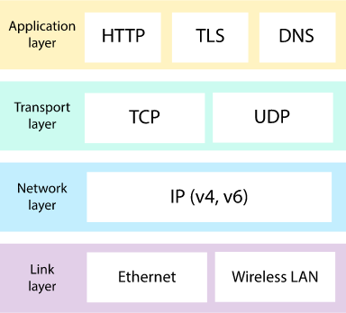
Layers of IP

Slide 4
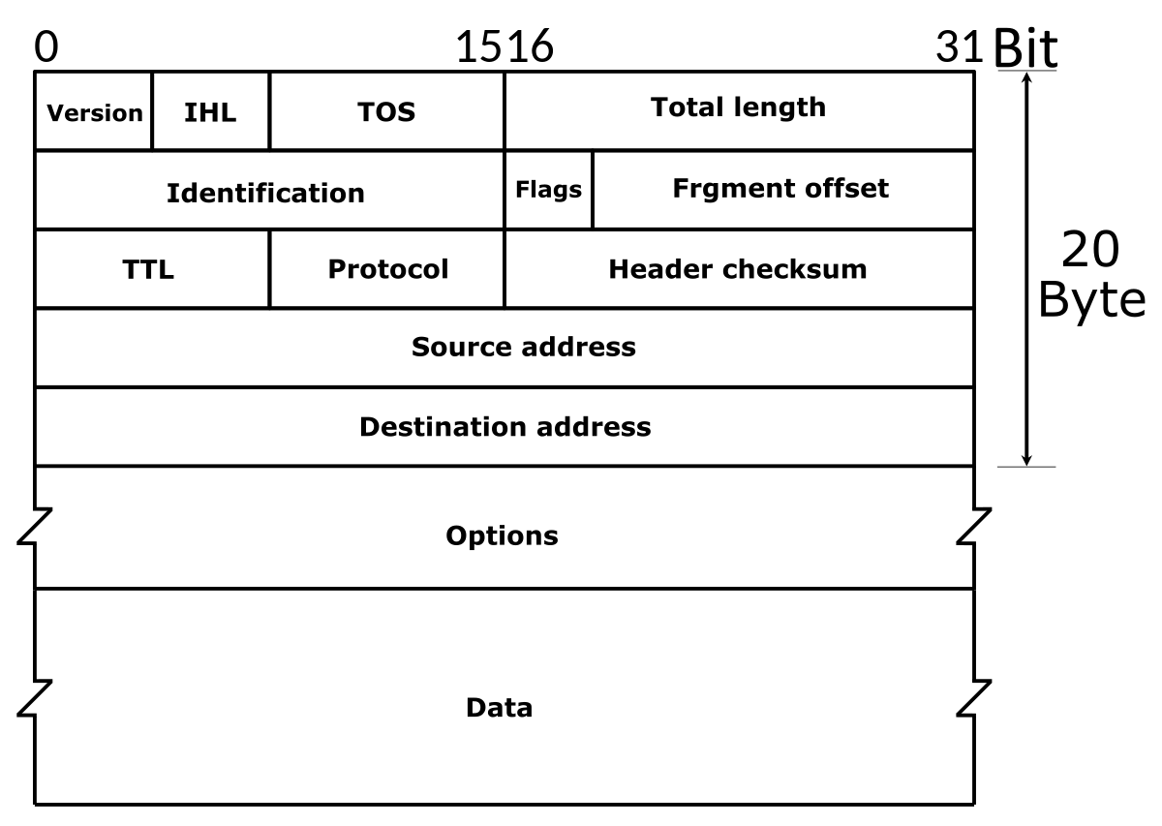
IP packet format (v4)

Slide 5
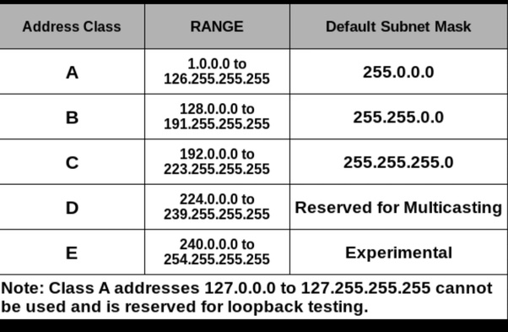
IP Address
Classes of addresses

Slide 6
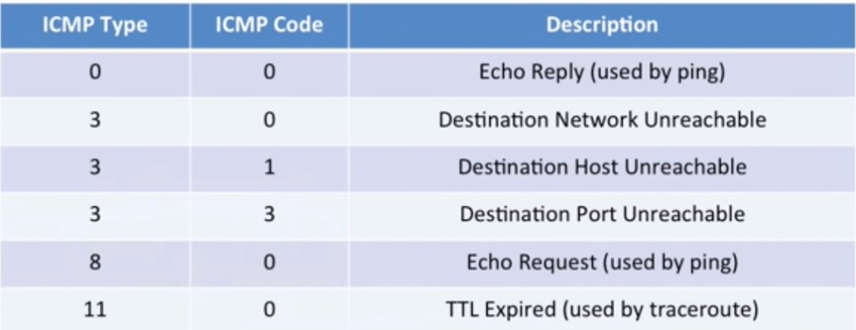
ICMP
Internet Control Message Protocol

Slide 7
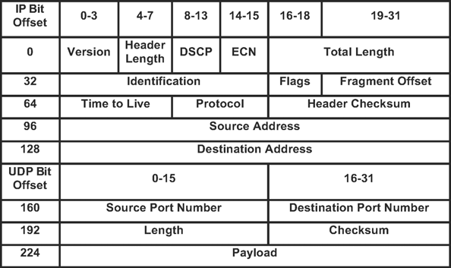
UDP packet format
User Datagram Protocol

Slide 8
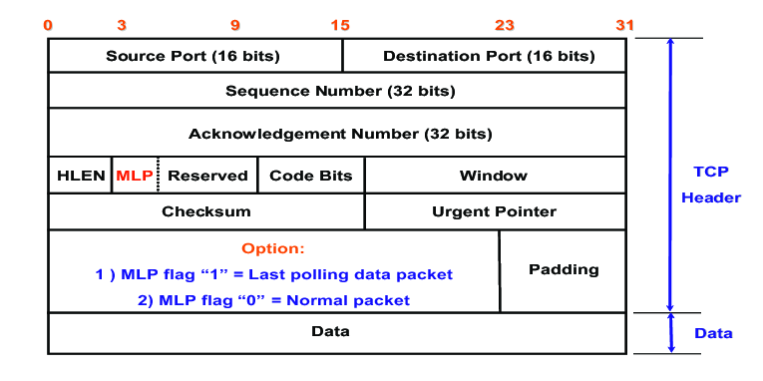
TCP packet format
Transmission Control Protocol

Slide 9
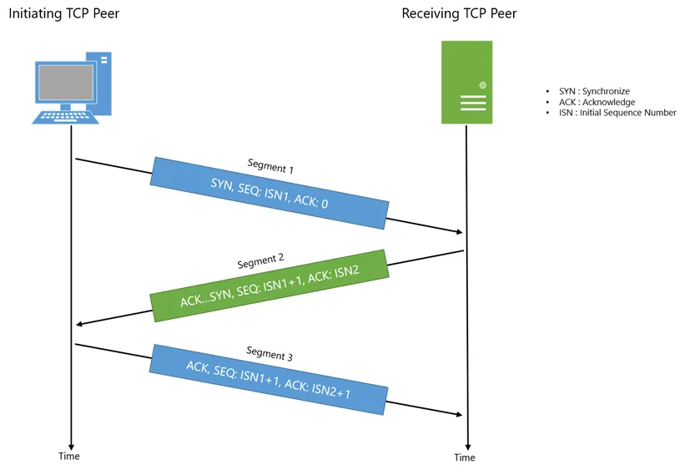
TCP handshake

Slide 10
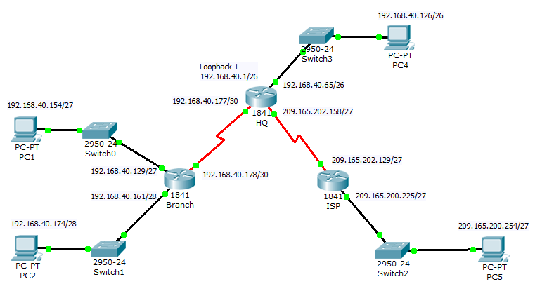
IP Routing

Slide 11
IP Routing Protocols
Routing Information Protocol (RIP)
Interior Gateway Protocol (IGRP)
Open Shortest Path First (OSPF)
Exterior Gateway Protocol (EGP)
Enhanced Interior Gateway Routing Protocol (EIGRP)
Border Gateway Protocol (BGP)
Intermediate System-to-Intermediate System (IS-IS)

Slide 12
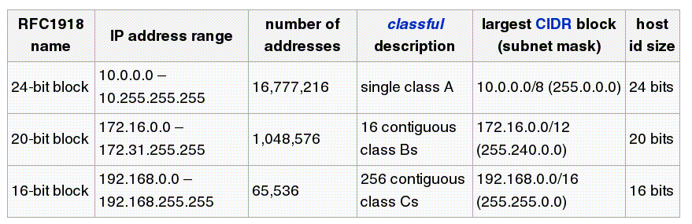
IP Address and routing
Non-routable IP addresses

Slide 13
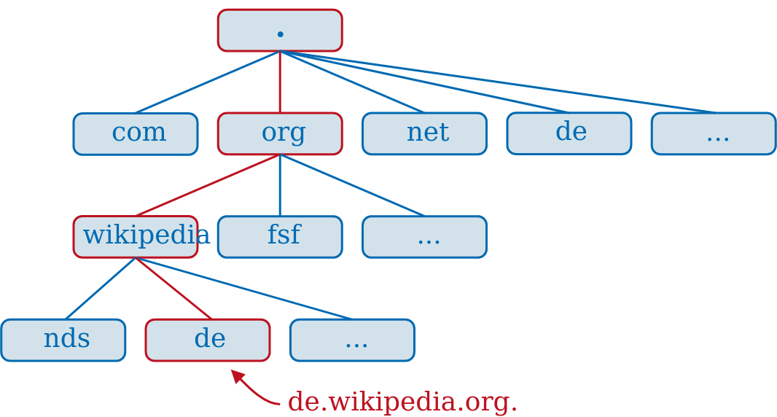
DNS

Slide 14
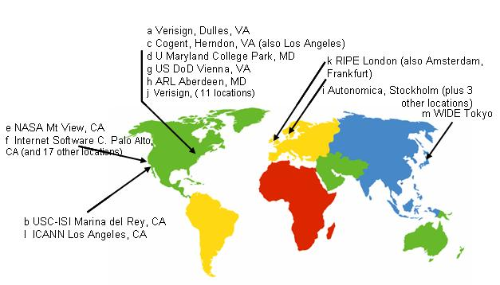
Root DNS servers

Slide 15
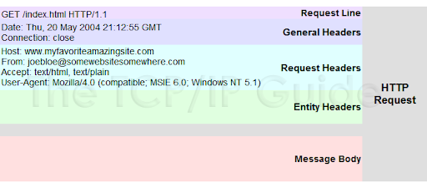
HTTP
HyperText Transfer Protocol

Slide 16
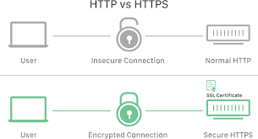
HTTPS
HTTP with encryption (S for Secure)

Slide 17
Other protocols
FTP File Transfer Protocol
SMTP Simple Mail Transfer Protocol
POP3 Post Office Protocol (v3)
IMAP Internet Message Access Protocol
… a lot of other protocols ...

