Slide 1


The R-SASSY System

Slide 2
Response Summary
All Astellas questions/requests can be addressed
Will take some code changes
Code changes are not difficult
All have been identified previously
Will prioritize to facilitate use of packages at Astellas
Timeline estimate is 2 or 3 months, due to constraints on the frequency of CRAN submissions

Slide 3

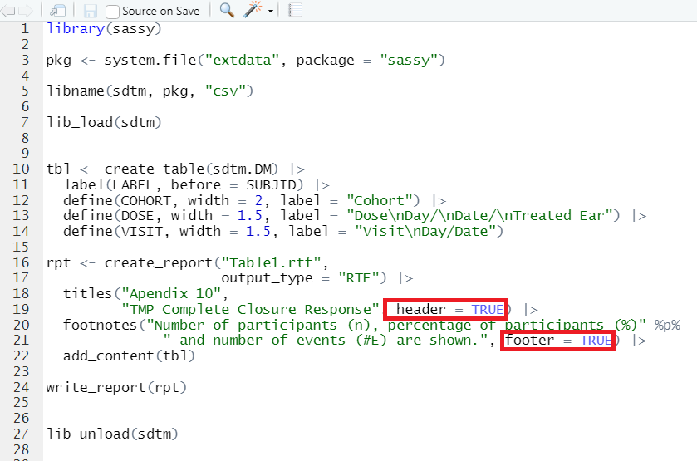
Question 1: Can we have multiple lines in page headers and page footers for TLFs?
Code:
Answer: Propose header parameter for titles() and footer parameter for footnotes().
Will only work on RTF and DOCX. Will be same throughout report.

Slide 4
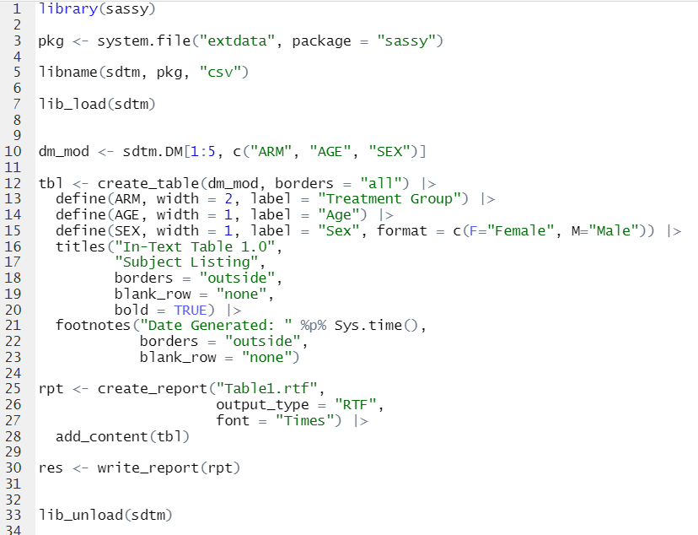
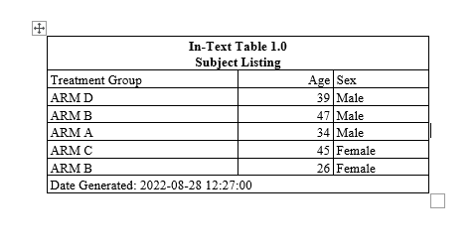
Question 2: Astellas has SAS programs to generate some standard in-text tables. Not sure if Sassy have any functions for generating in-text tables?
Code:
Result:
Answer: Can generate in-text style tables with borders, and titles/footnotes in body of the report, close to table. Have no package to generate “standard” tables. Would be happy to work with Astellas to develop a standard table library using R-sassy.

Slide 5
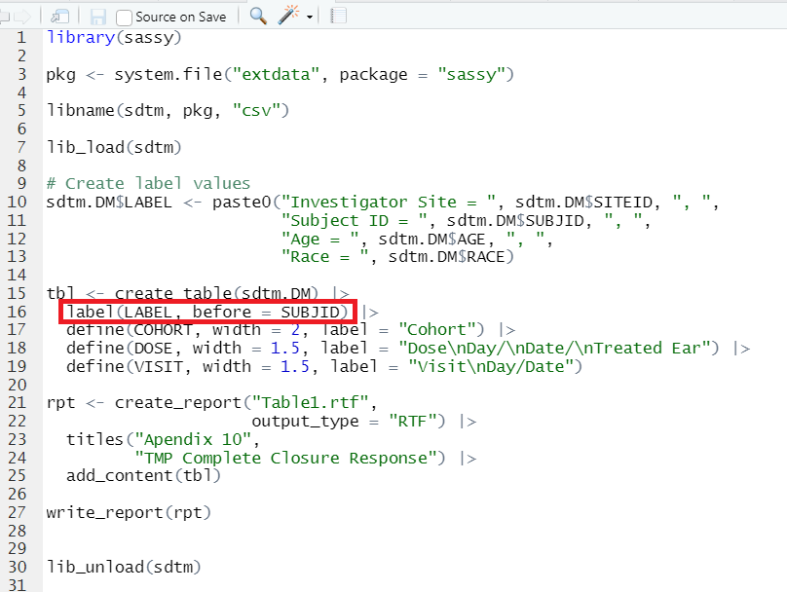
Question 3: We need to add a line for baseline characteristics for each subject in the listings. Are there any ways to do it?
Code:
Answer: Propose label() function to put a label row before or after specified variable(s).

Slide 6
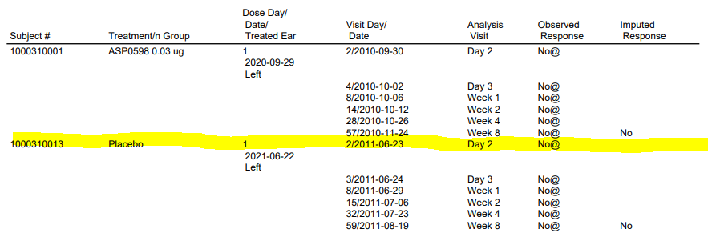

Question 4: Blank line on non-visible column
Code:
Answer: This is a known issue and will be fixed probably in the next release.

Slide 7

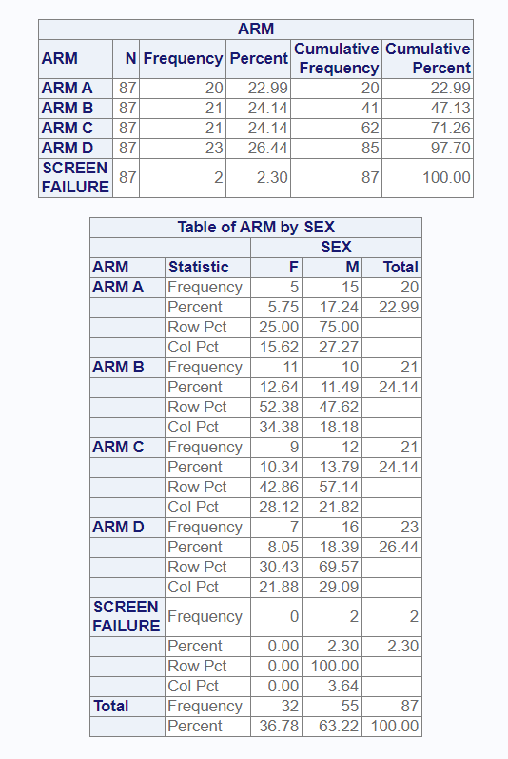
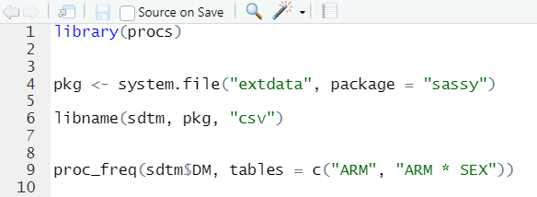
Question 5a: Can we get a proc contents?
Code:
Result:
Answer: proc_contents() coming in next package “procs”. This package is replicating several SAS procedures: proc freq, proc means, proc transpose, proc sort, proc print, and proc contents.

Slide 8

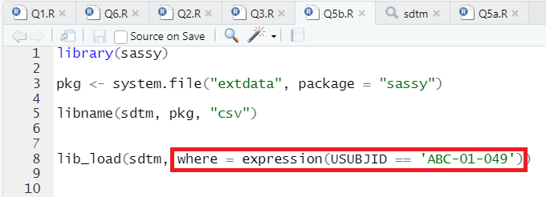
Question 5b: Can you add a filter to lib_load?
Code:
Answer: Propose to add a where expression to lib_load().
Will execute on all datasets. Will give a message if fails on a particular dataset.

Slide 9

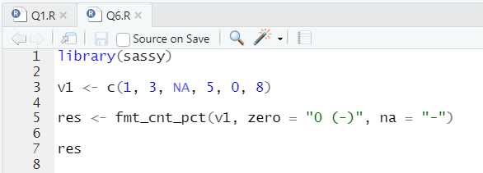
Question 6: Where is “zero” argument in fmt_cnt_pct()?
Code:
Result:
"1 ( 20.0%)"
"3 ( 60.0%)"
"-"
"5 (100.0%)"
"0 (-)"
"8 (160.0%)"
Answer: This is on CRAN. May have been a timing issue.

Slide 10
Discussion

Slide 11

Contact Info
Name:
Affiliation:
Contact Number:
E-mail:
Website:
Twitter:
LinkedIn:
David J. Bosak
Archytas Clinical Solutions
269-870-7343
dbosak01@gmail.com
r-sassy.org
@MidwestVulcan
linkedin.com/in/david-bosak-724b3911

