Slide 1
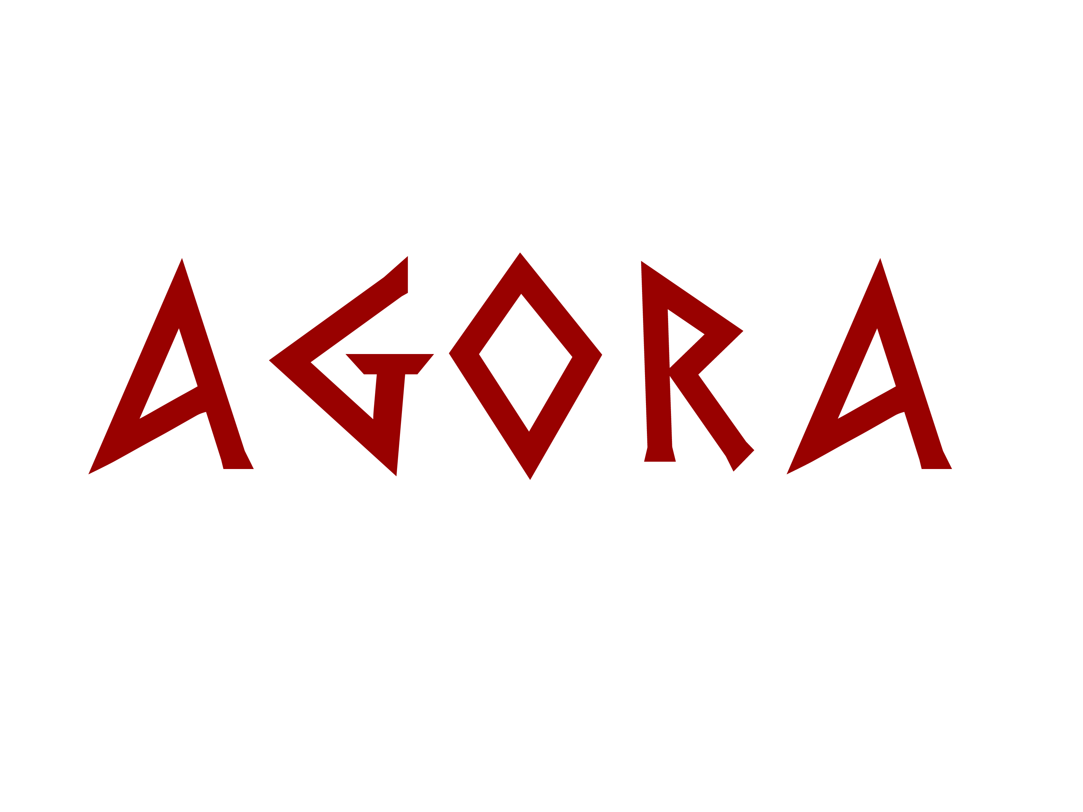
Team Agora

Slide 2
Development
Development
  Risk-Based
  Foundations first
How did it work?
  Pretty well!
Notes:
Risk based
Ended up working very well
A lot of hard work up front, but in the end, our open ended design and foundations paid off
We were meeting to review and several times we had a “oh we're missing this” moment. 2 minutes later that functionality was in.

Slide 3
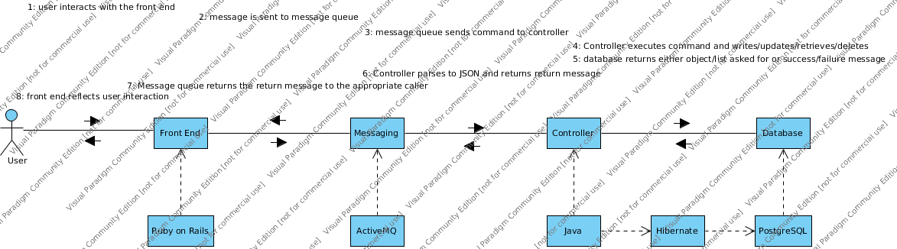
Design
High Level Architecture
  MVC
Notes:
Describe MVC
Systems used:
Java
Hibernate
Postgres
ActiveMQ
Ruby on Rails
Why?
Java: common lang
Hibernate: good for mapping objects to db
Postgres: solid open source db
ActiveMQ: experience with it
Ruby on Rails: simplicity, experience with it

Slide 4
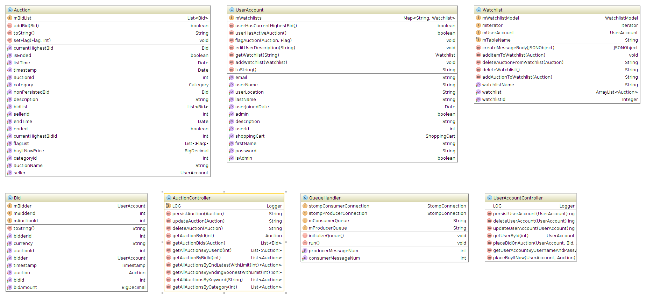
Design
Class UML
  Biggest classes
Notes:
Here are the big classes
Left to right is:
Auction
UserAccount
Watchlist
Bid
AuctionController
QueueHander
UserAccountController

Slide 5
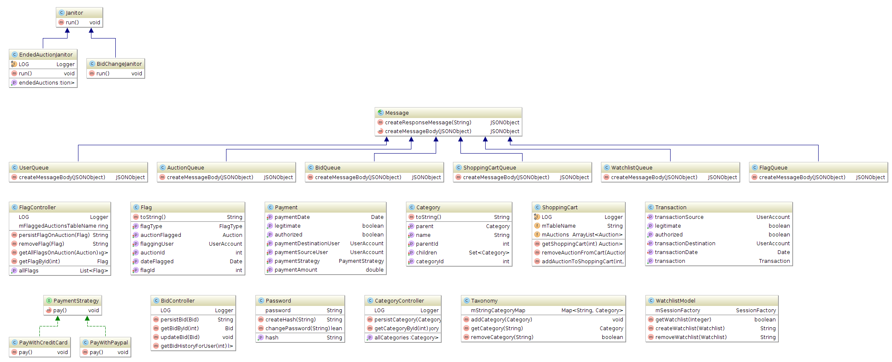
Design
Class UML
  Some notable classes
Notes:
Here are some notable classes that demonstrate some patterns we used.
Janitor is an abstract class that implements runnable.
Message is the class that all messages extend.
There is also a not pictured message factory that uses the factory pattern.
Payment uses the strategy pattern but unfortunately is not implemented.

Slide 6
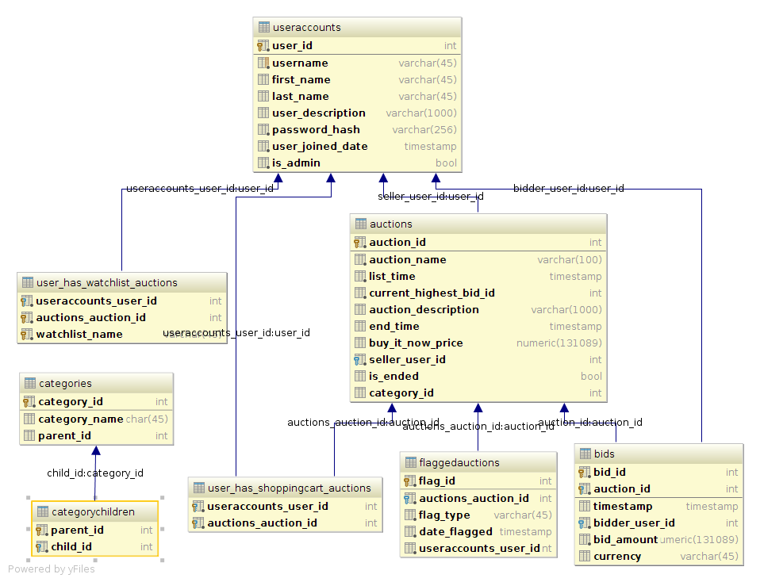
Database Design
Schema

Slide 7
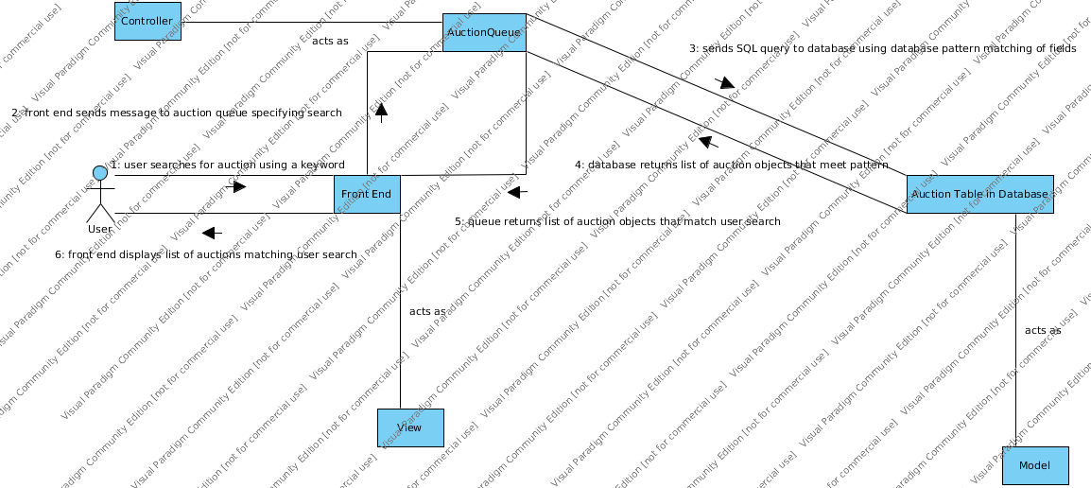
Design
Communication Diagrams
  Search for Auctions

Slide 8
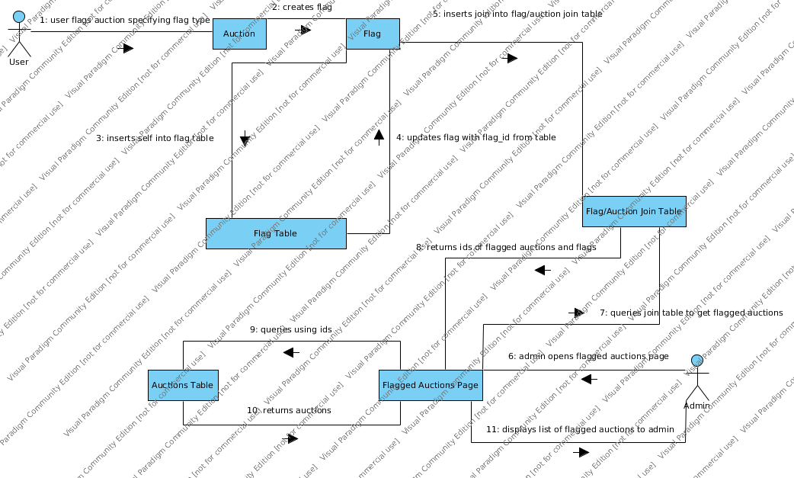
Design
Flag Auction

Slide 9
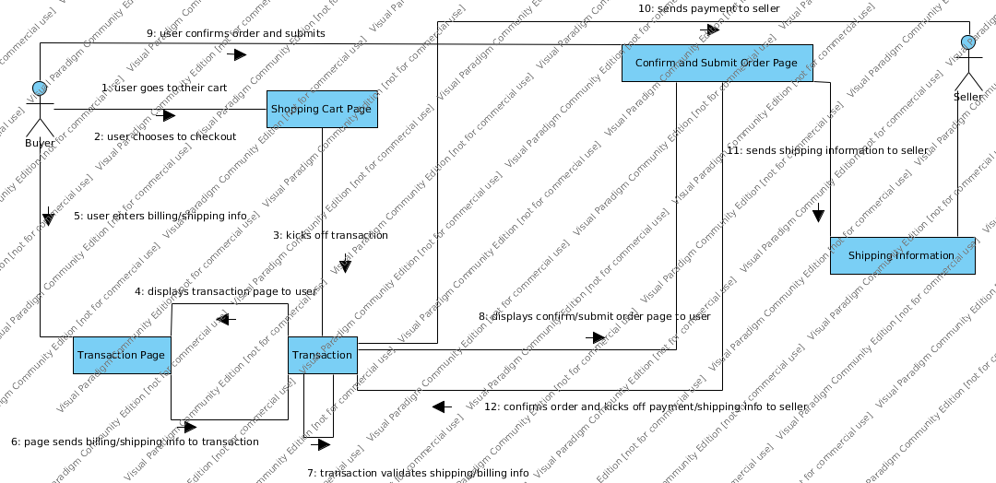
Design
Checkout

Slide 10
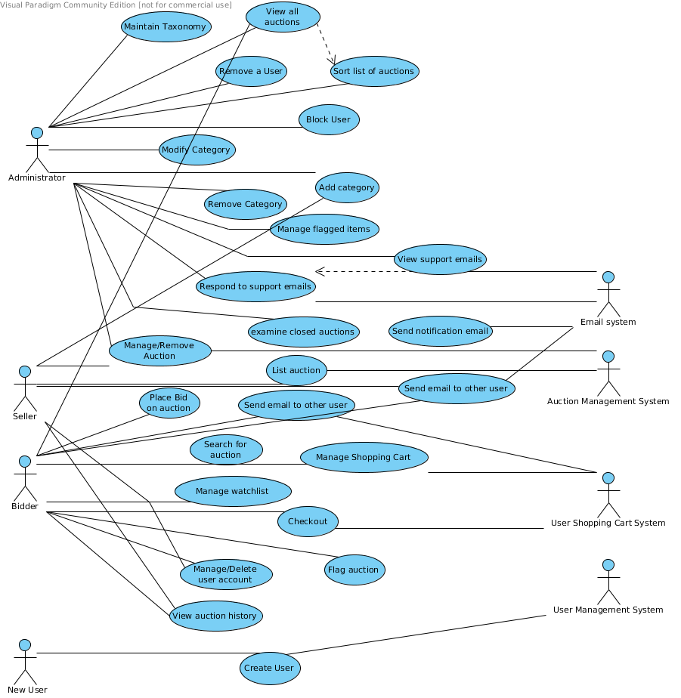
Design
Use Case Diagram

Slide 11
Story Map
Notes:
Reflections

Slide 12
Java – Hibernate - PostgreSQL
How did it go?
Pain Points
Eureka!
Wasn't hard
Wasn't easy
Notes:
Hibernate ended up working out really well. It was both the best and the most difficult part of the project for me. It was great in that it took care of a lot of things automagically. It wasn't great simply because I used it wrong. I didn't let Hibernate create its own schema. We had a schema that worked and wanted to use that. So I mapped that schema to the classes we had created. This ended up working just fine. It only meant a little bit of extra work to get things like join tables (Shopping Cart, Watchlist, Categories) working with pure SQL instead of the fancy methods Hibernate provides. ANd the SQL to do so was not very difficult.
####Pain Points####
However, this did lead to a pain point. I had never worked with Hibernate before, nor had I ever had to design or build a database controller. That said, once I started, it only got easier. But when an issue came up between Hibernate and the database, it took a lot of debugging to find the error. A lot of times it was something to do with parameter mapping between objects and Hibernate entities. This is probably due to my fiddling more than Hibernate doing anything wrong.
Not being collocated was another. Also, not knowing enough about the front end.
####Eureka Moment####
My Eureka Moment was when I first got Hibernate running and realized how simple it could be.
####What I thought was going to be hard but turned out easy. ####
I thought getting the controllers set up and the database ready to go was going to be very difficult. But, once I got Hibernate and postgres working, it was a cinch.
####What I thought was going to be easy but turned out hard. ####
Not much really. I anticipated a lot being hard, and was pleasantly surprised. But that may be my outlook on life.

Slide 13
Front End
Edit

Slide 14
Messaging
Edit

Slide 15
Email
Edit

Slide 16
Summary
Pain Points
Eureka!
Wasn't Hard
Wasn't Easy
Coolest Moment
Design Thinking vs. Code and Refactor
Reflection on general approach and process

