Slide 1
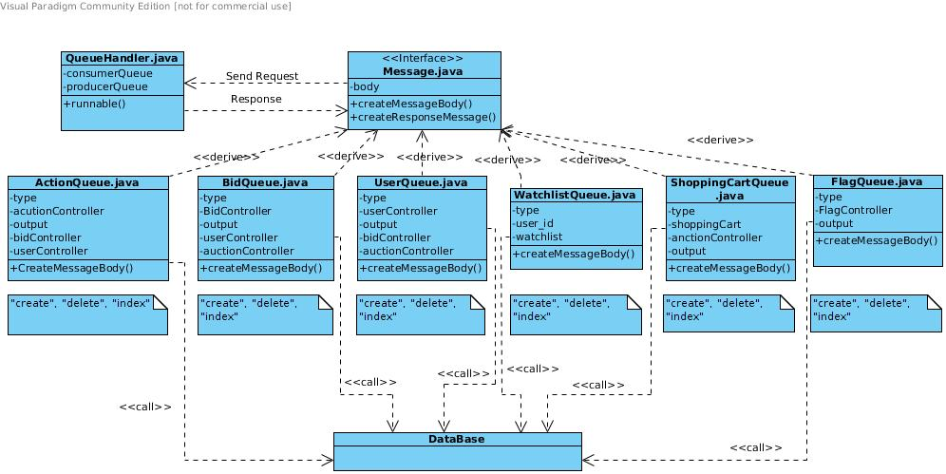
Messaging
“QueueHandler” <=> Queues <=> Engines&Database

