Slide 1
Private P2P File Transfer
3
relies on
SP²OR
Node Selection
2
e-Squad Overlays
SP²ORES
Node Availability Prediction
RPS*
Layer construction
. . .
. . .
. . .
configures
SphinxES (set-based onion routing)
1
. . .
. . .
. . .

Slide 2
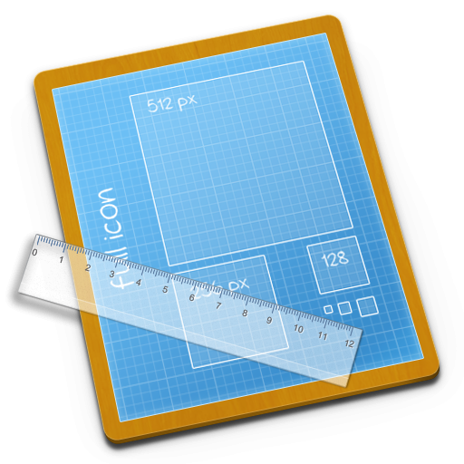

views
protocols
connected_to[ ]
Port Connection
Config file
towards_port[ ]
Port Selection
Shape Building
one node
Same Shape
Remote Shapes
Global Random Peer Sampling (RPS)
Key: membership shape connection

Slide 3
1
[
0
left
right
port at 0.75
port at 0.25
E_{ring}=[0,1[

Slide 7
Legend:
clique
star
port
(a)
(b)
(c)
Inter-shape binding

