Slide 1
A Farmer’s Choice
Project 7.5; 2 (pg. 285)
How should the farmer make informed business decisions?
Constraints:
Resources – land/water
Cost – labor
Demand
Non-negativity

Slide 2
A Farmer’s Choice
Linear Programming Method
Geometric Solution
R-based Solution: LpSolveAPI
Create Lp object and decision variables
Add constraints
Set objective function
Solve the model

Slide 3

Blackjack, the Monte Carlo way. Broad class of algorithms that rely on repeated random sampling to obtain results; using randomness to solve problems that are deterministic in principle.
Play 12 games (simulations) where each game lasts two decks.
When the two decks are out, the round is completed using two fresh decks (that is the last round of the game).
Everything is then reset for the start of the next game.
The player wins 3 dollars with a winning hand.
The player loses 2 dollars with a losing hand.
No money is exchanged if there is no winner.
No winner if neither goes bust and they stand at the same amount.
If the dealer goes bust, the player automatically wins.
The dealer strategy is to stand at 17 or above.
The player strategy is open and can be set as desired.

Slide 4
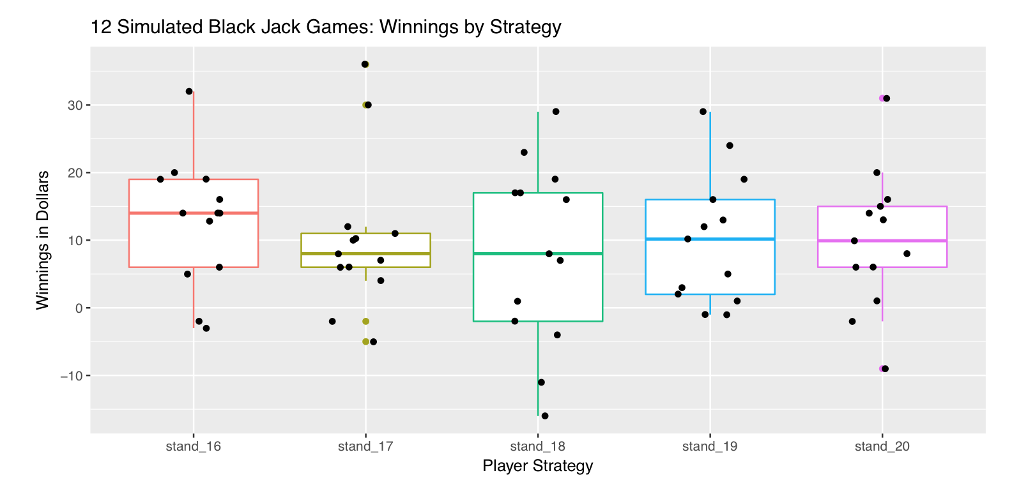
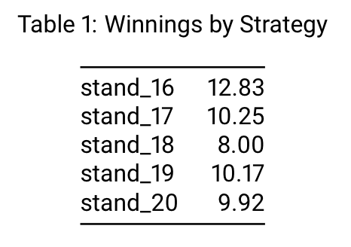
If you were to only look at the average winnings across 12 games, it would appear that standing at 16 is the best option when the dealer stands at 17.
The plot though illustrates just how much variation there is in results.

Slide 5
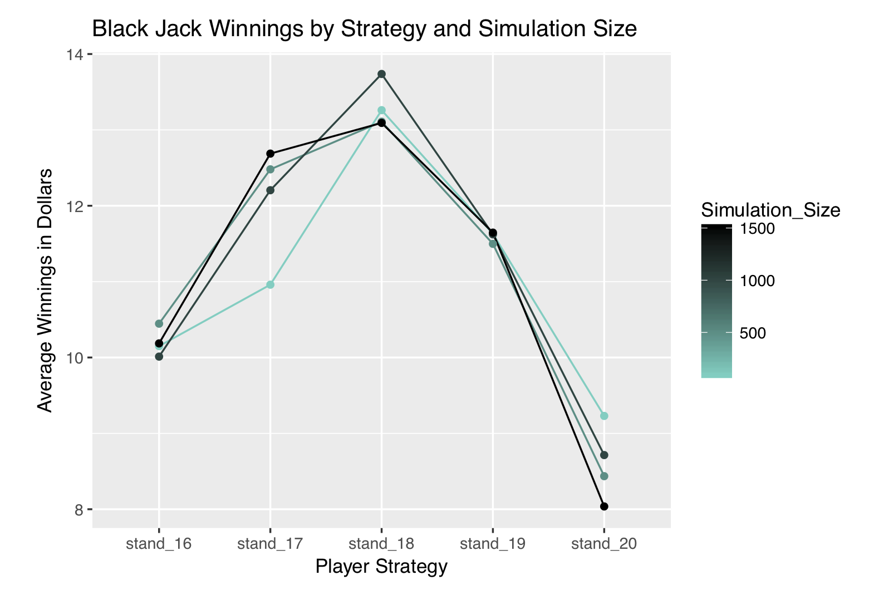
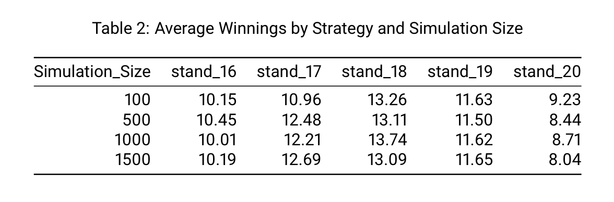
Standing at 18 is the best option, as standing at 19 leaves the player with fewer winnings.
Standing at 16, 17, or 20 results in fewer winnings overall. Therefore if the dealer stands at 17, the player should stand at 18.

Slide 6

UMAP Module 69 – The Digestive Process of Sheep
The problem
The digestive processes of sheep can highlight the nutritionally value in varied feeding schedules or mixed food preparation. This is especially important when raising sheep for commercial purposes.
The digestive process
Sheep are a cud-chewing animal which means that unchewed food goes through a series of storage stomachs called the rumen and the reticulum. The process is illustrated below:

Slide 7
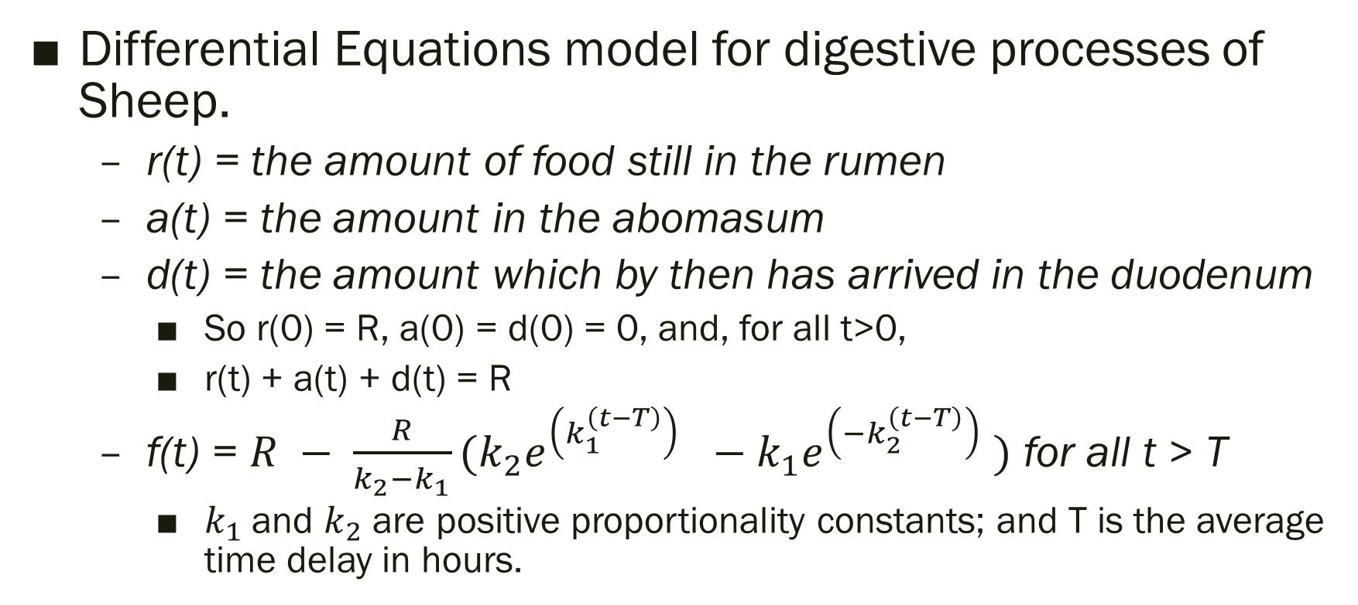
UMAP Module 69 – The Digestive Process of Sheep
Differential Equations model for digestive processes of Sheep.
r(t) = the amount of food still in the rumen
a(t) = the amount in the abomasum
d(t) = the amount which by then has arrived in the duodenum
So r(0) = R, a(0) = d(0) = 0, and, for all t>0,
r(t) + a(t) + d(t) = R
f(t) = $R − \frac{R}{k_{2}−k_{1}}(k_{2}e^{\left(k_{1}^{\left(t−T\right)}\right) }−k_{1}e^{\left(−k_{2}^{\left(t−T\right)}\right) })$ for all t > T
$k_{1}$and $k_{2}$ are positive proportionality constants; and T is the average time delay in hours.

Slide 8
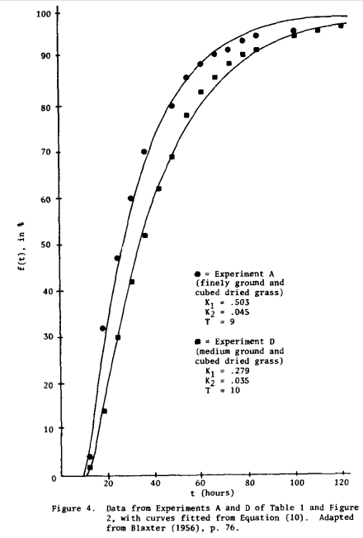
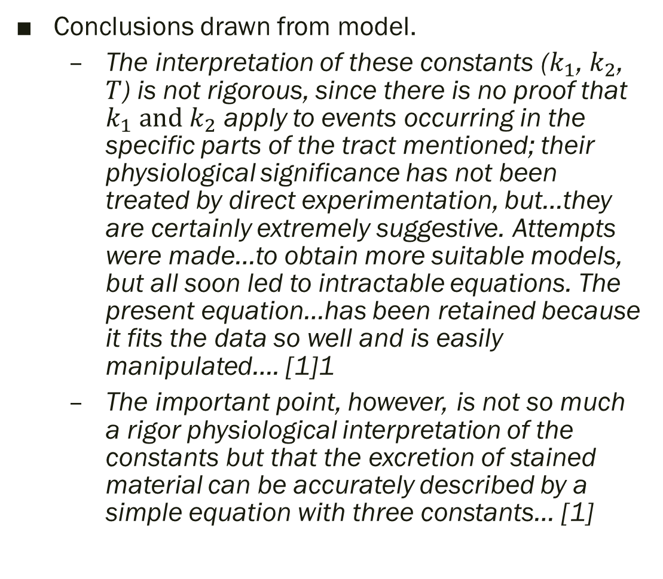
Conclusions drawn from model.
The interpretation of these constants ($k_{1}$, $k_{2}$, $T$) is not rigorous, since there is no proof that $k_{1} and$ $k_{2}$ apply to events occurring in the specific parts of the tract mentioned; their physiological significance has not been treated by direct experimentation, but…they are certainly extremely suggestive. Attempts were made…to obtain more suitable models, but all soon led to intractable equations. The present equation…has been retained because it fits the data so well and is easily manipulated…. [1]1
The important point, however, is not so much a rigor physiological interpretation of the constants but that the excretion of stained material can be accurately described by a simple equation with three constants… [1]
[1] Blaxter, K.L., Graham, N. McC., and Wainman, F.W. (1956). Some observations on the Digestibility of Food by Sheep and on Related Problems. British Journal of Nutrition, 10: 68-91

