Slide 2

UMAP Module 69 – The Digestive Process of Sheep
The problem
The digestive processes of sheep can highlight the nutritionally value in varied feeding schedules or mixed food preparation. This is especially important when raising sheep for commercial purposes.
The digestive process
Sheep are a cud-chewing animal which means that unchewed food goes through a series of storage stomachs called the rumen and the reticulum. The process is illustrated below:

Slide 3
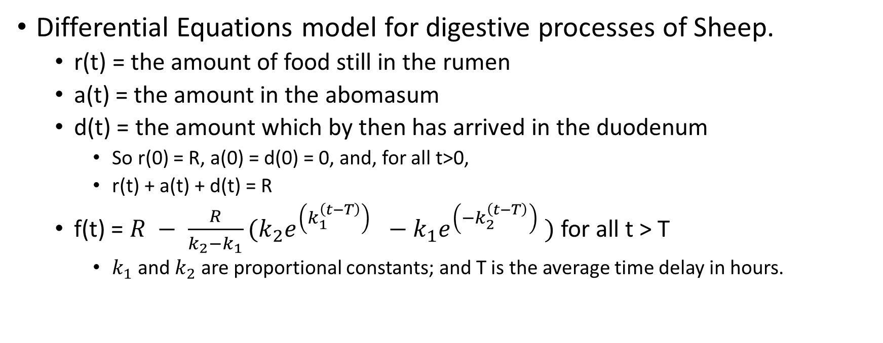
UMAP Module 69 – The Digestive Process of Sheep
Differential Equations model for digestive processes of Sheep.
r(t) = the amount of food still in the rumen
a(t) = the amount in the abomasum
d(t) = the amount which by then has arrived in the duodenum
So r(0) = R, a(0) = d(0) = 0, and, for all t>0,
r(t) + a(t) + d(t) = R
f(t) = $R − \frac{R}{k_{2}−k_{1}}(k_{2}e^{\left(k_{1}^{\left(t−T\right)}\right) }−k_{1}e^{\left(−k_{2}^{\left(t−T\right)}\right) })$ for all t > T
$k_{1}$and $k_{2}$ are proportional constants; and T is the average time delay in hours.

Slide 4
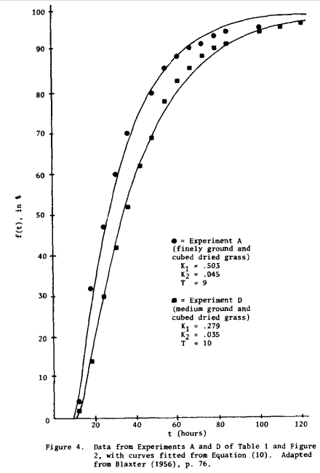
Validate Models and conclusions drawn from model.

