Slide 1

UMAP Module 69 – The Digestive Process of Sheep
The problem
The digestive processes of sheep can highlight the nutritionally value in varied feeding schedules or mixed food preparation. This is especially important when raising sheep for commercial purposes.
The digestive process
Sheep are a cud-chewing animal which means that unchewed food goes through a series of storage stomachs called the rumen and the reticulum. The process is illustrated below:

Slide 2
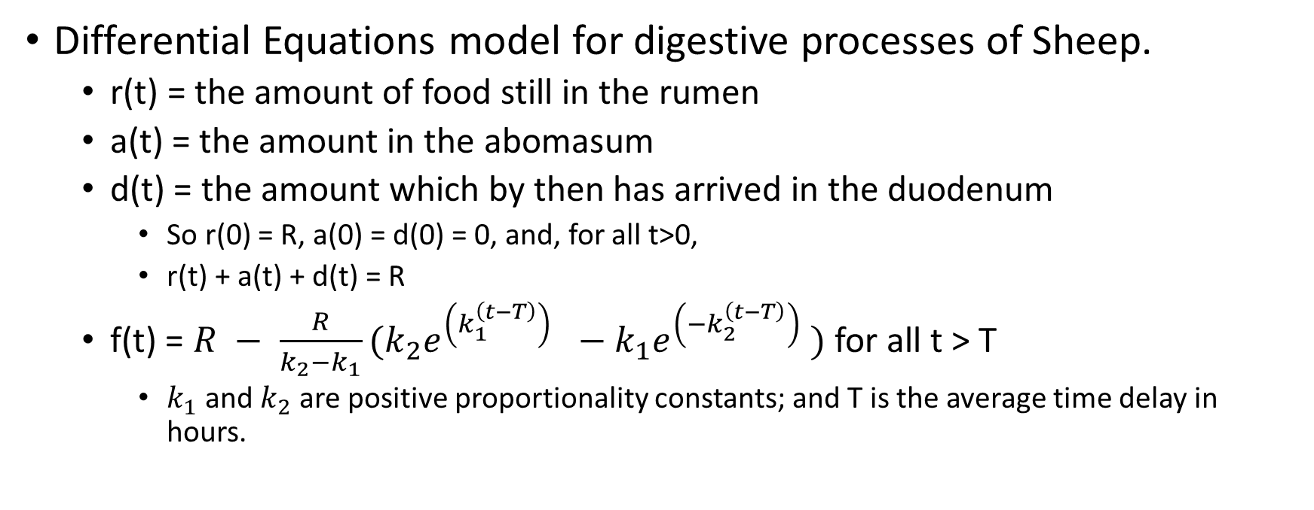
UMAP Module 69 – The Digestive Process of Sheep
Differential Equations model for digestive processes of Sheep.
r(t) = the amount of food still in the rumen
a(t) = the amount in the abomasum
d(t) = the amount which by then has arrived in the duodenum
So r(0) = R, a(0) = d(0) = 0, and, for all t>0,
r(t) + a(t) + d(t) = R
f(t) = $R − \frac{R}{k_{2}−k_{1}}(k_{2}e^{\left(k_{1}^{\left(t−T\right)}\right) }−k_{1}e^{\left(−k_{2}^{\left(t−T\right)}\right) })$ for all t > T
$k_{1}$and $k_{2}$ are positive proportionality constants; and T is the average time delay in hours.

Slide 3
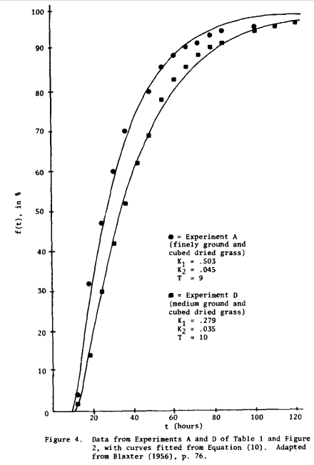
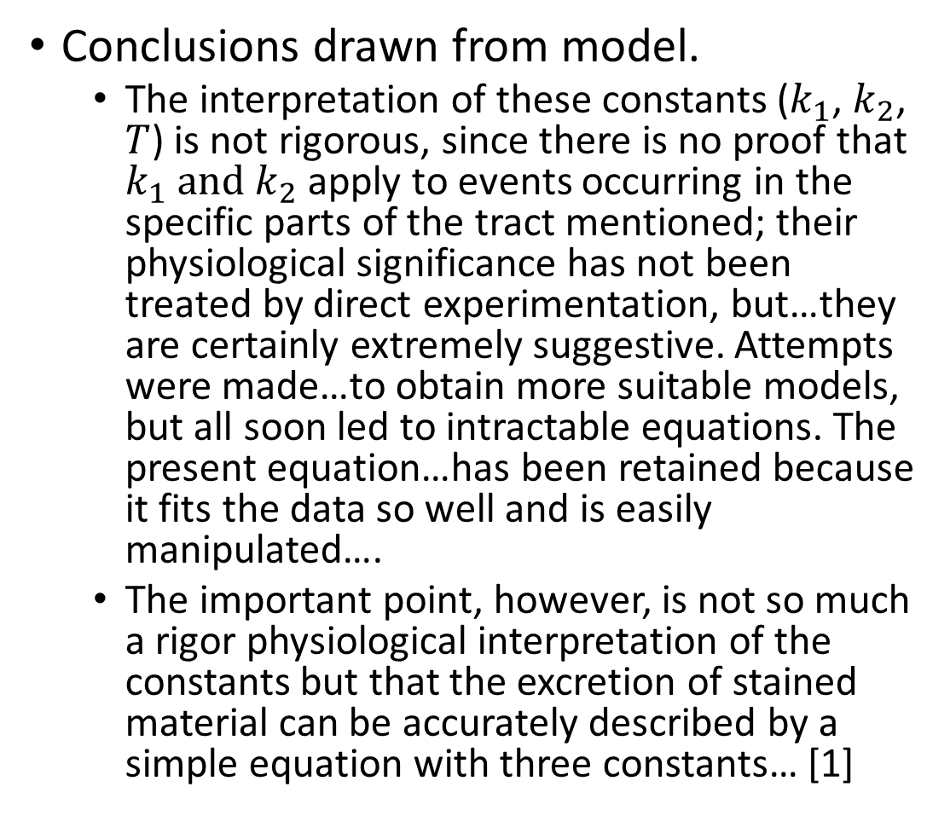
Conclusions drawn from model.
The interpretation of these constants ($k_{1}$, $k_{2}$, $T$) is not rigorous, since there is no proof that $k_{1} and$ $k_{2}$ apply to events occurring in the specific parts of the tract mentioned; their physiological significance has not been treated by direct experimentation, but…they are certainly extremely suggestive. Attempts were made…to obtain more suitable models, but all soon led to intractable equations. The present equation…has been retained because it fits the data so well and is easily manipulated….
The important point, however, is not so much a rigor physiological interpretation of the constants but that the excretion of stained material can be accurately described by a simple equation with three constants… [1]
[1] Blaxter, K.L., Graham, N. McC., and Wainman, F.W. (1956). Some observations on the Digestibility of Food by Sheep and on Related Problems. British Journal of Nutrition, 10: 68-91

