Slide 1
Team Review Meeting
Overview Sprint: 2 Team #: 3 Team Members: Alexis, Ben, Dylan, Jonathan, Kevin, Logan Software Title: GoalGetter - Make Goals Better Language/Framework/Library: Unity, C#, VSCode, Jira, GitHub | Accomplishments this Sprint Created two teams, Programming & UI Divvied-up tasks in each of the teams Started individual tasks Team 1 – Programming Logan Alexis Kevin Team 2 – UI Ben Dylan Jonathan
Current Issues Using Unity to collaborate: Certain amount of seats allowed, makes collaboration harder | Plan for Next Sprint Continue work on splitting-up tasks Goal Database Code improvements

Slide 2
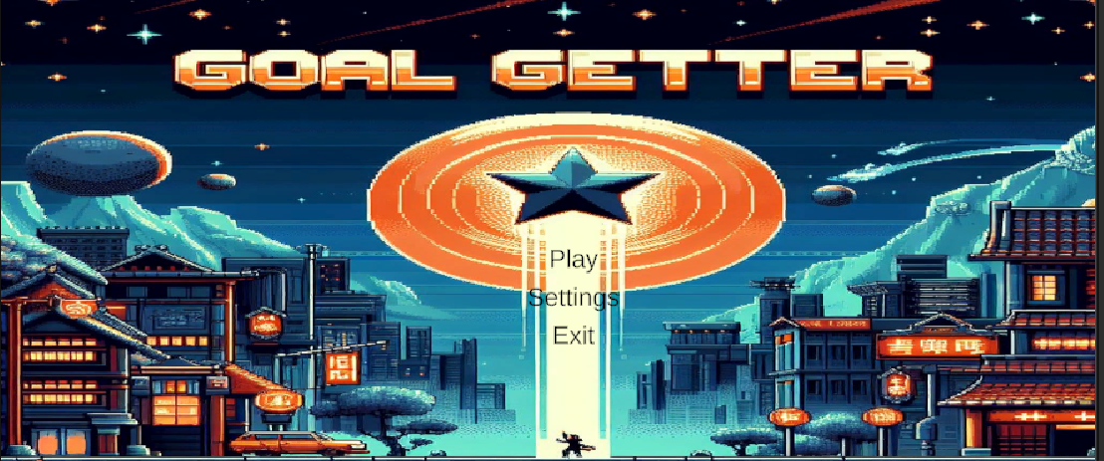

Slide 3
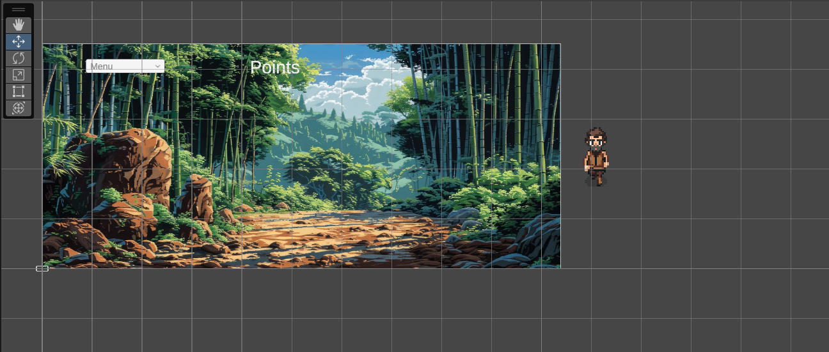

Slide 4
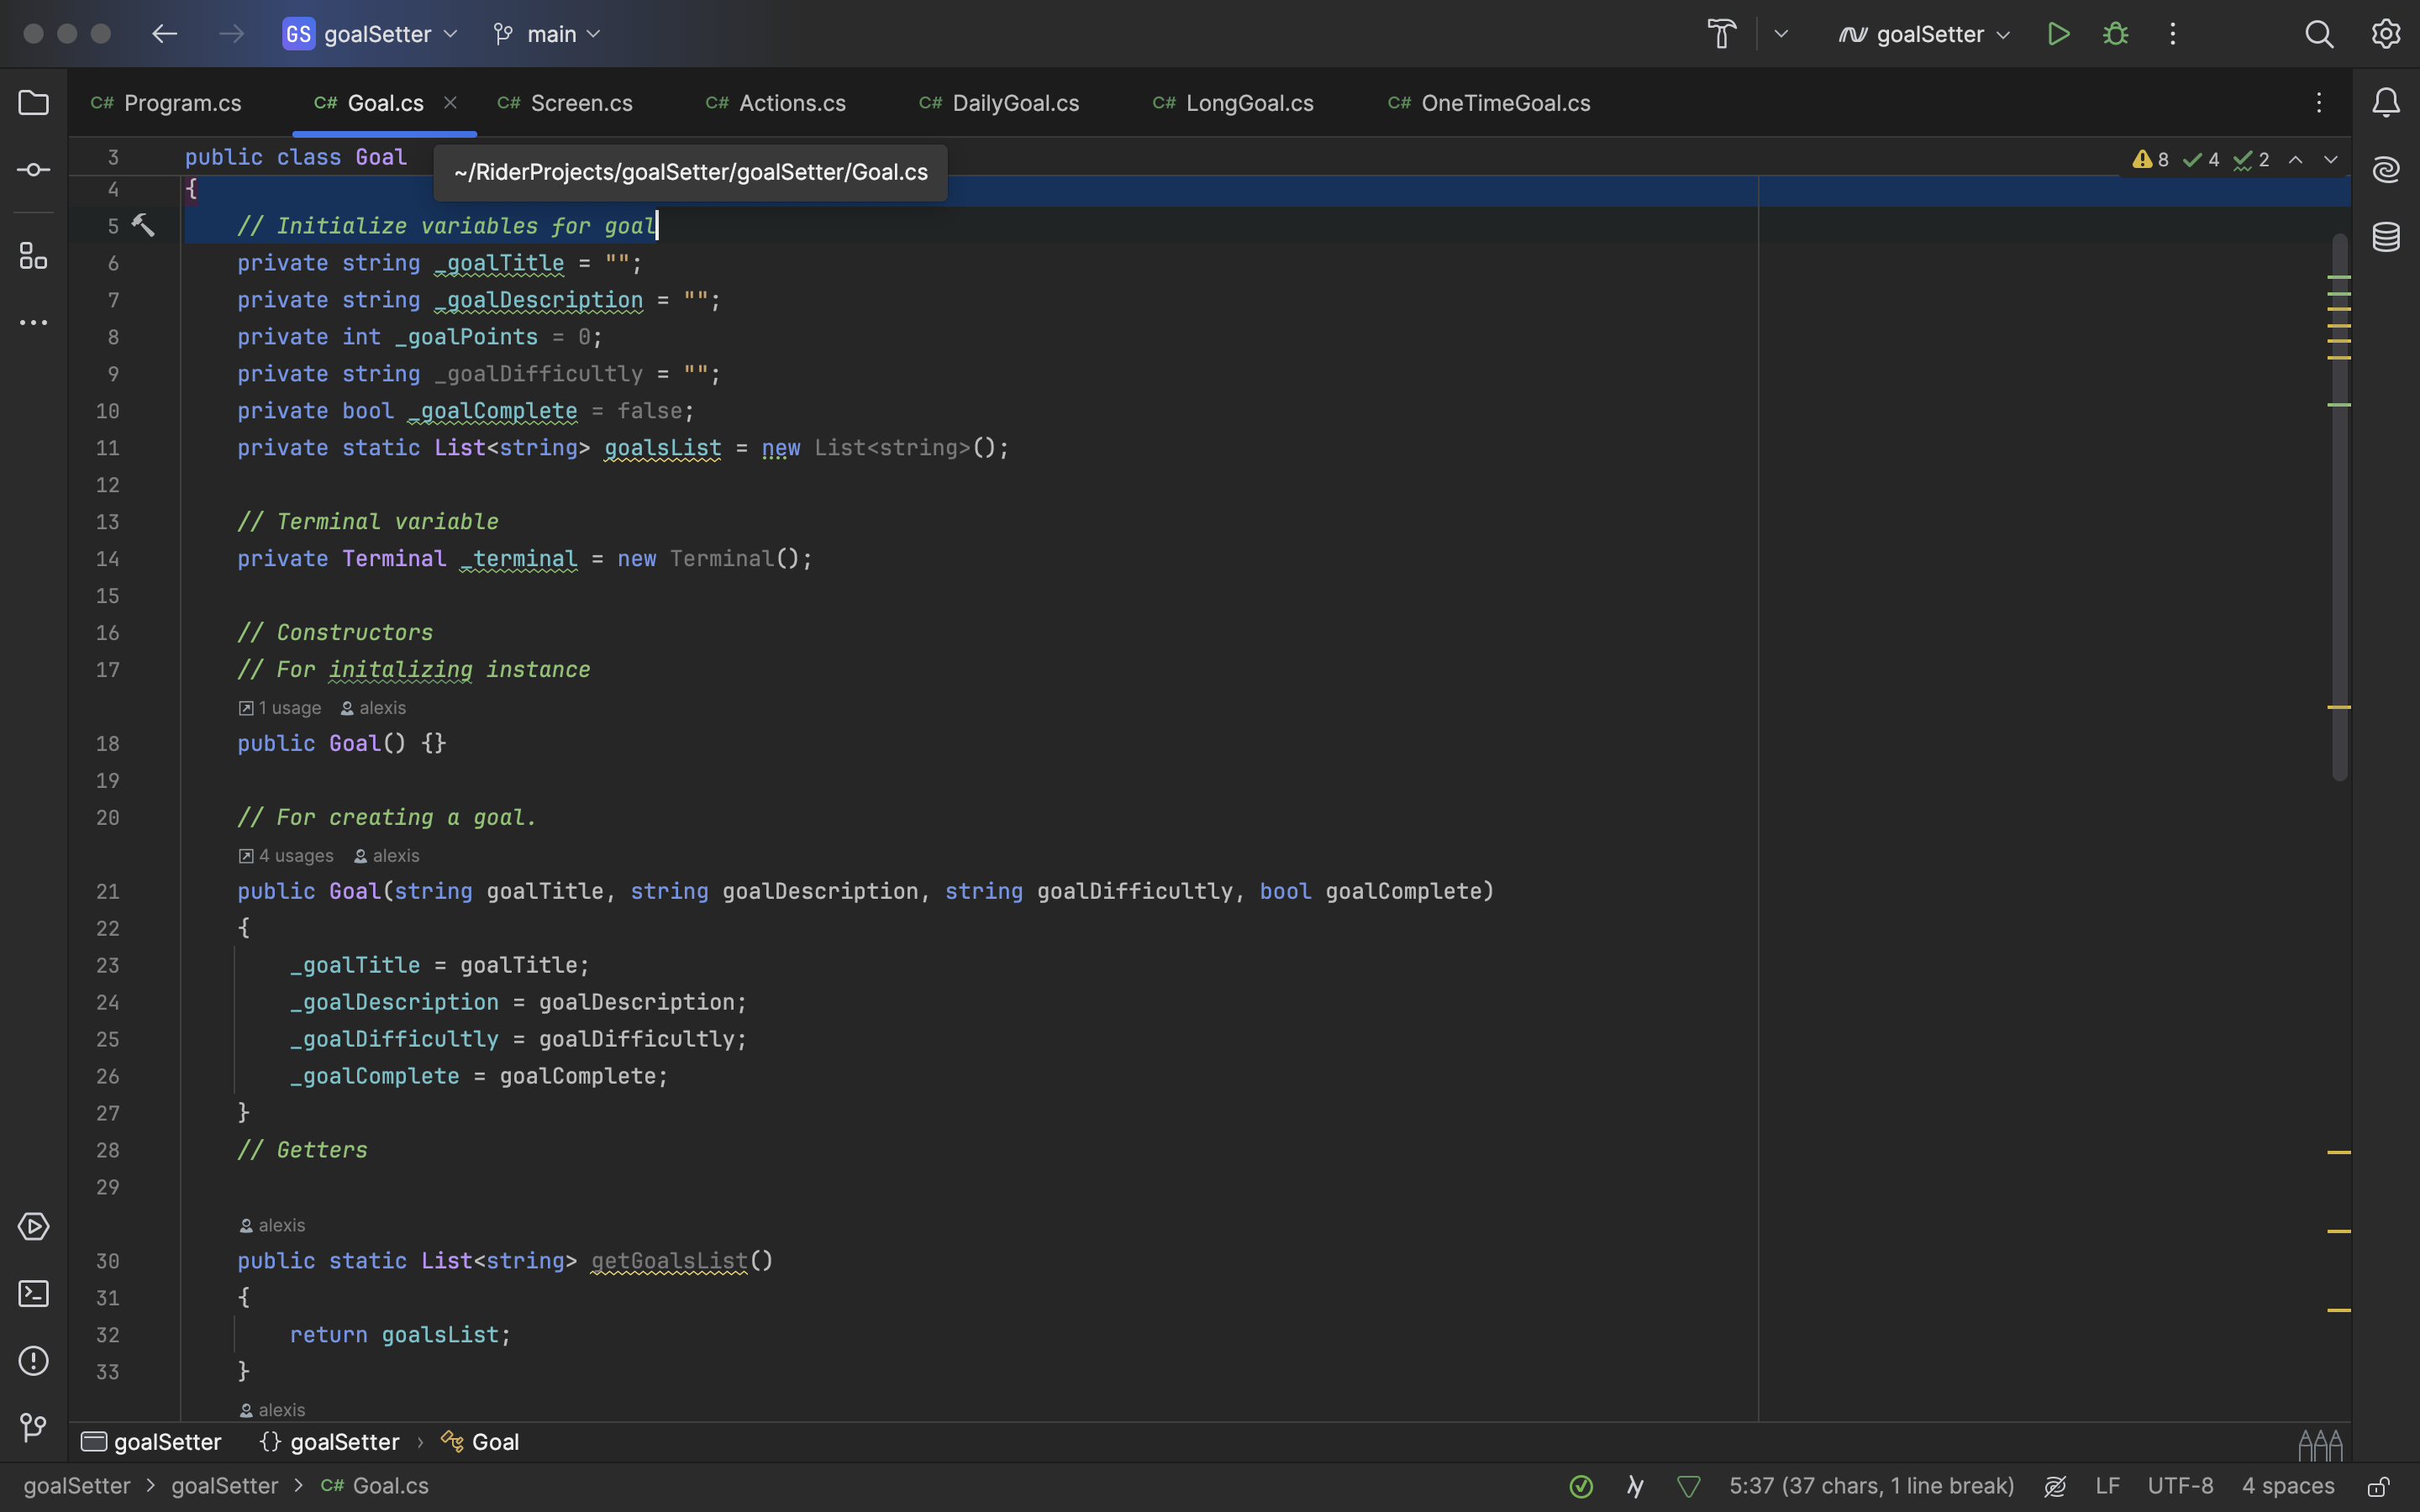

Slide 5
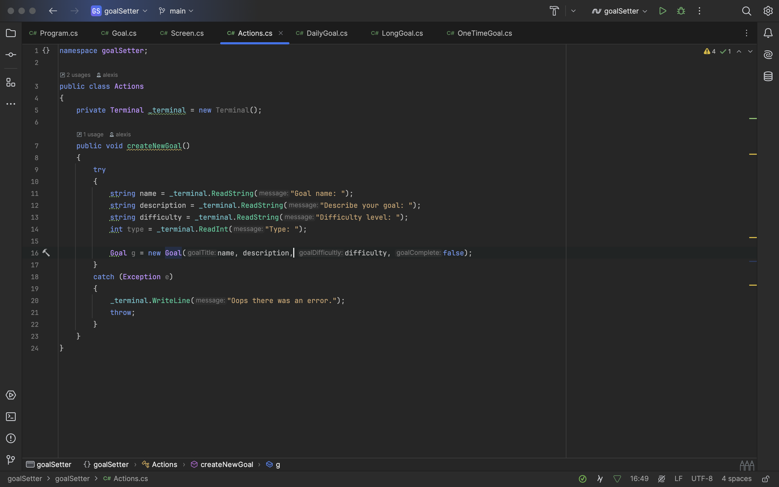

Slide 6
