Slide 1
$names
row.names

Slide 2
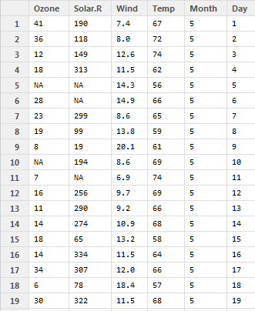

Slide 3
$names
row.names

Slide 4
columns
rows

Slide 5
columns
i-th row

Slide 6
j-th column
rows

Slide 7
j-th column
i-th row

Slide 8
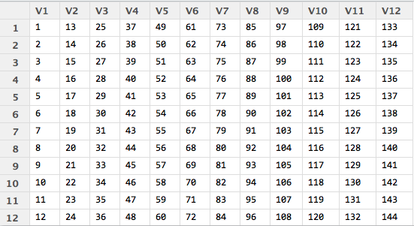

Slide 10
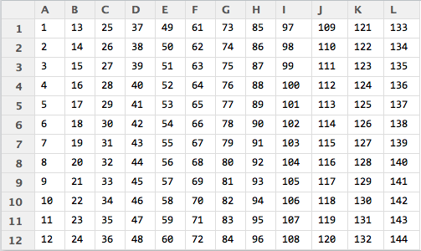

Slide 11
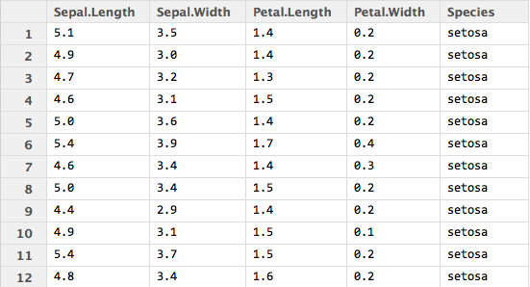
j
i

