Slide 2
$names
row.names

Slide 3
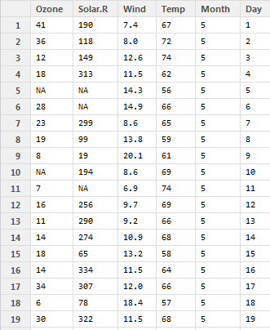

Slide 4
$names
row.names

Slide 5
columns
rows

