Slide 1
$names
row.names

Slide 2
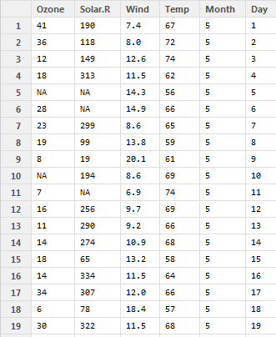

Slide 3
$names
row.names

Slide 4
columns
rows

Slide 5
columns
i-th row

Slide 6
j-th column
rows

Slide 7
j-th column
i-th row

Slide 8
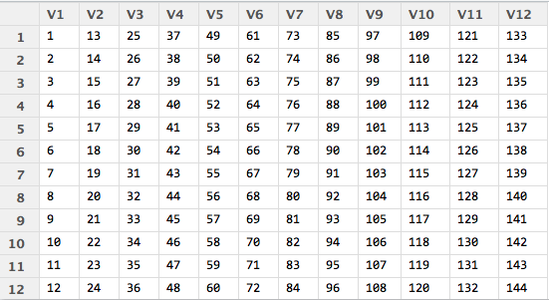

Slide 10
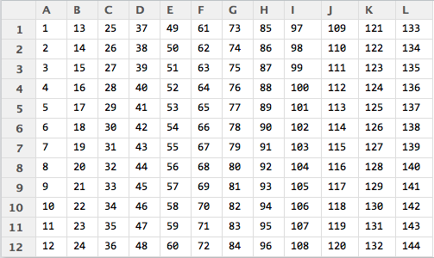

Slide 11
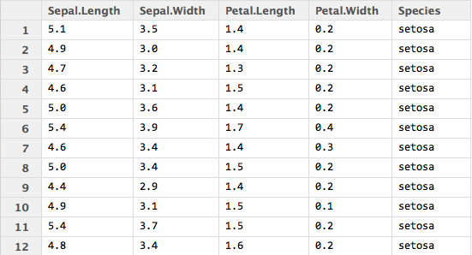
j
i

Slide 18



Slide 19
F =
,
Key1
,
Key2
,
Key3
Key4
Levels =
Value1
,
Value2
,
Value3
V =
Value1
,
Value2
,
Value3
,
Value4

