Slide 1
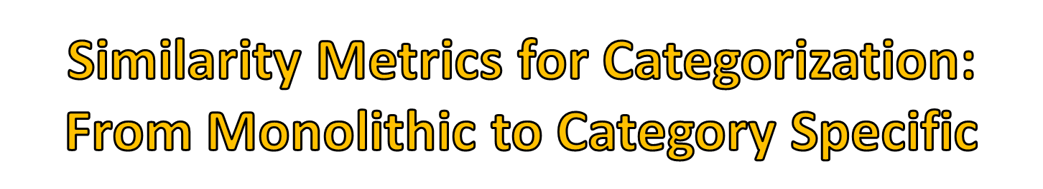

Boris Babenko, Steve Branson, Serge Belongie
University of California, San Diego
ICCV 2009, Kyoto, Japan

Slide 2

Recognizing multiple categories
  Need meaningful similarity metric / feature space

Slide 3
Recognizing multiple categories
  Need meaningful similarity metric / feature space
Idea: use training data to learn metric, plug into kNN
  Goes by many names:
    metric learning
    cue combination/weighting
    kernel combination/learning
    feature selection
Notes:
As we all know, to recognize multiple object categories we require…
- One idea that has been getting popular in the last couple years

Slide 4













Learn a single global similarity metric
Query Image
Similarity Metric
Labeled Dataset
Monolithic
Category 1
Category 2
Category 3
[ Jones et al. ‘03,
Chopra et al. ‘05,
Goldberger et al. ‘05,
Shakhnarovich et al. ‘05
Torralba et al. ‘08]
Category 4
Notes:
There a couple different paradigms for doing this
The most straight forward

Slide 5




Learn similarity metric for each category (1-vs-all)
Query Image
Similarity Metric
Labeled Dataset
Monolithic
Category 1
Category 2
Category 3
Category
Specific
[ Varma et al. ‘07,
Frome et al. ‘07,
Weinberger et al. ‘08
Nilsback et al. ’08]
Category 4
Notes:
Alternatively, we could train a similarity metric for each category
For example, in this case we have 4 categories, so ..
Now to compute the similarity between the query image and an image from the labeled dataset, we will use the similarity metric that was trained for that particular category
An example of this type of approach is training a multiple kernel SVM in a 1-vs-all fashion, since each category gets its own cue weighting

Slide 6

Per category:
  More powerful
  Do we really need thousands of metrics?
  Have to train for new categories
Global/Monolithic:
  Less powerful
  Can generalize to new categories
Notes:
A natural question to ask is, which of these paradigms is better
Per category is more powerful because each category requires different cues or features to be recognized
There is something unsatisfying about this approach. Suppose we had 1000 categories. Do we need that many. Would many of them be redundant?
The second issue is that if we decide to add a new category to our dataset, we of course have to do some more training
global problems
neither of these paradigms is quite right. And as a quick side note, the paper that will be presented in the next talk does a much better job of organizing all the different metric learning approaches, but for our purposes we will focus on just these two.

Slide 7

Would like to explore space between two extremes
Idea:
  Group categories together
  Learn a few similarity metrics, one for each super-category
Notes:
The goal of this work is..
Our idea is very simple:

Slide 8




Learn a few good similarity metrics
Query Image
Similarity Metric
Labeled Dataset
Monolithic
Category 1
MuSL
Category 2
Category 3
Category
Specific
Category 4
Notes:
- Here’s what that will look like..
We have 4 categories, and instead of training just 1 or 4 different metrics, we train 2 metrics.
We group the two flower categories because they probably share a lot of features

Slide 9

Need some framework to work with…
Boosting has many advantages:
  Feature selection
  Easy implementation
  Performs well
Can treat metric learning as binary classification
Notes:
We’d like to develop an algorithm for doing this
To do so, we needed to pick some framework to work with, and we decided to pick boosting
So, we treat metric learning as a binary classifier problem – in other words, we will train a classifier that will take a pair of image as input, and it will output a high score if they are similar and a low score if they are not similar
- from this point forth, I will use the terms classifier and similarity metric interchangably

Slide 10

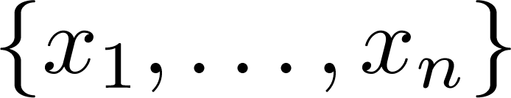
Training data:
Generate pairs:
  Sample negative pairs
Images
Category Labels
( , ), 1
( , ), 0
Notes:
In our training data we receive a bunch of images and a category label for each image
To train our classifier we first generate positive and negative pairs. We sample the negative pairs.

Slide 11

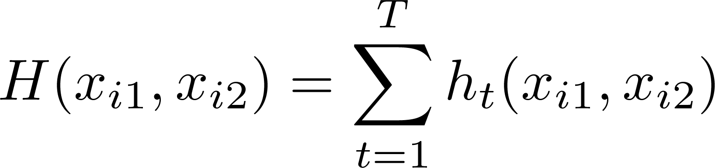
Train similarity metric/classifier:
Notes:
Like I mentioned before, we will train a boosted classifier that takes a pair of images as input
Our classifier will look exactly like a standard boosting classifier – it just a linear combination of weak classifiers
We choose the weak classifiers to have this special form – each weak classifier is an absolute difference of some feature computed for both images

Slide 12
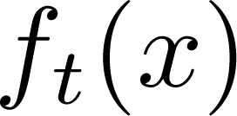
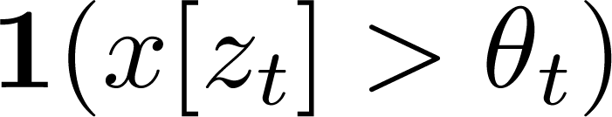

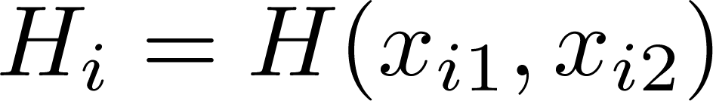
Choose to be binary -- i.e.
= L1 distance over binary vectors
  Can pre-compute for training data
  Efficient to compute (XOR and sum)
For convenience:
[Shakhnarovich et al. ’05, Fergus et al. ‘08]
Notes:
If we choose the feature
It turns out that H, our over all similarity metric, can be computing by finding the L1 between two binary vectors
This is nice for two reasons: first, we can pre compute these binary vectors for all images in dataset
Second, computing L1 for binary is extremely efficient
This idea was first proposed by shakh. Et al

Slide 13

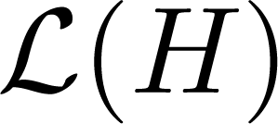
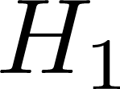
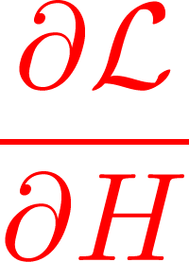
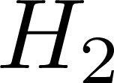
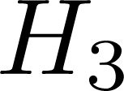
Given some objective function
Boosting = gradient ascent in function space
Gradient = example weights for boosting
chosen weak
classifier
current strong
classifier
other weak classifiers
function space
[Friedman ’01, Mason et al. ‘00]
Notes:
To develop our algorithm we are going to use a framework called gradient boosting, developed by friedman
This is a nice framework that allows you to derive a boosting algorithm for any differentiable objective function
The way it works is we interpret boosting as gradient ascent in function space, which is a space where each axis corresponds to the score of a training example
So each weak classifier is a vector in this space
In each boosting iteration, we compute the gradient, and then find a weak classifier that is as close as possible to this vector
The final important note here is that the gradient vector can be thought of as a vector of weights for the training examples. So in most of the standard boosting algorithms these weights are usually high for examples that are currently misclassified

Slide 14

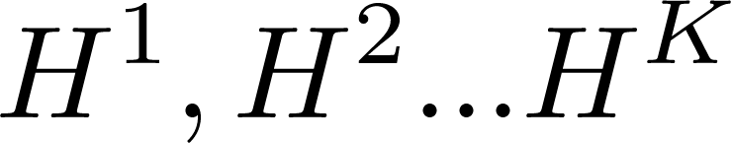
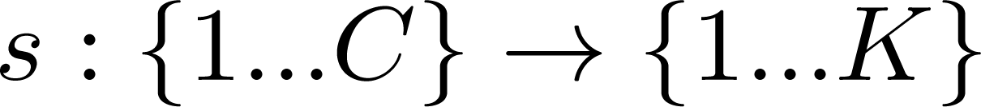

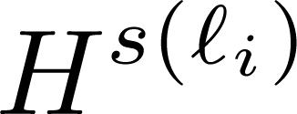










Goal: train and recover mapping
At runtime
  To compute similarity of query image to
  use
Category 1
Category 2
Category 3
Category 4
Notes:
Our goal… and to recover this mapping s which will tell us which metric to use for each category.
So at run time when we compute the similarity of a new image and an image x_i from our set, we’re gonna look up which metric to use by plugging the label of x_i into s

Slide 15

Run pre-processing to group categories (i.e. k-means), then train as usual
Drawbacks:
  Hacky / not elegant
  Not optimal: pre-processing not informed by class confusions, etc.
How can we train & group simultaneously?
Notes:
How do we train this?

Slide 16
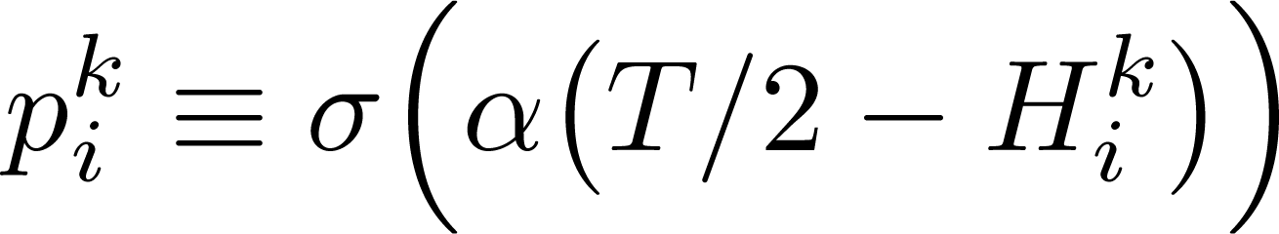
Definitions:
Sigmoid Function
Parameter
Notes:
Here how we do this..
Pik is going to approximate the posterior probability that pair I is positive according to classifier k, and we define this using the sigmoid function as in most boosting algorithms

Slide 17
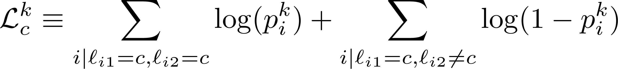
Definitions:
Notes:
- Next we define Lck, which is the log likelihood of category c for classifier k

Slide 18
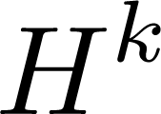

Definitions:
How well works with category
Notes:
- This quantity tells us how well classifier k works with category c

Slide 19
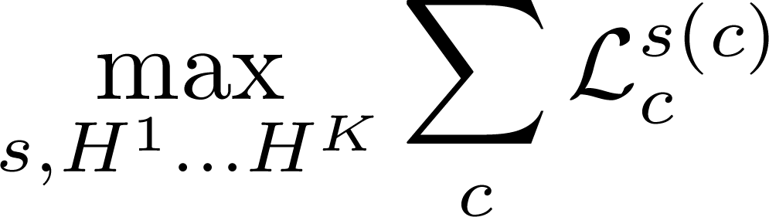
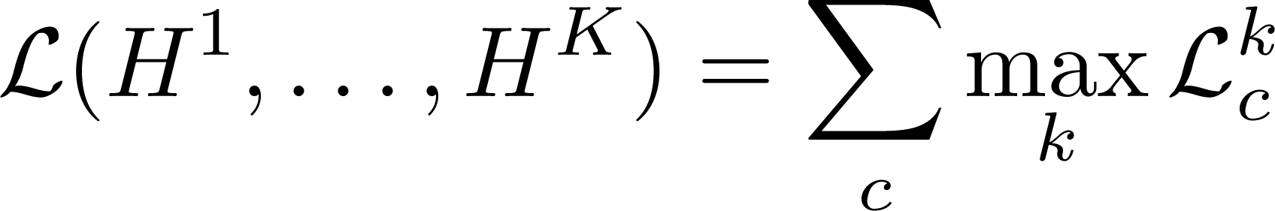
Objective function:
Each category “assigned” to classifier
Notes:
Our objective is to find the K classifiers and a mapping s that maximizes the log likelihood of all the data
After moving things around a bit, we get the second equation, which is the objective function we will optimize
The intuition here is that we will find the best classifier for each category, and maximize the corresponding log likelihood

Slide 20

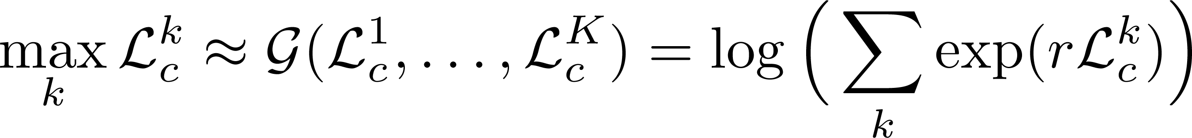

Replace max with differentiable approx.
where is a scalar parameter
Notes:
- there’s a minor obstacle

Slide 21


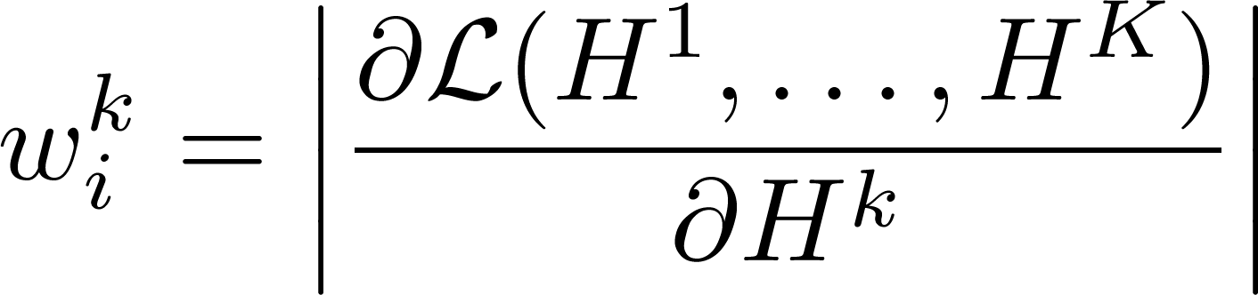
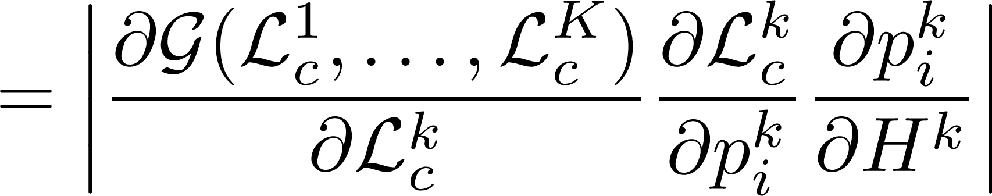
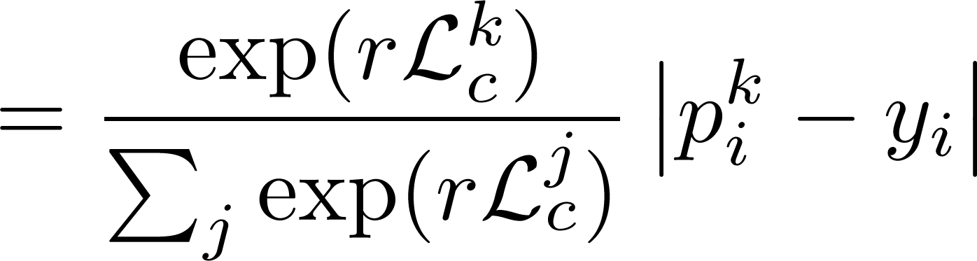
Each training pair has weights
Notes:
Now all we need to derive our boosting algorithm is to find compute the gradient, which again will give us an equation for the training pairs.
We are going to have a weight per training pair, per classifier

Slide 22
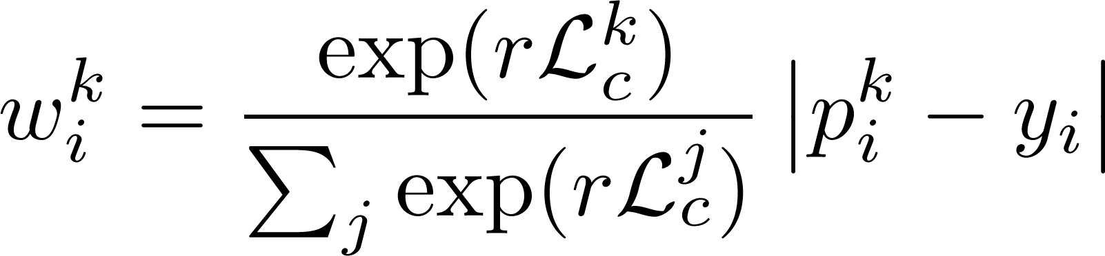
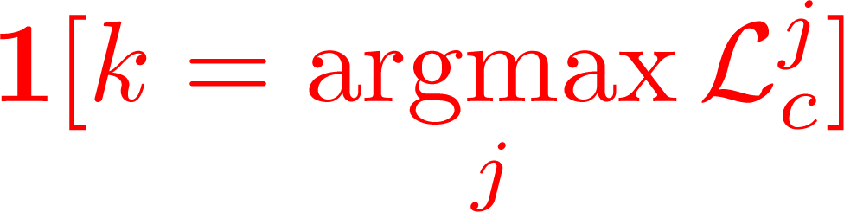
Intuition:
Approximation of
Difficulty of pair
(like regular boosting)
Notes:
- When we finish the algebra, we end up with a formula that actually has an intuitive interpretation.
Term on the right..
term on the left is close to 1 if classifier k works well with the category of the I’th training pair

Slide 23

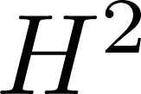
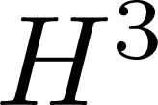
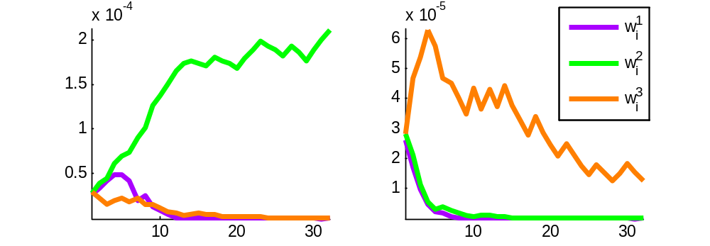




Difficult Pair
Easy Pair
Assigned to
Assigned to
(boosting iteration)
(boosting iteration)
Notes:
To visualize this, here I have two plots showing the boosting iteration on the x axis, and the weight on the y axis
The two plots are for two different training pairs, and here we are training 3 classifiers, so there are three curves for each training pair
the first thing to notice is that after the first 10 iterations, a single classifier dominates, and the weights of the other classifiers go to 0. this is the effect of the first term of the weight equation
The second thing to notice is that in the left plot, the training pair is difficult, so the weight remains high….

Slide 24

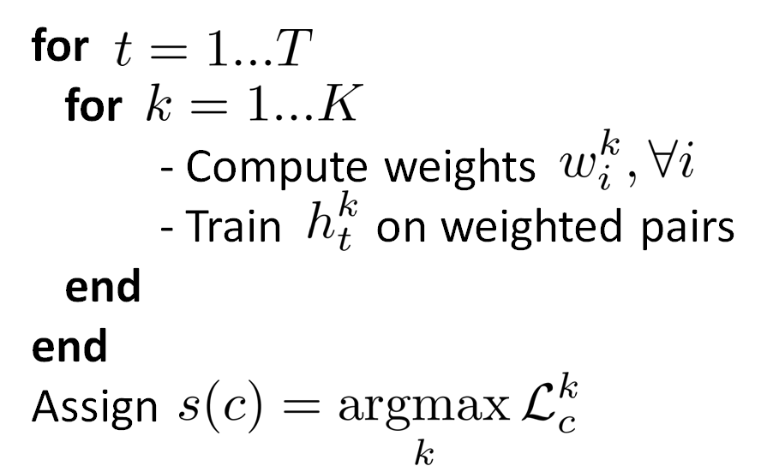
Notes:
- Algorithm itself looks a lot like a standard boosting algorithm, the main thing that is different is the way we compute weights

Slide 25

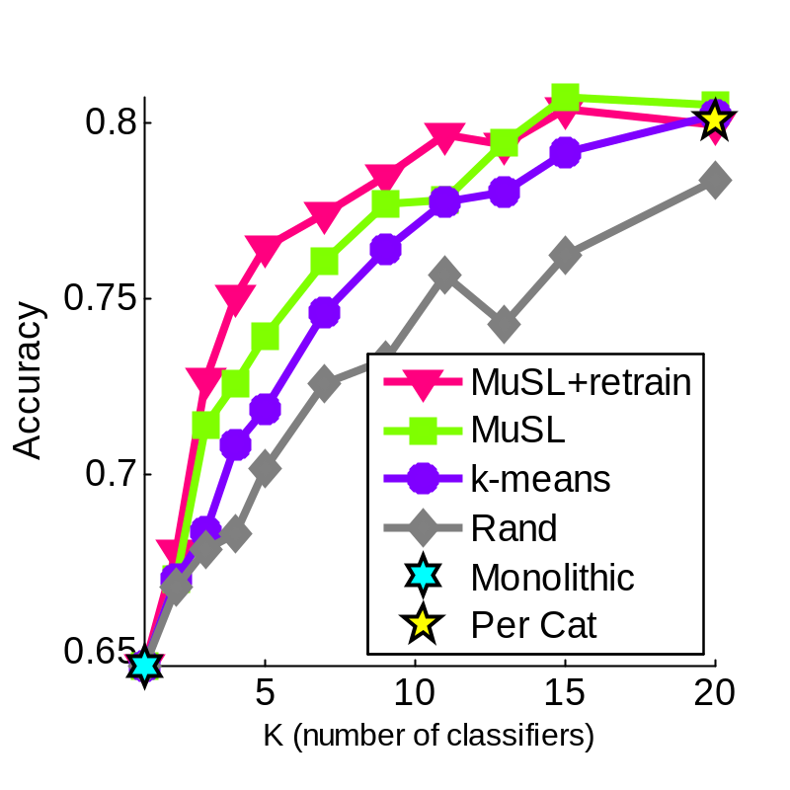
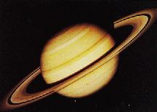








Created dataset with hierarchical structure of categories
Merged categories from:
Caltech 101 [Griffin et al.]
Oxford Flowers [Nilsback et al.]
UIUC Textures [Lazebnik et al.]
Notes:
We wanted to run experiments on some data where there was a learn hierarchical structure for the categories
So what we ended up doing is taking a few categories from 3 different sources:
We had 20 categories total
In the plot on the right we see the categorization accuracy versus the number of metrics.
we are comparing two variations of our method to two other approaches: the first is to group the categories using kmeans, random
two things to notice about this plot – the first is that our original hypothesis was correct, using more metrics is indeed advantageous, but using just a few metrics achieves almost as good of performance as using all 20

Slide 26

















































MuSL
k-means

Slide 27

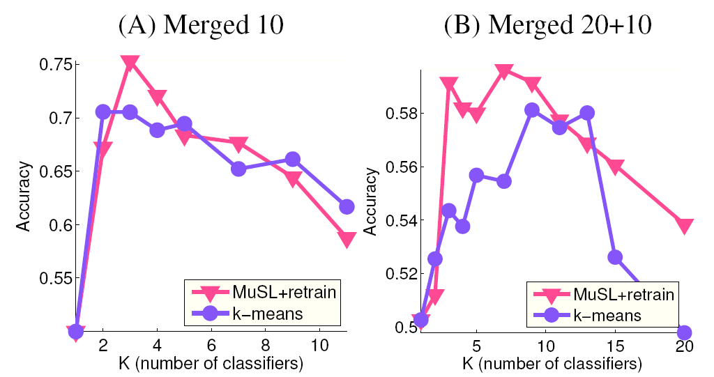
New categories only
Both new and old categories
Training more metrics overfits!
Notes:
In this experiment we took 10 more categories from those same 3 sources
We then took the metrics that we trained using the original 20 categories, and we assigned one of these metrics to each of the new categories
And when we looked at the performance as we swept through the value of K, we saw something really interesting
As we start to use more metrics, the performance goes up. However, if we continue increasing the number of metrics, the performance starts to degrade significantly.
This is a type of over fitting behavior.

Slide 28

Studied categorization performance vs number of learned metrics
Presented boosting algorithm to simultaneously group categories and train metrics
Observed overfitting behavior for novel categories

Slide 29

Supported by
  NSF CAREER Grant #0448615
  NSF IGERT Grant DGE-0333451
  ONR MURI Grant #N00014-08-1-0638
  UCSD FWGrid Project (NSF Infrastructure Grant no. EIA-0303622)

Slide 30
Train similarity metric/classifier:
Let
then

Slide 31

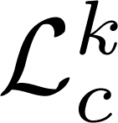



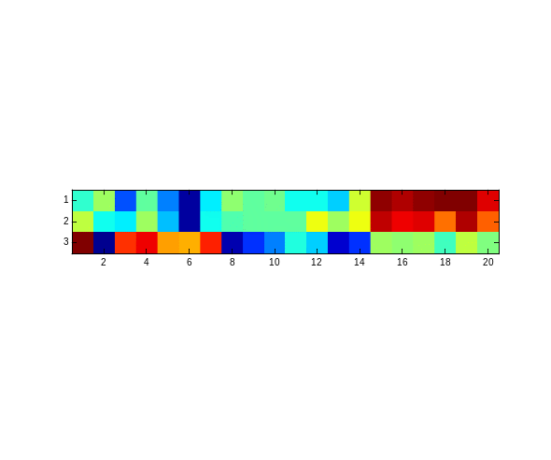
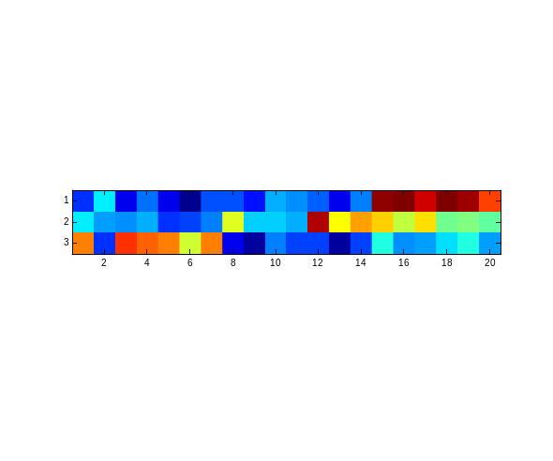
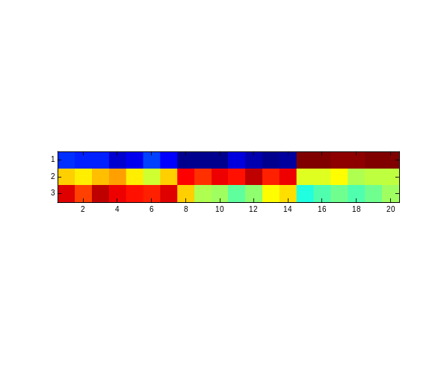

Matrix:
Caltech
Flowers
Textures
Caltech
Flowers
Textures
Caltech
Flowers
Textures
High value
Low value

