Slide 1
Memory Allocation Optimization for Neural Network with OR-Tools
Dboy Liao <qmalliao@gmail.com> https://github.com/dboyliao

Slide 2
OR-Tools
Optimization Package developed by Google
Capable of Solving Various Optimization Problem
Linear Programming (LP)
Mixed-Integer Programming (MIP)
Constraint Programming (CP)
https://developers.google.com/optimization
More examples in https://developers.google.com/optimization/introduction/overview

Slide 3
What We Will Cover Today: CP
CP: Finding feasible solutions from a large set of candidates
Ex: Finding all (x, y) that satisfy following constraints
2x + y = 100
x >= 3
y <= 4

Slide 4
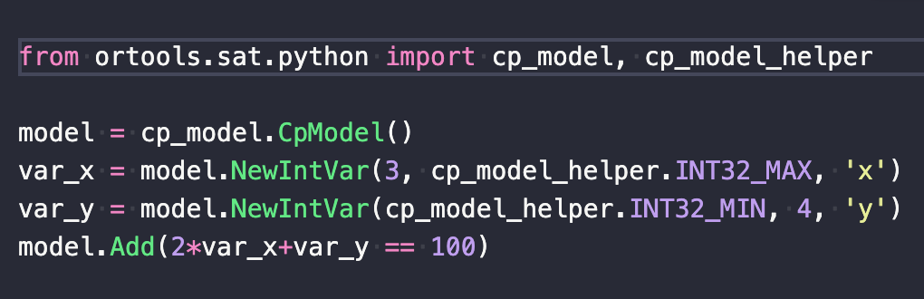
Solving CP with OR-tools

Slide 5
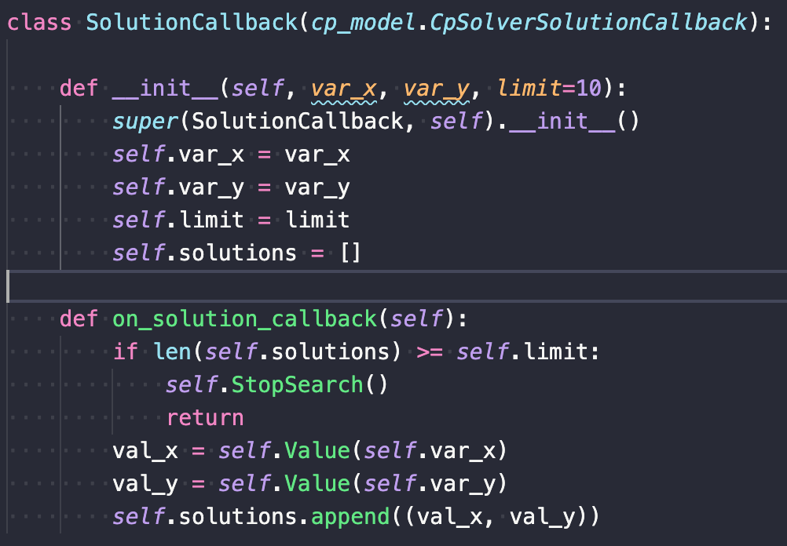

Slide 6
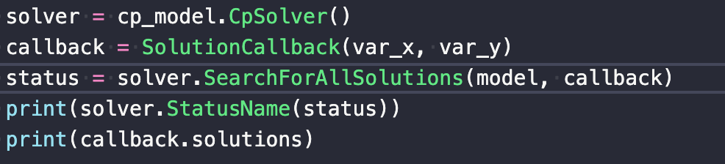

Slide 7
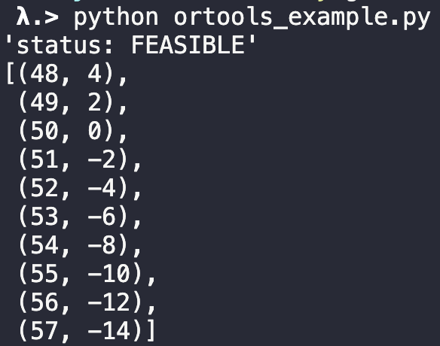

Slide 8
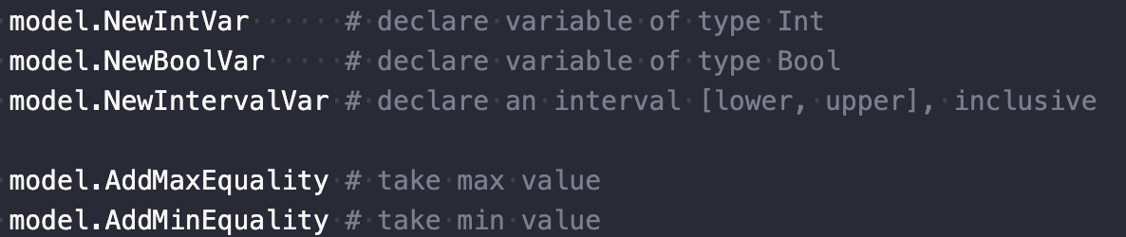
Expressive API

Slide 9
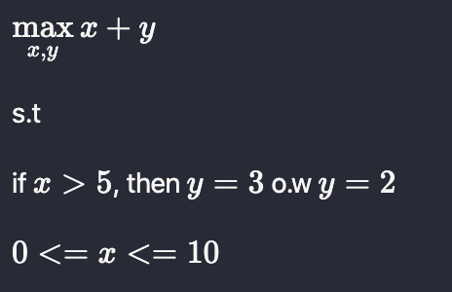
Branching via Channeling

Slide 10
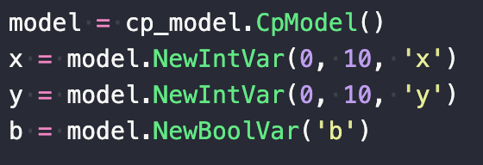
Branching via Channeling

Slide 11
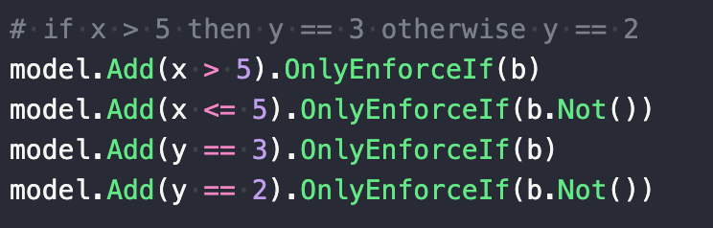
Branching via Channeling

Slide 12
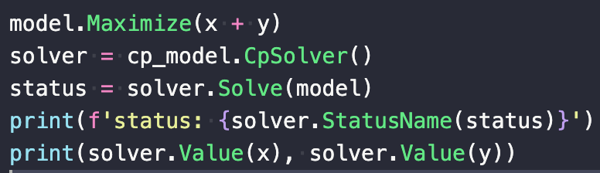
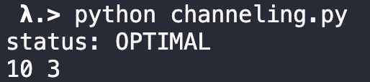
Branching via Channeling

Slide 13
Memory Allocation Problem for Neural Network Inference

Slide 14
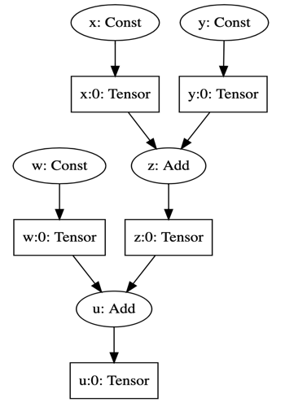
An Simple Example
Adding three scalar tensors
Float32 (4 bytes each)
What is the minimum memory required for computing final output (u:0)?

Slide 15
An Simple Example (Cont.)
4 bytes for x:0 and y:0 each (8 bytes in total)
4 bytes for z:0
4 bytes for w:0, which can reuse the space for x:0
4 bytes for u:0
Total: 8 + 4 + 4 = 16 bytes

Slide 16
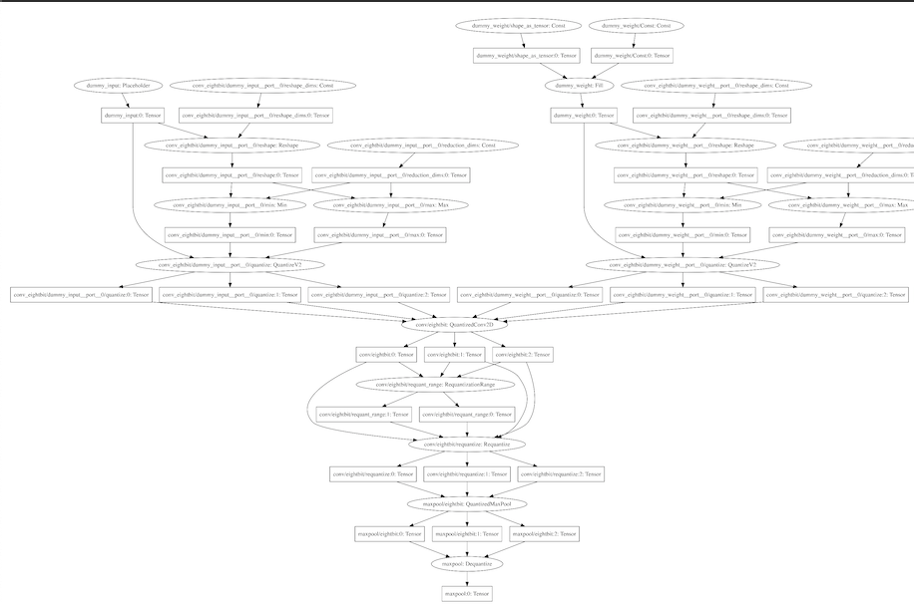
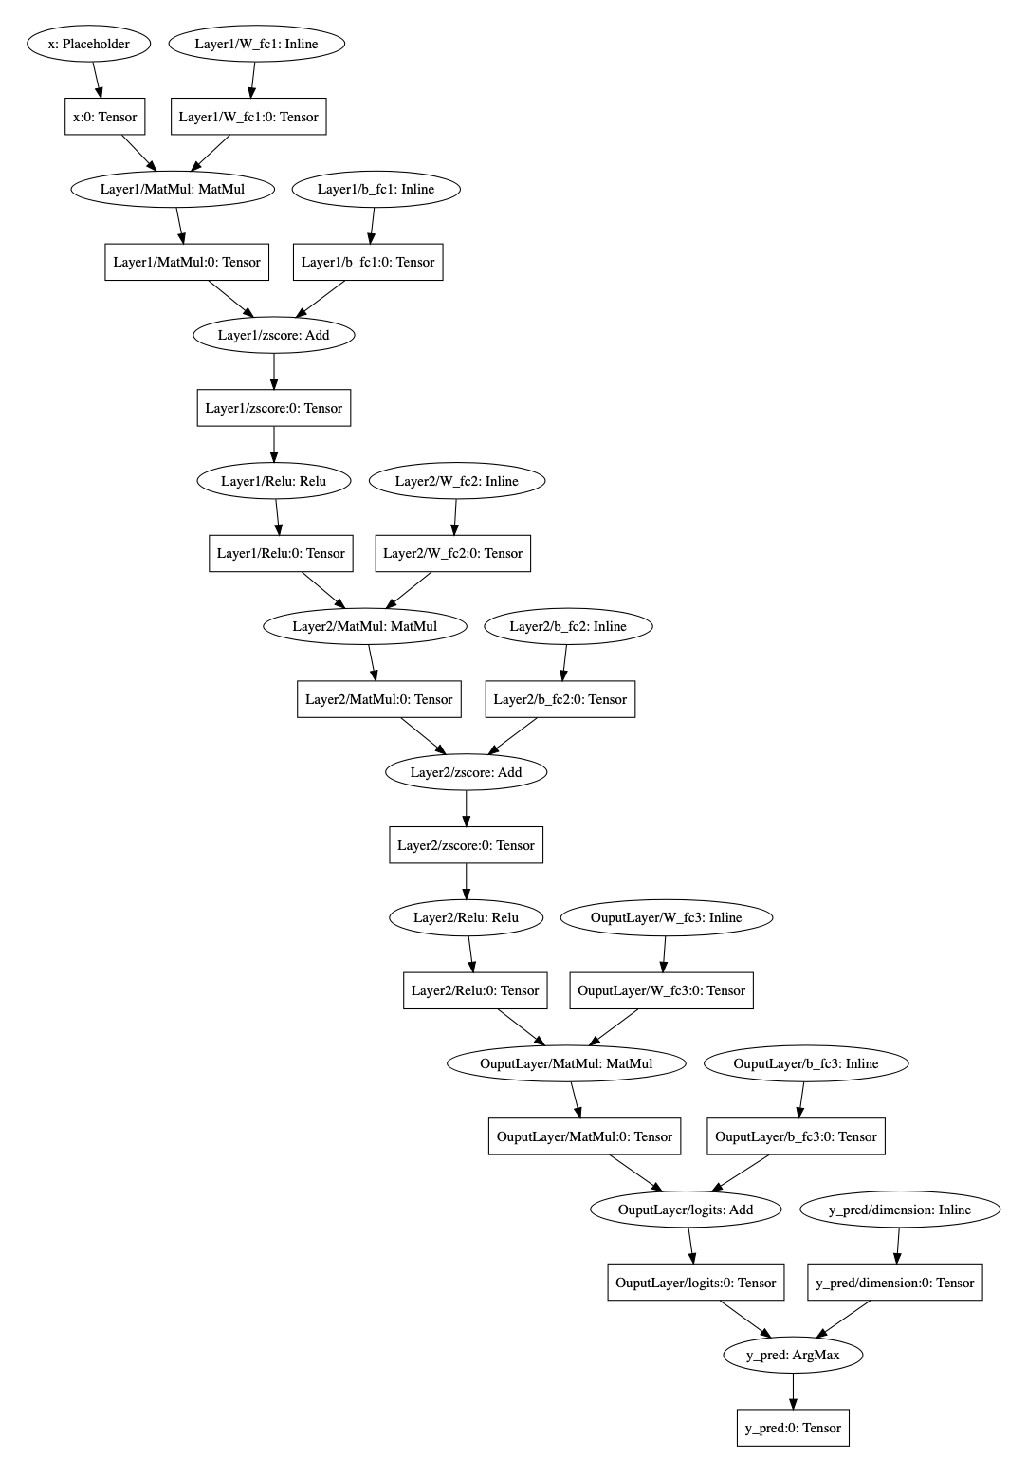
Large Graph
What is the (sub)optimal memory allocation plan for evaluating the graph on the right?

Slide 17
Memory Allocation Plan
Time slot for each tensor, i.e the life-cycle of tensor
Memory allocation, i.e where to store the value of tensor
Goal: Find the minimum memory pool required to evaluate a graph

Slide 18
Simple Memory Allocation Plan
Evaluate nodes by topological ordering
So we can find the life-cycle of each tensor accordingly
Also, we will keep track of reference count of each tensor
In each time slot, find all tensors that
Exists before current time slot
Still alive at current time slot
Make sure the memories occupied by output tensors do not overlap with the tensors found at last step

Slide 19
Start Simple
Declare interval variable for each tensor
Find non overlapping tensors
Ex: z:0 -> [x:0, y:0]
Add no overlapping constraints
Find maximum span of all intervals

Slide 20
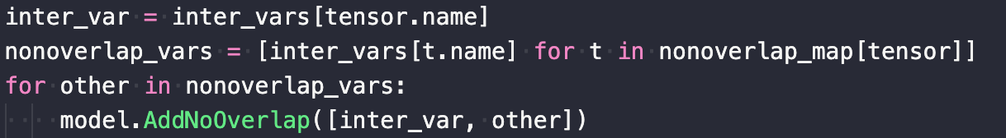
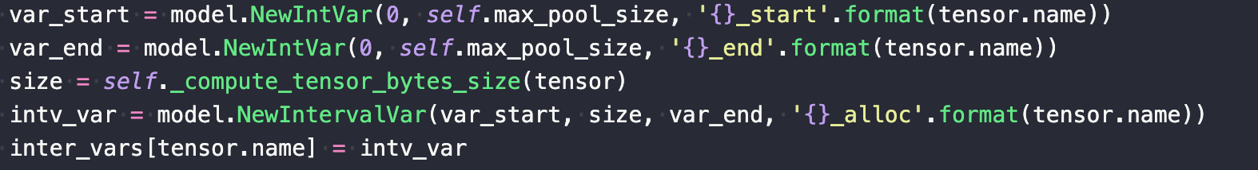
The Code

Slide 21
uTensor Memory Allocation Optimizer
https://colab.research.google.com/drive/16r9onWzjwLSdztM0Z4yjdQh4n8DGEBE3
ONNX support will be available in next release.

