Slide 1
six barriers for open public data
lack of information that certain data actually exists and is available
a lack of clarity of which public authority holds the data
a lack of clarity about the terms of re-use
data which is made available only in formats that are difficult or expensive to use
complicated licensing procedures or prohibitive fees
exclusive re-use agreements with one commercial actor or re-use restricted to a government-owned company

Slide 2
publishing data with DataId
DataId provides unambigous and precise meta-information describing your dataset
your dataset (metadata) gains an online presence (dataid.dbpedia.org & datahub.io)
your data becomes searchable (search engines & specialized dataset search on dataid.dbpedia.org)
providing a simple version control system for your data
automated discovery of similar datasets

Slide 3
benefits when publishing LOD data
automated link discovery and link count between datasets
become a (visual) member of the LOD cloud
validate your dataset against a given ontology (future feature: powered by RDFUnit)
In general: keeping your data at 5 ★

Slide 4
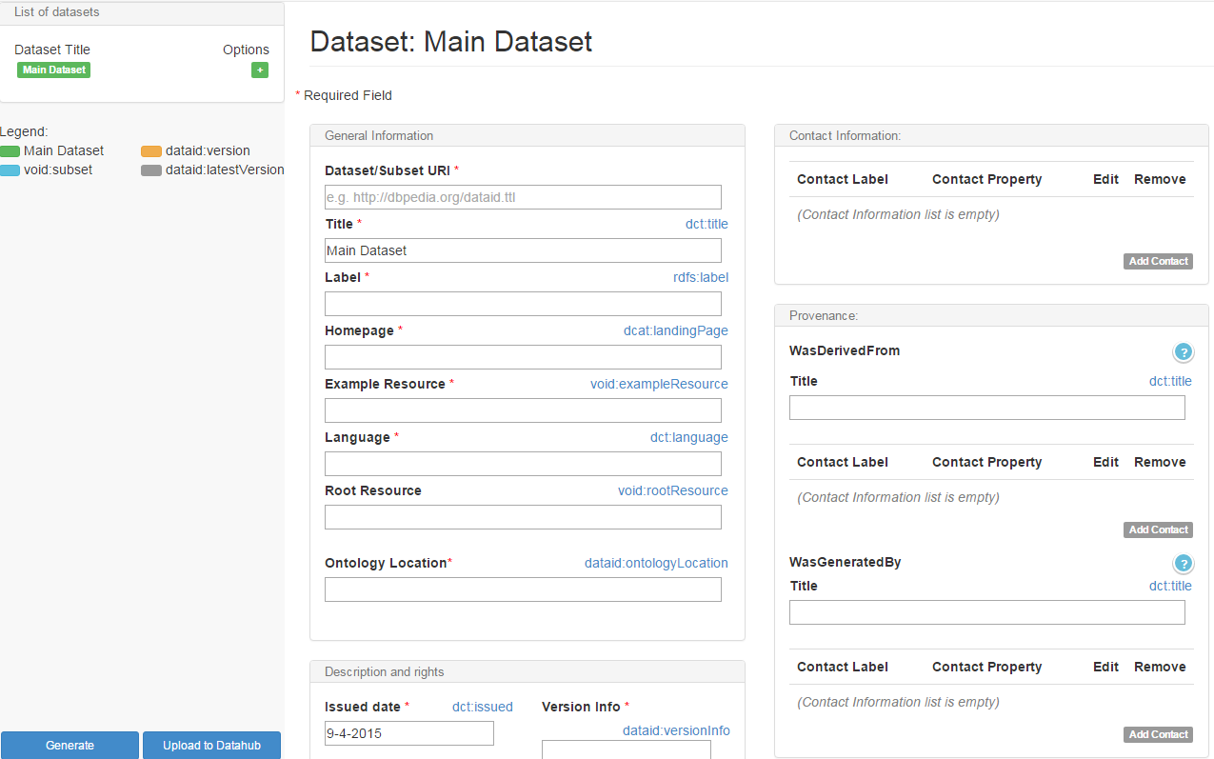
in use
1. generate a DataId

Slide 5
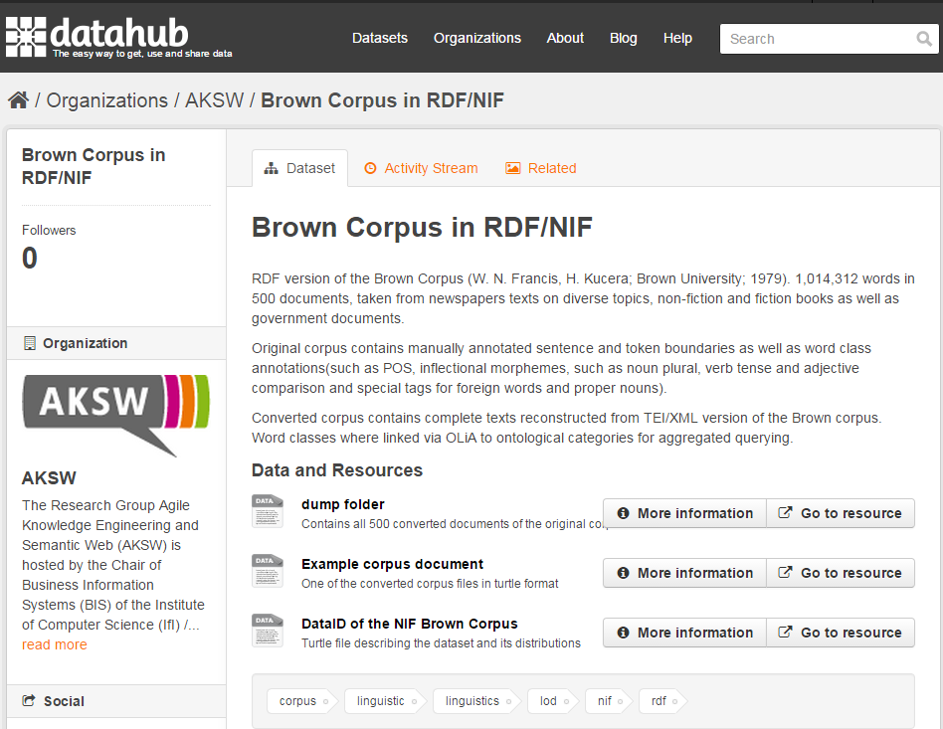
2. publish and revise any time

Slide 6
3. search other datasets
Cool pic here, not available yet...

Slide 7
Dont know...

Slide 8
