Slide 1
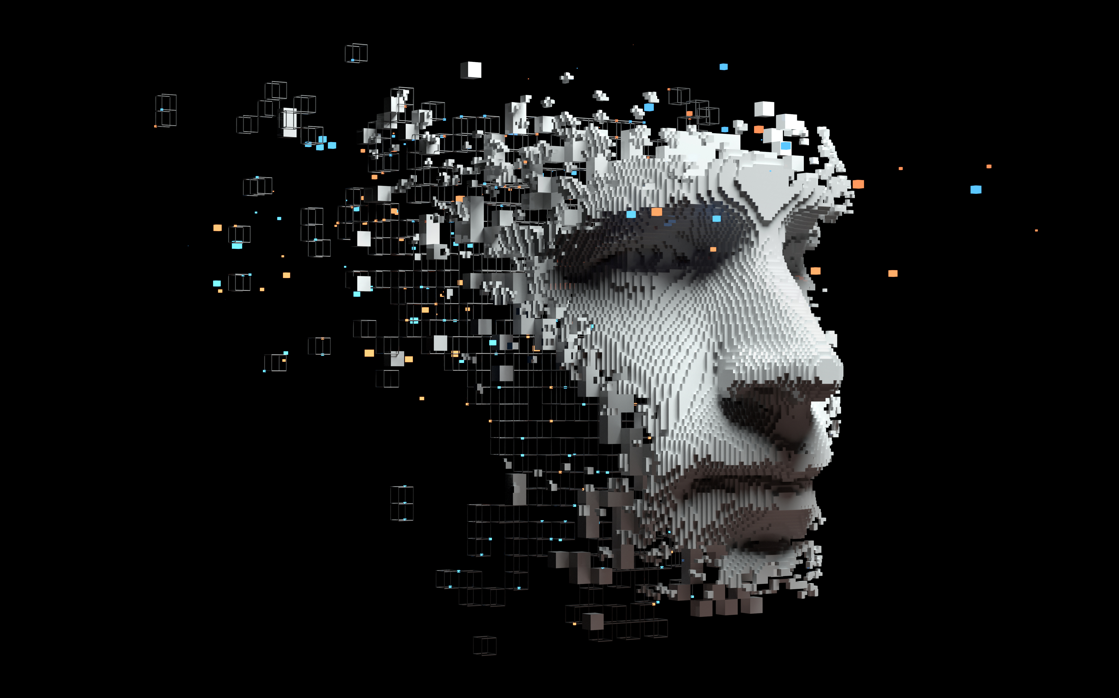
Vision
Dr. David Bracewell

Slide 2
Path to the Classroom: An Industry Perspective
20+ Years in Applied AI: Principal Investigator and Principal Scientist building multimillion-dollar SaaS and federal systems (NSA, DoD, USSOCOM, etc.)
Hiring Manager: Directly managed engineering pipelines from interns to seasoned professionals
Academic: 7+ years of college-level teaching, has helped me in identifying the friction points between graduation and production readiness

Slide 3
The Skills Divide
Education (Computer Science)
Industry
Do a great job at teaching data structures, algorithms, operating systems, database theory, etc
They spend less time on the applied engineering of developing systems
Students learn how to use dynamic programming in the classroom, but cannot recognize it in real code
Capstone projects help, but cannot fully simulate the daily grind of a being an engineer
What they learn is a small percentage of what they do
  What is version control?
  What is Agile, a sprint, a user story?
  How to make the leap from programming assignments to large complex applications with legacy code?
  What does engineering software mean?
  How to relate the in-class problems to real-word solutions?

Slide 4
AI can bridge or enlarge the divide
Past to Present
The 21st Century Digital Tradescraft
Largely an academic pursuit with new models proposed in academia and daring organizations trying to apply them in production
As it became more routine, the gap between AI/Machine learning theory taught in school and actual practice was huge
Fast forward to now: AI and machine learning are no longer a nice to have, they are baked into the products we use everyday
AI is the new foundational infrastructure, much like electrical grids or plumbing
Educational institutions must pivot from producing pure "thinkers" to also producing "doers"
Next generation engineers and engineering educators need to be equally capable of pontificating the merits of a particular AI model or architecture as they can roll up their sleeves and put theory to practice

Slide 5
What does this mean for education?
Applied AI programs cannot just teach students what supervised/unsupervised learning is or how a Transformer works, instead, they must train a new class of Applied AI Artisans who know the theory and have the skills to put it into practice
Students need to be treated less like minds to mold and more like high-tech apprentices who are honing their craft by actively building, breaking, and deploying things in real-world environments and simulations
Brains and Hands on

Slide 6
How do we bridge the gap?
For beginning students, the cognitive load of learning both theory (How to think like a programmer) and syntax is often too high (think of trying to learn Japanese and having to craft novels why still struggling with reading, writing, and grammar)
This becomes exponentially harder when talking about AI theory and AI practice (ml-ops, fine tuning, selecting the right model, edge AI, etc.)
One professor and a team of TAs cannot meet the individual needs of every student and instead we focus on the many
We need a Pedagogical Shift, and I believe that shift is possible with what I call Personal AI

Slide 7
Personal AI
In first-year programming classes a good deal of time is spent focusing on syntax and debugging. Students often don't get the critical "How to think like an engineer"
In graduate-level AI and machine learning classes students often get the theory and terminology, but not the "syntax" for production, i.e., how to deploy at scale, how to A/B test, when is 60% better than 99%
Personal AI would alleviate faculty focusing extensively on syntax in early classes or how to operationalize in graduate courses

Slide 8
Personal AI empowers the student
Acts as a localized, highly individualized TA that understands a student's specific culture, learning style, knowledge level, and potential learning disabilities/struggles
The Personal AI handles the "how-to-build-it", the faculty focuses on the "how to think like an engineer", high-level theory, systems architecture, and other much needed topics like ethics
Students are trained to view AI as a collaborative tool for modern engineering and not a way to get out of their homework assignment

Slide 9
Incorporating Personal AI in the classroom
Instead of banning AI and fighting a losing battle against LLM-generated code in upper level and graduate course, I propose that students treat their Personal AI as a combination "junior developer" and "CS Wikipedia"
But why let students use AI to code?
Before modern IDEs everyone memorized all the methods/functions and their arguments. After autocompletion no one cared to remember
Now we have line and multi-line completion and built-in and agentic coding tools
Just like version control and software engineering methodologies were required for employment before, now you need to know how to code with AI and are invited to bring your AI with you

Slide 10
How AI can be a partner in the learning process?
How do we ensure that students are learning system level thinking skills that incorporate theory/thinking while also building non-trivial systems allowing them to explore how that thinking is operationalized?
Agentic Agile
Treating the AI as a junior programmer means we must provide detailed plans for what they do, not letting them decide on their own, but instead giving them the solution they need to build
Before writing a line of code, the student must write the user stories, define the sprint architecture, and outline the exact logic flow for the AI agent

Slide 11



Agentic Agile
The Old Way
The Agentic Agile Way
Epics / User Stories / Spikes
writes
writes
feeds
Give up
Compiles
Review / Learn
Increased Frustration: No longer thinking at a high-level focused on the syntax
Compiler Error
missing ; on line 20
Generates
Implementation Outline

Slide 12
Agentic Agile
Using Agile forces the student into a systems-thinking mindset
They must plan how the pieces work together, how to break down problems into manageable chunks, make strategic decisions about algorithms and data structures to meet the goal of the product
Faculty and TAs can focus on teaching these higher-level harder to learn skills while the student learns to communicate their design and manage the coding process
Bonus: A secondary specialized AI can monitor the student and provide hints/feedback on their design choices

Slide 13
Measuring Impact
Student Cognitive Load: measure (survey & telemetry) to determine the cognitive load of the student during development
  Prompt-to-Code Ratio: More prompt-writing vs error-debugging indicates more systems level thinking vs bogged down in syntax
  Time-to-Resolution: Does the time delta between a compiler error and fix decrease
  The NASA Task Load Index: Does Agentic Agile drop Frustration while maintaining or increasing Mental Demand indicating students are thinking harder about the system but struggling less with the tools
Student Retention: does allowing the use of AI for assisting in coding increase student retention as they can focus on the concepts and less on the syntax reducing burnout

Slide 14
Measuring Impact
Student's Comprehension: how well can they see the solution for a given problem, architect it, and define how to build it. Pen & paper with system diagrams and pseudocode
Student's Coding Ability: by doing peer reviews of AI generated code the student learns to translate concept to code making them more able to learn and retain vs a student who just one-shots a solution. Moreover, if we force a student to develop in an unfamiliar language it shouldn't matter, if they can define how things should work

Slide 15
Measuring Impact
AI's Output Quality: Giving the AI small well-defined tasks leads to better code. Measure code quality, performance, security audits, etc.
AI Interaction: Small tasks lead to limited context windows which can keep the model from going off the rails. Couple this with feature-based engineering and the student will find they are needing to ask the AI to correct things less and are immune to when/if the AI does mess up (goes back to the prompt-to-code ratio)

Slide 16
Foundational Courses (COP 2271, 2273, CGS 2531)
Paradigm Shift: Moving from syntax memorization to the Digital Tradescraft model
Elevated Cognitive Focus: Local LLMs handle boilerplate; freshmen master "Thinking like a programmer" using AI as a pair-programmer
The Multiplier Effect: Training Ph.D. TAs to assess students using AI workflows, exporting UF’s methodology nationwide
Notes:
In our foundational programming courses, we have to stop treating Python like a syntax-memorization exercise and introduce the Digital Tradescraft model.
We briefly explain the boilerplate, but then immediately teach freshmen how to use local LLMs to generate it.
This forces them to focus entirely on logic and architecture using Agentic Agile.
But the real value here isn't just for the freshmen.
These massive courses become our laboratory for our Ph.D. teaching assistants.
We train them how to grade and assess these AI-augmented workflows.
When these Ph.D. students graduate and become faculty at other R1 institutions, they take this exact methodology with them, positioning UF as the epicenter of modern engineering pedagogy

Slide 17
Design & Fundamentals Core (EGN 2020C & EEL 3872)
Contextual Failure (EGN 2020C): Teaching freshmen that AI models failing across cultural contexts is a catastrophic engineering failure
Infinite TA (EEL 3872): Deploying Personal AI to scale individualized learning and introducing Agentic Agile
Pedagogical Lab: EEd Grad Students manage these AI-augmented sections, shifting their future roles from syntax-graders to high-level mentors
Notes:
As we move into the design and fundamentals core, we hit courses like EGN 2020C. This is where we introduce Personal AI. We have to walk freshmen through the harsh realization that an engineering solution or an AI model that works perfectly in one cultural context can fail catastrophically in another. It is a critical design constraint."
"Then, in AI Fundamentals (EEL 3872), we deploy our Personal AI concept. This acts as an individualized TA, allowing us to scale our teaching across the highly diverse learning speeds of hundreds of students, while formally introducing them to Agentic Agile model development."
"But again, the meta-goal here is for our EEd graduate students. These high-enrollment courses become their laboratory. By managing these AI-augmented sections, we are training our grad students to shift their future faculty roles away from being exhausted syntax-graders, and into being high-level engineering mentors.

Slide 18
SoTL Research (EGS 6012 & EGS 6056)
The Living Laboratory: Undegraduate "Agentic Agile" telemetry serves as the dataset
Analysis: Partnering with EEd grad students, other faculty (in and out of EEd) to analyze Personal AI cognitive impacts
Publication: Sustainable, built-in model for high-impact pedagogy research
Notes:
This brings us to the graduate pedagogy core—Research Methods and Learning & Teaching. This is where the whole system closes the loop. The telemetry and data generated by thousands of freshmen using Agentic Agile doesn't just sit on a server; it becomes the raw dataset for our EEd graduate students. Instead of trying to conduct SoTL research in a vacuum, we use our foundational classes as a living laboratory. I mentor the grad students to analyze how Personal AI impacts cognitive load, and together we co-author the papers. We turn our own curriculum into a scalable publication engine.

Slide 19
Cross-Functional Capstones (IPPD)
Beyond the Silo: Expanding AI capstones to include non-engineering majors, e.g., public policy, sociology, journalism, health majors, etc.
Building for Humans: Forcing technical students to align AI models with human-centric domains. Further forcing connection to the messy real world
Covert Pedagogy: When engineers must explain complex AI pipelines to non-technical stakeholders, they master leadership and teaching skills
Notes:
And finally, the IPPD Capstones. Right now, engineering students build products for other engineers. As AI scales, that is no longer how the real world works. I propose expanding these multidisciplinary teams to include non-engineering disciplines—sociology, journalism, health. When our engineering students have to justify their AI pipeline to a public policy major, they are forced to deeply understand the human loop. But more importantly, they are engaging in covert pedagogy. By teaching their system to a non-technical peer, they are mastering the exact communication and teaching skills that industry demands from its technical leaders.

Slide 20
Knowing a specific programming language is no longer a barrier
Freshman
Sophomore
Junior / Senior
Graduate
Personal AI
Agentic Agile
Research Assistant
Personal AI
Agentic Agile
Industry / Grad Prep
Managing AI Agents
Personal AI
Agentic Agile
Student focuses on data structure and algorithm selection
Personal AI
Boilerplate
Pair Programmer
Agentic Agile
(Scaffolded Prompting)
Complexity of AI Integration
Notes:
To be clear, I am not advocating that we stop teaching students how to code. I am advocating for a scaffolded integration of AI across the four-year curriculum. > When they are Freshmen, the Personal AI acts as a Pair Programmer—helping them through the frustration of boilerplate syntax. By Sophomore year, because they aren't bogged down in syntax, they can use Agentic Agile to focus heavily on data structure and algorithm selection. By the time they are Juniors and Seniors, they are using AI exactly how they will in industry: managing complex, multi-agent systems in their capstones. Finally, our EEd Graduate students elevate the AI into a full Research Assistant. We aren't replacing foundational learning; we are using AI to accelerate them up Bloom's Taxonomy.

