Slide 1
yass Yet Another Service Solution

Slide 2

yass ?
client processes
(initiator)
a small software library for efficient peer-to-peer communication
Java (3000 LOC, 150KB jar)
TypeScript (800 LOC)
Python
high throughput, low latency, low CPU requirement
explicit type-safe contract with DTOs and interfaces
session based, bidirectional message streaming
Open Source (BSD-style license)
https://github.com/softappeal/yass
MavenCentral: groupId=ch.softappeal.yass, artifactId=yass
Client
Application
Contract
yass
session
yass
Contract
Server
Application
server process
(acceptor)

Slide 3
Design
client process
yass
Service
maps contract (DTOs and interfaces) to messages
Client
Application
Contract
Serialize
transforms messages to byte chunks
yass
Transport
transports byte chunks between (distributed) processes
session
TCP/IP socket (300 LOC)
Java
SSL/TLS
yass
Contract
WebSocket (100 LOC)
“socket over http”
Java (JSR 356, Java API for WebSocket)
TypeScript (Browser WebSocket)
Server
Application
server process

Slide 4
Service ?
service contract (interface)
interface Calculator {
int add (int a, int b);
int multiply(int a, int b);
}
service implementation (server side)
class CalculatorImpl implements Calculator {
int add (int a, int b) { return a + b; }
int multiply(int a, int b) { return a * b; }
}
service usage (client side)
Calculator calculator = new CalculatorImpl();
int a = calculator.add(1, 2);
int m = calculator.multiply(2, 3);

Slide 5
Interceptor (AOP, around advice)
printing calculator
class Printer implements Calculator {
int add(int a, int b) {
System.out.println("add");
return a + b;
}
int multiply(int a, int b) {
System.out.println(“multiply");
return a * b;
}
}
logging interceptor
Interceptor LOGGER =
(method, arguments, invocation) -> {
System.out.println(method.getName());
return invocation.proceed();
};
service usage
usage
Calculator calculator = Interceptor.proxy(
Calculator.class,
new CalculatorImpl(),
LOGGER // , PROFILER, AUTHORIZATOR
);
int a = calculator.add(1, 2);
int m = calculator.multiply(2, 3));
output
add
multiply

Slide 6
Contract example
interfaces
DTOs
interface StockService {
List<Stock> getStocks();
}
class Stock {
int id;
String name;
Rating rating;
}
Server
interface PriceService {
void subscribe (List<Integer> stockIds);
void unsubscribe(List<Integer> stockIds);
}
enum Rating { AAA, AA, A }
Client
class Price {
int stockId;
int bid;
int ask;
}
interface PriceListener {
@OneWay void notify(List<Price> prices);
}
implements
uses

Slide 7
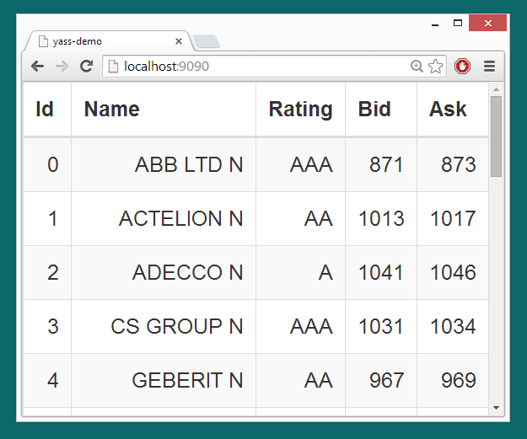
yass Tutorial
Browser (TypeScript)
UI
Contract
generated
yass
WebSocket
yass
Contract
by hand
Simulation
WebServer (Java)
Stock (static)
Price (dynamic)

Slide 8
Serialize
message (graph in process memory)
Stock stock = new Stock();
stock.id = 31;
stock.name = "ABB";
stock.rating = Rating.AAA;
transforms messages
to byte chunks
XML serializer
FastSerializer (800 LOC)
<Stock>
<id>31</id>
<name>ABB</name>
<Rating>AAA</Rating>
</Stock>
01 01 1F 02 03 41 42 42 03 00
Tags, Base 128 Varints
UTF-8 strings
Optional fields
Custom BaseTypes
10 bytes
78 bytes
Dumper
Stock(
id = 31
name = "ABB"
rating = AAA
)

Slide 9
Recap
a small software library (Java, TypeScript, Python)
efficient peer-to-peer communication (FastSerializer)
explicit type-safe contract with DTOs and interfaces
Interceptor
session based, bidirectional message streaming
TCP/IP Socket and WebSocket transports
Open Source: https://github.com/softappeal/yass
client process
Client
Application
Contract
yass
session
yass
Contract
Server
Application
server process

Slide 10
?

Slide 11
SocketTransport: Executors
Client
void sendOrder(…) {}
int addNumbers(…) {}
sendPrice(…);
ping(…);
sendOrder(…);
addNumbers(…);
void sendPrice(…) {}
void ping(…) {}
Server
Socket
OneWay
Caller Thread
SocketExecutor: Writer
RPC
RequestExecutor
SocketExecutor: Reader

