Slide 1
Memory Management Unit IA-32 from Bovet & Cesati – Understanding the Linux Kernel
Logical address 16 + 32 bit
RPL |  | TI | INDEX
15 | 14 | 13 | 12 |  |  |  |  |  |  |  |  |  |  |  | 0
Segment Selector
31 |  |  |  |  |  |  |  |  |  |  |  |  |  |  |  |  |  |  |  |  |  |  |  |  |  |  |  | 0
Offset
Segment Selector are loaded into Segmentation Registers:
cs, ss, ds and es, fs, gs

Slide 2
Segment Descriptors
Segment registers point to Segment Descriptors stored in:
  Global Description Table and Local Description Table
A 8 byte Segment Descriptor includes
  A 32-bit Base field (linear address of the first byte of the segment)
  A G granularity flag (1 -> multiples of 4 KB)
  A 20-bit Limit field (length in byte of the segment)
  A S system flag (1 -> kernel data structures)
  A 4-bit Type field
    Code segment descriptor
    Data segment descriptor
    Task State Segment Descriptor (appears only in GDT)
    Local Descriptor Table Descriptor (appears only in GDT)
  A Segment-Present flag

Slide 3
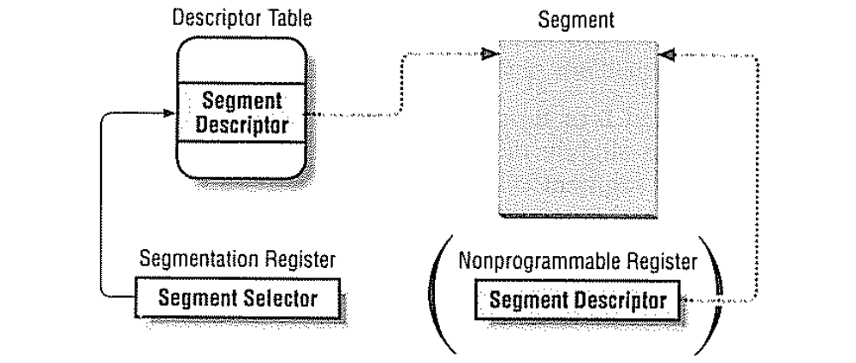
Segment Selectors
To speed up the translation of logical to linear addresses

Slide 4
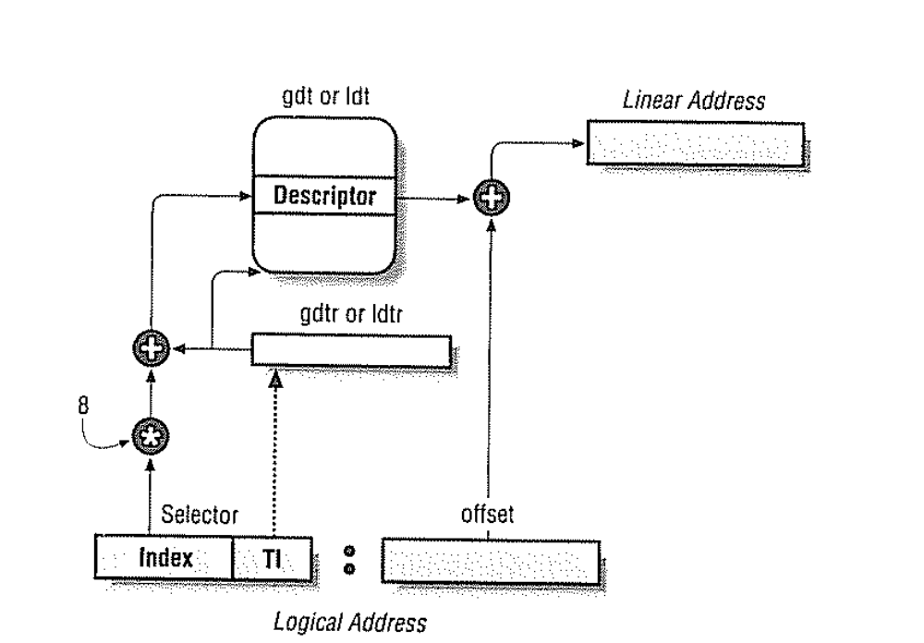
Logical to linear address translation

Slide 5
Segmentation in Linux
Linux uses these segments:
A kernel code segment
A kernel data segment
A user code segment shared by all processes in User Mode
A user data segment shared by all processes in User Mode
A Task Segment State segment for each process
A LDT segment usually shared by all processes

Slide 6
Paging in Hardware IA-32
The entries of Page Directories and Page Tables
include the same fields
Present flag
Accessed flag
Dirty flag
R/W flag permission
User/kernel flag
Page size flag (for Page Directory entries, 1 -> page of 4 MB)

