Slide 1
Chapter 5: CPU Scheduling

Slide 2
Chapter 5: CPU Scheduling
Basic Concepts
Scheduling Criteria
Scheduling Algorithms
Multiple-Processor Scheduling
Real-Time Scheduling
Thread Scheduling
Operating Systems Examples
Algorithm Evaluation

Slide 3
Basic Concepts
Maximum CPU utilization obtained with multiprogramming
CPU–I/O Burst Cycle – Process execution consists of a cycle of CPU execution and I/O wait
CPU burst distribution

Slide 4

Alternating Sequence of CPU And I/O Bursts

Slide 5

Histogram of CPU-burst Times

Slide 6
CPU Scheduler
Selects from among the processes in memory that are ready to execute, and allocates the CPU to one of them
CPU scheduling decisions may take place when a process:
  1. Switches from running to waiting state
  2. Switches from running to ready state
  3. Switches from waiting to ready
  4. Terminates
Scheduling under 1 and 4 is nonpreemptive
All other scheduling is preemptive

Slide 7
Dispatcher
Dispatcher module gives control of the CPU to the process selected by the short-term scheduler; this involves:
  switching context
  switching to user mode
  jumping to the proper location in the user program to restart that program
Dispatch latency – time it takes for the dispatcher to stop one process and start another running

Slide 8
Scheduling Criteria
CPU utilization – keep the CPU as busy as possible
Throughput – # of processes that complete their execution per time unit
Turnaround time – amount of time to execute a particular process
Waiting time – amount of time a process has been waiting in the ready queue
Response time – amount of time it takes from when a request was submitted until the first response is produced, not output (for time-sharing environment)

Slide 9
Optimization Criteria
Max CPU utilization
Max throughput
Min turnaround time
Min waiting time
Min response time

Slide 10
First-Come, First-Served (FCFS) Scheduling
Process Burst Time
P₁ 24
P₂ 3
P₃ 3
Suppose that the processes arrive in the order: P₁ , P₂ , P₃
The Gantt Chart for the schedule is:
Waiting time for P₁ = 0; P₂ = 24; P₃ = 27
Average waiting time: (0 + 24 + 27)/3 = 17
P₁
P₂
P₃
0
24
27
30

Slide 11
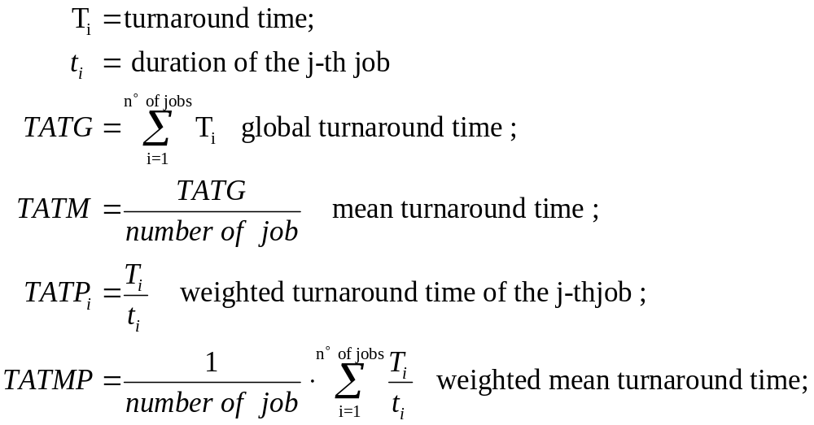
Definitions

Slide 12
Example J=(7, 6.5, 2, 2, 2)
Processor
3
P
1
2
P
2
1
P
3
P
4
P
5
0
1
2
3
4
5
6
7
T_{i} = (7, 6.5, 2, 4, 6)
TATG = 7+6.5+2+4+6 = 25.5
TATM = 5.1
TATMP = (7/7+6.5/6.5+2/2+4/2+6/2) = 8/5= 1.6

Slide 13
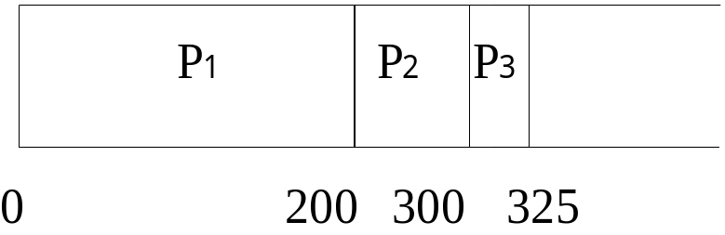
Single processor systems - FIFO
P
Arrival
t_{i}
P | Arrival | Begin | End | T_{i} | TATP_{i}
1 | 0 | 0 | 200 | 200 | 1
2 | 10 | 200 | 300 | 290 | 2.9
3 | 25 | 300 | 325 | 300 | 12
1
0
200
2
10
100
3
25
25
TATG = 790
TATM = 263
TATMP = 15.9/3 = 5.3

Slide 14
Shortest-Job-First (SJF) Scheduling
Associate with each process the length of its next CPU burst. Use these lengths to schedule the process with the shortest time
Two schemes:
  nonpreemptive – once CPU given to the process it cannot be preempted until completes its CPU burst
  preemptive – if a new process arrives with CPU burst length less than remaining time of current executing process, preempt. This scheme is know as the
  Shortest-Remaining-Time-First (SRTF)
SJF is optimal – gives minimum average waiting time for a given set of processes

Slide 15
Example of Non-Preemptive SJF
Process Arrival Time Burst Time
P₁ 0.0 7
P₂ 2.0 4
P₃ 4.0 1
P₄ 5.0 4
SJF (non-preemptive)
Average waiting time = (0 + 6 + 3 + 7)/4 = 4
P₁
P₃
P₂
P₄
0
3
7
8
12
16

Slide 16
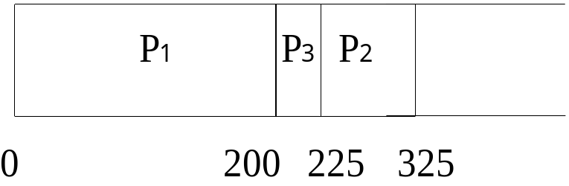
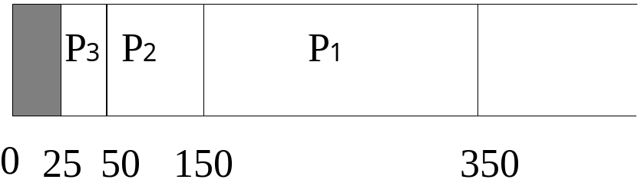
Single processor systems - SJN
P | Arrival | t_{i}
1 | 0 | 200
2 | 10 | 100
3 | 25 | 25
P | Arrival | Begin | End | T_{i} | TATP_{i}
1 | 0 | 0 | 200 | 200 | 1
2 | 10 | 225 | 325 | 315 | 3.15
3 | 25 | 200 | 225 | 200 | 8
TATG = 715
TATM = 238
TATMP = 12.15/3 = 4.05
Lookhaed

Slide 17
Lookhaed algorithm
P | Arrival | t_{i}
1 | 0 | 200
2 | 10 | 100
3 | 25 | 25
P | Arrival | Begin | End | T_{i} | TATP_{i}
1 | 0 | 150 | 350 | 350 | 1.75
2 | 10 | 50 | 150 | 140 | 1.4
3 | 25 | 25 | 50 | 25 | 1
TATG = 515
TATM = 171
TATMP = 4.15/3 = 1.38

Slide 18
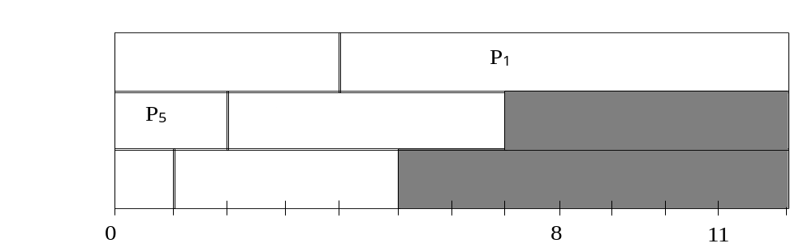
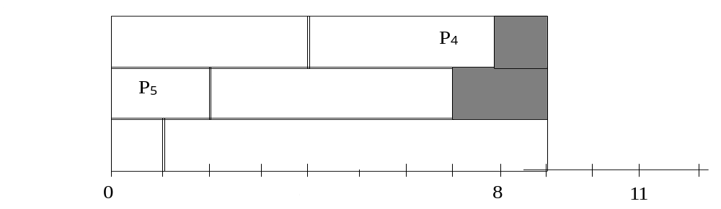
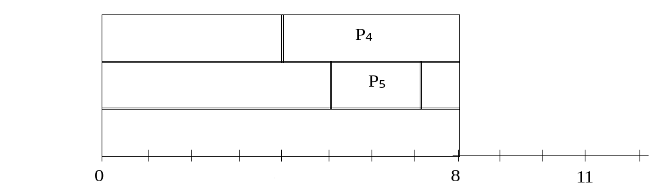
Multiprocessor system - J=(8, 5, 4, 4, 2, 1)
SJN
Ad hoc
LJN

Slide 19
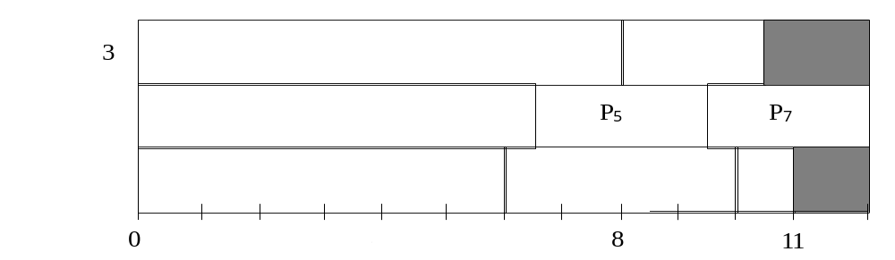
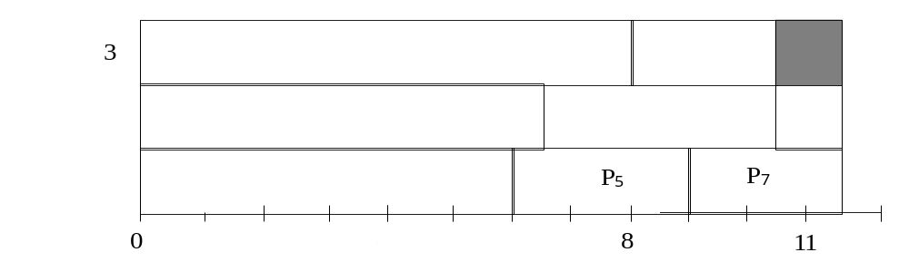
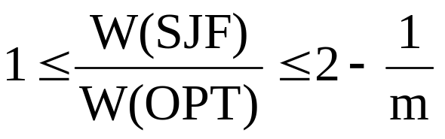
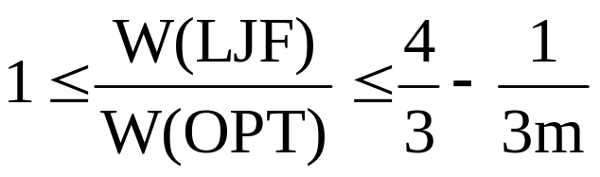
LJF is not optimal
J=(8,
6.5,
6,
4,
3,
2.5,
2.5,
1)

Slide 20
Example of Preemptive SJF
Process Arrival Time Burst Time
P₁ 0.0 7
P₂ 2.0 4
P₃ 4.0 1
P₄ 5.0 4
SJF (preemptive)
Average waiting time = (9 + 1 + 0 +2)/4 = 3
P₁
P₂
P₃
P₂
P₄
P₁
0
2
4
5
7
11
16

Slide 21
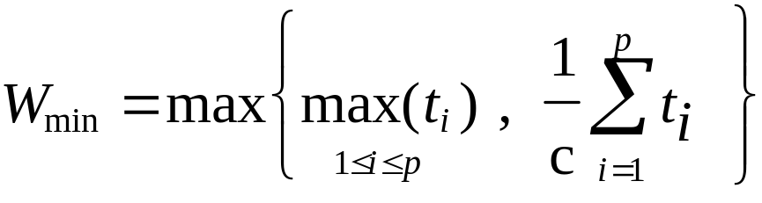
Preemptive SJF
2
P
1
P
3
2
P
1
P
3
1
P
2
1
P
2
P
1
0
1
2
3
0
1
2
3
Scheduling without preemption
Scheduling with preemption

Slide 22
Completion time
p : processes
c: processors
t_{i} : completion time
Example:
J_{a}=(1, 2, 2) W_{min} = 2.5
J_{b}=(1, 2, 4) W_{min} = 4

Slide 23
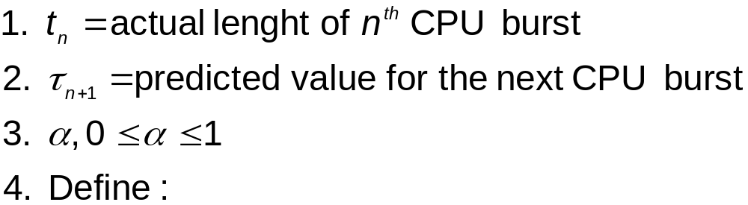

Determining Length of Next CPU Burst
Can only estimate the length
Can be done by using the length of previous CPU bursts, using exponential averaging

Slide 24

Prediction of the Length of the Next CPU Burst

Slide 25
Examples of Exponential Averaging
α =0
  τ_{n+1} = τ_{n}
  Recent history does not count
α =1
  τ_{n+1} = α t_{n}
  Only the actual last CPU burst counts
If we expand the formula, we get:
    τ_{n+1} = α t_{n}+(1 - α)α t_{n} -1 + …
    +(1 - α )^{j} α t_{n} _{-j} + …
    +(1 - α )^{n +1} τ₀
Since both α and (1 - α) are less than or equal to 1, each successive term has less weight than its predecessor

Slide 26
Priority Scheduling
A priority number (integer) is associated with each process
The CPU is allocated to the process with the highest priority (smallest integer ≡ highest priority)
  Preemptive
  nonpreemptive
SJF is a priority scheduling where priority is the predicted next CPU burst time
Problem ≡ Starvation – low priority processes may never execute
Solution ≡ Aging – as time progresses increase the priority of the process

Slide 27
Round Robin (RR)
Each process gets a small unit of CPU time (time quantum), usually 10-100 milliseconds. After this time has elapsed, the process is preempted and added to the end of the ready queue.
If there are n processes in the ready queue and the time quantum is q, then each process gets 1/n of the CPU time in chunks of at most q time units at once. No process waits more than (n-1)q time units.
Performance
  q large ⇒ FIFO
  q small ⇒ q must be large with respect to context switch, otherwise overhead is too high

Slide 28
Example of RR with Time Quantum = 20
Process Burst Time
P₁ 53
P₂ 17
P₃ 68
P₄ 24
The Gantt chart is:
Typically, higher average turnaround than SJF, but better response
P₁
P₂
P₃
P₄
P₁
P₃
P₄
P₁
P₃
P₃
0
20
37
57
77
97
117
121
134
154
162

Slide 29

Time Quantum and Context Switch Time

Slide 30

Turnaround Time Varies With The Time Quantum

Slide 31
Multilevel Queue
Ready queue is partitioned into separate queues:
foreground (interactive)
background (batch)
Each queue has its own scheduling algorithm
  foreground – RR
  background – FCFS
Scheduling must be done between the queues
  Fixed priority scheduling; (i.e., serve all from foreground then from background). Possibility of starvation.
  Time slice – each queue gets a certain amount of CPU time which it can schedule amongst its processes; i.e., 80% to foreground in RR
  20% to background in FCFS

Slide 32

Multilevel Queue Scheduling

Slide 33
Multilevel Feedback Queue
A process can move between the various queues; aging can be implemented this way
Multilevel-feedback-queue scheduler defined by the following parameters:
  number of queues
  scheduling algorithms for each queue
  method used to determine when to upgrade a process
  method used to determine when to demote a process
  method used to determine which queue a process will enter when that process needs service

Slide 34
Example of Multilevel Feedback Queue
Three queues:
  Q₀ – RR with time quantum 8 milliseconds
  Q₁ – RR time quantum 16 milliseconds
  Q₂ – FCFS
Scheduling
  A new job enters queue Q₀ which is served FCFS. When it gains CPU, job receives 8 milliseconds. If it does not finish in 8 milliseconds, job is moved to queue Q₁.
  At Q₁ job is again served FCFS and receives 16 additional milliseconds. If it still does not complete, it is preempted and moved to queue Q₂.

Slide 35

Multilevel Feedback Queues

Slide 36
Multiple-Processor Scheduling
CPU scheduling more complex when multiple CPUs are available
Homogeneous processors within a multiprocessor
Load sharing
Asymmetric multiprocessing – only one processor accesses the system data structures, alleviating the need for data sharing

Slide 37
Real-Time Scheduling
Hard real-time systems – required to complete a critical task within a guaranteed amount of time
Soft real-time computing – requires that critical processes receive priority over less fortunate ones

Slide 38
Pthread Scheduling API
PTHREAD_SCOPE_SYSTEM
  A thread that content with other processes and other PTHREAD_SCOPE_SYSTEM threads for the CPU.
  If there is one process P1 with 10 threads and a single threaded process P2,
    P2 will get one timeslice out of 11 and
    every thread in P1 will get one timeslice out of 11.

Slide 39
Operating System Examples
Windows XP scheduling
Linux scheduling

Slide 40
Pthread Scheduling API
PTHREAD_SCOPE_PROCESS
  All threads of a process are grouped together and this group of threads contents for the CPU.
  If there is a process with 4 PTHREAD_SCOPE_PROCESS threads and 4 PTHREAD_SCOPE_SYSTEM threads
    each PTHREAD_SCOPE_SYSTEM threads will get a fifth of the CPU (4/5) and
    the other 4 PTHREAD_SCOPE_PROCESS threads will share the remaining fifth of the CPU.

Slide 41
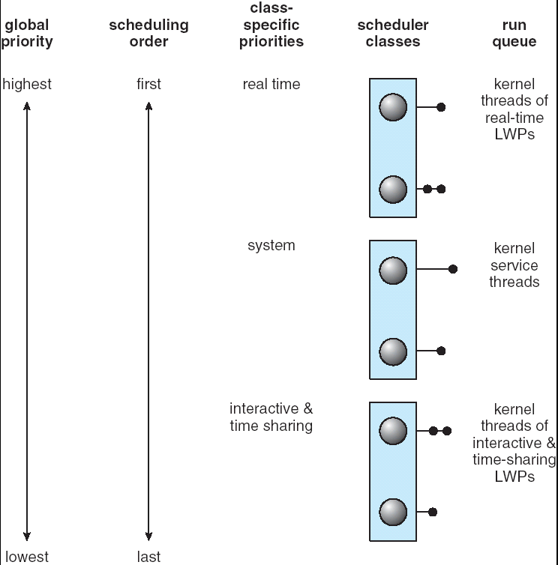
Solaris 2 Scheduling

Slide 42

Solaris Dispatch Table

Slide 43

Windows XP Priorities

Slide 44
Linux Scheduling
Two algorithms: time-sharing and real-time
Time-sharing
  Prioritized credit-based – process with most credits is scheduled next
  Credit subtracted when timer interrupt occurs
  When credit = 0, another process chosen
  When all processes have credit = 0, recrediting occurs
    Based on factors including priority and history
Real-time
  Soft real-time
  Posix.1b compliant – two classes
    FCFS and RR
    Highest priority process always runs first

Slide 45

The Relationship Between Priorities and Time-slice length

Slide 46

List of Tasks Indexed According to Prorities

Slide 47
End of Chapter 5

Slide 48

Dispatch Latency

Slide 49
Thread Priorities
Priority Comment
Thread.MIN_PRIORITY Minimum Thread Priority
Thread.MAX_PRIORITY Maximum Thread Priority
Thread.NORM_PRIORITY Default Thread Priority
Priorities May Be Set Using setPriority() method:
setPriority(Thread.NORM_PRIORITY + 2);

