Slide 1
Chapter 12: Mass-Storage Systems

Slide 2
Chapter 12: Mass-Storage Systems
Overview of Mass Storage Structure
Disk Structure
Disk Attachment
Disk Scheduling

Slide 3
Overview of Mass Storage Structure
Magnetic disks provide bulk of secondary storage of modern computers
  Drives rotate at 60 to 200 times per second
  Transfer rate is rate at which data flow between drive and computer
  Positioning time (random-access time) is time to move disk arm to desired cylinder (seek time) and time for desired sector to rotate under the disk head (rotational latency)
Disks can be removable
Drive attached to computer via I/O bus
  Busses vary, including EIDE, ATA, SATA, USB, Fibre Channel, SCSI
  Host controller in computer uses bus to talk to disk controller built into drive or storage array

Slide 4

Moving-head Disk Machanism

Slide 5
Disk Structure
Disk drives are addressed as large 1-dimensional arrays of logical blocks, where the logical block is the smallest unit of transfer.
The 1-dimensional array of logical blocks is mapped into the sectors of the disk sequentially.
  Sector 0 is the first sector of the first track on the outermost cylinder.
  Mapping proceeds in order through that track, then the rest of the tracks in that cylinder, and then through the rest of the cylinders from outermost to innermost.

Slide 6
Disk Attachment
Host-attached storage accessed through I/O ports talking to I/O busses
SCSI itself is a bus, up to 16 devices on one cable, SCSI initiator requests operation and SCSI targets perform tasks
  Each target can have up to 8 logical units (disks attached to device controller
FC is high-speed serial architecture
  Can be switched fabric with 24-bit address space – the basis of storage area networks (SANs) in which many hosts attach to many storage units
  Can be arbitrated loop (FC-AL) of 126 devices

Slide 7
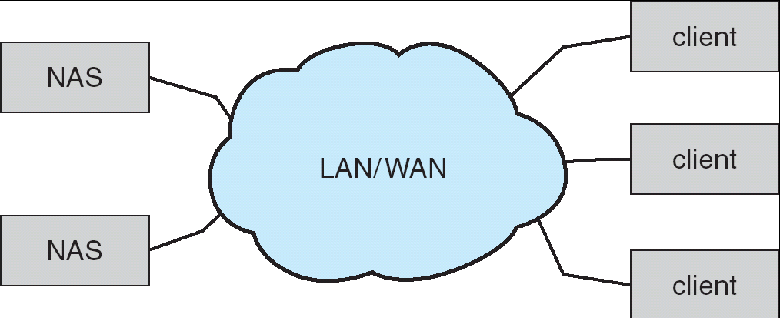
Network-Attached Storage
Network-attached storage (NAS) is storage made available over a network rather than over a local connection (such as a bus)
NFS and CIFS are common protocols
Implemented via remote procedure calls (RPCs) between host and storage
New iSCSI protocol uses IP network to carry the SCSI protocol

Slide 8
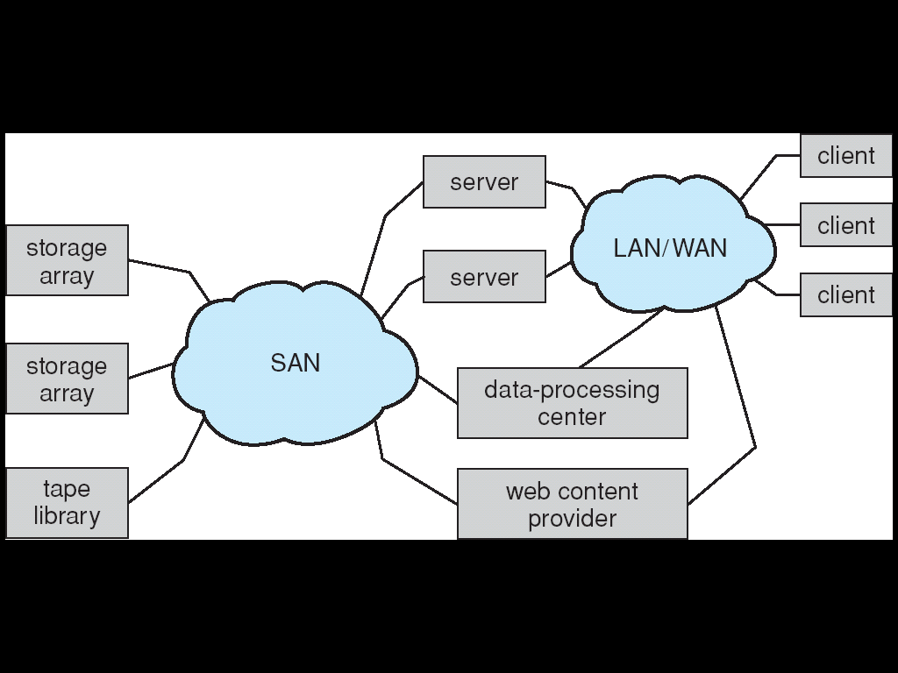
Storage Area Network
Common in large storage environments (and becoming more common)
Multiple hosts attached to multiple storage arrays - flexible

Slide 9
Disk Scheduling
The operating system is responsible for using hardware efficiently — for the disk drives, this means having a fast access time and disk bandwidth.
Access time has two major components
  Seek time is the time for the disk are to move the heads to the cylinder containing the desired sector.
  Rotational latency is the additional time waiting for the disk to rotate the desired sector to the disk head.
Minimize seek time
Seek time ≈ seek distance
Disk bandwidth is the total number of bytes transferred, divided by the total time between the first request for service and the completion of the last transfer.

Slide 10
Positioning time
T_{e} = m ⋅ n + s [msec]
T_{s} is the estimated positioning time.
n is the number of crossed tracks .
m is the mean track-to-track seek time.
s is the time necessary to accelerate the head from 0 to its cruise speed.
For a movement of 1000 tracks:
T_{e} = 0.1 x 100 + 3 = 13 msec.

Slide 11
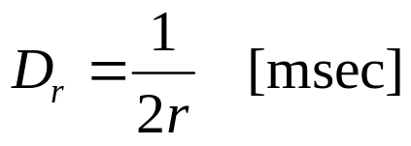
Rotational latency
Hard disk with rotation speed of 6000 rpm.
6000 rpm -> r = 0.1 ms⁻¹ (rotation per millisecond)
a rotation in 10 msec.
the rotational latency is D_{r} = 5 ms.

Slide 12
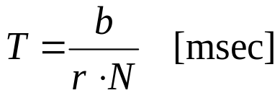
Transfer time
b is the nnumber of transferred blocks
N is the number of sectors per track
r is the rotation speed in rotations per millisecond

Slide 13
I/O completion time
T_{I/O} = t ⋅ (T_{e} + D_{r} + T) [msec]
t is the number of accessed tracks.
Read a 256 KB file from a disk with
1KB sectors and 32 sectors per track
256 sectors -> t = 8 tracks.
If T_{e} = 15 ms and rotation speed = 6000 rpm
D_{r} = 5 msec e T = 10 ms.
T_{I/O} = 8 ⋅ ( 15 + 5 +10) = 240 msec.

Slide 14
I/O completion time
If tracks are contiguous
T_{I/O} = (15 + 5 + 10) + 7⋅(0.1 + 5 + 10) = 135.7 ms
If the file sectors are randomly stored on disk, reading a sector requires
15 + 5 + 10/32 = 20.3
T_{I/O} = 256 ⋅ 20.3 = 5197 msec = 5.2 sec

Slide 15
Disk Scheduling (Cont.)
Several algorithms exist to schedule the servicing of disk I/O requests.
We illustrate them with a request queue (0-199).
98, 183, 37, 122, 14, 124, 65, 67
Head pointer 53

Slide 16

FCFS
Illustration shows total head movement of 640 cylinders.

Slide 17
SSTF
Selects the request with the minimum seek time from the current head position.
SSTF scheduling is a form of SJF scheduling; may cause starvation of some requests.
Illustration shows total head movement of 236 cylinders.

Slide 18

SSTF (Cont.)

Slide 19
SCAN
The disk arm starts at one end of the disk, and moves toward the other end, servicing requests until it gets to the other end of the disk, where the head movement is reversed and servicing continues.
Sometimes called the elevator algorithm.
Illustration shows total head movement of 208 cylinders.

Slide 20

SCAN (Cont.)

Slide 21
C-SCAN
Provides a more uniform wait time than SCAN.
The head moves from one end of the disk to the other. servicing requests as it goes. When it reaches the other end, however, it immediately returns to the beginning of the disk, without servicing any requests on the return trip.
Treats the cylinders as a circular list that wraps around from the last cylinder to the first one.

Slide 22

C-SCAN (Cont.)

Slide 23
C-LOOK
Version of C-SCAN
Arm only goes as far as the last request in each direction, then reverses direction immediately, without first going all the way to the end of the disk.

Slide 24

C-LOOK (Cont.)

Slide 25
Selecting a Disk-Scheduling Algorithm
SSTF is common and has a natural appeal
SCAN and C-SCAN perform better for systems that place a heavy load on the disk.
Performance depends on the number and types of requests.
Requests for disk service can be influenced by the file-allocation method.
The disk-scheduling algorithm should be written as a separate module of the operating system, allowing it to be replaced with a different algorithm if necessary.
Either SSTF or LOOK is a reasonable choice for the default algorithm.

